Slide 1



PVM: Efficient Shadow Paging for Deploying Secure
Containers in Cloud-native Environments
Hang Huang✻, Jiangshan Lai✮, Jia Rao✧, Hui Lu✧, Wenlong Hou ✮, Hang Su ✮,
Quan Xu✻, Jiang Zhong✻, Jiahao Zeng✻, Xu Wang ✮, Zhengyu He ✮,
Weidong Han✻, Jiang Liu✻, Tao Ma✻, Song Wu §
✻
✮
✧
§
jiangshan.ljs@antgroup.com
Notes:
Thank you very much for the introduction. I’m Lai Jiangshan from the Ant group. I am going to present PVM: an Efficient nested virtualization approach for deploying containers within lightweight virtual machines in a public cloud environment.
This is a joint work among Alibaba Cloud, the Ant group, the university of Texas at Arlington and Huazhong University of Science and technology.

Slide 2







Cloud native and containers
Cloud-native applications
Highly scalable, flexible, and resilient
Often appear as microservices
Run in containers
Containers
Lightweight and efficient
Lack of isolation
Dev/Ops
CD/CI
Cloud-native
Microservices
Orchestration
Run within virtual machines (VMs) for strong isolation, a.k.a., secure containers
Notes:
As cloud computing becomes ubiquitous, containers have gained widespread popularity for building and deploying cloud-native applications due to their flexibility, portability, and scalability. Container technology is also the key to serverless computing and microservices. While containers are lightweight and more efficient than traditional virtual machines, they do not offer the same level of isolation as they share the same OS kernel, opening up doors to a slew of security and privacy issues. (action 1) Although there have been efforts to enhance container isolation in the OS kernel or design userspace kernels, deploying containers in lightweight VMs, such as Kata containers, and leveraging VM isolation to address the security vulnerability in containers remain the preferred and widely adopted approach in production systems. These containers and their hosting VMs are often referred to as secure containers.

Slide 3


Hosting containerized applications in clouds
Secure container
Secure container
Secure container
Secure container
Secure container
Secure container
Secure container
Secure container
Kubernetes
Bare-metal
Bare-metal
VM
VM
Hosting secure containers in VMs leased from clouds: Low cost, reconfigurable, and elastic
Need nested virtualization!
Notes:
There are two options to host secure containers in a public cloud if users want to deploy their own container framework, such as Kubernetes, rather than using microservice APIs, such as Amazon lambda, provided by the cloud provider. Users can lease bare-metal servers or VM instances to host their secure containers and the associated lightweight VMs. (action 1) The latter option with VM instances is cheaper, more flexible, and can scale on the fly. However, it requires nested virtualization in which users run lightweight VMs inside VMs leased from an infrastructure as a service cloud.

Slide 4
Single-level virtualization
Non-root Mode
Guest Virtual Address
(GVA)
Guest Page Tables
(GPT)
Syscalls
#PF
Ring3
Guest user
Ring0
Guest kernel
External interrupt
Privileged inst.
Hypercall
VMX inst.
VM Exit
VM Entry
Guest Physical Address
(GPA)
read
Extended Page Table
(EPT)
Ring0
KVM
VMCS
write
Host Physical Address
(HPA)
Root Mode
CPU Virtualization
Memory Virtualization
Notes:
Before we analyze the overhead of nested virtualization, I will first briefly explain the hardware supports that assist single-level virtualization. Without loss of generality, we focus our discussions on Intel platforms. (action 1) An important issue in CPU virtualization is the handling of privileged instructions and the transition between a VM and the host hypervisor. As shown in the left figure, Intel VTX adds a non-root mode with guest ring levels from 0-3 to run a VM. Therefore, （action 1) guest system calls can be entirely handled by the VM kernel without any involvement of the host hypervisor. To handle external interrupts and privileged instructions (action 2), a VM traps to the hypervisor and enters the root mode via VM-exit.
(action 3) Memory virtualization involves two-level address translations, from the guest virtual address (GVA) to guest physical address (GPA), and then to the host physical address (HPA). To assist memory virtualization and allow the two level address translations to be handled entirely by the MMU hardware, Intel processors allow an extended page table (EPT) to be registered to MMU and handle GPA to HPA translation. With EPT, the two-level translations can be handled by VM without help from the hypervisor.

Slide 5
Nested (2-level) virtualization
Privileged inst.
L2 (non-root mode): lightweight VM running in an L1 VM
Secure Container
VM Entry
VMCS12
VM Exit
L1 (non-root mode): guest hypervisor running in a cloud VM
VM Exit
shadowing
EPT12
VM-Entry
VMCS01
VMCS02
L0 (root mode): host hypervisor on a bare-metal machine
EPT01
EPT02
World switch:
The switching of both the execution modes (e.g., non-root vs. root) and address spaces
Notes:
Nested virtualization builds upon the hardware support for single-level virtualization and requires additional software effort. To facilitate the transition among the lightweight VM which runs a container or L2, the VM instance leased from the cloud provider or L1, and the host hypervisor or L0, current 2-level virtualization places both L1 and L2 in the non-root mode. (Action 1) Upon the execution of a privileged instruction in L2, a VM exit to L0 is triggered. Since the privileged instruction needs to be handled by L2’s hypervisor L1, (Action 2) it is forwarded from L0 to L1 via VM entry. After the privileged instruction is handled in L1, L1 is unable to resume L2 on its own and therefore traps to L0 again (Action 3), where L2 is resumed via VM entry (Action 4). Note that since L0 must be involved in handling L2’s transitions, it maintains VMCS for both L1 and L2, while L1 maintains a shadow copy of L2’s VMCS.
Compared to single-level virtualization, the transition between L2 and L1 requires traps to the L0 hypervisor and causes twice as many world switches as that in single-level virtualization. (Action 5) We define world switches as the switching of both execution modes, for example from non-root to root mode and vice versa, and address spaces.

Slide 6
Nested Memory Virtualization
EPT-on-EPT: Multiplex 3 page tables (L2, L1, and L0) onto 2-dimensional EPT hardware
L2 (non-root mode ring3)
L1 (non-root mode ring3)
L2 (non-root mode ring0)
L1 (non-root mode ring0)
GPT2
EPT12
GVA(L2) -> GPA (L2)
GPA(L2) -> GPA (L1)
EPT02
EPT01
GPA(L2) -> HPA
GPA(L1) -> HPA
MMU uses GPT2 and EPT02 to translate L2’s virtual address to host physical address
L0 (root mode ring0)
VMCS02
VMCS01
One page fault from L2 triggers two phases of page table updates
Notes:
Nested memory virtualization is more complicated and incurs even higher overhead. It involves an additional layer of address translation from the L2 guest virtual address (GVA) to the L2 physical address (GPA). Since there are only two page tables that can be registered with MMU, the challenge lies in how to map the three-level address translation onto the 2-dimensional EPT hardware. The state-of-the-art nested memory virtualization in KVM uses a method called EPT-on-EPT.
(Action 1) This method registers the L2 guest page table with MMU and uses a page table that directly maps the L2 guest physical address to the L0 host physical address or EPT02 (Action 2) as the hardware extended page table. The benefit is that if both page tables are properly populated and there are no page faults, address translations are entirely handled by hardware, achieving high efficiency. To construct EPT02, (Action 3) the host hypervisor needs to compress the other two page tables EPT12 and EPT01 into one. EPT12 is the L1 page table and EPT01 is the extended page table for L1. This requires the L0 host hypervisor to expose the EPT capability to the L1 VM.
In summary, (Action 4) MMU uses GPT2 and EPT02 to run the L2 VM. (Action 5) Next, we explain how page faults are handled and the two phases needed to update these two page tables.

Slide 7
EPT-on-EPT: Phase 1
Phase 1
Update GPT2
L2 (non-root mode ring3)
L1 (non-root mode ring3)
③ iret
① #PF
L1 (non-root mode ring0)
L2 (non-root mode ring0)
GPT2
EPT12
② fix
PF Handler
GVA(L2) -> GPA (L2)
GPA(L2) -> GPA (L1)
EPT02
EPT01
GPA(L2) -> HPA
GPA(L1) -> HPA
L0 (root mode ring0)
VMCS02
VMCS01
Involve no world switch
Notes:
In the first phase, a page fault in GPT2 can be handled entirely within the L2 guest since GPT2 is registered with MMU (Action 1-3). This phase does not involve any world switches.

Slide 8


EPT-on-EPT: Phase 2
Phase 2.1
Update EPT12 and EPT01
L2 (non-root mode ring3)
L1 (non-root mode ring3)
L2 (non-root mode ring0)
L1 (non-root mode ring0)
GPT2
EPT12
VMCS12
GVA(L2) -> GPA (L2)
GPA(L2) -> GPA (L1)
Phase 2.2
Update EPT02
EPT02
EPT01
GPA(L2) -> HPA
GPA(L1) -> HPA
L0 (root mode ring0)
Trap to L0 for up to n+3 times with 2n+6 world switches
VMCS02
VMCS01
Notes:
After a new page is added in GPT2, its corresponding entry in EPT02 needs to be updated, triggering an EPT violation when it is accessed in EPT02. Upon such an EPT violation (Action 1), in phase 2.1, an L0 trap is triggered and the EPT violation is forwarded to L1 to fix EPT12. As L0 needs to record any updates to EPT12 in order to update EPT02, EPT12 is set to read-only. Any fix to EPT12 will trigger another trap to L0 for bookkeeping. The first EPT violation only updates EPT12 leaving EPT02 not updated. Next access to EPT02 will trigger another EPT violation (Action 2) and another L0 trap. In phase 2.2, L0 compresses EPT12 and EPT01 to update EPT02.
As modern Oses use multi-level page tables, updates to each level need to follow the above steps. (Action 3) Therefore, in the worst case, when a new page is added to GPT2, there are n+3 L0 traps and a total number of 2n+6 world switches to completely update both EPT12 and EPT02, where n is the number of levels in the page tables.

Slide 9
Nested virtualization – performance overhead
Lower is better
5
552
Nested virtualization incurs up to two orders of magnitude performance overhead for memory-intensive and concurrent workloads
Notes:
Nested virtualization is known to be expensive. We ran representative benchmarks to demonstrate how expensive 2-level nested virtualization is compared to single-level virtualization in KVM. (Action 1) Results show that nested virtualization cause substantial performance loss to some workloads, (Action 2), especially for memory-intensive and concurrent workloads that require concurrent page table updates. The performance difference is up to two orders of magnitude.

Slide 10
Nested virtualization - takeaways
High overhead
Costly traps to L0
Involvement of L0
Increased L0 complexity
Enlarged L0 attack surface
A potential performance bottleneck
Limited adoption in production clouds
Exposing hardware virtualization support to L1 affects cloud management
non-root ring3
L1 User
L2 User
non-root ring0
L1 Kernel
L2 Kernel
root ring0
L0
Notes:
Our analysis reveals three issues with state-of-the-art nested virtualization approaches. First, world switches between an L2 guest and the L1 hypervisor is expensive. Second, the involvement of the L0 hypervisor in CPU virtualization and memory virtualization requires the L0 hypervisor to be modified, not only making the host hypervisor more complex, and enlarging its attack surface but also being a potential performance bottleneck. Third, to support unmodified L1 and L2 VMs, it is necessary to expose hardware virtualization support to L1, increasing the coupling between cloud VM instances and the underlying host hypervisor. Cloud providers are reluctant to support hardware-assisted nested virtualization in their production systems.

Slide 11
PVM design: objectives
Avoid expensive traps to L0
Handle syscalls and L2 memory virtualization entirely within L1
Support unmodified L0
Fully compatible with cloud management
High performance
Comparable to hardware-assisted nested virtualization
L1: Self-contained, assuming
no hardware virtualization support
L2 User
non-root ring3
L1 User
Other ordinary
VMs
L2 Kernel
non-root ring0
L1 Kernel
root ring0
L0
L0: Oblivious of nested virtualization inside L1
PVM: a software-based nested virtualization approach independent of the host hypervisor
Notes:
To address these issues, we propose PVM a high-performance nested virtualization framework for KVM. The over-arching goals of PVM are to 1) handle nested virtualization within an L1 VM without any hardware or host hypervisor support, making it fully compatible with cloud management; 2) avoid costly exits to the host hypervisor, devise fast world switching mechanisms and efficient memory virtualization. As shown in the right figure, the key in PVM is to deprivilege the L2 guest to stay entirely at ring3 in the non-root mode so as to let the L1 VM take total control of resource virtualization.
(Action 1) PVM is a software-based nested virtualization approach that is as efficient or even more efficient than hardware-assisted nested virtualization.

Slide 12
PVM design: overview
L2 guest
h_ring3
user
(v_ring3)
kernel
(v_ring0)
L2 guest runs entirely at ring3 featuring a para-virtualized kernel.
syscall/
interrupt/exception
hypercall/
interrupt/exception
sysret/iret
L1 VM
switcher
h_ring0
Switcher enables efficient world switches.
VM entry
(function call)
VM exit
(function return)
kvm.ko
kvm-pvm.ko
PVM hypervisor handles CPU, memory, and I/O virtualization.
PVM hypervisor on a cloud VM
Notes:
This slide shows the overall design of PVM. It consists of a para-virtualized L2 guest kernel (Action 1), a switcher, (Action 2) a highly efficient piece of assembly code residing in the L1 VM that enables fast world switches. (Action 3) and the PVM hypervisor that handles CPU, memory and I/O virtualization. Note that the entire PVM software stack is within an L1 VM and can interface any unmodified host hypervisors that support KVM virtualization APIs.

Slide 13
PVM: L1-to-L2 world switches via switcher
VM-Exit
L2
VM-Entry
L2
Guest
Guest
❶syscall/
hypercall
①interrupt/
exception
② iret
msr_lstar
idtr
syscall entry
syscall entry
idt entries
idt entries
enter_guest
enter_guest
L1
L1
to_hypervisor
to_hypervisor
Switcher
switcher
switcher
②/❷ ret
① function call
Hypervisor
Hypervisor
Notes:
Switcher的目的是为了便于在L2 guest和L1 hypervisor之间以及由于系统调用、hypercalls和中断而在L2用户空间和内核空间之间进行转换。由于PVM不假设任何硬件支持，switcher中的一个关键组件是每CPU状态，这类似于VMCS，并且在world switches期间保存和恢复L2 guest和L1 host状态。需要注意的是，为了完全控制L2，PVM会将L2的用户空间和内核空间，在非根模式下都降级到ring 3。
除了每个vCPU的状态之外，switcher还包含系统调用入口和中断描述符表条目，这些实际上是跳转表，它们将系统调用和中断重定向到PVM hypervisor，以便进行虚拟化或模拟。与VMX硬件支持相比，后者需要L0维持L2状态，PVM不涉及L0，并且完全在L1内部处理L2到L1的transitions。由于缺乏硬件VMX支持，另一个显著的区别和缺点是系统调用现在不能直接由L2 guest处理，而需要PVM hypervisor介入。
The objective of the switcher is to facilitate the transition between an L2 guest and the L1 hypervisor as well as between the L2 user and kernel spaces due to system calls, hypercalls, and interrupts. Since PVM does not assume any hardware support, a key component in switcher is per-CPU states, similar to VMCS, which saves and restores 𝐿2 guest and 𝐿1 host states during world switches. Note that to take complete control over L2, PVM deprivileges L2, both the user and kernel spaces to ring 3 in the non-root mode. In addition to the per-vCPU states, switcher also includes system call entries and interrupt descriptor table entries, which are effectively jump tables that redirect system calls and interrupts to the PVM hypervisor for virtualization or emulation. Compared to the VMX hardware support that requires L0 to maintain L2 states, PVM does not involve L0 and handles L2 to L1 transitions entirely in L1. Another notable difference and drawback due to the lack of hardware VMX support is that system calls now can not be handled directly by an L2 guest but need to involve the PVM hypervisor.

Slide 14




PVM: direct switch
Guest User
(v_ring3)
Guest Kernel
(v_ring0)
h_ring3
sysret hypercall
syscall
h_ring0
$$\text{❸} \text{sysretq}$$
switcher
$$❶ \text{turn} \text{to}\text{ \%}\text{rip}$$
$$① \text{turn} \text{to}\text{ \%}\text{rip}$$
$$\text{③} \text{sysretq}$$
direct switch
❷ switch to
switch hCR3
switch cpl, stack and gs_base
② switch to
v_ring3_hw_cr3
v_ring0_hw_cr3
Save one world switch (to hypervisor) per syscall/sysret
Notes:
This motivated us to develop direct switch, an optimization in switcher that helps direct a system call intercepted by switcher back to the L2 guest kernel for execution. (Action 1) Specifically, instead of directing a system call to PVM hypervisor for emulation, direct switch constructs a system call frame, prepares the L2 guest kernel stack and page table to execute the system call, and eventually switches to the L2 guest kernel. (Action 2) The return-to-user process is similar. This process is similar to that with VMX which involves a ring level change from 3 to 0 and system call execution in the guest kernel.
(Action 3) Thanks to direct switch, PVM saves one world switch to the L1 hyervisor per syscall/sysret, again without hardware support.

Slide 15
PVM memory virtualization
PVM-on-EPT: L1 maintains a shadow page table SPT12 for L2
L2 (virtual ring3)
L1 (non-root mode ring3)
L2 (virtual ring0)
L1 (non-root mode ring0)
GPT2
SPT12
MMU
GVA(L2) -> GPA (L2)
GVA (L2) -> GPA (L1)
EPT01
MMU
GPA (L1) -> HPA
L0 (root mode ring0)
VMCS01
Notes:
The heart of PVM is a shadow page table approach that handles L2 guest page faults and maintain the shadow page table entirely in L1. As shown in the figure, (Action 1) the shadow page table in L1 and L1’s EPT are registered with the MMU. Since EPT01 is no different from an ordinary VM’s extended page table, the L0 hypervisor is unaware of shadow page table management inside L1. The challenge, however, lies in how to efficiently synchronize GPT2 and SPT12 within L1. Unlike the traditional shadow page table on GPT over EPT approaches in which GPT2 page faults must first trap to L0 and then be forwarded to L1 to update SPT12, PVM-on-EPT does not cause any exit to L0.

Slide 16
PVM memory virtualization
PVM-on-EPT: L1 maintains a shadow page table SPT12 for L2
Phase 1
Update GPT2
① #PF
L2 (virtual ring3)
L1 (non-root mode ring3)
L2 (virtual ring0)
L1 (non-root mode ring0)
④ vm entry
switcher
PVM
PF Handler
⑤ iret
② vm exit
GPT2
SPT12
⑥ fix
⑦ iret hc
PVM
HC Handler
PF Handler
GVA(L2) -> GPA (L2)
EPT01
GVA(L2) -> GPA (L1)
③ inject #PF
GPA(L1) -> HPA
No L0 involvement!
Trap to L1 for up to n+1 times with 2n+2 world switches
L0 (root mode ring0)
VMCS01
Notes:
There are also two phases of page table updates for every GPT2 page fault. To capture all updates to GPT2, it is made read-only. Upon a GPT2 page fault occurring in L2 user space (Action 1), L2 traps to switcher where the fault is injected (Action 2) into L2’s kernel space for handling. After GPT2 has been updated, L2 returns to the switcher via an iret upper call and eventually returns to L2 user space (Action 3,4). (Action 5) The updates to GPT2 require n+1 traps to L1 with a total number of 2n+2 world switches, where n is the number of levels in GPT2. Most importantly, this process does not involve L0.

Slide 17
PVM memory virtualization
PVM-on-EPT: L1 maintains a shadow page table SPT12 for L2
Phase 2
Update SPT2
L2 (virtual ring3)
L1 (non-root mode ring3)
L2 (virtual ring0)
L1 (non-root mode ring0)
switcher
⑨ iret
PVM
PF Handler
GPT2
SPT12
⑦ iret hc
PVM
HC Handler
PF Handler
⑧ prefault
GVA(L2) -> GPA (L2)
EPT01
GVA(L2) -> GPA (L1)
GPA(L1) -> HPA
L0 (root mode ring0)
Trap to L1 for one more time with 2 world switches
VMCS01
Notes:
The second phase updates SPT12. After competing the updates on GPT2 and before returning to L2 user space, PVM opportunistically updates SPT12 via a prefault mechanism (Action 1) . During prefault, SPT12 is updated according to the recently updated entries in GPT2. This prefault mechanism proactively updates SPT12 to avoid future page faults and traps to L1. (Action 2) Eventually, switcher returns to L2 user space as if an L2 page fault has been completed. (Action 3) The phase2 requires one additional trap to L1 and 2 more world switches if the prefault misfires.

Slide 18
PVM-on-EPT vs. EPT-on-EPT
World switches
2n+4 vs. 2n+6
# of traps to L0
0 vs. n+3
Avg. cost of world switches
0.179 μs (PVM L2-L1) vs. 1.3 μs (NST L2-L0-L1) vs. 0.103 μs (BM L1-L0)
World switches (L1-to-L2) due to PVM memory virtualization are almost an order of magnitude cheaper than that in state-of-the-art
Notes:
In this slide, we compare PVM-on-EPT and the state-of-the-art EPT-on-EPT, and explain why PVM’s approach is more efficient. While PVM’s approach only saves two world switches compared to EPT-on-EPT, all its world switches are between L2 and L1 or between L2’s user and kernel spaces, with no exit to L0. We measured the cost of world switches between PVM's L2-to-L1, NESTED's L2-to-L1, and BM's L1-to-L0 and found that (Action 1) the world switches due to PVM’s memory virtualization are almost an order of magnitude cheaper than that in EPT-on-EPT, which relies on hardware support in VMX. PVM’s software-based world switches are also comparable to that in single-level virtualization.

Slide 19
Additional optimizations
An optimized PCID mapping mechanism
Avoid unnecessary TLB flushes during world switches
Fine-grained shadow page table locking
Allow concurrent page fault handling
Optimizations are user-specific and only take effect in L1, requiring no changes to the host hypervisor
Notes:
PVM also devises two optimizations for memory virtualization. Please read our papers for more details about the optimizations as well as PVM’s approach for CPU and I/O virtualization. (action 1) Note that these optimizations only take effect within a specific L1 VM and requires no changes to the L0 hypervisor. Therefore, PVM allows users to devise customized optimizations without affecting the underlying cloud management.

Slide 20
Evaluation
PVM as a host hypervisor on a bare-metal machine
PVM performance in single-level virtualization
PVM as a guest hypervisor in a VM on Alibaba Cloud
Benefits of PVM in nested virtualization
Metrics
Cost of VM-exit/entry
System call performance (direct switch)
Cost of page fault handling
Application performance
Notes:
To evaluate the effectiveness of PVM, we first deploy PVM on a bare-metal server in Alibaba cloud and use it as an L0 host hypervisor to understand the overhead of software-based virtualization compared to hardware-assisted single-level virtualization. Next, we run PVM inside an L1 VM instance on Alibaba cloud to study the benefits of PVM in nested virtualization. We used microbenchmarks and real applications to measure the cost of VM-exit/entry, syscall performance, cost of page fault handling and overall application performance, especially multi-threaded applications.

Slide 21
Evaluation: VM-Entry/Exit
The round-trip latency (μs) of VM exits/entries
Configurations | kvm (BM) | pvm (BM) | kvm (NST) | pvm (NST)
Hypercall | 0.46 | 0.54 | 7.43 | 0.48
Exception | 1.66 | 1.67 | 9.20 | 2.21
MSR access | 0.87 | 2.53 | 8.18 | 2.88
CPUID | 0.54 | 0.6 | 7.1 | 0.51
PIO | 3.79 | 4.91 | 29.34 | 12.94
For each privileged L2 guest operation:
KVM (NST) triggered two expensive exits to the L0 hypervisor
PVM needed one less expensive VM exit to the L1 guest hypervisor
Lower is better
Notes:
We used a set of micro-benchmarks to perform privileged guest operations to trigger VM exits and measured the round-trip time until VM entries. The table lists the average round-trip latency under five privileged guest operations. The results show that hardware-assisted single-level virtualization performed the best (Action 1), which is expected, and PVM achieved comparable performance as a bare-metal hypervisor. In contrast, PVM significantly outperformed hardware-assisted approaches in nested virtualization (Action 2) by as much as an order of magnitude. (Action 3) The reason is that for these privileged guest operations, PVM causes fewer and less expensive VM-exit to the underlying hypervisor.

Slide 22
Evaluation: system calls (direct switch)
The Execution time (μs) of syscall get_pid:
Configurations | Optimization | Syscall (μs)
kvm-ept (BM) |  | 0.22
pvm (BM) | none | 1.91
 | direct-switch | 0.29
kvm (NST) |  | 0.23
pvm (NST) | none | 1.93
 | direct-switch | 0.3
Lower is better
Notes:
L2 system call handling is a challenge for PVM since the hardware-assisted approach allows syscalls to be handled entirely in an L2 guest. We measured the execution time of a simple system call and found that the direct switch mechanism in PVM significantly reduces system call overhead and achieved similar performance as hardware-assisted approaches on both (Action 1) bare-metal machines and in (Action 2) VM instances.
PVM uses separate page tables for the L2 guest user and kernel and the baselines presented had Linux kernel page table isolation (KPTI) enabled. For results comparing with baselines with KPTI disabled, please see our paper. PVM still achieves comparable performance compared to this baseline, though without KPTI, this baseline does provide a similar level of security guarantee.
===when time is limited:
this table shows that direct switch improves syscall’s performance.

Slide 23
Evaluation: Page fault handling
To stress-test memory virtualization, a micro-benchmark repeatedly allocated/released memory and accessed the allocated data
Lower is better
PVM(NST)
PVM(BM)
KVM(BM)
Notes:
Next, we study the cost of handling page faults. Besides evaluating various approaches, we also studied concurrent page fault handling with increasing concurrency, We break down the performance benefits due to individual PVM optimizations. As shown in the figure, PVM significantly outperformed EPT in a nested environment. Prefault is mostly effective and contributes to PVM’s superior performance when concurrency is moderate. Under high concurrency, fine-grained locking, which is a user-customized optimization contributed most to the performance benefit.
Please refer to our paper for more experimental results including evaluation with real applications.

Slide 24
Cloud Adoption
Adopted by Alibaba Cloud
100K PVM-enabled secure containers with 500K vCPUs daily
36% users switch from bare-metal instances to general-purpose instances
PVM offers comparable performance with bare-metal servers
Notes:
PVM has been adopted in Alibaba Cloud and is currently used to host 100K secure containers daily. Since VM instances are significantly cheaper than bare-metal servers, there are 36% users who switched from bare-metal servers to VM instances due to PVM’s close-to-native performance in a nested environment.

Slide 25
Conclusion
We introduce PVM: a software-based approach for nested virtualization
Assume no hardware support
Support unmodified L0 and avoid expensive L0 trap
Two key designs in PVM
Efficient world switches via Switcher
Efficient shadow page table for nested memory virtualization
PVM achieves superior performance than hardware-assisted nested virtualization
Comparable performance with single-level virtualization
PVM has been adopted in Alibaba Cloud
Thank you!
Notes:
To conclude, our experiences in designing and experimenting with PVM found that a software-based approach for nested virtualization can be made as efficient as hardware-assisted approaches but also offer a slew of benefits, including the support of unmodified host hypervisors and opportunities to deploy customized, application-specific optimizations in an L1 VM without affecting other collocated cloud users.
Optional: Our main insights from this paper are two fold: First, when hardware support is not sufficient to handle multiple levels of virtualization, carefully designed software approaches can be made efficient. Second, self-contained approaches like PVM, are more practical and preferred in production systems.
Action1: This concludes my talk. Thank you for your attention and I would like to take questions.

Slide 26
Backup slides …

Slide 27
PVM CPU Virtualization
Guest
A hybrid approach based on instruction emulation and paravirtualization
Privilege Instruction
Sensitive Instruction
pv_ops
#GP exception
hypercall
switcher
Privilege/sensitive instructions are captured via #GP exceptions or paravirtualization
PVM Hypervisor
KVM Instruction
Emulator
Notes:
PVM adopts a hybrid approach based on instruction emulation, and paravirtualization for CPU virtualization.
PVM currently focuses on supporting the 64-bit mode with paging for 𝐿2 guest vCPUs.
when an 𝐿2 vCPU executes a privileged instruction, it leads to a general protection exception and triggers an exit to the 𝐿1 hypervisor.
The PVM hypervisor employs an instruction simulator to emulate instruction execution for the 𝐿2 guest.
Non-privileged but sensitive instructions also need to be captured because of their capability to modify/observe privileged host state.
PVM uses the Linux paravirtualization (PV) mechanism – initially proposed by Xen - to capture and handle any sensitive instructions even though x86 is not fully virtualizable.

Slide 28
IO virtualization
VM-exit
Inject Interrupt to L1
L2 Interrupt occurs
L0
IDTR
Switcher
Guest CPU Entry Area
L1
VMCS12
Customized
IDT
Guest
IDT
shadowing
L0
Trap to PVM
VMCS02
PVM Hypervisor
L1
Inject to L2
Default KVM interrupt handling – multiple L0 traps
PVM interrupt handling – zero L0 involvement

Slide 29
Evaluation: VM-Entry/Exit
The round-trip latency (μs) of VM exits/entries with KPTI enabled/disabled:
Configurations | kvm (BM) | pvm (BM) | kvm (NST) | pvm (NST)
Hypercall | 0.46/0.46 | 0.54/0.54 | 7.43/7.87 | 0.48/0.48
Exception | 1.66/1.65 | 1.67/1.65 | 9.20/9.01 | 2.21/2.2
MSR access | 0.87/0.87 | 2.53/2.51 | 8.18/8.47 | 2.88/2.86
CPUID | 0.54/0.54 | 0.6/0.59 | 7.1/7.16 | 0.51/0.51
PIO | 3.79/3.39 | 4.91/4.54 | 29.34/28.27 | 12.94/12.03
For each privileged L2 guest operation:
KVM (NST) triggered two expensive exits to the L0 hypervisor
PVM needed one less expensive VM exit to the L1 guest hypervisor
Lower is better
Notes:
We used a set of micro-benchmarks to perform privileged guest operations to trigger VM exits and measured the round-trip time until VM entries, both with KPTI enabled/disabled. The table lists the average round-trip latency under five privileged guest operations: no-op hypercall, invalid opcode exception, MSR access of MSR_CORE_PERF_GLOBAL_CTRL, CPUID,port-mapped I/O (PIO). In single-level virtualization, VM exits/entries were efficiently handled by hardware: pvm (BM) offered performance comparable to kvm (BM) in most guest operations, except for MSR access.[Action #1] It is due to KVM’s capability to directly access MSR registers in non-root mode, avoiding VM exits. In nested virtualization, PVM significantly outperformed hardware-assisted approaches: pvm (NST), compared to kvm (NST), This clearly demonstrates the benefit of PVM’s software-based VM exit/entry: kvm (NST) triggered two expensive exits to the 𝐿0 hypervisor for each privileged 𝐿2 guest operation, while PVM needed one and less expensive VM exit to the 𝐿1 guest hypervisor. From these results, we did not discern any considerable impact from KPTI on VM exits/entries.

Slide 30
Evaluation: system calls (direct switch)
The Execution time (μs) of syscall get_pid with KPTI enabled/disabled:
Configurations | Optimization | Syscall (μs)
kvm-ept (BM-) |  | 0.22/0.06
kvm-spt (BM) |  | 2.09/0.06
pvm (BM) | none | 1.91/1.91
 | direct-switch | 0.29/0.29
kvm (NST) |  | 0.23/0.06
pvm (NST) | none | 1.93/1.93
 | direct-switch | 0.3/0.3
Lower is better
Direct switch via switcher significantly reduces PVM’s syscall overhead:
PVM achieves comparable performance as the hardware-assisted approach, e.g., kvm(NST)
Notes:
To test PVM’s efficiency in handling guest syscalls, we measured the execution time of the get_pid syscall. This syscall is simple and mostly involves a user/kernel transition. We analyzed two PVM variants: one with direct switching and the other without. Compared with hardware-assisted approaches, PVM noticeably slowed down syscall execution without direct switching, [Action #1]However, the direct switching feature can reduce PVM’s overhead, narrowing the syscall execution time gap between PVM and its hardware-assisted. [Action#2]We observed that with KPTI disabled, both kvm-ept (BM) and kvm (NST) executed the get_pid syscall faster due to reduced world switches between the guest user and kernel. However, this improvement was not observed in PVM, this is because PVM does not reduce its world switches. After a system call completes via sysret, there remains the necessity to exit either to switcher or to the PVM hypervisor. We are in the process of developing an advanced direct switching optimization that can return sysret at h_ring3.

Slide 31
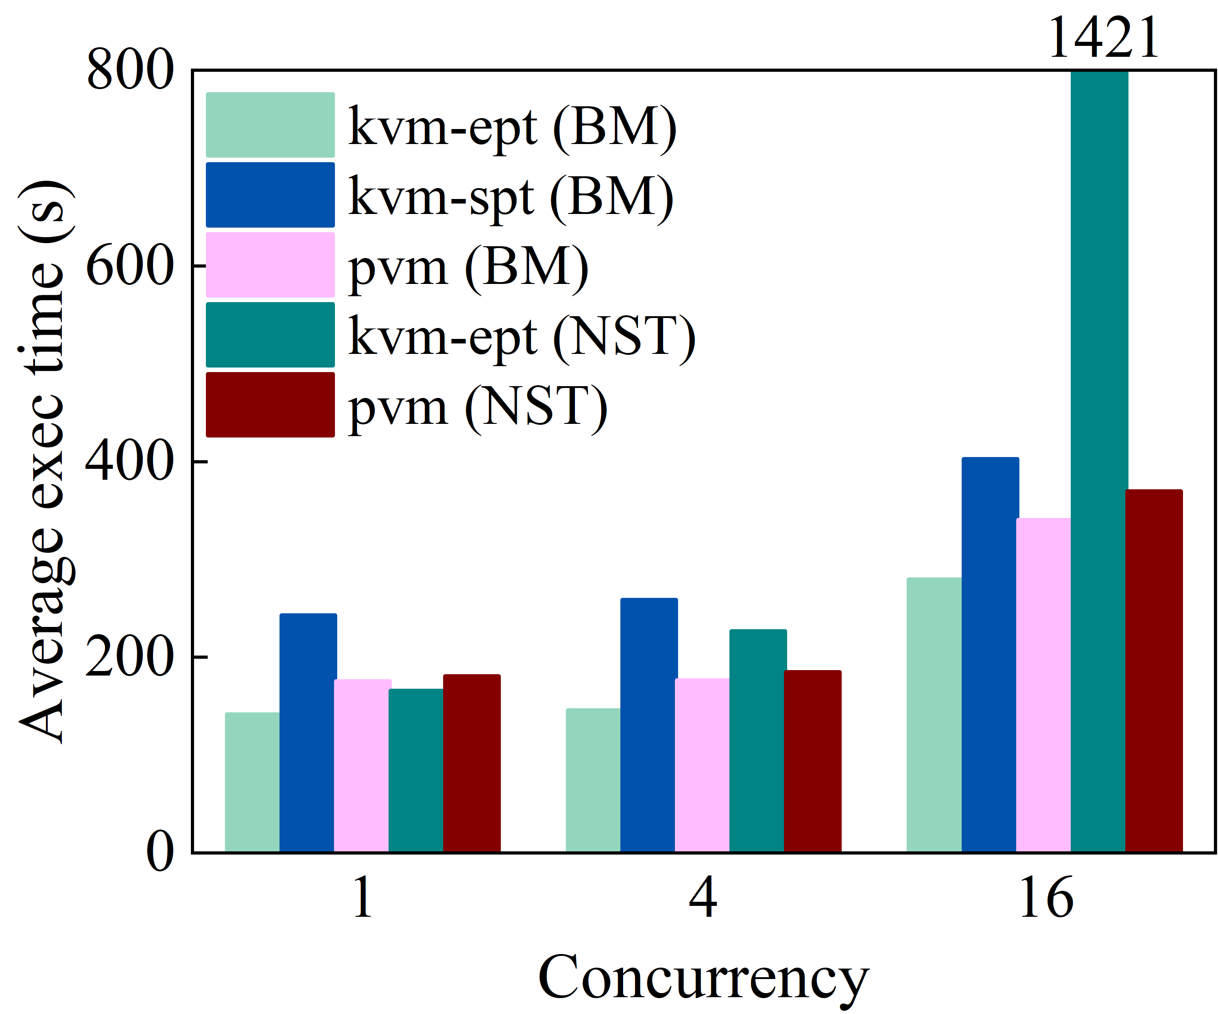
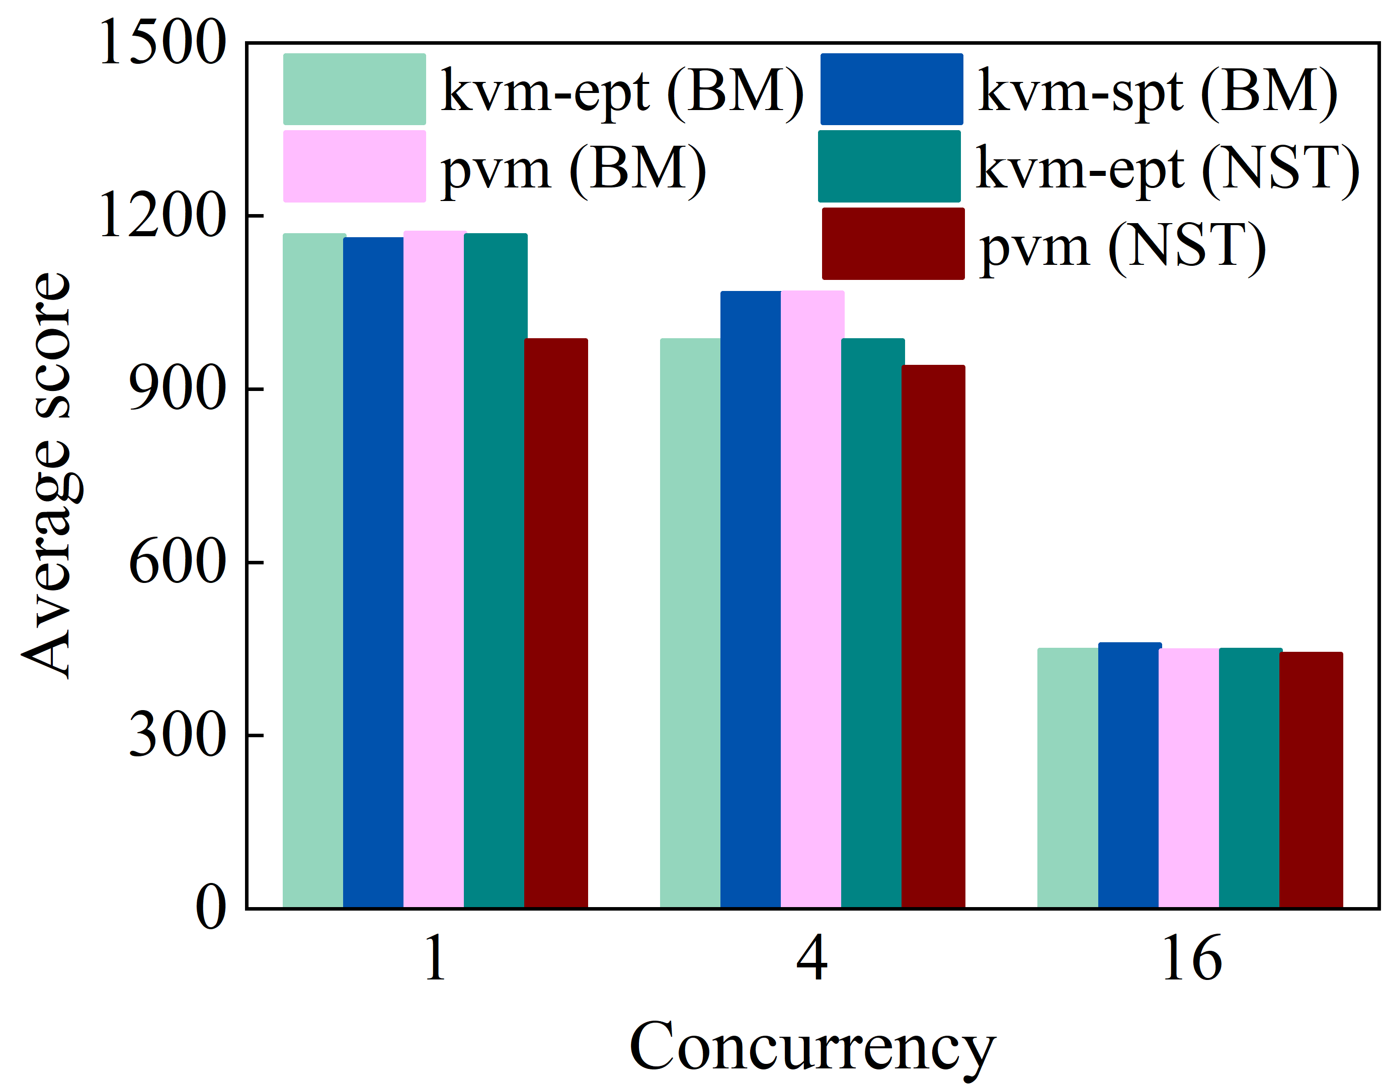
Evaluation: Results on Real-world Applications
Multiple instances run in separate secure containers
↓ 74%
Lower is better
Higher is better
Kbuild
Blogbench
Notes:
We continued the evaluation of PVM using four representative real-world applications with distinct characteristics: 1) Kbuild builds the Linux kernel from the source involving a mixture of compute and file I/O; 2) Blogbench is a filesystem benchmark that reproduces the load of a busy file server; We ran multiple instances of the same benchmark, each in a separate secure container, and varied the concurrency level from 1 to 16. For all applications, PVM offered performance close to the hardware-assisted approach for single-level virtualization. Further, the performance of kvm-ept (NST) collapsed in all cases when concurrency was high, suggesting that the 𝐿0 hypervisor became the bottleneck. [Action #2]PVM even outperformed the hardware-assisted approach in fluidanimate due to more efficient handling of the HALT instruction.

Slide 32
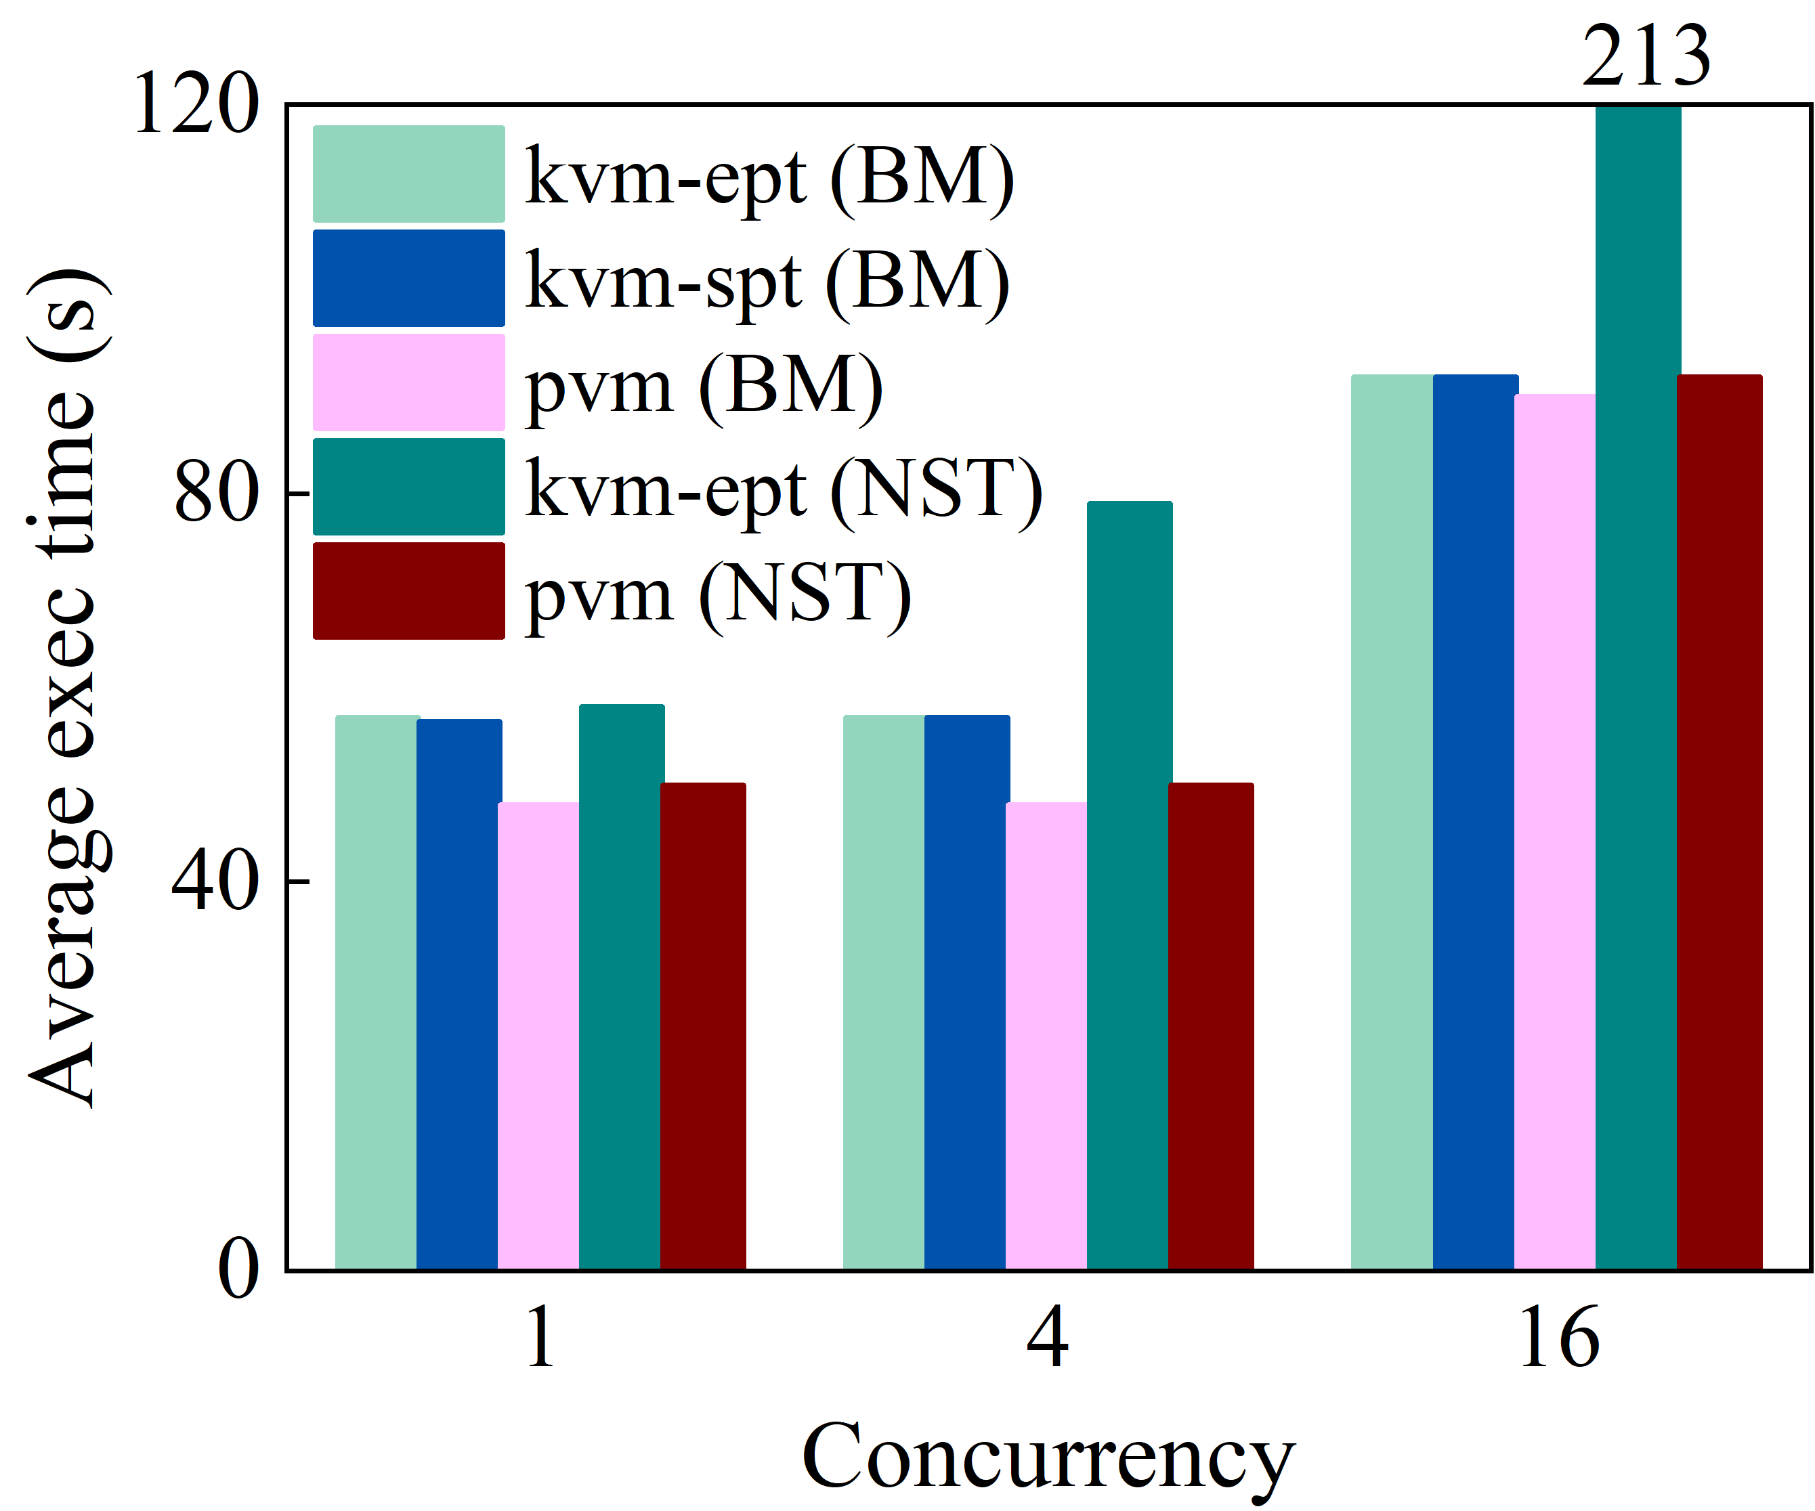
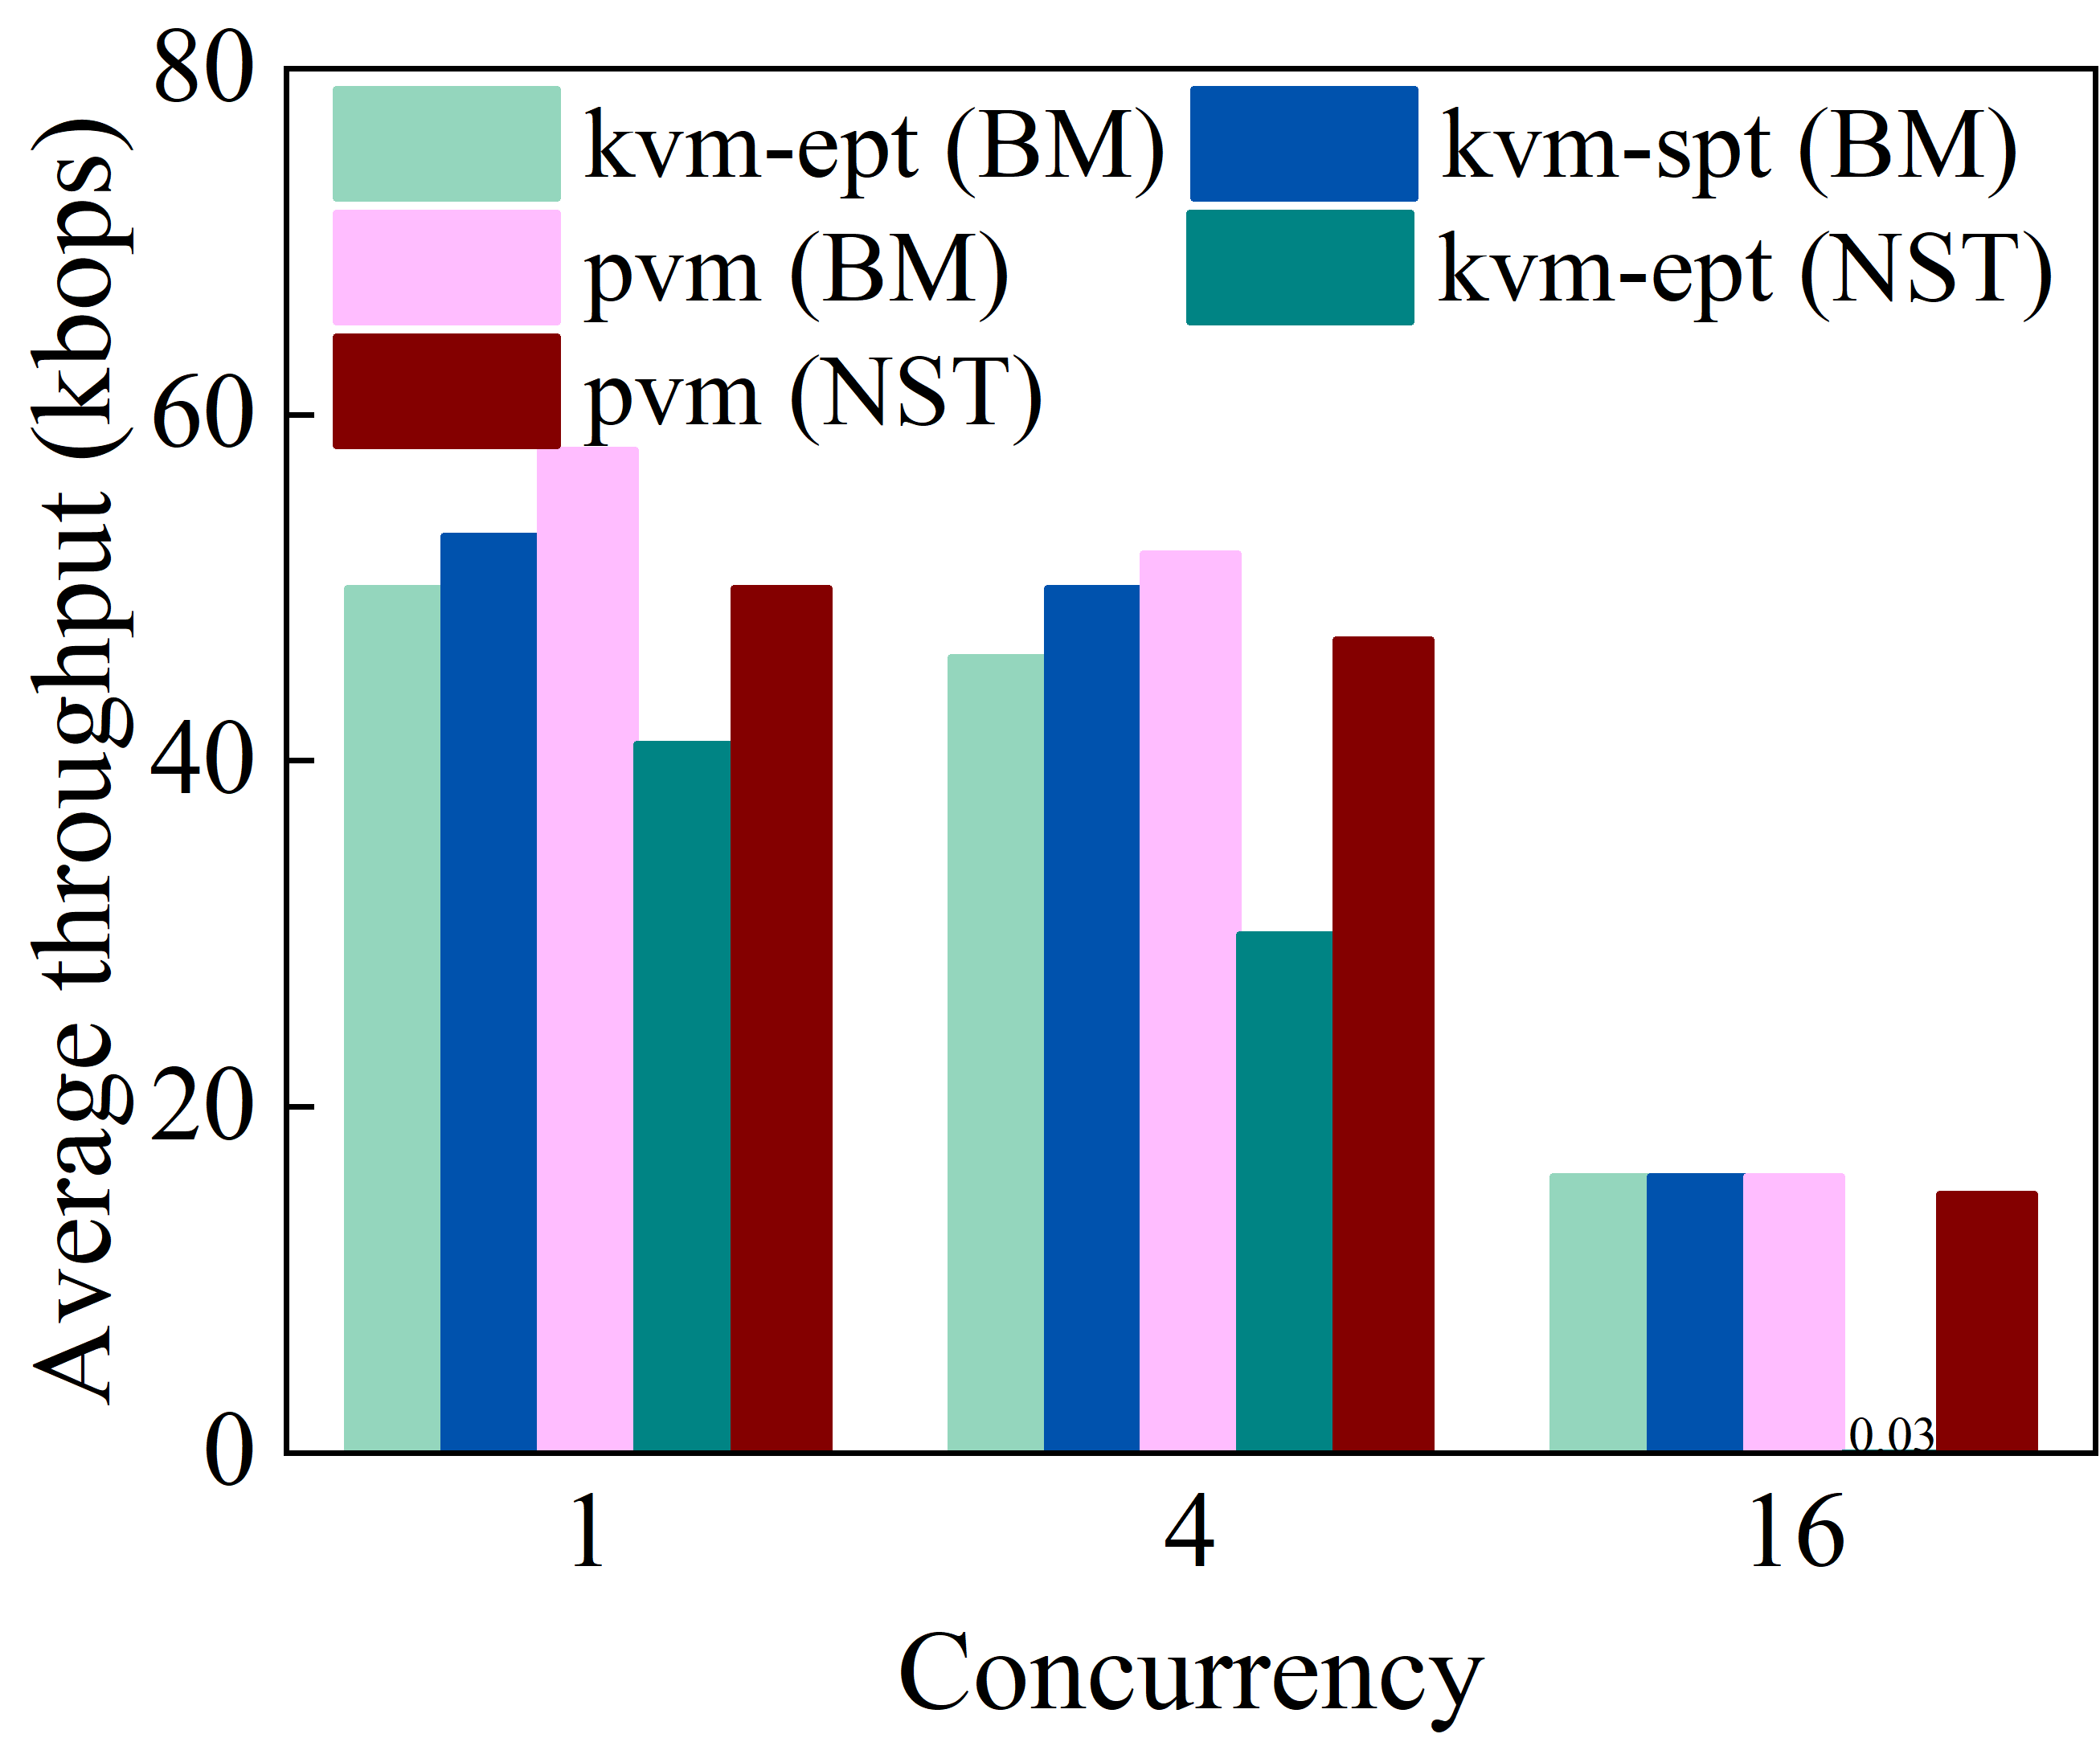
Evaluation: Results on Real-world Applications
Multiple instances run in separate secure containers
Higher is better
Lower is better
Specjbb2005
Fluidanimate
Notes:
3) SPECjbb2005 is a Java benchmark involving he use of a Java virtual machine ; 4) Fluidanimate is a benchmark with a large dataset selected from the PARSEC benchmark suite. PVM even outperformed the hardware-assisted approach in fluidanimate due to more efficient handling of the HALT instruction.

Slide 33
Evaluation configurations
Hardware
Server | ecs.ebmg6.26xlarge and ecs.g6.26xlarge
CPU | 2 x Intel Xeon Platinum CPUs (i.e., 26 cores at 2.50GHz and hyperthreading on)
RAM | 385 GB
Storage | 1 x 500 GB SATA SSD
Software
System | Anolis OS 7.9
Host/Guest kernel | 4.19.91
Runtime | Rund
Benchmarks | LMbench, PECjbb2005, Kbuild, Parsec 3.0, Cloud Bench Suit
Notes:
We compared PVM with two existing approaches: hardware-assisted and shadow page table based (software) approaches in both single-level (bare-metal) and nested (2-level) virtualization. Without loss of generality, we conducted the experiments using Intel processors. We used two Intel x86 instances from Alibaba Cloud – 1) a bare-metal instance and 2) a general-purpose (VM) instance with identical software and hardware configurations. Each instance was configured with two Intel Xeon Platinum CPUs,385 GB RAM, and a 500 GB SATA SSD. The bare-metal instance was equipped with Intel virtualization technology (VT), supporting VMX root and non-root modes, EPT, and VMCS Shadowing. The VM instance had no hardware virtualization support and did not colocate with other VMs.

Slide 34
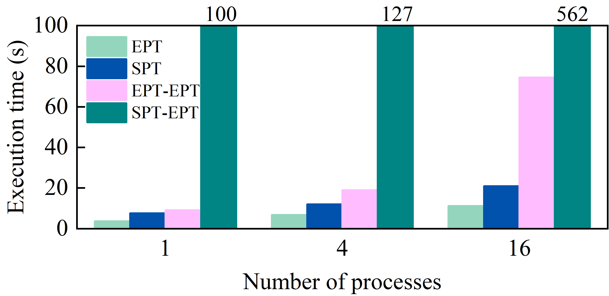
Performance Comparison: EPT-on-SPT vs EPT-on-EPT
The lower the better
EPT-on-EPT is more efficient in terms of fewer number of world switches and 𝐿0 traps
world switches in nested virtualization (1.3 μs) is an order of magnitude more expensive than those in single-level virtualization (0.105 μs)
Notes:
We used a memory-intensive micro-benchmark running in 𝐿2 to sequentially allocate 1 MB memory spaces and access pages within the allocated regions one by one. We varied the number of benchmark instances from 1 to 16. EPT-on-EPT significantly outperformed SPT-on-EPT in all cases. However, a considerable performance gap persisted between EPT-on-EPT and single-level memory virtualization (EPT only), and this gap widened as concurrency levels increased. We quantified the cost of world switches in EPT-on-EPT and EPT only. We quantified the cost of world switches in EPT-on-EPT and EPT only. Our measurements showed that world switches in nested virtualization (1.3 μs) is an order of magnitude more expensive than those in single-level virtualization (0.105 μs)

