Slide 1
Experiment 3 (according to new list; as per old list Experiment 2)
To study the optical Rotatory
Dispersion(ORD) of some chiral substances
(following slides will explain the page layouts as expected from the design team)

Slide 2
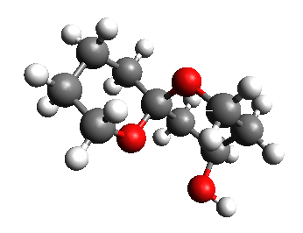
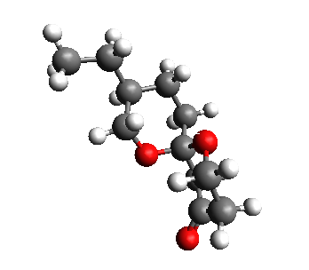
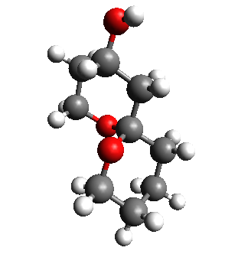
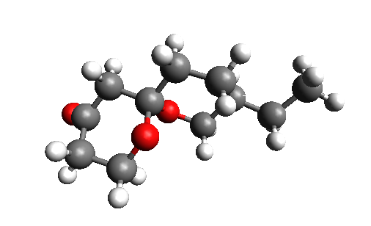
Introduction to the structures of the sample molecules used
Sample 1
Sample 2
Sample 3
Sample 4
Instead of tese pictures there will be 4 Jmol aplets on which user can click and view the molecules in 3D
NEXT >

Slide 3
Determination of the type of Chirality of the sample molecules
Jmol aplet of
Sample1
Instruction
R
S
how to use the Jmol aplets
How to assign labels to diff groups
Told the user to decide R/S
Select the corresponding radio button
Jmol aplet of
Sample2
R
S
Jmol aplet of
Sample3
R
If ALL correct go to next page
Else ask “Retry” or “Skip”
If “Retry” load this page again
Else go to next page
S
Jmol aplet of
Sample4
R
S
SKIP
SUBMIT

Slide 4
Here will the flash page you have designed but this time with 4 samples (corresponding data are given at the end of the ppt)
These are the following actions that will take place in the page
(1) it will be the same as it is of now upto the generation of graphs
(2)after graphs are generated for the selected sample NO structures will arrive
(3)Instead they will be asked to choose the next sample.
(4)user can do the generation of graph for all the 4 samples or SKIP in between.
(5)once all the 4 graphs are done ACTIVATE the ANALYSIS button.
(6) On selecting ANALYSIS or “SKIP” --> directed to the next HTML page.
[if this modification task is too heavy to do in Flash, design team can switch to HTML if they wish]
ANALYSIS
SKIP

Slide 5
ANALYSIS
INFORMATION : R-spiroacytal has -ve ORD curves
Graph 1
Structure
(load picture of 3D structure of an RANDOM sample(1-4))
These pictures will be provided
The appearance of the picture will be with some animation/effects
Graph 2
Select the ORD curve given by this Structure
(user will select one graph)
If correct show some animation/effect and load the next structure
If wrong again show some effect/animation
Ask to RETRY or NEXT
Graph 3
Graph 3
If all 4 structers are loaded or
SKIP is pressed redirect to self-evaluation page
SKIP

Slide 6
Some Basic Information
Sample No: Name in Excel Sheet
Sample 1 = R-spiroacytal
Sample 2 = R-spiroacytol with carbonyl
Sample 3 = S-spiroacytal
Sample 4 = S-spiroacytol with carbonyl

