Slide 1
Experiment 4 (according to new list; as per old list Experiment 3)
To study the circular Dichroism of some
substances with chiral chromophores.
(following slides will explain the page layouts as expected from the design team)

Slide 2
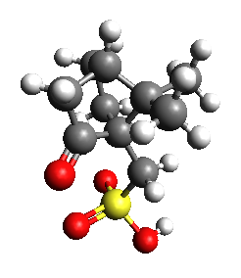
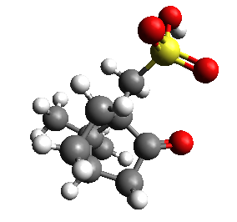
Introduction to the structures of the sample molecules used
Sample 1
Sample 2
Instead of tese pictures there will be 2 Jmol aplets on which user can click and view the molecules in 3D.
Please Note: Here Sample1 is R-camphor-10-sulphonic-acid and Sample2 is S-camphor-10-sulphonic-acid
ORD data for these samples are given into 3rd tab of ORD spectra.xlsx
CD data for these samples are given into 3rd tab of CD_spectra.xlsx
NEXT >

Slide 3
Determination of the type of Chirality of the sample molecules
Jmol aplet of
Sample1
Instruction
R
S
how to use the Jmol aplets
How to assign labels to diff groups
Told the user to decide R/S
Select the corresponding radio button
Jmol aplet of
Sample2
R
S
If ALL correct go to next page
Else ask “Retry” or “Skip”
If “Retry” load this page again
Else go to next page
SKIP
SUBMIT

Slide 4
Measuring ORD curve of the Samples
Here will the flash page you have designed for previous exp but this time with 2 samples
These are the following actions that will take place in the page
(1) it will be the same as it is of now upto the generation of graphs
(2)after graphs are generated for the selected sample NO structures will arrive
(3)Instead they will be asked to choose the next sample.
(4)user can do the generation of graph for all the 2 samples or SKIP in between.
(5)once all the 4 graphs are done ACTIVATE the “Measure CD” button.
(6) On selecting “Measure CD” or “SKIP” --> directed to the next HTML/Flash page which will measure the CD.
[if this modification task is too heavy to do in Flash, design team can switch to HTML if they wish]
Measure CD
SKIP

Slide 5
Measuring CD curve of the Samples
Here will the flash page you have designed for previous CD measurement experiment but this time with 2 samples
These are the following actions that will take place in the page
(1) it will be the same as it is of now upto the generation of graphs
(2)after graphs are generated for the selected sample NO structures will arrive
(3)Instead they will be asked to choose the next sample.
(4)user can do the generation of graph for all the 2 samples or SKIP in between.
(5)once all the 2 graphs are done ACTIVATE the ANALYSIS button.
(6) On selecting ANALYSIS or “SKIP” --> directed to the next HTML page.
[if this modification task is too heavy to do in Flash, design team can switch to HTML if they wish]
ANALYSIS
SKIP

Slide 6
ANALYSIS
INFORMATION : ORD and CD spectra are interconvertable according to Kroning-Kramer transformation
ORD Graph 1
CD Graph 1
(load picture of CD graph of an RANDOM sample(1 or 2))
The appearance of the picture will be with some animation/effects
ORD Graph 2
Select the ORD curve with which this CD curve matches
(user will select one graph)
If correct show some animation/effect and load the next CD graph
If wrong again show some effect/animation
Ask to RETRY or NEXT
If all 2 structers are loaded or
SKIP is pressed redirect to self-evaluation page
SKIP

