Slide 1
Further Data Structures
The story so far
  Saw some fundamental operations as well as advanced operations on arrays, stacks, and queues
  Saw a dynamic data structure, the linked list, and its applications.
  Saw the hash table so that insert/delete/find can be supported efficiently.
This week we will
  Study data structures for hierarchical data
  Operations on such data.
  Leading to efficient insert/delete/find.

Slide 2
Motivation
Consider your home directory.
/home/user is a directory, which can contain sub-directories such as work/, misc/, songs/, and the like.
Each of these sub-directories can contain further sub-directories such as ds/, maths/, and the like.
An extended hierarchy is possible, until we reach a file.

Slide 3
Motivation
Consider another example. The table of contents of a book.
A book has chapters.
A chapter has sections
A section has sub-sections.
A sub-section has sub-subsections,
Till some point.

Slide 4
Motivation
In both of the above examples, there is a natural hierarchy of data.
  In the first example, a (sub)directory can have one or more sub-directories.
Similarly, there are several setting where there is a natural hierarchy among data items.

Slide 5
Motivation
What kind of questions arise on such hierarchical data?
  Find the number of levels in the hierarchy between two data items?
  Print all the data items according to their level in the hierarchy.

Slide 6
Motivation
As a data structure question
  how can more members be added to the hierarchy?
  how can existing data items be deleted from the hierarchy?

Slide 7
A New Data Structure
This week we will propose a new data structure that can handle hierarchical data.
Study several applications of the data structure to
  expression evaluation
  searching

Slide 8
The Tree Data Structure
Our new data structure will be called a tree.
Defined as follows.
  A tree is a collection of nodes.
  An empty collection of nodes is a tree.
  Otherwise a tree consists of a distinguished node r, called the root, and 0 or more non-empty (sub)trees T₁, T₂, · · · , T_{k} each of whose roots r₁, r₂, ..., r_{k} are connected by a directed edge from r.
  r is also called as the parent of the the nodes r₁, r₂, ..., r_{k}.

Slide 9
Basic Observations
A tree on n nodes always has n-1 edges.
Why?
  One parent for every one, except the root.
Before going in to how a tree can be represented, let us know more about the tree.

Slide 10
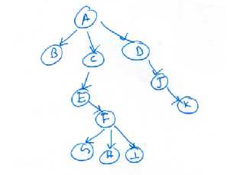
An Example
Consider the tree shown to the right.
The node A is the root of the tree.
It has three subtrees whose roots are B, C, and D.
Node C has one subtree with node E as the root.

Slide 11
An Example
Nodes with the same parent are called as siblings.
In the figure, G, H, and I are siblings.
Nodes with no children are called leaf nodes or pendant nodes.
  In the figure, B and K are leaf nodes.

Slide 12
A Few More Terms : Height, Level, and Path
A path from a node u to a node v is sequence of nodes u=u₀, u₁, u₂, ..., u_{k} = v such that u_{i} is the parent of u_{i+1}, i > 0.
  The path is said to have a length of k-1, the number of edges in the path.
  A path from a node to itself has a length of 0.
Example: A path from node C to F in our earlier tree is C->E->F.
Observation: In any tree there is exactly one path from the root to any other node.

Slide 13
Depth
Given a tree T, let the root node be said to be at a depth of 0.
The depth of any other node u in T is defined as the length of the path from the root to u.
Example: Depth of node G = 4.
Alternatively, let the depth of the root be set to 0 and the depth of a node is one more than the depth of its parent.

Slide 14
Height
Another notion defined for trees is the height.
The height of a leaf node is set to 0. The height of a node is one plus the maximum height of its children.
The height of a tree is defined as the height of the root.
Example: Height of node C = 3.

Slide 15
Ancestors and Descendants
Recall the parent-child relationship between nodes.
Alike parent-children relationship, we can also define ancestor-descendant relationship as follows.
In the path from node u to v, u is an ancestor of v and v is a descendant of u.
If u ≠ v, then u (v) is called a proper ancestor (descendant) respectively.

Slide 16
Implementing Trees
Briefly, we also mention how to implement the tree data structure.
The following node declaration as a structure works.
  struct node
  {
  int data;
  node *children;
  }

Slide 17
Applications
Can use this to store the earlier mentioned examples.
Need more tools to perform the required operations.
We'll study them via a slight specialization.

Slide 18
Binary Trees
A special class of the general trees.
Restrict each node to have at most two children.
  These two children are called the left and the right child of the node.
  Easy to implement and program.
  Still, several applications.

Slide 19
An Example
Figure shows a binary tree rooted at A.
All notions such as
  height
  depth
  parent/child
  ancestor/descendant
are applicable.

Slide 20
Our First Operation
To print the nodes in a (binary) tree
This is also called as a traversal.
Need a systematic approach
  ensure that every node is indeed printed
  and printed only once.

Slide 21
Tree Traversal
Several methods possible. Attempt a categorization.
Consider a tree with a root D and L, R being its left and right sub-trees respectively.
Should we intersperse elements of L and R during the traversal?
  OK – one kind of traversal.
  No. -- One kind of traversal.
  Let us study the latter first.

Slide 22
Tree Traversal
When items in L and R should not be interspersed, there are six ways to traverse the tree.
  D L R
  D R L
  R D L
  R L D
  L D R
  L R D

Slide 23
Tree Traversal
Of these, let us make a convention that R cannot precede L in any traversal.
We are left with three:
  L R D
  L D R
  D L R
We will study each of the three. Each has its own name.

Slide 24
The Inorder Traversal (LDR)
The traversal that first completes L, then prints D, and then traverses R.
To traverse L, use the same order.
  First the left subtree of L, then the root of L, and then the right subtree of R.

Slide 25
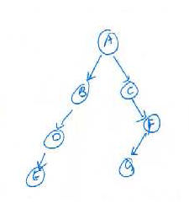
The Inorder Traversal -- Example
Start from the root node A.
We first should process the left subtree of A.
Continuing further, we first should process the node E.
Then come D and B.
The L part of the traversal is thus E D B.

Slide 26
The Inorder Traversal -- Example
Then comes the root node A.
We first next process the right subtree of A.
Continuing further, we first should process the node C.
Then come G and F.
The R part of the traversal is thus C G F.
Inorder: E D B A C G F

Slide 27
The Inorder Traversal -- Example
Procedure Inorder(T)‏
begin
  if T == NULL return;
  Inorder(T->left);
  print(T->data);
  Inorder(T->right);
end
Inorder: E D B A C G F

Slide 28
The Preorder Traversal (DLR)
The traversal that first completes D, then prints L, and then traverses R.
To traverse L (or R), use the same order.
  First the root of L, then left subtree of L, and then the right subtree of L.

Slide 29
The Preorder Traversal -- Example
Start from the root node A.
We first should process the root node A.
Continuing further, we should process the left subtree of A.
This suggests that we should print B, D, and E in that order.
The L part of the traversal is thus B D E.

Slide 30
The Preorder Traversal -- Example
We first next process the right subtree of A.
Continuing further, we first should process the node C.
Then come F and G in that order.
The R part of the traversal is thus C F G.
Preorder: A B D E C F G

Slide 31
The Preorder Traversal – Example
Procedure Preorder(T)‏
begin
  if T == NULL return;
  print(T->data);
  Preorder(T->left);
  Preorder(T->right);
end
Preorder: A B D E C F G

Slide 32
The Postorder Traversal (LDR)
The traversal that first completes L, then traverses R, and then prints D.
To traverse L, use the same order.
  First the left subtree of L, then the right subtree of R, and then the root of L.

Slide 33
The Postorder Traversal -- Example
Start from the root node A.
We first should process the left subtree of A.
Continuing further, we first should process the node E.
Then come D and B.
The L part of the traversal is thus E D B.

Slide 34
The Postorder Traversal -- Example
We next process the right subtree of A.
Continuing further, we first should process the node C.
Then come G and F.
The R part of the traversal is thus G F C.
Then comes the root node A.
postorder: E D B G F C A

Slide 35
The Postorder Traversal -- Example
Procedure postorder(T)‏
begin
  if T == NULL return;
  Postorder(T->left);
  Postorder(T->right);
  print(T->data);
end
Inorder: E D B G F C A

Slide 36
Another Kind of Traversal
When left and right subtree nodes can be intermixed.
One useful traversal in this mode is the level order traversal.
The idea is to print the nodes in a tree according to their level starting from the root.

Slide 37
How to Perform a Level Order Traversal
Consider the same example tree.
Starting from the root, so A is printed first.
What should be printed next?
Assume that we use the left before right convention.
So, we have to print B next.
How to remember that C follows B.
And then D should follow C?

Slide 38
Level Order Traversal
Indeed, can remember that B and C are children of A.
But, have to get back to children of B after C is printed.
For this, one can use a queue.
  Queue is a first-in-first-out data structure.

Slide 39
Level Order Traversal
The idea is to queue-up children of a parent node that is visited recently.
The node to be visited recently will be the one that is at the front of the queue.
  That node is ready to be printed.
How to initialize the queue?
  The root node is ready!

Slide 40
Level Order Traversal
Procedure LevelOrder(T)‏
begin
  Q = queue;
  insert root into the queue;
  while Q is not empty do
    v = delete();
    print v->data;
    if v->left is not NULL insert v->left into Q;
    if v->right is not NULL insert v->right into Q;
  end-while
end

Slide 41
Level Order Traversal Example
Queue
----------
A
B C
C D
D F
F E
E G
G
EMPTY
Output
----------
A
B
C
D
F
E
G
Queue and output are shown at every stage.

Slide 42
Analysis – Level Order Traversal
How to analyze this traversal?
Assume that the tree has n nodes.
Each node is placed in the queue exactly once.
The rest of the operations are all O(1) for every node.
So the total time is O(n).
This traversal can be seen as forming the basis for a graph traversal.

Slide 43
Application to Expression Evaluation
We know what expression evaluation is.
We deal with binary operators.
An expression tree for a expression with only unary or binary operators is a binary tree where the leaf nodes are the operands and the internal nodes are the operators.

Slide 44
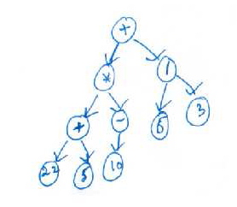
Example Expression Tree
See the example to the right.
The operands are 22, 5, 10, 6, and 3.
These are also leaf nodes.

Slide 45
Questions wrt Expression Tree
How to evaluate an expression tree?
  Meaning, how to apply the operators to the right operands.
How to build an expression tree?
  Given an expression, how to build an equivalent expression tree?

Slide 46
A Few Observations
Notice that an inorder traversal of the expression tree gives an expression in the infix notation.
  The above tree is equivalent to the expression ((22 + 5) × (−10)) + (6/3)‏
What does a postorder and preorder traversal of the tree give?
  Answer: ??

Slide 47
Why Expression Trees?
Useful in several settings such as
  compliers
  can verify if the expression is well formed.

Slide 48
How to Evaluate using an Expression Tree
Notice that to evaluate a node, its left subtree and its right subtree need to be operands.
For this, may have to evaluate these subtrees first, if they are not operands.
Essentially, have to evaluate the root.
So, Evaluate(root) should be equivalent to:
  Evaluate the left subtree
  Evaluate the right subtree
  Apply the operator at the root to the operands.

Slide 49
How to Evaluate using an Expression Tree
This suggests a recursive procedure that has the above three steps.
Recursion stops at a node if it is already an operand.

Slide 50
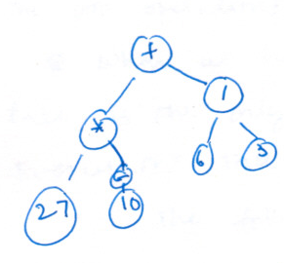
How to Evaluate using an Expression Tree
Example

Slide 51
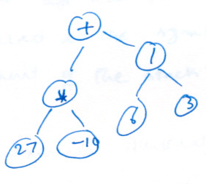
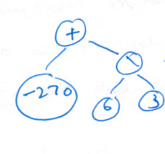
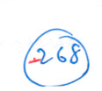
Example Contd...

Slide 52
Pending Question
How to build an expression tree?
Start with an expression in the infix notation.
Recall how we converted an infix expression to a postfix expression.
The idea is that operators have to wait to be sent to the output.
  A similar approach works now.

Slide 53
Building an Expression Tree
Let us start with a postfix expression.
The question is how to link up operands as (sub)trees.
As in the case of evaluating a postfix expression, have to remember operators seen so far.
  need to see the correct operands.
A stack helps again.
But instead of evaluating subexpression, we have to grow them as trees.
  Details follow.

Slide 54
Building an Expression Tree
When we see an operand :
  That could be a leaf node...Or a tree with no children.
  What is its parent?
  Some operator.
  In our case, operands can be trees also. The result of the expression tree could be an operand.
The above observations suggest that operands should wait on the stack.
  Wait as trees.

Slide 55
Building an Expression Tree
What about operators?
Recall that in the postfix notation, the operands for an operator are available in the immediate preceding positions.
Similar rules apply here too.
So, pop two operands (trees) from the stack.
Need not evaluate, but create a bigger (sub)tree.

Slide 56
Building an Expression Tree
Procedure ExpressionTree(E)‏
//E is an expression in postfix notation.
begin
  for i=1 to |E| do
    if E[i] is an operand then
      create a tree with the operand as the only node;
      add it to the stack
    else if E[i] is an operator then
      pop two trees from the stack
      create a new tree with E[i] as the root and the two trees popped as its children;
      push the tree to the stack
  end-for
end

Slide 57
Example
Consider the expression
The postfix of the expression is a b + f − c d × e + /
Let us follow the above algorithm.

Slide 58
Example
Stack
b
a
  + f − c d × e + /

Slide 59
Example
Stack
b
+
a
  f − c d × e + /

Slide 60
Example
Stack
f
b
+
a
  − c d × e + /

Slide 61
Example
Stack
  c d × e + /
f
-
b
+
a

Slide 62
Example
Stack
  × e + /
d
c
f
-
b
+
a

Slide 63
Example
Stack
  e + /
d
+
c
f
-
b
+
a

Slide 64
Example
Stack
  + /
e
d
+
c
f
-
b
+
a

Slide 65
Example
Stack
  /
e
+
d
+
f
c
-
b
+
a

Slide 66
Example
Stack
e
+
d
+
/
c
f
-
b
+
a

Slide 67
Another Application – Dictionary Operations
Consider designing a data structure for primarily three operations:
  insert,
  delete, and
  search.
Why not use a hash table?
  a hash table can only give an average O(1) performance
  Need worst case performance guarantees.

Slide 68
Dictionary Operations
Further extend the repertoire of operations to standard dictionary operations also such as findMin and findMax.
Specifically, our data structure shall support the following operations.
  Create()‏
  Insert()‏
  FindMin()‏
  FindMax()‏
  Delete(), and
  Find()‏

Slide 69
Binary Search Tree
Our data structure shall be a binary tree with a few modifications.
Assume that the data is integer valued for now.
Search Invariant:
  The data at the root of any binary search tree is larger than all elements in the left subtree and is smaller than all elements in the right subtree.

Slide 70
Binary Search Tree
The search invariant has to be maintained at all times, after any operation.
This invariant can be used to design efficient operations, and
Also obtain bounds on the runtime of the operations.

Slide 71
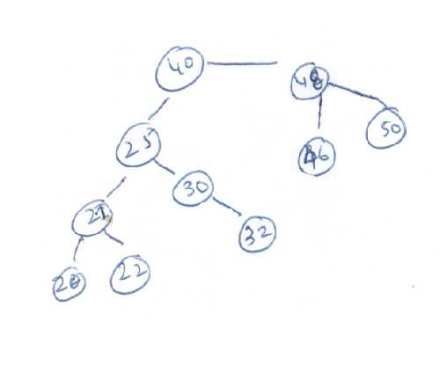
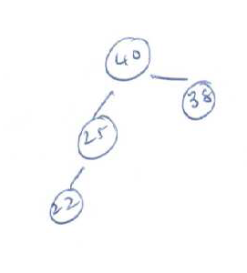
Binary Search Tree – Example
A binary search tree
Not a binary search tree

Slide 72
Operations
Let us start with the operation Find(x).
We are given a binary search tree T.
Answer YES if x is in T, and answer NO otherwise.

Slide 73
Find(x)‏
Let us compare x with the data at the root of T.
There are three possibilities
  x = T->data : Answer YES. Easy case.
  x < T->data : Where can x be if it is in T? Left subtree
  x > T->data : Where can x be if it is in T? Right subtree
So, continue search in the left/right subtree.
When to stop?
  Successful search stops when we find x.
  Unsuccessful search stops when we reach a leaf node without finding x.

Slide 74
Find(x)‏
Notice the similarity to binary serach.
In both cases, we continue search in a subset of the data.
  In the case of binary search the subset size is exactly half the size of the current set.
  Is that so in the case of a binary search tree also?
  May not always be true.

Slide 75
Find(x)‏
How to analyze the runtime?
Number of comparisons is a good metric.
Notice that for a successful or an unsuccessful search, the worst case number of comparisons is equal to the height of the tree.
What is the height of a binary search tree?
  We'll postpone this question for now.

Slide 76
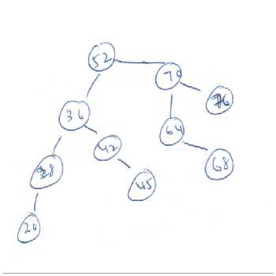
Example – Find(x)‏
Search for 64.
Since 52 < 64, we search in the right subtree.

Slide 77
Example – Find(x)‏
Search for 68.
Since 52 < 68, we search in the right subtree.
Since 64 < 65, again search in the right subtree.

Slide 78
Example – Find(x)‏
Search for 68.
Since 52 < 68, we search in the right subtree.
Since 64 < 65, again search in the right subtree.

Slide 79
Example – Find(x)‏
Search for 68.
Since 52 < 68, we search in the right subtree.
Since 64 < 68, again search in the right subtree.
Finally, find 68 as a leaf node.

Slide 80
Example -- Find(x)‏
Consider the same tree and Find(48).
Since 52 > 48, we search in the left subtree.

Slide 81
Example -- Find(x)‏
Consider the same tree and Find(48).
Since 52 > 48, we search in the left subtree.

Slide 82
Example -- Find(x)‏
Consider the same tree and Find(48).
Since 52 > 48, we search in the left subtree.
Since 36 < 48, search in the right subtree.

Slide 83
Example -- Find(x)‏
Consider the same tree and Find(48).
Since 52 > 48, we search in the left subtree.
Since 36 < 48, search in the right subtree.

Slide 84
Example -- Find(x)‏
Consider the same tree and Find(48).
Since 52 > 48, we search in the left subtree.
Since 36 < 48, search in the right subtree.
Since 42 < 48, search in the right subtree.

Slide 85
Example – Find(x)‏
Consider the same tree and Find(48).
Since 52 > 48, we search in the left subtree.
Since 36 < 48, search in the right subtree.
Since 42 < 48, search in the right subtree.
finally, 45 < 48, but no right subtree. So declare NOT FOUND.

Slide 86
Find(x) Pseudocode
procedure Find(x, T)‏
begin
  if T == NULL return NO;
  if T->data == x return YES;
  else if T->data > x
    return Find(x, T->right);
  else
    return Find(x, T->left);
end

Slide 87
Observation on Find(x)‏
Travel along only one path of the tree starting from the root.
Hence, important to minimize the length of the longest path.
  This is the depth/height of the tree.

Slide 88
Operation FindMin and FindMax
Consider FindMin.
Where is the smallest element in a binary search tree?
Recall that values in the left subtree are smaller than the root, at every node.
So, we should travel leftward.
  stop when we reach a leaf or
  a node with no left child.
FindMax is similar. How should we travel?

Slide 89
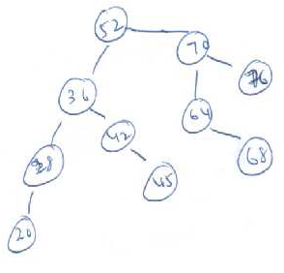
Operation FindMin and FindMax
On the above tree, findMin will travese the path shown in red.
FindMax will travel the path shown in green.

Slide 90
Operation FindMin and FindMax
procedure FindMin(T)‏
begin
if T = NULL return null;
if T−> left = NULL return T;
return FindMin(T−>left);
end
Both these operations also traverse one path of the tree.
Hence, the time taken is proportional to the depth of the tree.
Notice how the depth of the tree is important to these operations also.

Slide 91
Insert(x)‏
Let us now study how to insert an element into an existing binary tree.
Assume for simplicity that no duplicate values are inserted.

Slide 92
Insert(x)‏
Where should x be inserted?
Should satisfy the search invariant.
  So, if x is larger than the root, insert in the right subtree
  if x is smaller than the root, insert in the left subtree.
Repeat the above till we reach a leaf node.
Can always add a new child to a leaf node.
So, add node with value x as a child of some leaf node.

Slide 93
Insert(x)‏
Notice the analogy to Find(x)‏
If x is not in the tree, Find(x) stops at a leaf node.
Now, we are inserting x as a child of the leaf node last visited by Find(x).
If the tree is presently empty, then x will be the new root.
Let us consider a few examples.

Slide 94
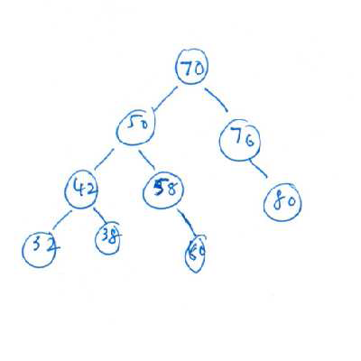
Insert(x)‏
Consider the tree shown and inserting 36.
We travel the path 70 – 50 – 42 – 32.
Since 32 is a leaf node, we stop at 32.

Slide 95
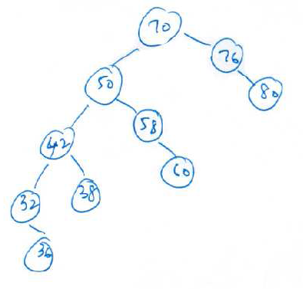
Insert(x)‏
Now, 36 > 32. So 36 is inserted as a right child of 32.
The resulting tree is shown in the picture.

Slide 96
Insert(x)
Procedure insert(x)‏
begin
T′ = T;
if T′ = NULL then
T′ = new Node(x, Null, Null);
else
while T′ is not a leaf node do
if T′−> data < x then T′ = T′−> left;
else T′ = T′−> right;
end-while;
if T′−> data < x then
Add x as a right child of T′;
else
Add x as a left child of T′;
End-if
End-if
End.

Slide 97
Insert(x)‏
New node always inserted as a leaf.
To analyze the operation insert(x), consider the following.
  Operation similar to an unsuccessful find operation.
  After that, only O(1) operations to add x as a child.
So, the time taken for insert is also proportional to the depth of the tree.

Slide 98
Duplicates?
To handle duplicates, two options
  report an error message
  to keep track of the number of elements with the same value

Slide 99
Remove(x)‏
Finally, the remove operation.
Difficult compared to insert
  new node inserted always as a leaf.
  but can also delete a non-leaf node.
We will consider several cases
  when x is a leaf node
  when x has only one child
  when x has both children

Slide 100
Remove(x)‏
If x is a leaf node, then x can be removed easily.
  parent(x) misses a child.
Remove(60)‏

Slide 101
Remove(x)‏
Suppose x has only one child, say right child.
Say, x is a left child of its parent.
Notice that x < parent(x) and child(x) > x, and also child(x) < parent(x).
So, child(x) can be a left child of parent(x), instead of x.
In essence, promote child(x) as a child of parent(x).

Slide 102
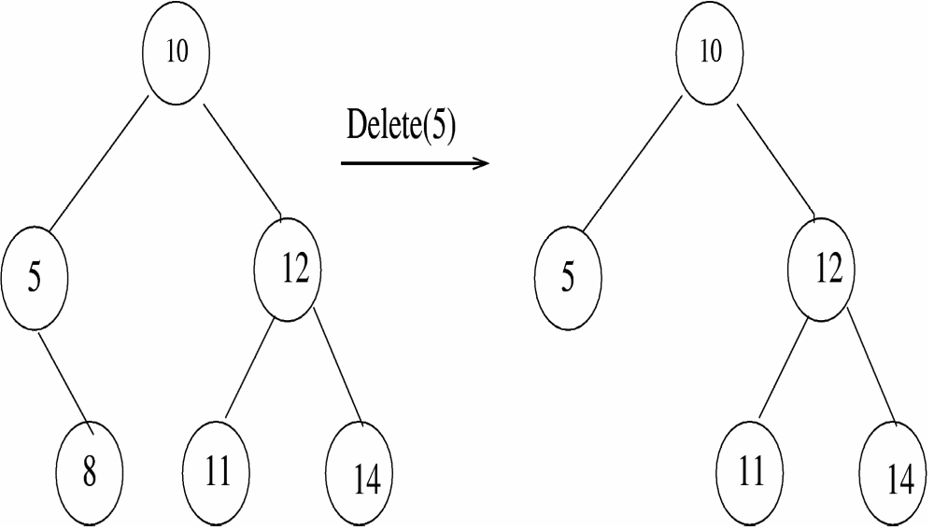
Remove(x)‏

Slide 103
Remove(x) – The Difficult Case
x has both children.
Cannot promote any one child of x to be child of parent(x).
But, what is a good value to replace x?
Notice that, the replacement should satisfy the search invariant.
So, the replacement node should have a value more than all the left subtree nodes and smaller than all right subtree nodes.

Slide 104
Remove(x)‏
One possibility is to consider the maximum valued node in the left subtree of x.
Equivalently, can also consider the node with the minimum value in the right subtree of x.
Notice that both these replacement nodes are leaf nodes. Hence easy to remove them.
In a way, to remove x, we physically remove a leaf node.

Slide 105
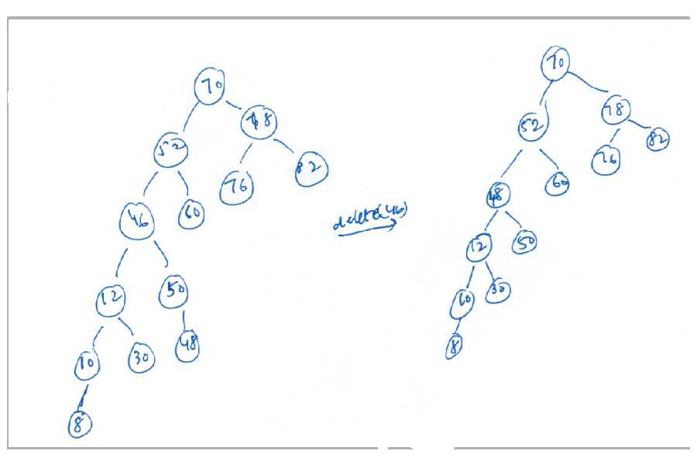
Remove(x)‏

Slide 106
Remove(x)‏
Procedure Delete(x, T)‏
begin
if T = NULL then return NULL;
T′ = Find(x);
if T′ has only one child then
adjust the parent of the remaining child;
else
T′′ = FindMin(T′−> right);
Remove T′′ from the tree;
T′−> value = T′′−> value;
End-if
End.

Slide 107
Remove(x)‏
Time taken by the remove() operation also proportional to the depth of the tree.

Slide 108
Depth of a Binary Search Tree
What are some bounds on the depth of a binary search tree of n nodes?
A depth of n is also possible.

Slide 109
Depth of a Binary Search Tree
Imagine that each internal node has exactly two children.
A depth of log₂ n is the best possible.
So the depth can be between log₂ n and n.
What is the average depth?

Slide 110
Average Depth
A good notion as most operations take time proportional on the depth of the binary search tree.
Still, not a satisfactory measure as we wanted worst-case performance bounds.

Slide 111
Depth of a Binary Search Tree
Let us analyze the average depth of a binary search tree.
This average is on what?
  Assume that all subtree sizes are equally likely.
Under the above assumption, let us show that the average depth of a binary search tree is O(log n).

Slide 112
Depth of a Binary Search Tree
Internal path length : The sum of the depths of all nodes in a tree.
Let D(N) to be the internal path length of some binary search tree of N nodes.
  _{i=1} ^{n} d(i), where d(i) is the depth of node i.
Note that D(1) = 0.

Slide 113
Depth of a Binary Search Tree
In a tree with N nodes, there is one root node and a left subtree of i nodes and a right subtree of n−i−1 nodes.
Using our notation, D(i) is the internal path length of the left subtree.
D(n-i-1) is the internal path length of the right subtree.

Slide 114
Depth of a Binary Search Tree
i
nodes
n-i-1
nodes
T_{L}
T_{R}
Further, if now these trees are attached to the root
  the depth of each node in T_{L} and T_{R} increases by 1.

Slide 115
Depth of a Binary Search Tree
i
nodes
n-i-1
nodes
T_{L}
T_{R}
So, D(N) = D(i) + D(n-i-1) + n-1

Slide 116
Solving the Recurrence Relation
If all subtree sizes are equally likely then D(i) is the average over all subtree sizes.
  That is, i ranges over 0 to N – 1.
  Can hence see that D(i) = (1/n) _{j=0}^{n−1} D(j)‏
Similar is the case with the right subtree.
The recurrence relation simplifies to
    D(n) = (2/n) ( _{j=0}^{n−1} D(j) ) + N – 1
Can be solved using known techniques.
  Left as homework.

Slide 117
Solving the Recurrence Relation
The solution to D(N) is D(N) = O(N log N).
How is D(N) related to the average depth of a binary search tree.
  Explain.
Does this mean that each operation has an average O(log N) runtime.
  Not quite.

Slide 118
Average Runtime
Now, remove() operation may introduce a skew.
Replacement node can skew left or right subtree.
Can pick the replacement node from the left or the right subtree uniformly at random.
  Still not known to help.
So, at best we can be satisfied with an average O(log n) runtime in most cases.
Need techniques to restrict the height of the binary search tree.

Slide 119
Towards Height Balanced Trees
How can we control the height of a binary search tree?
  should still maintain the search invariant
  additional invariants required.
What if the root of every subtree is the median of the elements in that subtree?
  Difficult to maintain as median can change due to insertion/deletion.
Would it suffice if we say that the root has both a left and a right subtree of equal height?
  No. example next slide.

Slide 120
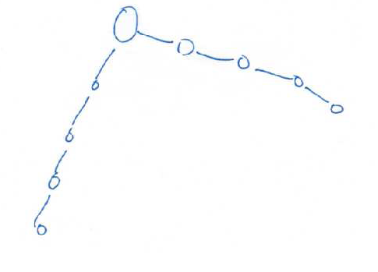
Towards Height Balanced Trees
In the above tree, irrespective of values at the nodes, the root has left and right subtrees of equal height.
Still, the depth of the tree is not O(log n).

Slide 121
Towards Height Balanced Trees
Our condition is too simple. Need more strict invariants.
Consider the following modification. For every node, its left and right subtrees should be of the same height.
The condition ensures good balance, but
The above condition may force us to keep the median as the root of every subtree.
  Fairly difficult to maintain.

Slide 122
Towards Height Balanced Trees
a small relaxation to Condition 2 works suprisingly well.
The relaxed condition, Condition 3, is stated below.
Height Invariant: For every node in the tree, the left and the right subtrees can have heights that differ by at most 1.

Slide 123
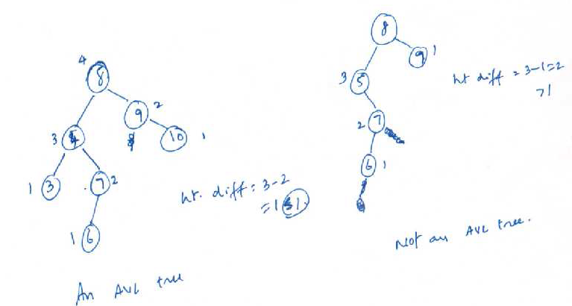
Example Height Balanced Trees
Not a Height Balanced Tree
Height Balanced Tree

Slide 124
The AVL Tree
A binary search tree satisfying the
  search invariant, and
  the height invariant
is called an AVL tree.
Named after after its inventors, Adelson–Velskii and Landis.
Throughout, let us define the height of an empty tree to be -1.

Slide 125
Operations on an AVL Tree
An insertion/removal can violate the height invariant.
We'll show how to maintain the invariant after an insert/remove.

Slide 126
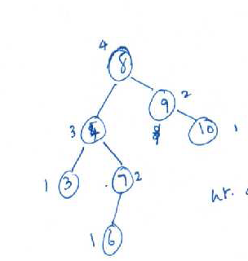

Insert in an AVL Tree
Proceed as insertion into a search tree.
  At least satisfies the search invariant.
It may violate the height invariant as follows.
insert(5)‏
5

Slide 127
Insert in an AVL Tree
After inserting as in a binary search tree, notice that all the nodes in the path along the insert may now violate the height invariant.
5

Slide 128
Insert in an AVL Tree
How to restore balance?
Notice that node 7 was in height balance before the insert, but not lost balance.
Let us try to fix balance at that node.
Node 7 has a left subtree of height 2 and a right subtree of height 0.
If node 6 were the root of that subtree, then that subtree will have a left and right subtree of height 1 each.

Slide 129
Insert in an AVL Tree
Making that change at node 7, would also fix the height violations in all other places too.
Suggests that fixing the height violation at one node can be of great help.
Holds true in general.
So, need to formalize this notion.

Slide 130
Insert in an AVL Tree
Let node t be the deepest node that violates the height condition.
Such a violation can occur due to the following reasons:
  An insertion into the left subtree of the left child of t.
  An insertion into the right subtree of the left child of t.
  An insertion into the left subtree of the right child of t, and
  An insertion into the right subtree of the right child of t.

Slide 131
Insert into an AVL Tree
Notice that cases 1 and 4 are symmetric.
Similarly, cases 2 and 3 are symmetric.
So, let us treat cases 1 and 2.

Slide 132
Insert into an AVL Tree
Recall the earlier fix at node 7.
We call that operation a single rotation.
  In a single rotation, we consider a node x, its parent p, and its grandparent g.
  Let x be a left child of p, and p a left child of g.
  After rotation, we make p the root of the subtree.
  To satisfy the search invariant, g should now be the right child of p and x the left child of p.

Slide 133
Single Rotation Example
g
p
p
Single Rotation
x
g
x

Slide 134
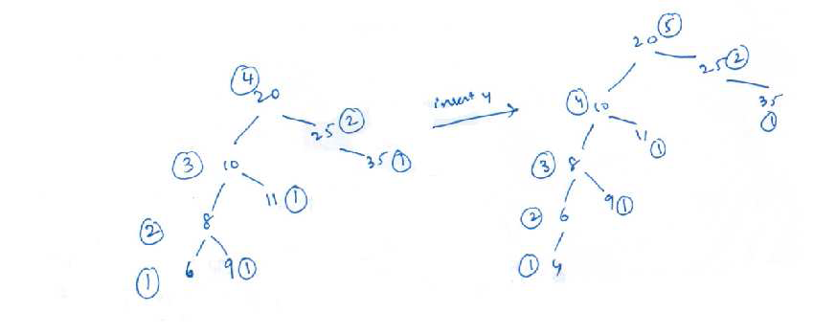
Single Rotation Example

Slide 135
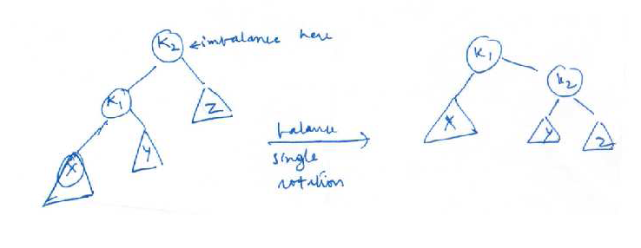
Single Rotation – Generalization

Slide 136
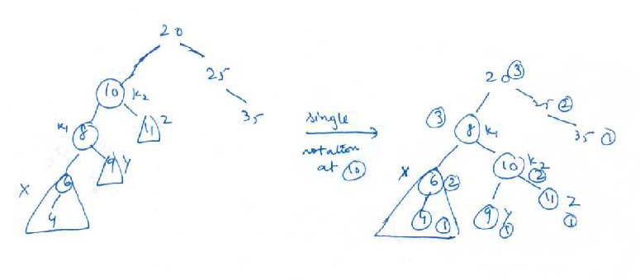
Single Rotation – Example

Slide 137
Single Rotation
Why does it help?
If k2 is out of balance after the insert, the height difference between Z and k1 is 2.
  Why can't it be more than 2?
Now, the height of Z increases by 1 after the rotate
Also, the height of X and Y decrease by 1.
So, the subtree at k1 now has the same height as k2 had before the insert.

Slide 138
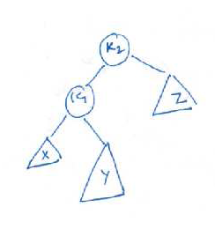

Case 2 of the Insert
Single rotation may not help here.

Slide 139
Case 2 of Insert
Why single rotation did not help?
Height of Y increased, resulting in increase of height of k2.
After rotate also, height of Y is same as earlier.
So, does not help fix the height imbalance.

Slide 140
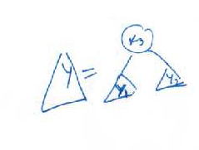
Case 2 of Insert
Need more fixes.
Idea : Y should reduce height by 1.
We hence introduce double rotation.
Would be helpful to view as follows.

Slide 141
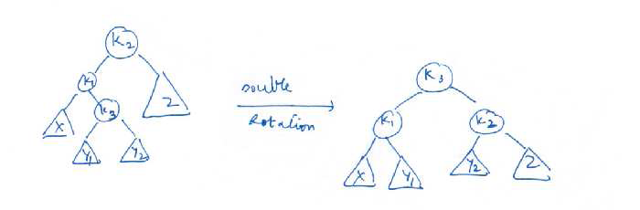
Double Rotation Generalization

Slide 142
Double Rotation
Any of X, Y1, Y2, and Z can be empty.
After the rotation, one of Y1 and Y2 are two levels deeper than Z.
Though we cannot say which is deeper among Y1 and Y2, it turns out that fortunately, it does not matter.
The resulting tree satisfies search invariant also.
  Hence the placement of Y1, Y2, etc.

Slide 143
Remove Operation in an AVL Tree
A similar approach can be designed.

Slide 144
AVL Tree
What is the height of an AVL tree?
The maximum height can be derived as follows.
Let H(n) be the maximum height of an AVL tree.
At any node, its left and right subtrees can differ in height by at most 1.

Slide 145
More on Search Trees
AVL trees do have a O(log n) height in all situations.
So, each operation takes O(log n) time in the worst case.
So, better solution than hash tables.
Further optimizations as follows.

Slide 146
More on Search Trees
Notice that a successful search operation can stop as soon as the element is found.
If the element is a leaf node, then search operation on that node takes the largest time.
A successive search to the same node still takes the same amount of time.
In some settings, a few elements are searched more often than the others.
  should focus on optimizing these searches.

Slide 147
More on Search Trees
One way to make future search operations on the same node is to bring that node (closer) to the root.
This is what we will do. Called as splaying.
The search tree using this technique is called as splay tree.

Slide 148
Splay Trees
In a splay tree, during every operation, including a search(), the current (serach) tree is modified.
The item searched is made as the root of the tree.
During this process, other nodes also change their height.

Slide 149
The Splay Operation
Let x be a node in the search tree.
To make x as the root, we use operations similar to that of rotations.
To splay a tree at node x, repeat the following splaying step until x is the root of the tree.
  Let p(x) denote the parent node of x.
  The following cases are used depending on whether x is a left child of p(x), etc.

Slide 150
Four Cases
Case Zig − Zig : If p(x) is not the root, and x and p(x) are both left (right) children
x
g(x)‏
A
p(x)‏
p(x)‏
D
B
C
g(x)‏
x
Splay at x
D
A
B
C

Slide 151
Four Cases
Case Zig − Zag - If p(x) is not the root, and x is left (right) child and p(x) is right (left) child.
g(x)‏
x
p(x)‏
D
g(x)‏
Splay at x
p(x)‏
x
A
B
C
D
A
B
C

Slide 152
Two More Cases
What if p(x) is the root? g(x) is not defined.
If x is the left child of p(x), proceed as follows.
The other case is easy to figure out.
p(x)‏
x
C
Splay at x
p(x)‏
x
A
A
B
B
C

Slide 153
Search(x) in a Splay Tree
Proceed as search in a binary search tree.
Once x is found, spaly(x) till x is the root.
Splay uses the above cases.

Slide 154
Insert(x)‏
Make x the root after inserting as in a binary search tree.

Slide 155
Delete(x)‏
Delete x as in a binary search tree.
If y is the node physically deleted, then make the parent of y as the root., i.e., spaly(y)‏
This is a bit artificial, but required for analysis to go through.

Slide 156
Analysis
Analyzing the splay tree is a bit tough at this stage.
Here are a few results:
Any sequence of m operations on a splay tree can be completed in time O((m+n) log n).
Other claims such as working set claims, also hold.
Topic for advanced classes.

Slide 157
Another Variation
Consider the following setting.
Imagine creating a system for a billion records.
  Like the Unique ID project.
The system should enable search/insert/delete and other dictionary operations.
What kind of data structures should we use?

Slide 158
Another Variation
Imagine using the height balanced search trees, i.e. AVL trees.
For n = 10⁹ records, the AVL tree will have about 1.4 log₂ n ~ 40 levels.
However, the entire tree may not fit in the memory of a computer.
  Need secondary storage such as disk to hold the tree.
That is pretty reasonable. However, has a few problems.

Slide 159
Another Variation
However, has to understand the way the memory system interacts with the computer.
A typical memory system has at least two levels in the hierarchy.
  A main memory
  A cache
The reason for this is that main memory access times are much higher than the processor speeds.
  A cache can help reduce the memory latency.
Pages, a unit of memory, are moved back and forth.

Slide 160
Another Variation
Pages are brought into the cache sometimes on demand and sometimes prefetched.
Another advantage of the cache is that

Slide 161
Another Variation
In a binary search tree, nodes may belong to various pages in memory.
So, cache may not help much.
Though the tree has only ~40 levels, the actual number of disk accesses may be high enough to slow down the process.
Let us see if we can modify the structure so as to reduce the number of disk accesses.

Slide 162
The B+ Tree
62
Instead of a binary tree, imagine a k-ary search tree.
The k subtrees of a node shall be k-ary trees so that the values in tree T_{i} are between T_{i-1} and T_{i+1}.
  Generalizes a binary search tree.

Slide 163
B+ Tree
Is that the best way to organize a k-ary tree?
The above translates to :
Does not help a cache as the references can be in different pages.
struct karynode
{
int data
struct karynode*[k];
};

Slide 164
B+ Tree
Another problem is that the definition allows for many of the children to be non-existent
So, may not fully benefit from a k-ary structure.
  Need rules to improve occupancy.

Slide 165
B+ Tree
p1
v1
p2
v2
v_{k-1}
p_{k}
Another way to organize a node is as shown.

Slide 166
Advantages
A disk access can bring in a node and up to k-1 values along with it.
Reduces the number of disk accesses.
Still, the same rules with respect to searchability.

Slide 167
B+ Tree Occupancy Conditions
The root of the tree is either a leaf node or has at least 2 children and at most M − 1 keys and M pointers.
Pointer i in any non-leaf node points to the smallest value in the i + 1st child of the node.
Each non-leaf node has at least ⌈M/2⌉ and at most M − 1 children.
Each leaf node contains at least ⌈L/2⌉ keys and at most L keys.

Slide 168
B+ Tree Occupancy Conditions
All leaf nodes are at the same level of the tree and are arranged in sorted order of keys.
All data items are stored at the leaf nodes.

Slide 169
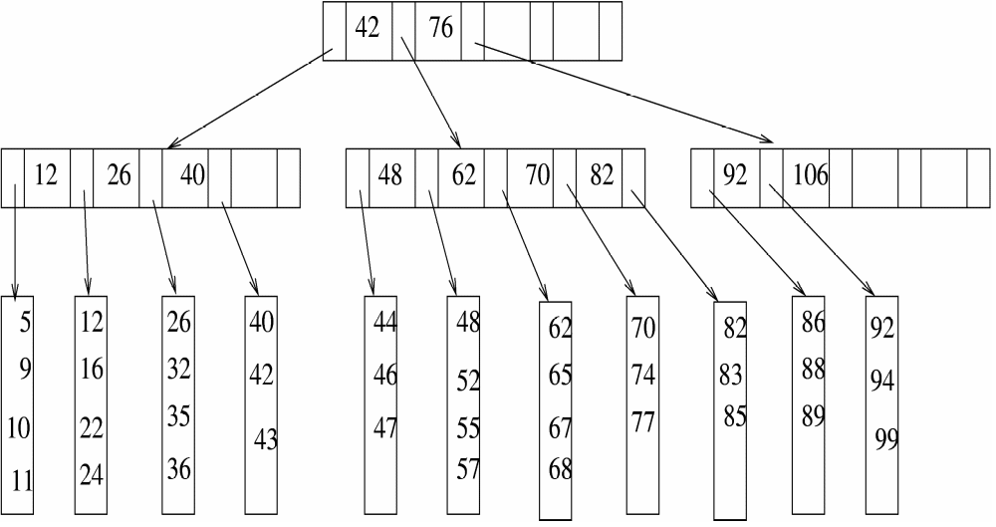
B+ Tree Example with M = L = 5

Slide 170
How to Choose M and L
For choosing L, notice that leaf nodes store only records.
The basic idea behind the present approach is to place lot of useful information in each disk page.
So, if each record is for R Bytes, and a page is of size P Bytes, then we require that each page has L = P/R records.
Similar considerations apply to choose M.

Slide 171
Choosing M
A page of P Bytes should contain one non-leaf node.
Each non-leaf node has at most M − 1 keys and M pointers.
If each pointer takes 4 B and each key takes about K bytes, then the total storage for a non-leaf node is K(M − 1) + 4M Bytes.
So, we should choose M so that K(M − 1) + 4M = P.

Slide 172
Operations on the B+ Tree
Search is by far the easiest.
Proceed as in a binary search tree with suitable modifications.

Slide 173
Insert in a B+ Tree
Apart from the search invariant, we need to maintain the occupancy invariants.
So, have to be careful when a node is already full and cannot accommodate a new item.
Consider when a leaf node is full.
25
29
35
insert x = 32

Slide 174
Insert in a B+ Tree
The idea is to “split” the leaf node into two.
Copy the old contents and the new item into two leaf nodes.
Add these as children on their parent.
Notice that each new leaf node has at least L/2 records.
25
29
32
35
insert x = 32

Slide 175
Insert in a B+ Tree
25
29
32
35
insert x = 32
The parent is also likely to be full.
So, split the parent too, redistribute the values.
Add them as two children to its parent.
  The new internal nodes shall satisfy the occupancy rules.
The above may continue till we reach the root.

Slide 176
Insert in B+ Tree
What if the root is also full?
Then split the root node itself.
The new root will have two children.
  Recall the occupancy rule with respect to the root.

Slide 177
Delete from B+ Tree
What could go wrong with respect to occupancy?
A leaf node may have less than L/2 records.
Then have to merge with other leaf nodes.
  Borrow records from other leaf nodes.
  Redistribute contents.
Can happen that an internal node may violate occupancy rules.
  Merge internal nodes.
Can continue till the root.

Slide 178
B+ Tree
Operations takes only O(log_{M} n) time and disk accesses.

