Slide 1
Data Structures Week 9
Introduction to Graphs
Consider the following problem.
A river with an island and bridges.
The problem is to see if there is a way to start from some landmass and using each bridge exactly once, return to the starting point.

Slide 2
Data Structures Week 9
Introduction to Graphs
The above problem dates back to the 17th century.
Several people used to try to solve it.
Euler showed that no solution exists for this problem.
Further, he exactly characterized when a solution exists.
By solving this problem, it is said that Euler started the study of graphs.

Slide 3
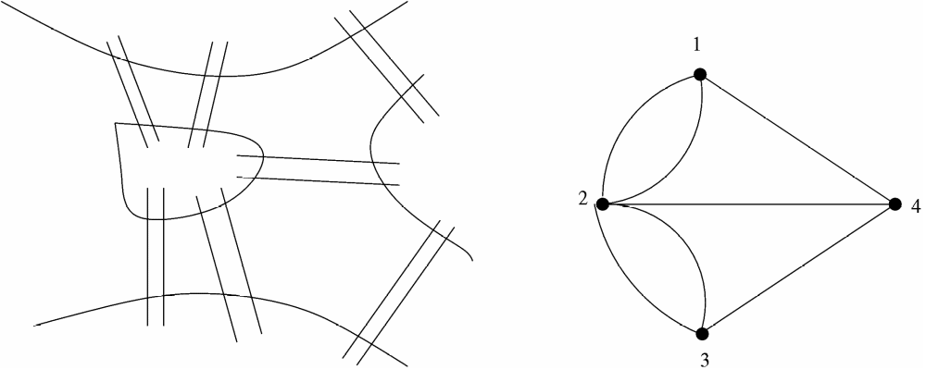
Data Structures Week 9
Introduction to Graphs
The figure on the right shows the same situation modeled as a graph.
There exist several such classical problems where graph theory has been used to arrive at elegant solutions.

Slide 4
Data Structures Week 9
Introduction to Graphs
Another such problem: In any set of at least six persons, there are either three mutual acquaintances or three mutual strangers.

Slide 5
Data Structures Week 9
Introduction to Graphs
Formally, let V be a set of points, also called as vertices.
Let E ⊆ VxV be a subset of the cross product of V with itself. Elements of E are also called as edges.
A graph can be seen as the tuple (V, E). Usually denoted by upper case letters G, H, etc.

Slide 6
Data Structures Week 9
Our Interest
Understand a few terms associated with graphs.
Study how to represent graphs in a computer program.
Study how traverse graphs.
Study mechanisms to find paths between vertices.
Spanning trees
And so on...

Slide 7
Data Structures Week 9
Few Terms
Recall that a graph G = (V, E) is a tuple with E being a subset of VxV.
Scope for several variations: for u, v in V
  Should we treat (u,v) as same as (v,u)?

Slide 8
Data Structures Week 9
Few Terms
Recall that a graph G = (V, E) is a tuple with E being a subset of VxV.
Scope for several variations: for u, v in V
  Should we treat (u,v) as same as (v,u)? In this case, the graph is called as a undirected graph.
  Treat (u,v) as different from (v,u).

Slide 9
Data Structures Week 9
Few Terms
Recall that a graph G = (V, E) is a tuple with E being a subset of VxV.
Scope for several variations: for u, v in V
  Should we treat (u,v) as same as (v,u)? In this case, the graph is called as a undirected graph.
  Treat (u,v) as different from (v,u). In this case, the graph is called as a directed graph.
  Should we allow (u,u) in E? Edges of this kind are called as self-loops.

Slide 10
Data Structures Week 9
Undirected Graphs
1
2
8
3
7
4
6
5
In this case, the edge (u,v) is same as the edge (v,u).
  Normally written as edge uv.

Slide 11
Data Structures Week 9
Undirected Graphs
The degree of a node v in a graph G = (V,E) is the number of its neighbours.
  It is denoted by d(v).
In the above example, the degree of vertex 4 is 4. The neighbors of vertex 4 are {3, 5, 6, 7}.
The degree of a graph G = (V,E) is the maximum degree of any node in the graph and is denoted Δ(G). Sometimes, written as just Δ when G is clear from the context.
  Thus, Δ = max_{v∈V} d(v).
  Thus Δ = 6 for the above graph.

Slide 12
Data Structures Week 9
Some Terms
In a graph G = (V,E), a path is a sequence of vertices v1, v2, · · · , vi, all distinct, such that v_{k}v_{k+1} ∈ E for 1 ≤ k ≤ i − 1.
If, under the above conditions, v1 = vi then it is called a cycle.
The length of such a path(cycle) is i − 1(resp. i).
An example: 3 – 8 – 5 – 2 in the above graph is a path from vertex 3 to vertex 2.
Similarly, 2 – 7 – 6 – 5 – 2 is a cycle.

Slide 13
Data Structures Week 9
Directed Graphs
1
2
3
4
6
5
In this case, the edge (u,v) is distinct from the edge (v,u).
  Normally written as edge 〈u, v〉.

Slide 14
Data Structures Week 9
Directed Graphs
Have to alter the definition of degree as
in-degree(v) : the number of neighbors w of v such that (w,v) in E.
out-degree(v) : the number of neighbors w of v such that (v,w) in E.
in-degree(4) = 1
out-degree(2) = 2.

Slide 15
Data Structures Week 9
Directed Graphs
Have to alter the definition of path and cycle to directed path and directed cycle.

Slide 16
Data Structures Week 9
Representing Graphs
How to represent graphs in a computer program.
Several ways possible.

Slide 17
Data Structures Week 9
Adjacency Matrix
The graph is represented by an n × n–matrix where n is the number of vertices.
Let the matrix be called A. Then the element A[i, j] is set to 1 if (i, j) ∈ E(G) and 0 otherwise, where 1 ≤ i, j ≤ n.
The space required is O(n²) for a graph on n vertices.
By far the simplest representation.
Many algorithms work very efficiently under this representation.

Slide 18
Data Structures Week 9
Adjacency Matrix Example
A
1 2 3 4 5 6
1
4
1
2
3
4
5
6
0
1
0
1
1
0
1
0
1
0
1
0
0
1
0
1
0
1
1
0
1
0
0
0
1
1
0
0
0
0
0
0
1
0
0
0
2
6
5
3

Slide 19
Data Structures Week 9
Adjacency Matrix Observations
Space required is n²
The matrix is symmetric and 0,1—valued.
  For directed graphs, the matrix need not be symmetric.
Easy to check for any u,v whether uv is an edge.
Most algorithms also take O(n²) time in this representation.
The following is an exception: The Celebrity Problem.

Slide 20
Data Structures Week 9
Adjacency List
Imagine a list for each vertex that will contain the list of neighbours of that vertex.
The space required will only be O(m).
However, one drawback is that it is difficult to check whether a particular pair (i, j) is an edge in the graph or not.

Slide 21
Data Structures Week 9
Adjacency List Example
1
2
3
4
5
6
2
5
4
1
4
5
1
3
2
6
2
6
4
6
1
3
5
3
1
2
3

Slide 22
Data Structures Week 9
Adjacency List
Useful representation for sparse graphs.
Extends to also directed graphs.

Slide 23
Data Structures Week 9
Other Representations
Neighbor maps

