Slide 1
Data Structures Week 9
Searching Graphs
A fundamental problem in graphs. Also called as traversing a graph.
Need to visit every vertex.
Can understand several properties of a graph using a traversal.
Two main techniques : breadth first search, and depth first search.

Slide 2
Data Structures Week 9
Breadth First Search
Recall level order traversal of a tree.
  Starting from the root, visits every vertex in a level by level manner.
Let us develop breadth first search as an extension of breadth first search.

Slide 3
Data Structures Week 9
Breadth First Search
For a graph, no notion of a root vertex.
So, have to specify a starting vertex. Typically denoted s.
Still other problems exist.

Slide 4
Data Structures Week 9
Breadth First Search
In a tree, using level order traversal, each vertex is visited also exactly once.
  Why?

Slide 5
Data Structures Week 9
Breadth First Search
In a tree, using level order traversal, each vertex is visited also exactly once.
  Recall that a tree is connected and has no cycles.

Slide 6
Data Structures Week 9
Breadth First Search
In a tree, using level order traversal, each vertex is visited also exactly once.
  Recall that a tree is connected and has no cycles.
In a graph, that is no longer guaranteed.
  Start from s = 2.
1
2
5

Slide 7
Data Structures Week 9
Breadth First Search
In a tree, using level order traversal, each vertex is visited also exactly once.
  Recall that a tree is connected and has no cycles.
In a graph, that is no longer guaranteed.
  Start from s = 2.
  One of 1 or 5 visited more than once.
1
2
5

Slide 8
Data Structures Week 9
Breadth First Search
How to resolve that problem?
1
2
5

Slide 9
Data Structures Week 9
Breadth First Search
How to resolve that problem?
Can remember if a vertex is already visited.
Each vertex has a state among VISITED, NOT_VISITED, IN_PROGRESS.
Why three states instead of just two?
  Need them for a later use.
1
2
5

Slide 10
Data Structures Week 9
Breadth First Search
Another problem is with respect to some vertices that cannot be reached from s.
For example, when s = 2, vertex 3 can never be visited.
What to do with those vertices?
Answer depends on the idea behind graph searching via BFS.
1
3
2
5

Slide 11
Data Structures Week 9
Breadth First Search
The basic idea of breadth first search is to find the least number of edges between s and any other vertex in G.
  The same property holds for level order traversal of a tree also with s as the root.
Starting from s, we can thus visit vertices of distance k before visiting any vertex of distance k+1.
For that purpose, define d_{s}(v) to be the least number of edges between s and v in G.

Slide 12
Data Structures Week 9
Breadth First Search
So, for vertices v that are not reachable from s, can say that d_{s}(v) is ∞.
Alike a level order traversal of a tree, can use a queue to store vertices in progress.

Slide 13
Data Structures Week 9
BFS Procedure
Procedure BFS(G)‏
for each v ∈ V do
π(v)= NIL;colour[v] = RED; d(v) = ∞;
End-for
d[s] = 0; colour[s] = YELLOW; π[s]= NIL, Q = EMPTY; Q.Enqueue(s);
While Q is not empty do
v = Q.Dequeue();
for each neighbour w of v do
if colour[w] = RED then
colour[w] = YELLOW; π[w] = v;
d[w] = d[v] + 1; Q.Enqueue(w);
end-if
colour[v] = GREEN
end-for
end-while

Slide 14
Data Structures Week 9
BFS Example
Start from s = 2.
1 2 3 4 5 6
1
4
d : ∞ 0 ∞ ∞ ∞ ∞
π : − − − − − −
2
6
6
5
3

Slide 15
Data Structures Week 9
BFS Example
Start from s = 2.
1 2 3 4 5 6
1
4
d : ∞ 0 ∞ ∞ ∞ ∞
π : − − − − − −
2
6
6
d : 1 0 1 ∞ 1 2
π : 2 − 2 − 2 3
d : 1 0 1 2 1 2
π : 2 − 2 1 2 3
5
3

Slide 16
Data Structures Week 9
BFS
The runtime of BFS is O(m+n)
  Each vertex enters the queue at most once.
  Each edge is considered only once.
The value of a vertex v denotes the vertex u that discovered v.
The π values maintained during BFS can be used to define a tree as follows.
Define the predecessor subgraph of G = (V,E) as
  G π = (V π,E π) where
  V π = {v ∈ V : π(v) != NULL} U {s} and
  E π = {(π(v), v) ∈ E : v ∈ V π − {s}}.

Slide 17
Data Structures Week 9
BFS Example Contd...
1
4
2
6
5
3

Slide 18
Data Structures Week 9
Properties BFS
Notice that once color of a vertex v changes YELLOW, then d_{s}(v) can never change after that.
At that time, v has entered the queue.
Can classify edges of G according to BFS from a given s as follows.

Slide 19
Data Structures Week 9
Classifying Edges
The edges of E π are also called as tree edges.
It holds that for a tree edge (u, v), d(v) = d(u) + 1.
The edges of E_{N} := E \ E π are called as non-tree edges.
These edges can be further classified as follows.

Slide 20
Data Structures Week 9
Classifying Edges
An edge (u, v) ∈ E_{N} is called as a back edge if d_{s}(v) < d_{s}(u).
In other words, u can be reached from s via v, but there is yet another shortest path through path u can be reached from s.
An edge (u, v) ∈ E_{N} is called a cross edge if d(v) ≤ d(u) + 1.

Slide 21
Data Structures Week 9
Directed or Undirected
Most of the above observations hold even if G is directed.
Can thus extend the notion of BFS to directed graphs.

Slide 22
Data Structures Week 9
Yet Another Traversal
In BFS, vertices not reachable from s are never listed.
So the entire graph may not be visited at all.
We will study yet another traversal mechanism for graphs.
This is called depth first search (DFS) and has important applications.
Several graph algorithms use DFS as a subroutine.

Slide 23
Data Structures Week 9
Depth First Search
The idea of DFS is as follows.
Start from a specified start vertex, say s.
Explore from s as deep as possible. This suggests that we go from s, to one of its neighbors x, to a neighbor of x, and so on.
When to stop? When there are no new neighbors to explore from a given point.
What if all vertices are not visited?
  Pick another start vertex from such vertices.

Slide 24
Data Structures Week 9
Depth First Search
Alike BFS, have to keep track of a the state of a vertex.
A vertex can be in three states: VISITED, NOT_VISITED, IN_PROCESS
Why the third state? Same reason as BFS.

Slide 25
Data Structures Week 9
Depth First Search
When at a vertex v, search proceeds as follows:
If there are still vertices not visited, start with any of them. See the code above, right.
Explore(v)
begin
for each neighbor w of v
if w is not visited then
color(w) = YELLOW;
Explore(w);
end-if
end-for
color(v) = Green;
end
DFS(G)
begin
for v = 1 to n do
begin
if color(v) == RED then
color(v) = YELLOW;
Explore(v)
end
end
end

Slide 26






Data Structures Week 9
DFS – An Example

Slide 27






Data Structures Week 9
DFS – An Example

Slide 28
Data Structures Week 9
DFS – An Example

Slide 29
Data Structures Week 9
DFS – An Example

Slide 30
Data Structures Week 9
DFS – An Example

Slide 31
Data Structures Week 9
DFS – An Example

Slide 32
Data Structures Week 9
DFS – An Example

Slide 33
Data Structures Week 9
DFS – An Example

Slide 34
Data Structures Week 9
DFS – An Example

Slide 35
Data Structures Week 9
DFS – An Example

Slide 36
Data Structures Week 9
DFS – An Example

Slide 37
Data Structures Week 9
DFS – An Example

Slide 38
Data Structures Week 9
DFS – An Example

Slide 39
Data Structures Week 9
Discovery and Finish Times
With every vertex, can also associate start and finish times.
Start with time = 0 at the beginning.
Increment time for the following events
  A new vertex is discovered
  A discovered vertex finishes processing.

Slide 40
Data Structures Week 9
Discovery and Finish Times
The first time a vertex v changes state from NOT_VISITED to IN_PROCESS, the current time is recorded as the discovery time of v,
  denoted d(v)‏
The time at which vertex v changes state from IN_PROCESS to VISITED is recorded as the finish time of v
  denoted f(v)‏

Slide 41
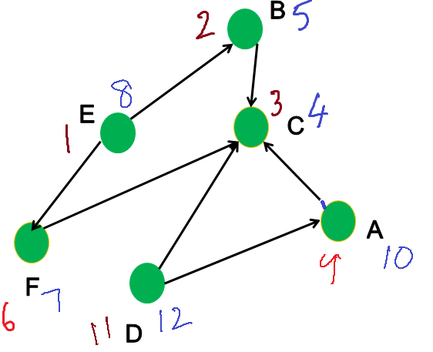

Discovery and Finish Times – Example
Data Structures Week 9

Slide 42
Data Structures Week 9
Discovery and Finish Times
Several graph properties can be observed using the d() and the f() times.
Interesting algorithms can be designed relying mostly on d() and f() times.
We will see at least one such example later.

Slide 43
Data Structures Week 9
Classifying Edges
Set π(v) = u if u discovered v.
Defines a graph(Tree) T = (V’, E’) with
  V’ = V, E’ = {(u,v) | π(v) = u }.
The edges of E’ are also called as tree edges.
The edges of E_{N} := E \ E’ are called as non-tree edges.
These edges can be further classified as follows.

Slide 44
Data Structures Week 9
Classifying Edges
Back Edges
  An edge (u, v) ∈ E_{N} is called as a back edge if v is an ancestor of u in the tree.
  In other words, u can be reached from v using tree edges, but there an edge from u to v also.
Forward Edge
  Edges (u, v) which connect a vertex u to a descendant of u in the DFS tree.
  In other words, v can be reached from u using tree edges, but there an edge from u to v also.

Slide 45
Data Structures Week 9
Classifying Edges
Cross Edges : Edges (u, v) where u and v do not share any ancestor/descendant relationship.
Depending on the type of the edge, certain relations between d() and f() values of the endpoints hold.
Find other such relations.

Slide 46
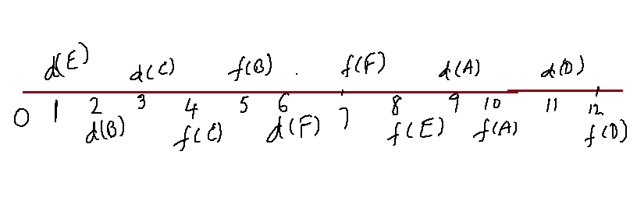






Discovery and Finish Time in Intervals
Data Structures Week 9

Slide 47
Classify Edges via d() and f() Times
Data Structures Week 9
Tree Edges.

Slide 48
pClassify Edges via d() and f() Times
Data Structures Week 9
Tree Edges.
  Easy to identity as π(v) = u for tree edge (u,v)

Slide 49
Classify Edges via d() and f() Times
Data Structures Week 9
Tree Edges.
  Easy to identity as π(v) = u for tree edge (u,v)
Back Edges

Slide 50
Classify Edges via d() and f() Times
Tree Edges.
  Easy to identity as π(v) = u for tree edge (u,v)
Back Edges
  (u, v) is a back edge if [d(u), f(u)] is a subinterval of [d(v), f(v)]

Slide 51
Classify Edges via d() and f() Times
Data Structures Week 9
Tree Edges.
  Easy to identity as π(v) = u for tree edge (u,v)
Back Edges
  (u, v) is a back edge if [d(u), f(u)] is a subinterval of [d(v), f(v)]
Forward Edges

Slide 52
Classify Edges via d() and f() Times
Data Structures Week 9
Tree Edges.
  Easy to identity as π(v) = u for tree edge (u,v)
Back Edges
  (u, v) is a back edge if [d(u), f(u)] is a subinterval of [d(v), f(v)]
Forward Edges
  (u, v) is a forward edge if [d(v), f(v)] is a subinterval of [d(u), f(u)].

Slide 53
Classify Edges via d() and f() Times
Data Structures Week 9
Tree Edges.
  Easy to identity as π(v) = u for tree edge (u,v)
Back Edges
  (u, v) is a back edge if [d(u), f(u)] is a subinterval of [d(v), f(v)]
Forward Edges
  (u, v) is a forward edge if [d(v), f(v)] is a subinterval of [d(u), f(u)].
Cross edges
  Neither of these

