Slide 1
Data Structures Week 9
Spanning Trees
We will now consider another famous problem in graphs.
Recall the bridges problem again.
The purpose of the bridge is to provide connectivity.
In reality, each bridge requires a certain cost to be built.

Slide 2
Data Structures Week 9
Spanning Trees
So, there is a trade-off here.
How to provide connectivity while minimizing the total cost of building the bridges.
The weights on the edges indicate the cost of building that bridge.
The total cost of bridges = sum of all the bridge costs built.
26
25
29

Slide 3
Data Structures Week 9
Spanning Trees
Formalize the problem as follows.
Let G = (V, E, W) be a weighted graph.
Find a subgraph G' of G that is connected and has the smallest cost where cost is defined as the sum of the edge weights of edges in G'.

Slide 4
Data Structures Week 9
Spanning Trees
Observation I : If G' has a cycle and is connected, then there exists a G'', which is also a subgraph of G and is connected so that
cost(G'') < cost(G')‏
To get G'', simply break at least one cycle of G'.
Hence, the optimal G' shall have no cycles and is connected.
  Suggests that G' is a tree.

Slide 5
Data Structures Week 9
Spanning Trees
Two keywords : spanning and tree.
Some notation: A subgraph G' of G is called a spanning subgraph if V(G') = V(G).
A spanning subgraph G' of G that is also a tree is called as a spanning tree of G.

Slide 6
Data Structures Week 9
Spanning Trees
So, our problem can be reduced to “Find a spanning tree of G that has the least cost.”
Such a spanning tree is also called as a minimum spanning tree of G.

Slide 7
Data Structures Week 9
MST
Let us now think of devising an algorithm to construct an MST of a given weighted graph G.
There are several approaches, but let us consider a bottom-up approach.
Let us start with a graph (tree) that has no edges and add edges successively.
Every new edge we add should not create a cycle.
Further, the total cost of the final tree should be the least possible.

Slide 8
Data Structures Week 9
MST
Suggests that we should prefer edges of smaller weight.
  But should not add edges that create cycles.
Indeed, that is intuitive and turns out that is correct too.
  we will skip the proof of this.

Slide 9
Data Structures Week 9
MST Algorithm
Algorithm MST(G)‏
begin
  sort the edges of G in increasing order of weight as e₁, e₂, ..., e_{m}
  i = 1; E(T) = Φ
  while |E(T)| < n-1 do
      if E(T) U e_{i} does not have a cycle then
        E(T) = E(T) U e_{i}
      end-if
      i = i + 1;
  end-while
End.

Slide 10
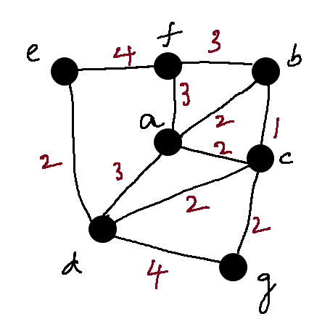
Data Structures Week 9
MST Example

Slide 11
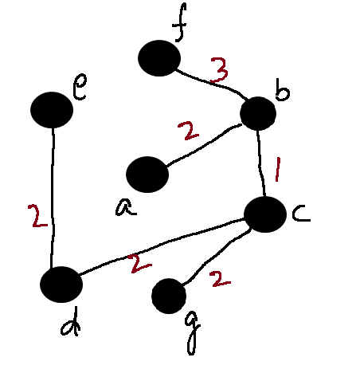
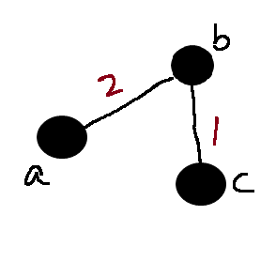
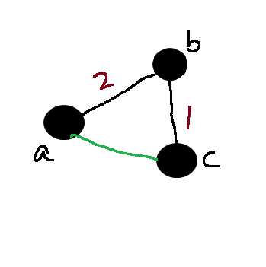
Data Structures Week 9
l
MST Example
List of edges by weight
  bc, ab, ac, cg, cd, de, bf, af, ad, ef, dg

Slide 12
Data Structures Week 9
MST Algorithm Analysis
The algorithm we devised is called the Kruskal's algorithm.
Belongs to a class of algorithms called greedy algorithms.
How do we analyze our algorithm?
  Need to know how to implement the cycle checker.

Slide 13
Data Structures Week 9
MST Algorithm Analysis
How quickly can we find if a given graph has a cycle?
  O(m+n) is possible.
Notice that if the graph is a forest, then m = O(n).
So, can be done in O(n) time.
Also, need to try all m edges in the worst case.
So the time required in this case is O(mn).

Slide 14
Data Structures Week 9
MST Algorithm Analysis
Too high in general.
But, advanced data structures exist to bring the time down close to O(m log n).
  Cannot be covered in this class.

Slide 15
Data Structures Week 9
MST – Another Approach
The previous approach has to check for cycles every iteration.
Another approach that has a smaller runtime even with basic data structures.
Largely simplifies the solution.

Slide 16
Data Structures Week 9
MST – Another Approach
The current approach is characterized by having a single tree T at any time.
In each iteration, T is extended by adding one vertex v not in T and one edge from v to some vertex in T.
Starting from a tree of one node, this process is repeated n-1 times.

Slide 17
Data Structures Week 9
MST – Another Approach
Two questions:
  How to pick the new vertex v?
  How to pick the edge to be added from v to some other vertex in T?

Slide 18
Data Structures Week 9
MST – Another Approach
The answers are provided by the following claims.
Claim 1: Let G = (V, E, W) be a weighted undirected graph. Let v be any vertex in G. Let vw be the edge of smallest weight amongst all edges with one endpoint as v. Then vw is always contained in any MST of G.

Slide 19
Data Structures Week 9
MST – Another Approach
Claim 1 can be shown in the following way.
For each vertex v in G, there must be at least one edge in any MST.
Considering the edge of the smallest weight is useful as it can decrease the cost of the spanning tree.

Slide 20
Data Structures Week 9
Generalizing Claim 1.
Claim 2 can be generalized further.
Let T be a subtree of some MST of an undirected weighted graph G. Consider edges uv in G such that u is in T and v is not in T. Of all such edges, let e = xy be the edge with the smallest weight. Then T U {e} is also a subtree of some MST of G.

Slide 21
Data Structures Week 9
Generalizing Claim 1.
Claim 2 allows us to expand a given sub-MST T.
We can use Claim 2 to expand the current tree T.
How to start?

Slide 22
Data Structures Week 9
Towards an Algorithm
Let v be any vertex in the graph G. Pick v as the starting vertex to be added to T.
T now contains one vertex and no edges.
T is a subtree of some MST of G.
Now, apply Claim 2 and extend T.

Slide 23
Data Structures Week 9
Towards an Algorithm
Algorithm MST(G, v)
Begin
Add v to T;
While T has less than n – 1 edges do
w = vertex s.t. vw has the smallest weight
amongst edges with one endpoint in T and another not in T.
Add vw to T.
End
End

Slide 24
MST : Example
B
7
D
10
3
A
F
5
3
2
2
C
E
5

Slide 25
MST : Example (Using Prim’s)
7
B
D
3
10
A
F
5
3
2
2
C
E
5
The green edges form the part of the MST. The vertices turn yellow in the order in which they will be included in the MST.

Slide 26
Data Structures Week 9
Towards an Algorithm
How to find w in the algorithm?
Need to maintain the weight of edges that satisfy the criteria.
A better approach:
  Associate a key to every vertex
  key[v] is the smallest weight of edges with v as one endpoint and another in the current tree T.
  key[v] changes only when some vertex is added to T.
  Vertex with the smallest key[v] is the one to be added to T.

Slide 27
Data Structures Week 9
Towards an Algorithm
Suggests that key[v] need to be updated only when a new vertex is added to T.
Further, not all key[v] may change in every iteration.
  Only the neighbors of the vertex added to T.
  Similar to Dijkstra's algorithm.

Slide 28
Data Structures Week 9
Towards an Algorithm
Therefore, can maintain a heap of vertices with their key[ ] values.
Initially, key[v] = infinity for every vertex except the start vertex for which key value can be 0.
Perform DeleteMin on the heap. Let v be the result.
Update the key[ ] value for neighbors w of v as:
  key[w] = min{key[w], W(vw)}

Slide 29
Data Structures Week 9
Algorithm Using a Heap
Algorithm MST(G, u)
begin
for each vertex v do key[v] = infty.
key[u] = 0;
Add all vertices to a heap H.
While T has less than n-1 edges do
v = deleteMin();
Add v to T via uv s.t. u is in T
For each neighbor w of v do
if W(vw) > key[w] then DecreaseKey(w)
end
end
end

Slide 30
Data Structures Week 9
Algorithm Using a Heap
The algorithm is called as Prim's algorithm.
Runtime easy to analyze;
  Each vertex deleted once from the heap. Each DeleteMin() takes O(log n) time. So, this accounts for a time of O(nlog n).
  Each edge may result in one call to DecreaseKey(). Over m edges, this accounts for a time of O(mlog n).
  Total time = O((n+m)log n).

Slide 31
Data Structures Week 9
Advanced Data Structures
An abstract problem:
Given n elements, grouped into a collection of disjoint sets S1, S2, …, Sk, design a data structure to:
  Find the set to which an element belongs
  Combine two sets
The abstract problem finds applications in several settings:
  Spanning tree algorithm of Kruskal
  Graph connected components
  Least common ancestors
  …

Slide 32
Data Structures Week 9
Some Notation
Imagine a collection S = {S1, S2, …, Sk} of sets.
Each set has a representative element
  Some member of the set, typically.
  Depending on application, can be
    The smallest numbered element
    A number
    Or other
Typical operations
  MakeSet(x)
  Union(x, y)
  FindSet(x)

Slide 33
Data Structures Week 9
Some Notations
Two parameters
  n : The number of MakeSet operations.
  m : The total number of MaketSet, Union, and Find operations.
Some observations
  Each Union operation reduces the number of sets by 1.
  When starting with n elements, at most n-1 Union operations.
  Also, m >= n.
Assume that the n MakeSet operations are the first n operations.

Slide 34
Data Structures Week 9
How to Implement the Operations?
Option 1 : Use linked lists.
For every set, there is a linked list.
The representative of a set is the head of the list.
Every element also stores a pointer to the representative.
There is a tail pointer indicating where to append.

Slide 35
Data Structures Week 9
Operations
MakeSet(x): Create a new linked list.
FindSet(x) : Can be answered via the direct pointer
Union(x, y) : Can append the list of x to the list of y.
But have to update the pointer for each element in the list of x.

Slide 36
Application to Connected Components
Data Structures Week 9
Problem: Given an undirected graph G = (V, E), partition V into disjoint sets V1, V2, …, Vk so that two vertices u and v are in the same partition if and only if there is a path between u and v.
Several ways to solve this problem
Example follows.

Slide 37
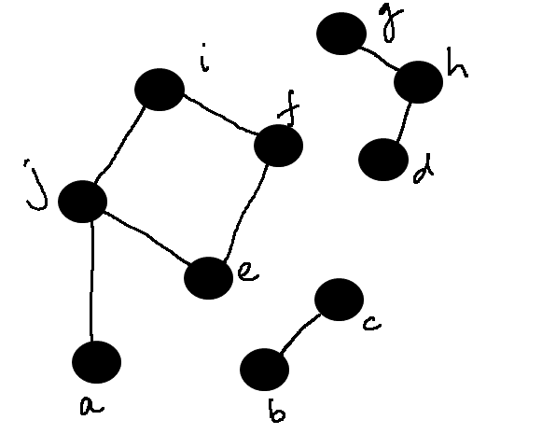
Data Structures Week 9
Example

Slide 38
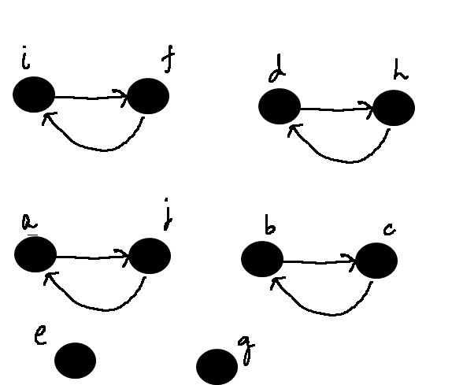
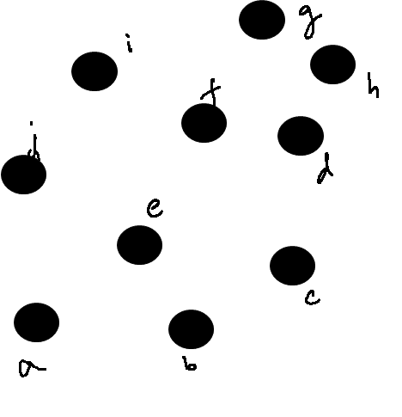
Data Structures Week 9
Example

Slide 39
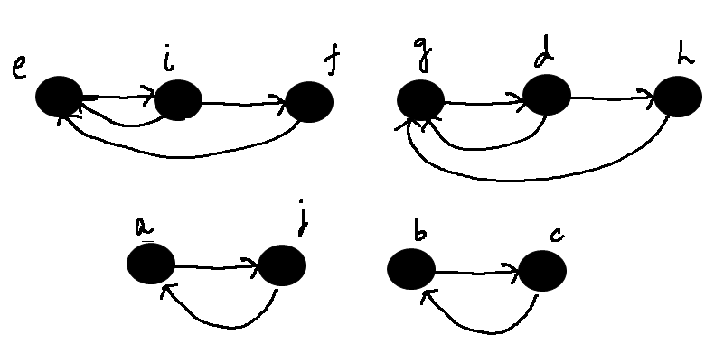
Data Structures Week 9
Example

Slide 40
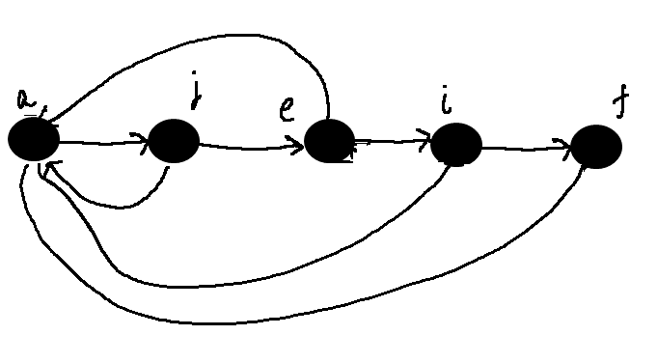
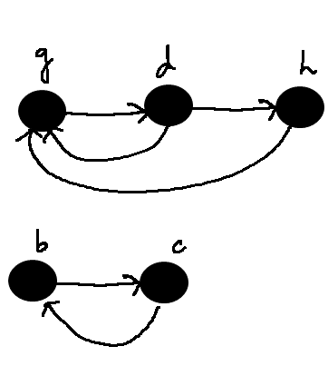
Data Structures Week 9
Example

Slide 41
Data Structures Week 9
Operations
How difficult is it to append the lists?
Claim: There exists a sequence of m operations on n objects so that the total time required for the entire sequence of operations is O(n²).

Slide 42
Data Structures Week 9
Operations
How difficult is it to append the lists?
Claim: There exists a sequence of m operations on n objects so that the total time required for the entire sequence of operations is O(n²).
After the first n MakeSet operations, call Union(x1,x2), Union(x2, x3), Union(x3, x4), …, Union(x_{n-1}, x_{n}).
The kth union call takes time proportional to k.
Total time is therefore O(n²).
The average time per operation is also O(n).

Slide 43
Data Structures Week 9
Application to Kruskal’s Algorithm
An average time of O(n) is not helpful for Kruskal’s algorithm.
We have several Union calls and several FindSet calls.

Slide 44
Data Structures Week 9
Better Solution
Most time spent is in the Union operation.
Can we modify the operation slightly?
Intuitively, it is easier to append a smaller list to a larger list.
  Required fewer updates.
  Will the overall time decrease?
We will show that indeed it does.

Slide 45
Data Structures Week 9
The Weighted Union Heuristic
Maintain the length of each list. Corresponds to the size of the set.
To perform Union(x, y):
  Append the list of x to the list of y if len(x) < len(y)
  Append the list of y to the list of x otherwise.
A single Union operation can still take lot of time.
  Union of two large lists, say of size n/10 each.
But, a sequence of operations may be not so expensive.
  Hopefully.

Slide 46
Data Structures Week 9
Analysis
How many times can an element change its representative?
Consider any element x.
If in an Union operation, the representative of x changes, then x is in the smaller list.
  Why?

Slide 47
Data Structures Week 9
Analysis
How many times can an element change its representative?
Consider any element x.
If in an Union operation, the representative of x changes, then x is in the smaller list.
  Why?
The first time this happens, the resulting list has at least 2 elements.

Slide 48
Data Structures Week 9
Analysis
How many times can an element change its representative?
Consider any element x.
If in an Union operation, the representative of x changes, then x is in the smaller list.
  Why?
The first time this happens, the resulting list has at least 2 elements.
Next time, the resulting list has at least 4 elements.

Slide 49
Data Structures Week 9
Analysis
In general, if the representative of x changes k times, then the resulting list has size at least 2^{k}.
The largest set can have a size of n.
Therefore, the representative of x cannot change more than log n times, over all the Union operations.
This applies to every element.
Therefore, over all Union operations, the total time spent is O(n log n).

Slide 50
Data Structures Week 9
Analysis
Now, consider a sequence of m operations.
MakeSet and Find are O(1) time operations.
Therefore, the total time is O(m + nlog n).
The average time per operation is O(log n).

Slide 51
Data Structures Week 9
Application to Kruskal’s Algorithm
Do n MakeSet operations indicating that each vertex is in its own tree/set.
To check if e = uv creates a cycle, check if FindSet(u) = FindSet(v).
If not, add e to the current tree. Perform Union(u, v) to merge the trees of u and v.
There are at most m FindSet operations.
Overall time is therefore bound by O(m+nlog n).

Slide 52
Data Structures Week 9
Graphs and Matrices
Today we will see an approach which views the graph as a matrix.
Matrix operations then map to graph operations, and vice-versa.
Called as algebraic graph theory.
We will see an application to the all pairs shortest paths problem.

Slide 53
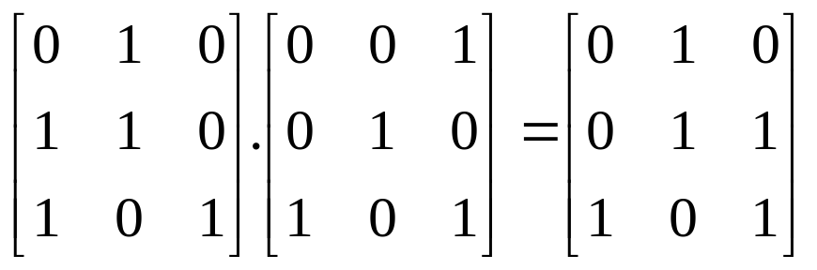
Data Structures Week 9
Basic Observations
Recall matrix multiplication.
Consider two square matrices A and B of size nxn each.
The matrix C = AxB is defined as:
  C[i,j] = Σ_{k} A[i,k].B[k,j]
Change the setting slightly:
  Boolean matrices : Entries are 0 or 1.
  Instead of multiply, take AND.
  Instead of addition, take OR.
  Example:

Slide 54
Data Structures Week 9
Implications to Graphs
Consider a directed graph G = (V,E) represented by its adjacency matrix A.
The matrix A is a Boolean matrix.
Consider the matrix A² = AxA.
When is A²[i,j] = 1 even when A[i,j] = 0?
  There is some index k such that A[i,k] = 1 and also A[k,j] = 1.
  In graph terms, vertices i and k are neighbors and vertices k and j are neighbors.
  Therefore, there is a path from i to j of length 2 even though i and j are not neighbors.
i
k
j

Slide 55
Data Structures Week 9
Further Extendible
By the same logic, A³ should be such that:
  A³[i, j] = 1 if and only if there is a path of length at most 3 between vertices i and j.
Extends all the way up to A^{n}.
Other applications of matrix based solutions:
  Number of spanning trees of a given graph G
  Number of matchings of a given graph G
  Random walks on graphs

