Slide 1
Data Structures
Project 5 – Expression Trees and Code Generation

Slide 2
Expression Trees
In this project, we will
  Use the tree data structure and apply them to expression evaluation again
  How to generate code for an expression given its expression tree.
  Understand how to traverse trees

Slide 3
Binary Trees
A special class of the general trees.
Restrict each node to have at most two children.
  These two children are called the left and the right child of the node.
  Easy to implement and program.
  Still, several applications.

Slide 4
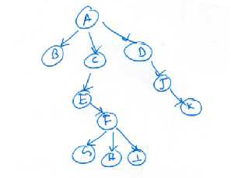
An Example
Figure shows a binary tree rooted at A.
All notions such as
  height
  depth
  parent/child
  ancestor/descendant
are applicable.

Slide 5
Application to Expression Evaluation
We know what expression evaluation is.
We deal with binary operators.
An expression tree for a expression with only unary or binary operators is a binary tree where the leaf nodes are the operands and the internal nodes are the operators.

Slide 6
Why Expression Trees?
Useful in several settings such as
  compliers to generate code
  can verify if the expression is well formed.

Slide 7
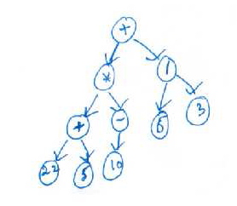
Example Expression Tree
See the example to the right.
The operands are 22, 5, 10, 6, and 3.
These are also leaf nodes.

Slide 8
Questions wrt an Expression Tree
How to evaluate an expression tree?
  Meaning, how to apply the operators to the right operands.
How to build an expression tree?
  Given an expression, how to build an equivalent expression tree?

Slide 9
A Few Observations
Notice that an inorder traversal of the expression tree gives an expression in the infix notation.
  The above tree is equivalent to the expression ((22 + 5) × (−10)) + (6/3)‏
What does a postorder and preorder traversal of the tree give?
  Answer: ??

Slide 10
How to Evaluate using an Expression Tree
Notice that to evaluate a node, its left subtree and its right subtree need to be operands.
For this, may have to evaluate these subtrees first, if they are not operands.
Essentially, have to evaluate the root.
So, Evaluate(root) should be equivalent to:
  Evaluate the left subtree
  Evaluate the right subtree
  Apply the operator at the root to the operands.

Slide 11
How to Evaluate using an Expression Tree
This suggests a recursive procedure that has the above three steps.
Recursion stops at a node if it is already an operand.

Slide 12
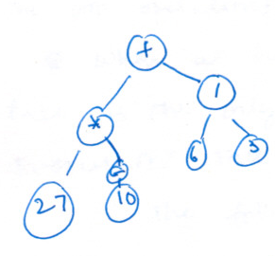
How to Evaluate using an Expression Tree
Example

Slide 13
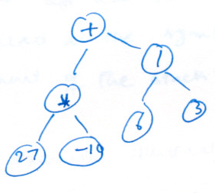
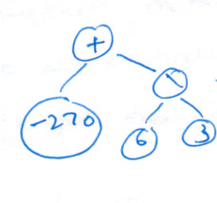
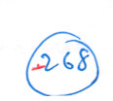
Example Contd...

Slide 14
Pending Question
How to build an expression tree?
Start with an expression in the infix notation.
Recall how we converted an infix expression to a postfix expression.
The idea is that operators have to wait to be sent to the output.
  A similar approach works now.

Slide 15
Building an Expression Tree
Let us start with a postfix expression.
The question is how to link up operands as (sub)trees.
As in the case of evaluating a postfix expression, have to remember operators seen so far.
  need to see the correct operands.
A stack helps again.
But instead of evaluating subexpression, we have to grow them as trees.
  Details follow.

Slide 16
Building an Expression Tree
When we see an operand :
  That could be a leaf node...Or a tree with no children.
  What is its parent?
  Some operator.
  In our case, operands can be trees also. The result of the expression tree could be an operand.
The above observations suggest that operands should wait on the stack.
  Wait as trees.

Slide 17
Building an Expression Tree
What about operators?
Recall that in the postfix notation, the operands for an operator are available in the immediate preceding positions.
Similar rules apply here too.
So, pop two operands (trees) from the stack.
Need not evaluate, but create a bigger (sub)tree.

Slide 18
Building an Expression Tree
Procedure ExpressionTree(E)‏
//E is an expression in postfix notation.
begin
  for i=1 to |E| do
    if E[i] is an operand then
      create a tree with the operand as the only node;
      add it to the stack
    else if E[i] is an operator then
      pop two trees from the stack
      create a new tree with E[i] as the root and the two trees popped as its children;
      push the tree to the stack
  end-for
end

Slide 19
Example
Consider the expression
The postfix of the expression is a b + f − c d × e + /
Let us follow the above algorithm.

Slide 20
Example
Stack
b
a
  + f − c d × e + /

Slide 21
Example
Stack
b
+
a
  f − c d × e + /

Slide 22
Example
Stack
f
b
+
a
  − c d × e + /

Slide 23
Example
Stack
  c d × e + /
f
-
b
+
a

Slide 24
Example
Stack
  × e + /
d
c
f
-
b
+
a

Slide 25
Example
Stack
  e + /
d
+
c
f
-
b
+
a

Slide 26
Example
Stack
  + /
e
d
+
c
f
-
b
+
a

Slide 27
Example
Stack
  /
e
+
d
+
f
c
-
b
+
a

Slide 28
Example
Stack
e
+
d
+
/
c
f
-
b
+
a

Slide 29
Generating Code
Given an expression tree, how to generate code?
What is the code for a tree with just three nodes, a parent and its two children?
  OP value1, value2
So, extend this idea.
  For nodes that are one level above the leaf nodes, it is easy.
  For other internal nodes, wait till their children are leaves.
  Few complications
    Have to wait till both values are known.
    Where to keep the temporary results?

Slide 30
Generating Code
Temporary values are typically in registers.
But registers are limited in number.
So, sometimes, temporary values are copied to memory from registers.
Assume enough registers and generate code.

Slide 31
Our Next Operation
To print the nodes in a (binary) tree
This is also called as a traversal.
Need a systematic approach
  ensure that every node is indeed printed
  and printed only once.

Slide 32
Tree Traversal
Several methods possible. Attempt a categorization.
Consider a tree with a root D and L, R being its left and right sub-trees respectively.
Should we intersperse elements of L and R during the traversal?
  OK – one kind of traversal.
  No. -- One kind of traversal.
  Let us study the latter first.

Slide 33
Tree Traversal
When items in L and R should not be interspersed, there are six ways to traverse the tree.
  D L R
  D R L
  R D L
  R L D
  L D R
  L R D

Slide 34
Tree Traversal
Of these, let us make a convention that R cannot precede L in any traversal.
We are left with three:
  L R D
  L D R
  D L R
We will study each of the three. Each has its own name.

Slide 35
The Inorder Traversal (LDR)
The traversal that first completes L, then prints D, and then traverses R.
To traverse L, use the same order.
  First the left subtree of L, then the root of L, and then the right subtree of R.

Slide 36
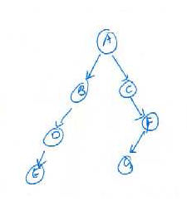
The Inorder Traversal -- Example
Start from the root node A.
We first should process the left subtree of A.
Continuing further, we first should process the node E.
Then come D and B.
The L part of the traversal is thus E D B.

Slide 37
The Inorder Traversal -- Example
Then comes the root node A.
We first next process the right subtree of A.
Continuing further, we first should process the node C.
Then come G and F.
The R part of the traversal is thus C G F.
Inorder: E D B A C G F

Slide 38
The Inorder Traversal -- Example
Procedure Inorder(T)‏
begin
  if T == NULL return;
  Inorder(T->left);
  print(T->data);
  Inorder(T->right);
end
Inorder: E D B A C G F

Slide 39
The Preorder Traversal (DLR)
The traversal that first completes D, then prints L, and then traverses R.
To traverse L (or R), use the same order.
  First the root of L, then left subtree of L, and then the right subtree of L.

Slide 40
The Preorder Traversal -- Example
Start from the root node A.
We first should process the root node A.
Continuing further, we should process the left subtree of A.
This suggests that we should print B, D, and E in that order.
The L part of the traversal is thus B D E.

Slide 41
The Preorder Traversal -- Example
We first next process the right subtree of A.
Continuing further, we first should process the node C.
Then come F and G in that order.
The R part of the traversal is thus C F G.
Preorder: A B D E C F G

Slide 42
The Preorder Traversal – Example
Procedure Preorder(T)‏
begin
  if T == NULL return;
  print(T->data);
  Preorder(T->left);
  Preorder(T->right);
end
Preorder: A B D E C F G

Slide 43
The Postorder Traversal (LDR)
The traversal that first completes L, then traverses R, and then prints D.
To traverse L, use the same order.
  First the left subtree of L, then the right subtree of R, and then the root of L.

Slide 44
The Postorder Traversal -- Example
Start from the root node A.
We first should process the left subtree of A.
Continuing further, we first should process the node E.
Then come D and B.
The L part of the traversal is thus E D B.

Slide 45
The Postorder Traversal -- Example
We next process the right subtree of A.
Continuing further, we first should process the node C.
Then come G and F.
The R part of the traversal is thus G F C.
Then comes the root node A.
postorder: E D B G F C A

Slide 46
The Postorder Traversal -- Example
Procedure postorder(T)‏
begin
  if T == NULL return;
  Postorder(T->left);
  Postorder(T->right);
  print(T->data);
end
Inorder: E D B G F C A

Slide 47
A Few Observations
Notice that an inorder traversal of the expression tree gives an expression in the infix notation.
What does a postorder and preorder traversal of the tree give?
  Answer: ??

Slide 48
Further Insights
It is common knowledge that any program that uses recursion can also be written without using recursion.
How to implement tree traversal without using recursion?
  Consider inorder traversal
  write a program for inorder traversal without using recursion.

Slide 49
Further Insights
Describing data structures uniquely.
  How can you describe a binary tree uniquely?
  One possibility is to give a complete level order description in an array.
    Too space consuming.
  Would a single traversal suffice?
    Too ambiguous

Slide 50
Further Insights
Turns out that two traversals suffice so long as one of them is inorder.
Claim: Given the inorder and preorder travesal of a binary tree, one can reconstruct the tree uniquely.
  Same holds for also inorder and postorder traversal.
Design an algorithm for the above claim.

Slide 51
Innovation

