Slide 1
SIMULATION: QUALITATIVE ANALYSIS OF AMINO ACIDS

Slide 2
In the first screen / window : Given an Unknown solution in a test tube. The student needs to identify which amino acid present in the unknown solution.
A series of buttons showing the name of “TESTS” to be done. This should come in one screen

Slide 3

For example; select ninhydrin test
NINHYDRIN TEST
Millon’s test
Unknown solution
Xanthoproteic acid test
Hopkins cole test
Unknown solution
Unknown solution
Pauly’S Diazo test
Lead sulphide test

Slide 4
The “TEST” which is selected by the student should open in a new screen / window. Now in that new screen materials and reagents required for doing all the TEST [6 test ] should be shown .

Slide 5
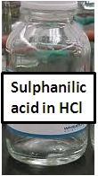
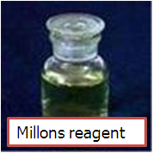
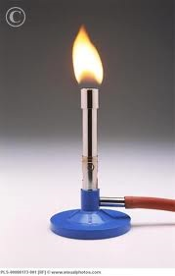
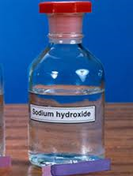
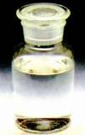
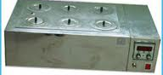
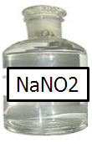
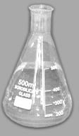
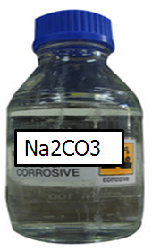
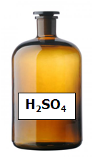

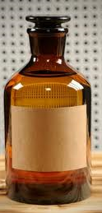
Water bath
Acetic acid – glyoxilic acid reagent
Test
Lead acetate solution
Unknown solution
Na₂CO₃
Conc: Nitric acid

Slide 6
In the case of ninhydin test,

Slide 7
Ninhydrin test
Take unknown solution to test tube
Add few drops of ninhydrin reagent to it[pale yellow color]
Place the test tube in a water bath (automatically show the clock for 5 minutes)
blue or yellow colored solution [ Yellow color for proline and blue color for other amino acids.
Xanthoproteic acid test
Add 1 ml of amino acid solution in a test tube
Add nitric acid solution to it (yellow color upon adding the nitric acid solution)
Heat the solution under bunsen burner
cool the solution under tap water
Add NaOH solution to it
Show orange color

Slide 8
Pauly’s diazo test
Show sulphanilic acid, amino acid solution and sodium nitrite solution in Ice box.
Add chilled sodium nitrite solution to sulphanilic acid.
Add amino acid solution to it.
Add sodium carbonate dropwise to it.
Presence of red color
Millon’s test
Take amino acid solution to test tube
Add Millon’s reagent to it.
Heat the test tube over flame.
Cool under tap water.
Add nitric acid solution to it.
Red precipitate

Slide 9
Hopkins cole test
Take amino acid solution in a test tube
Add acetic acid - glyoxilic acid reagent to it
Add H2SO4 ( show adding at the side of the test tube)
Show blue ring

Slide 10
Lead sulphide test
Take amino acid solution in a test tube.
Add NaOH solution
Heat the solution in bunsen burner
Cool test tube under tap water
Add lead acetate solution
Show black precipitate

Slide 11
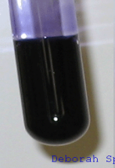
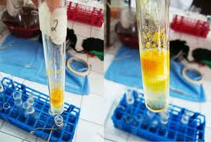
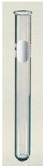
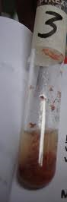
.DETECTION OF TYROSINE
Test
NINHYDRIN TEST
Blue – purple color
Presence of α amino acids
Xanthoproteic acid test
Orange color
Presence of Tyrosine, or Tryptophan
Pauly’S Diazo test
Red color
No color change
Tyrosine or Histidine
Tryptophan
Millon’s test
Red precipitate
Presence of Tyrosine

Slide 12
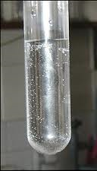
. DETECTION OF TRYPTOPHAN
Test
NINHYDRIN TEST
Blue – purple color
Presence of α amino acids
Xanthoproteic acid test
Orange color
Presence of Tyrosine or Tryptophan
Pauly’S Diazo test
No color
Tryptophan
Confirmatory test for Tryptophan
Hopkins cole test
Purple- violet ring is formed
Confirmation of Tryptophan

Slide 13

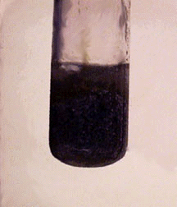
. DETECTION OF CYSTEINE
Test
NINHYDRIN TEST
Blue- purple color
Presence of α amino acids
Xanthoproteic acid test
No color
Presence of Cystine, Cysteine, Methionine and Arginine
Lead sulphide test
Black precipitate
Presence of Cysteine or Cystine

Slide 14
Tests | Tyrosine | Tryptophan | Cysteine
Ninhydrin test | Blue purple color | Blue purple color | Blue purple color
Xanthoproteic acid test | Orange color | Orange color | No color
Pauly’s Diazo test | Red color | No color | No color
Millon’s test | Red precipitate | No color | No color
Hopkins cole test | No color | Purple violet ring is formed | No color
Lead sulphide test | No color | No color | Black precipitate

