Slide 1
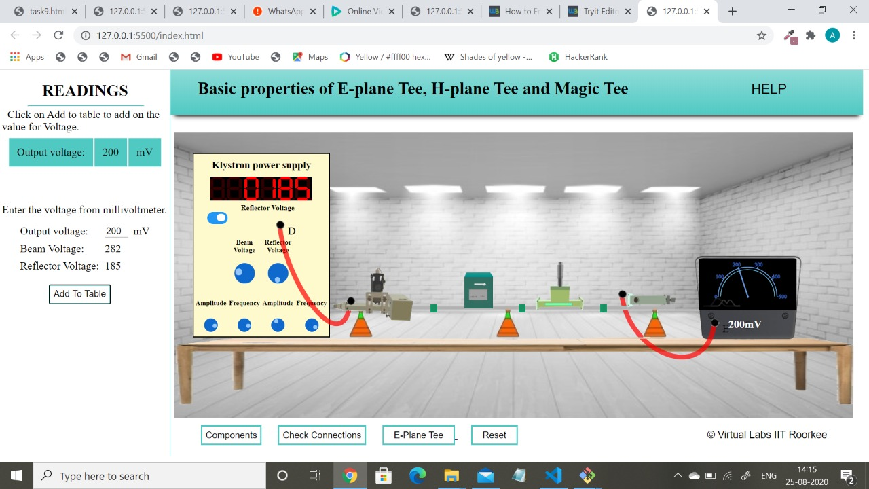
Value for Output Voltage

Slide 2
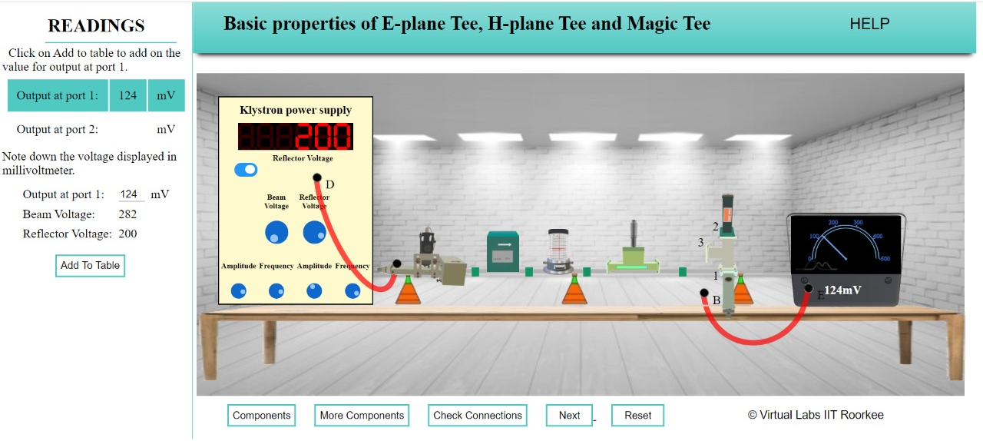
Basic characteristics of E-Plane Tee : when Input is at Port 3 and Output is at Port 1

Slide 3
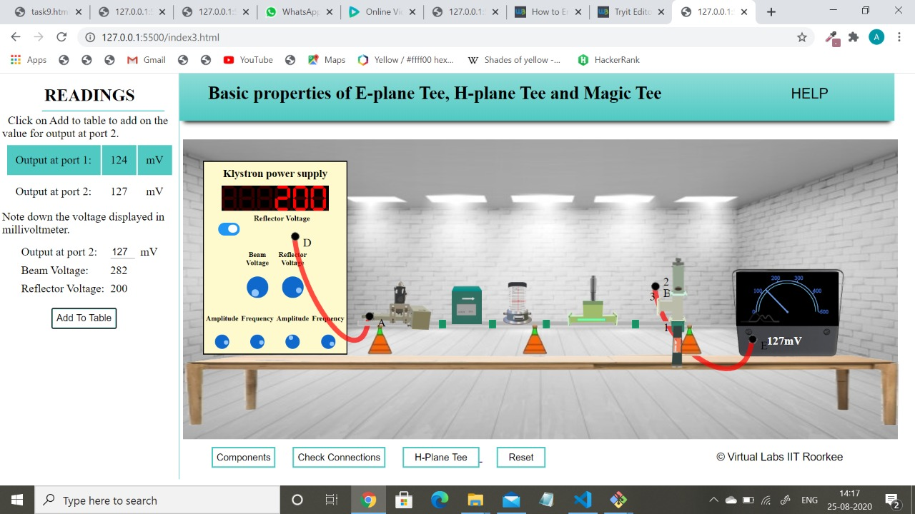
Basic characteristics of E-Plane Tee : when Input is at Port 3 and Output is at Port 2

Slide 4

Basic characteristics of H-Plane Tee : when Input is at Port 3 and Output is at Port 1

Slide 5

Basic characteristics of H-Plane Tee : when Input is at Port 3 and Output is at Port 2

Slide 6
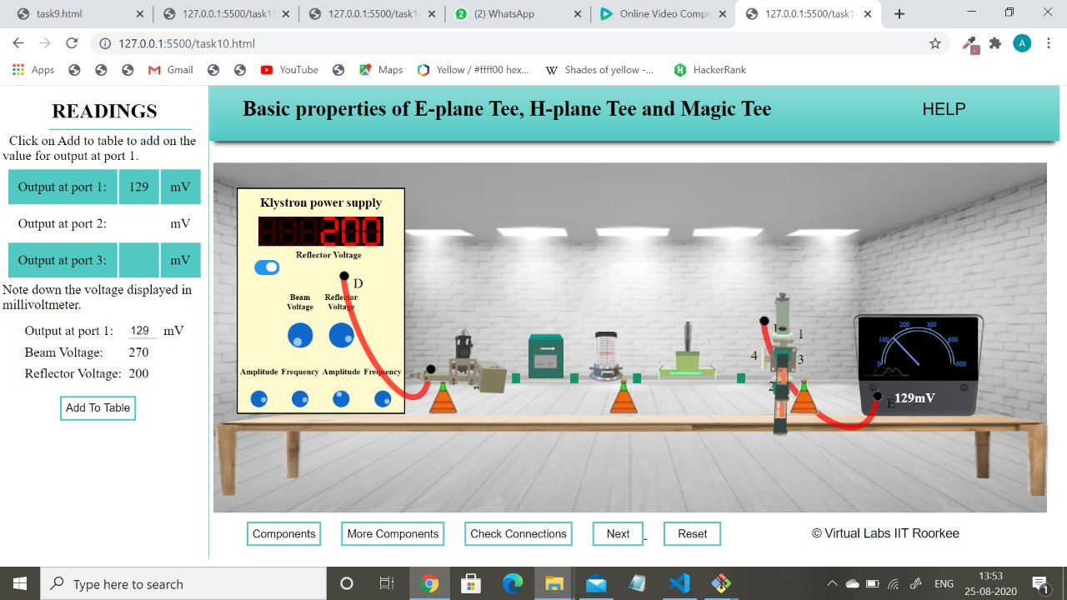
Basic characteristics of Magic Tee : when Input is at Port 4 and Output is at Port 1

Slide 7
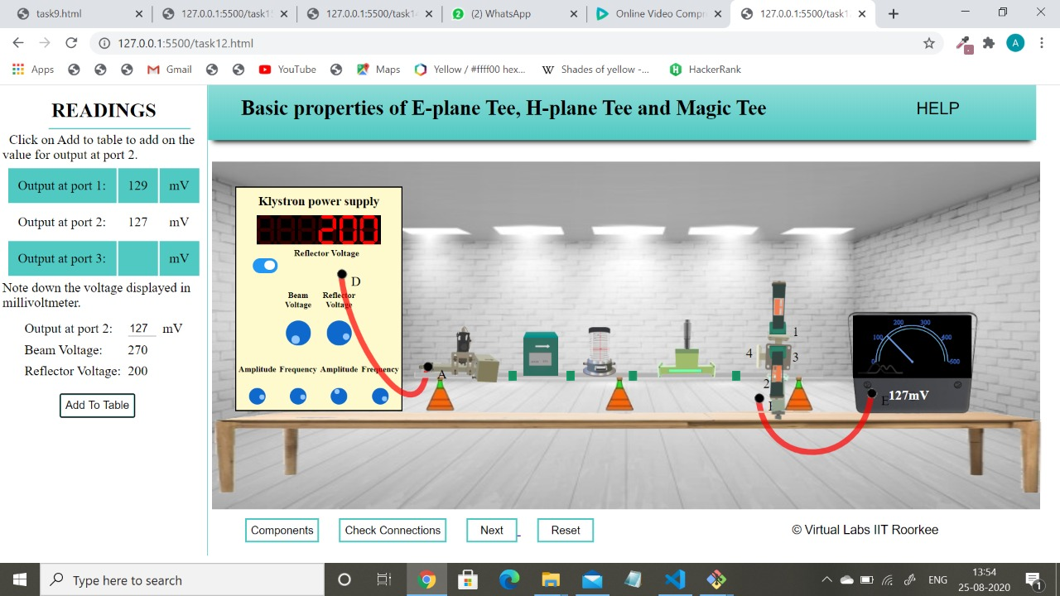
Basic characteristics of Magic Tee : when Input is at Port 4 and Output is at Port 2

Slide 8
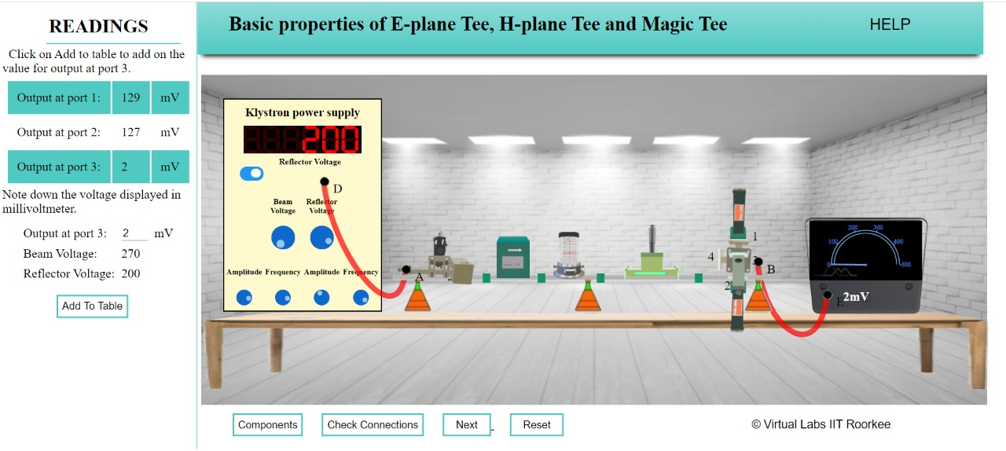
Basic characteristics of Magic Tee : when Input is at Port 4 and Output is at Port 3

Slide 9
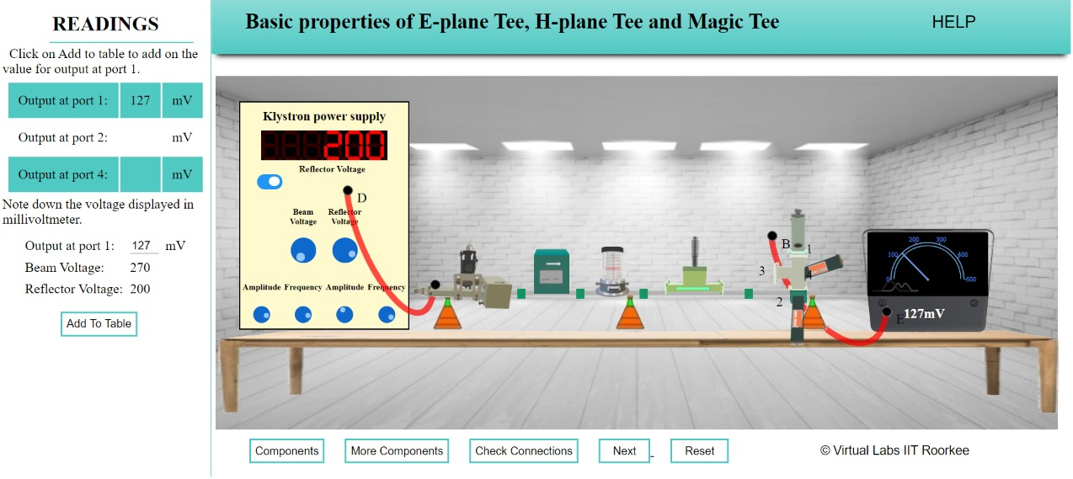
Basic characteristics of Magic Tee : when Input is at Port 3 and Output is at Port 1

Slide 10

Basic characteristics of Magic Tee : when Input is at Port 4 and Output is at Port 2

Slide 11

Basic characteristics of Magic Tee : when Input is at Port 4 and Output is at Port 3

