Slide 1
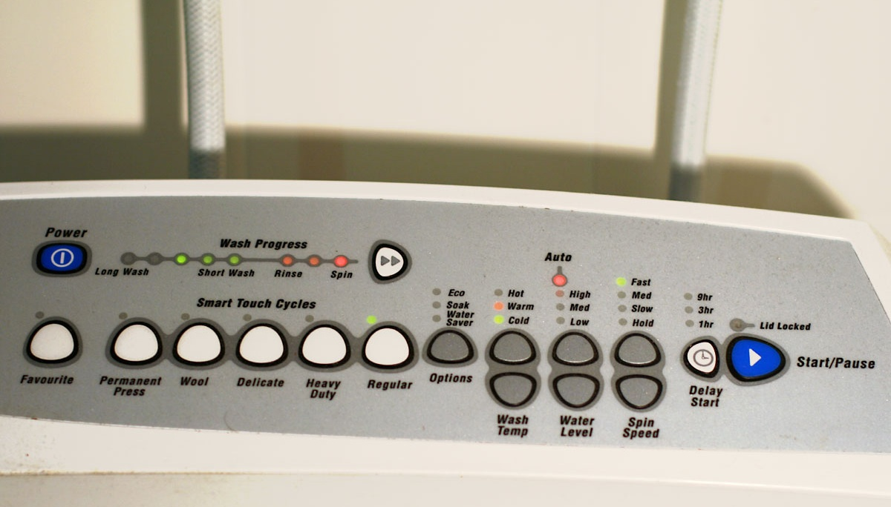

Slide 2
Hot
Fast
Warm
Med
Cold
Slow
Wash
Temp
Hold
High
Spin Speed
Med
Favourite
9 hr
Low
Wool
3 hr
Delicate
Water
Level
1 hr
Heavy
Duty
Delay
Start
Regular
Power
Eco
Soak
Water
Saver
Options
Start/Pause

