Slide 1
Robotics Laboratory
Experiment 1: Robot Teaching
Prof. D. K. Pratihar, ME

Slide 2
Purpose: To provide instructions to a robot
Robot used: PUMA (Programmable Universal Machine for Assembly)
It is a serial manipulator with 6 dof (6 rotary joints – 3 revolute joints and 3 twisting joint)
Revolute joint: When the axis of output link is at 90 degree with the axis of rotation
Twisting joint: When the axis of output link is either parallel or collinear to/with the axis of rotation

Slide 3
Teaching Methods
Teaching Methods
On-line Methods/ Teaching-by-showing (Robot itself is used during teaching)
Off-line Method (Robot is not used during teaching) By using Programming Language
Manual Teaching
Lead-through teaching

Slide 4
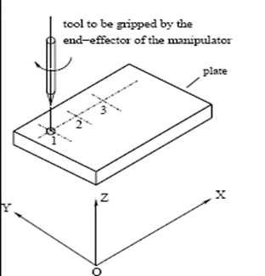
Manual Teaching
It is suitable for point-to-point (PTP) tasks like spot welding, drilling holes at some pre-specified locations.
Methods for manual teaching
Control handle/Joystick
Push buttons
Teach Pendant (works in Joint mode, World mode, Tool mode, Free mode)
Fig. . Point-to-point (PTP) task.

Slide 5
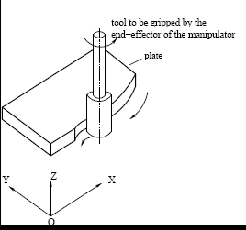
Lead – Through Teaching
It is suitable for continuous-path (CP) tasks like spray painting, arc welding, milling to generate complicated surface.
Fig. . Continuous-path (CP) task.

Slide 6
Lead – Through Teaching
Method
The operator grasps the robot’s end-effector and is leading it through the desired path at the required speed, while simultaneously recording the values of joint angles. However, it might not be possible to generate the motion of the robot’s joints by pulling its end-effector. To solve this problem, we use a robot-simulator, which is kinematically equivalent to the main robot to be taught. It is equipped with feedback devices (like encoders), but with no drives and transmission elements. This simulator is manually grasped by the operator and led through the required path. The values of joint angles are sampled at a constant frequency and stored in the computer. Once taught, the robot is capable of repeating the operation as many times as required.

Slide 7
Robot Programming (off-line method)
We use VAL (Versatile Assembly Language). Some of the VAL commands are similar to BASIC commands.

Slide 8
List of VAL commands:
CALI: Used for the calibration of robot.
DO READY: Takes the robot to home position from current location.
DO DRIVE: Used for moving individual joint.
EDIT: Used for writing the program to do a task.
EXECUTE: Used for executing the already written program.
SPEED: Used for setting the speed of the end-effector.
MOVE: Used to command the end-effector to move form one pre-defined point to another.

Slide 9
Tasks to be performed:
Prepare a sketch of the PUMA. Label all six joints of the robot. Draw kinematic diagram of the robot.
Prepare a list of VAL commands.
Write down VAL commands to solve a problem.

Slide 10
VAL programming for a pick and place job
DO DRIVE 1, 30, 25 // Move joint-1 by 30º CCW with 25 rpm
DO DRIVE 2, -45, 25
DO DRIVE 4, -60, 25
DO DRIVE 5, 50, 25
HERE P1 // Save the current position of the end-effector as P1(position to pick the job)

Slide 11
DO DRIVE 1, -40, 25 // Move joint-1 by 40º CW with 25 rpm
DO DRIVE 2, 30, 25
DO DRIVE 5, -55, 25
DO DRIVE 6, 60, 25
HERE P2 // Save the current position of the end-effector as P2 (position to place the job)
DO READY // Move to the home position
HERE HOME // Save the current position of the end-effector as HOME

Slide 12
EDIT PROGRAM1 // Design the program for the task name ‘PROGRAM1’
MOVE P1 // Move the end-effector to point P1 from current position
MOVE P2
MOVE HOME
E // End ‘PROGRAM1’
SPEED 30 // Define speed of the end-effector
EXECUTE PROGRAM1 // Execute the program for pick and place job

