Slide 1

Driver Station Dashboards Using HTML + Javascript
Dustin Spicuzza
September 10, 2016
NE FIRST University Day

Slide 2
Agenda
History + Alternatives
Why HTML + Javascript
How it works
Getting started
Real dashboard code
Demos

Slide 3
Intended Audience
Some familiarity with a browser
Some programming experience
If you don’t… that’s ok too

Slide 4
Who Am I?
Software engineer at BBN Technologies
Mentoring FRC since 2009
Co-maintainer of RobotPy since 2010
My team’s UI-related awards:
2012 Boston Regional; Innovation in Control
2013 Boston Regional; Innovation in Control
2014 Virginia Regional; Industrial Design
2015 Greater DC Regional; Innovation in Control
2016 Chesapeake Champs; Innovation in Control

Slide 5
Who Am I?
Software engineer at BBN Technologies
Mentoring FRC since 2009

Slide 6
Dashboards
Back in the day…
Lots of options now
LabVIEW Dashboard
SmartDashboard/SFX
Custom (Java, C#, et al)

Slide 7
Dashboard Applications
Robot Control by secondary operator
Click a button, make something happen
Set up autonomous mode
Makes it easy to switch between different mode settings on the fly

Slide 8
Dashboard Applications
Tuning the robot
Changing positions dynamically
Better than constant code redeploy!
Providing visual feedback for sensors
Good for debugging hardware issues

Slide 9
My JOURNEY
Dashboards

Slide 10
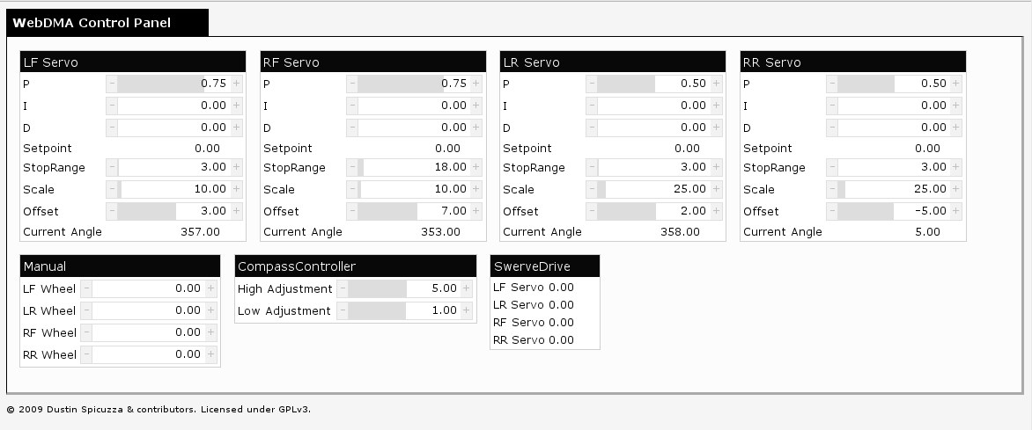
My Journey: 2009/2010
WebDMA (C++)

Slide 11
My Journey: 2009/2010
WebDMA (C++)
Not actually a dashboard
Ran an in-process webserver on the cRIO
UI was HTML/JS
Great for tuning

Slide 12
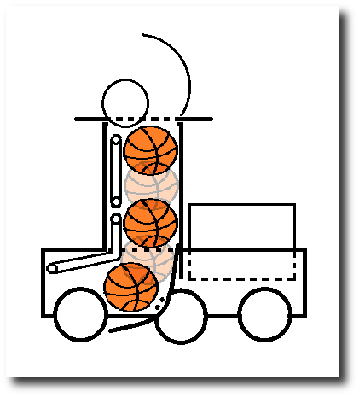
My Journey: 2012
Custom SmartDashboard widget (Java)
Show ball when sensor is on
But…
Little/poor documentation
Java swing is complicated
Layout is terrible
Hard to setup

Slide 13
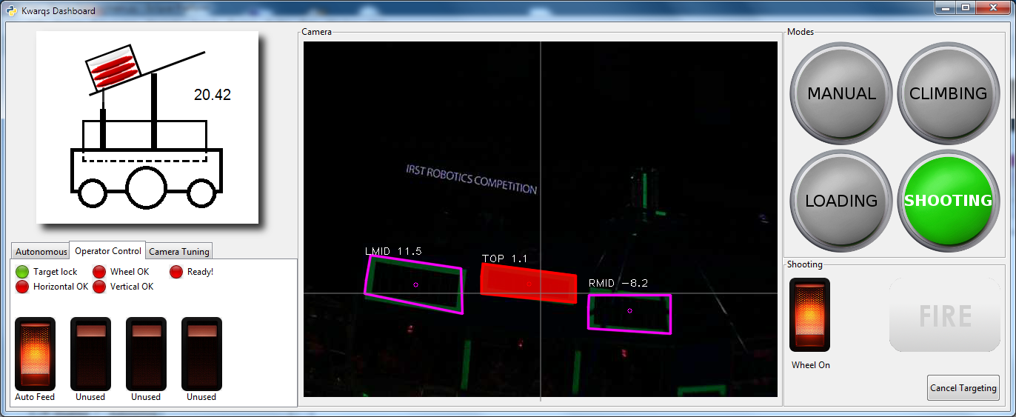
My Journey: 2013/2014
PyGTK + touchscreen laptop

Slide 14
My Journey: 2013/2014
PyGTK + touchscreen laptop
Very shiny
Integrated with image processing
Communications via pynetworktables
But…
Python is great, GTK is not
Difficult to customize interface
Very difficult to teach

Slide 15
pynetworktables2js
Introducing

Slide 16
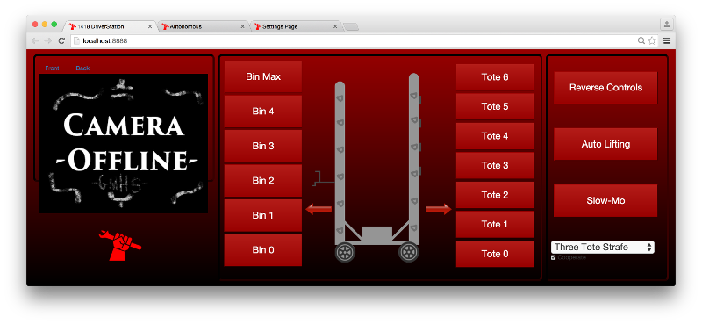
My Journey: 2015 - Present
2015 UI (Team 1418)

Slide 17
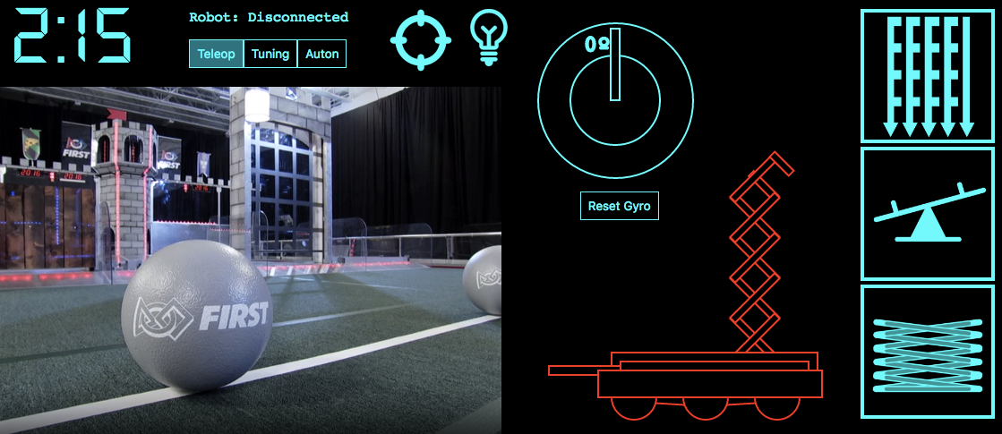
My Journey: 2015 - Present
2016 UI (Team 1418)

Slide 18
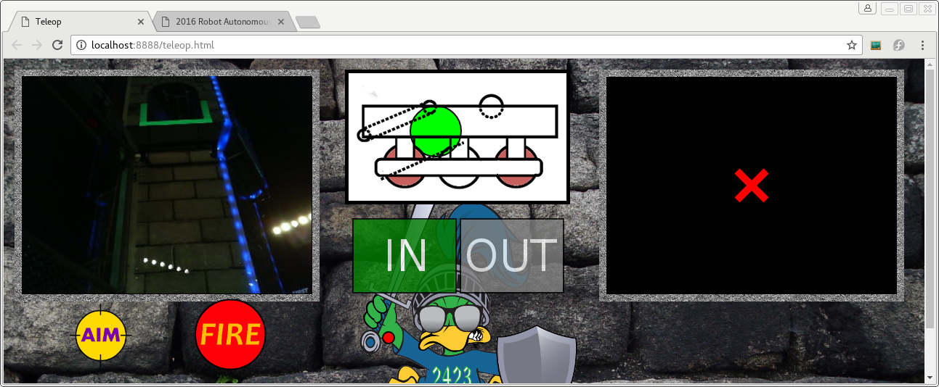
My Journey: 2015 - Present
2016 UI (Team 2423)

Slide 19
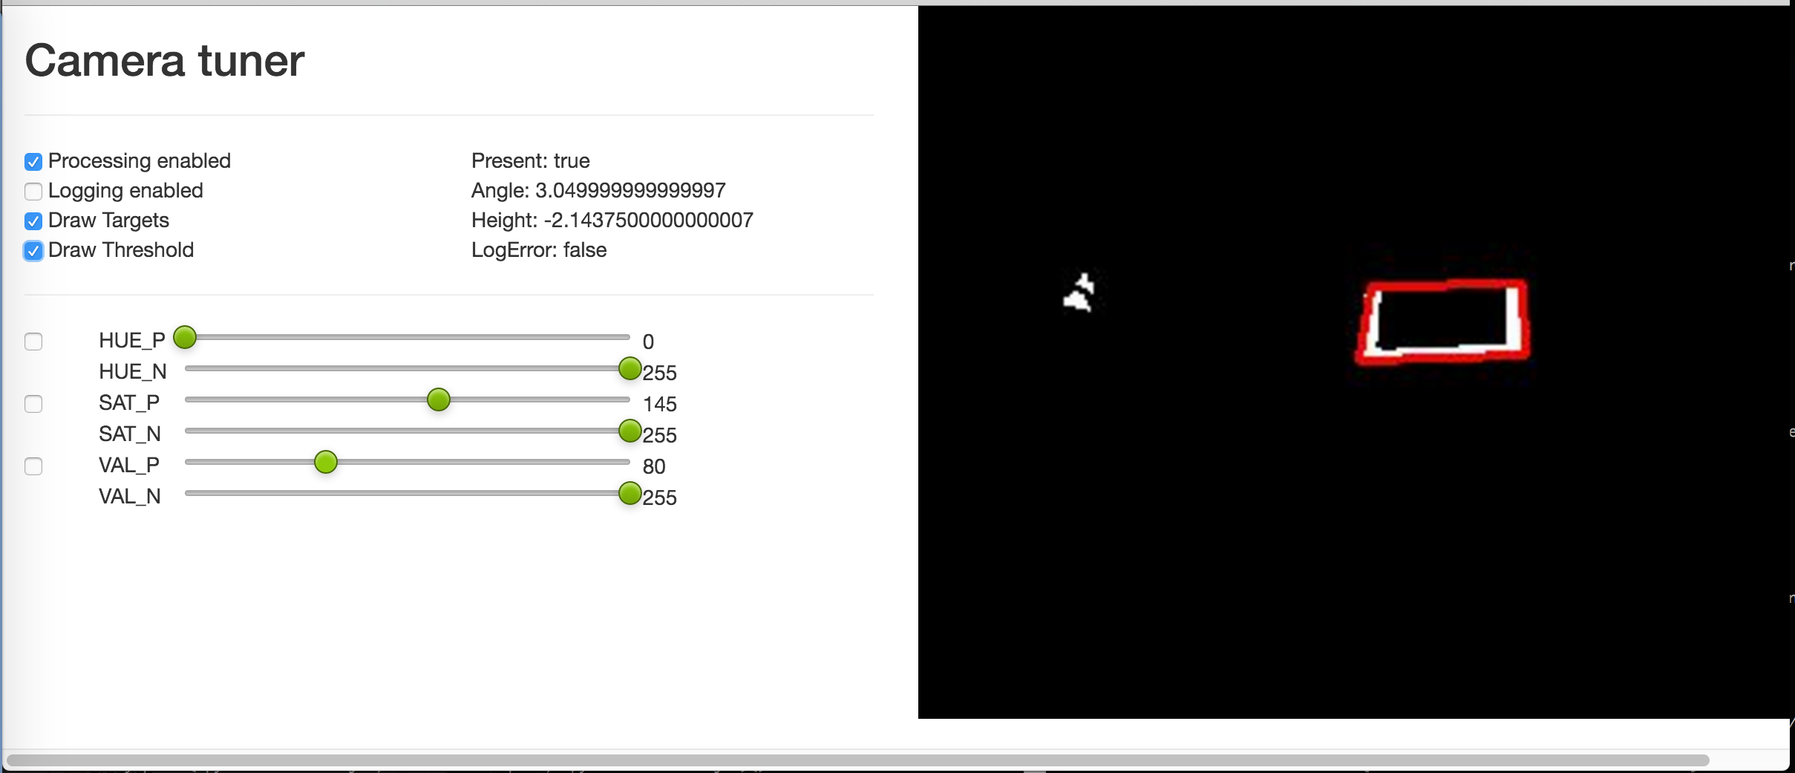
My Journey: 2015 - Present
Interactive camera threshold tuning

Slide 20
Why pynetworktables2js
TL;DR: It’s simpler
pynetworktables2js lowers the barrier of entry for teams that want an additional way to tune/control their robot with a minimal amount of programming.

Slide 21
Why pynetworktables2js
TL;DR: It’s simpler
It’s as easy as making a webpage.

Slide 22
Why pynetworktables2js
Many students already know how to create webpages
And if not, there’s TONS of ways to learn on the web
Outreach to nontraditional students
Introduce students to programming concepts
Artistic students
Yet another way to learn real world skills

Slide 23
Why pynetworktables2js
Very flexible
Anything you can do in a webpage
Simple to get started
Cross platform
Windows + OSX + Linux
Actually has documentation
Unlike most other dashboard alternatives

Slide 24
HOW IT WORKS
Let’s get started

Slide 25
How it works
Browser talks to Python server running on your laptop
Python server uses NetworkTables to communicate with Robot
Results are passed back/forth to webpage

Slide 26
How it works
NetworkTables
Websocket
Robot
Code
NT
NT
NT
Webpage
PythonWeb
Server

Slide 27
How it works
Note that the webserver runs on the laptop
You could run it on the robot
I don’t recommend this because of bandwidth reasons
Also, it means you can’t load the page until the robot connects to FMS

Slide 28
NetworkTables
Easy to use distributed key-value protocol created by WPILib team
Very little setup required*
Latency is “good enough” for 99% of teams
pynetworktables is 50ms max
* mDNS issues in 2016, hopefully they’ll be fixed in 2017…

Slide 29
NetworkTables Basics
On the server…
On the client…
table.putString(“key”, “something”)
x = table.getString(‘key’)
// output is ‘something’
printf(“%s\n”, x);

Slide 30
pynetworktables2js Basics
Very similar to other languages
getValue/putValue only
Doesn’t need getNumber/getString/etc
Uses full path of keys, no tables
// getValue will return the correct type
var coolThing = NetworkTables.getValue(“/table/key”); // putValue doesn’t care about what type you pass NetworkTables.putValue(“/table/string_key”, “my value”);
NetworkTables.putValue(“/table/bool_key”, true);
NetworkTables.putValue(“/table/number_key”, 42.0);

Slide 31
GETTING STARTED
Let’s get started

Slide 32
Getting Started
Install pynetworktables2js
See the documentation
Create a directory with web content
Run the server from inside the directory
On Windows:
py -m pynetworktables2js
On Linux/OSX:
python -m pynetworktables2js
Point your browser at http://localhost:8888

Slide 33
Your first webpage
<!DOCTYPE html> <html lang=”en”><body>
Connected: <span id=”connected”>false</span>
<!-- Include the API -->
<script src=”/networktables/networktables.js”></script>
<script type=”text/javascript”>
function onConnected(connected) {
document.getElementById(“connected”).textContent = connected;
}
NetworkTables.addRobotConnectionListener(onConnected, true);
</script>
</body>
</html>

Slide 34
pynetworktables2js API
NetworkTables.addRobotConnectionListener(f)
Calls a function to tell you that the page is connected to the robot
Driver wants to know if the dashboard isn’t going to actually do anything!

Slide 35
pynetworktables2js API
NetworkTables.putValue(k,v)
Sets the value in NetworkTables
Give it ~50ms to get to the Robot
If not connected to robot, value may be discarded

Slide 36
pynetworktables2js API
NetworkTables.getValue(k, [default])
Returns the current value of a key or null
I rarely use getValue
What happens if the value changes?
How do you find out about the change?
If not connected to robot, value isn’t always meaningful

Slide 37
pynetworktables2js API
NetworkTables.addKeyListener(k, f, [imm])
Set a function that will be called whenever the value for a particular key is changed.
It will usually call you when the robot connects, as the values will change
If you set the third parameter to true, it will call you immediately with the current value

Slide 38
REAL DASHBOARD CODE
Putting it all together

Slide 39
Putting it all together
Let’s show how to display simple feedback of a digital input
Here’s the steps
Create an SVG circle element
Add a listener for the value being sent over NetworkTables
Change color when the value is received

Slide 40
Putting it all together
Include the API in your page
<!DOCTYPE html> <html>
<head>
<script src=“/networktables/networktables.js”></script>
</head>

Slide 41
Putting it all together
Create an SVG circle element
<svg width="100" height="100">
<circle id="switch" cx="50" cy="50" r="40"
stroke="black" stroke-width="4"
fill="gray" />
</svg>

Slide 42
Putting it all together
Add a listener for the value being sent over NetworkTables
<script type=“text/javascript”>
function onSwitchChanged(key, value, isNew) {
// TODO
}
NetworkTables.addKeyListener('/SmartDashboard/switch',
onSwitchChanged, true);
</script>

Slide 43
Putting it all together
Change color upon new value
Hint: Use jQuery to make it easier :)
function onSwitchChanged(key, value, isNew) {
if (value) {
$("#switch").css("fill", "red");
} else {
$("#switch").css("fill", "green");
}
}

Slide 44
Demo
Putting it all together

Slide 45
2015 UI Demo
Putting it all together

Slide 46
pynetworktables2js API
There’s lots more...
Read the documentation

Slide 47
pynetworktables2js API
Useful helper functions for common UI tasks
Easy toggle button
HTTP Camera support
Robot connection indicator
SendableChooser related helpers

Slide 48
pynetworktables2js tips
Tell your team to buy a touchscreen laptop
Very inexpensive these days (<$700)
Create multiple pages, and show them using browser tabs
One page for teleop
One page for autonomous options
One page for tuning

Slide 49
Future work
pynetworktables2js is a good start…
Need more widgets/helpers
Single executable deploy for 2017
Would love more contributors (hint, hint)
Need a ‘TableViewer’ integrated into pynetworktables2js
There’s a PR on github, needs work

Slide 50
Future work
NetworkTables 3.0 support for 2017
Enables persistent settings
Can talk to LabVIEW
Will probably happen…

Slide 51
Want More?
This presentation + code available online*
https://github.com/virtuald/frc-dashboard-workshop
* Sometime on Sunday

Slide 52
FRCDashboard Project
Created by Erik Boesen, student on 1418
Uses Electron framework to run HTML/JS app
Same thing that Atom text editor uses
Goal is to provide easy customization and expansion using prebuilt modules
Project is still very new

Slide 53
Resources
pynetworktables2js
Code + Examples: https://github.com/robotpy/pynetworktables2js
Documentation: http://pynetworktables2js.readthedocs.io

Slide 54
Resources
1418’s UI repos
https://github.com/frc1418/2015-ui
https://github.com/frc1418/2016-ui
FRCDashboard
http://frcdashboard.github.io/

Slide 55

One more thing…
Publicly editable repository of information related to FIRST Robotics
Technical topics
Non-technical
Team pages
Add content to your team’s page!
https://firstwiki.github.io

Slide 56
Questions
???

