Slide 1
Introduction to RobotPy & pyfrc simulator
Dustin Spicuzza (Team 1418)
December 13, 2014
Team 1418 Workshops

Slide 2
Agenda
Why Python?
Quick Demo
Quick Python Primer
Putting it all together
New features coming in 2015

Slide 3
Intended Audience
Some familiarity with WPILib in C++/Java
For maximum benefit, you should have some programming experience
If you don’t, that’s ok too

Slide 4
Who Am I?
Software engineer at BBN Technologies
Mentoring FRC since 2009
Currently mentor for Team 1418
Co-maintainer of RobotPy since 2010

Slide 5
What is Python/RobotPy?
Python is a widely used general purpose, high-level programming language
It’s pretty sweet
RobotPy is the project that packages python for the cRio and RoboRIO
And maintains various other FRC related python packages

Slide 6
Why Python?
Simple language syntax
Fewer brackets and semicolons
Indentation is mandatory
Very understandable and readable
Designed for Rapid Development
Quick iteration, no compilation
Dynamic typing
Cross platform
Windows, OSX, and Linux

Slide 7
Why RobotPy + Python?
Mature, proven codebase on high performance robots
RobotPy project started in 2010
Supported for FRC teams by FRC teams
Quick bugfixing, because we’re using this code too
Have you ever submitted a bug report to WPILib? They don’t respond quickly.

Slide 8
Why Not Python?
Not officially supported by FIRST
Community isn’t as big as official languages
Support at competitions is low
However, because WPILib is the same, other teams can help you with problems that aren’t specific to python
Most problems are WPILib problems, not python problems
Documentation isn’t quite as good
But it’s getting better every year!

Slide 9
Why Not Python?
Spacing matters
Indentation is syntax
Requires that you actually test your code
Syntax error or mistyping something could crash your code
You DO test your code, right?

Slide 10
Quick Demo
Team 1418’s robot code for 2014
Same code runs on the Robot & on your PC
Running as simulation with pyfrc
Supports connection to UI on driver station laptop

Slide 11
How does this work?
Robot code is written in python, using WPILib
2014: wrappers around C++
2015: pure python
Communications via pynetworktables
Compatible with SmartDashboard/SFX
Simulation engine is pyfrc

Slide 12
pyfrc
A python library designed to make developing robot code easier

Slide 13
pyfrc
Easy to use testing framework you can use to test your robot code at home
Tool to upload code to the robot
Integrated with testing framework to prevent uploading bad code
Low fidelity robot simulator

Slide 14
Python Primer
Python syntax compared to Java

Slide 15
Python primer: comments
Python
Java
# This is a comment ‘’’This is sometimes used as a multiline comment’’’ | // This is a comment /* This is a multiline comment */

Slide 16
Python primer: variables
Python
Java
a = 13 b = False c = ‘foo’ c = “foo” d = None e = Bar(c) | int a = 13; boolean b = false; String c = “foo”; Object d = null; Bar e = new Bar(c);

Slide 17
Python primer: operands
Python
Java
a and b x == 3 and y == 7 a == x or b == y x == “string” o is None | a && b x == 3 && y == 7 a == x || b == y x.equals(“string”) o == null

Slide 18
Python primer: functions
Python
Java
def hello(): print(“Hi”) def add2(a): return a + 2 # Call the function hello() r = add2(2) | private void hello(){ System.out.println(“Hi”); } public int add2(int a){ return a + 2; } // Call the function hello(); int r = add2(2);

Slide 19
Python primer: if/else
Python
Java
if a: do_something() elif b == 4: doit(b) else: done = False | if (a == true) { do_something(); } else if (b == 4) { doit(b); } else { done = false; }

Slide 20
Python primer: objects
Python
Java
class Obj: def __init__(self): super().__init__() self.x = 2 def getX(self): return self.x | public class Obj { int x = 1; public Obj(){ super(); x = 2; } public int getX(){ return x; } }

Slide 21
Putting it all Together
Real robot code

Slide 22
Real robot code
python uses WPILib
Robot code isn’t that different from C++/Java, same principles still apply
Let’s create a robot that changes a solenoid based on a joystick trigger

Slide 23
Real robot code: robot.py
Create a file called robot.py
First, import WPILib so you can use it
try: import wpilib except: import pyfrc as wpilib

Slide 24
Real robot code: MyRobot
Next, need to define a robot object
We’ll use IterativeRobot for simplicity
class MyRobot(wpilib.IterativeRobot): def __init__(self): super().__init__()

Slide 25
Real robot code: MyRobot
Create a joystick and some devices in the __init__ function
# Note this is still indented.. self.joystick = wpilib.Joystick(1) self.dio = wpilib.DigitalInput(1) self.dio.label = “Device label in simulator” self.solenoid1 = wpilib.Solenoid(1) self.solenoid4 = wpilib.Solenoid(1)

Slide 26
Real robot code: MyRobot
Next, define your teleoperated code
def TeleopPeriodic(self): # control solenoid 1 via joystick trigger self.solenoid1.Set(self.joystick.GetTrigger()) # control solenoid 4 via digital input self.solenoid4.Set(self.dio.Get())

Slide 27
Real robot code: the end
Finally, robotpy needs some stuff to run your code correctly
# This won’t be needed in 2015 def run(): robot = MyRobot() robot.StartCompetition() return robot # This will still be needed in 2015 if __name__ == '__main__': wpilib.run()

Slide 28
Real Robot Code: Running it
Use python3 to execute robot.py, and pass it the ‘sim’ argument
Windows: Open cmd, and…
cd path\to\robot
python3 robot.py sim
OSX: Open Terminal, and…
cd path/to/robot
python3 robot.py sim

Slide 29
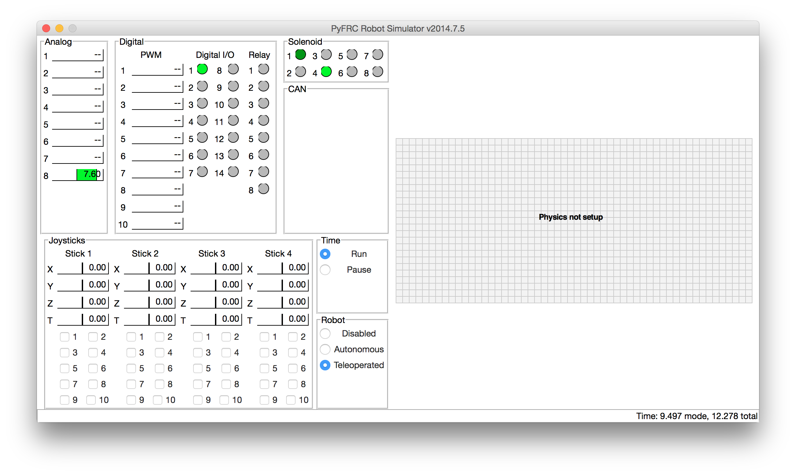
The result

Slide 30
Want More?
pyfrc has ‘physics’ support
Allows you to adjust various robot objects on the fly to make the simulation more useful
This will be easier in 2015
There are more pyfrc samples on github
https://github.com/robotpy/pyfrc/tree/master/samples

Slide 31
2015 Changes
WPILib is now 100% pure python
And you can run it on your PC
API is based on Java, not C++
getRawButton() instead of GetRawButton()

Slide 32
2015 Features
Gazebo 3D simulator support
Eclipse plugins to simplify development
You don’t have to use Eclipse
pyfrc simulator upgrades

Slide 33
2015 Development
We’re still adding features!
Lots of help needed before kickoff
Unit tests
Tool refinement
Eclipse plugin development + testing
Documentation improvement
Access to 2015 C++/Java WPILib available to contributors
See me afterward if you want to help

Slide 34
Learn Python
Code Academy
http://www.codecademy.com/tracks/python
Wikibooks Python Tutorial
https://en.wikibooks.org/wiki/Non-Programmer’s_Tutorial_for_Python_3
Official Python Tutorial
https://docs.python.org/3.4/tutorial/

Slide 35
Resources
RobotPy mailing list
https://groups.google.com/forum/#!forum/robotpy
ChiefDelphi Forums
http://www.chiefdelphi.com/forums/forumdisplay.php?f=187

Slide 36
Code Links
RobotPy github site
https://github.com/robotpy
pyfrc documentation
http://pyfrc.readthedocs.org/
Team 1418’s 2014 code
https://github.com/frc1418/2014

Slide 37
Questions
???

Slide 38
Special Thanks
Team 1418 Programming Team
Tim Winters for python tutorial help

