Slide 1

Robot programming & simulation using Python
Dustin Spicuzza
September 10, 2016
NE FIRST University Day

Slide 2
Agenda
Why Python?
Quick Simulation Demo
Quick Python Primer
Putting it all together
RoboRIO Demo

Slide 3
Intended Audience
Some familiarity with WPILib in C++/Java
For maximum benefit, you should have some programming experience
If you don’t, that’s ok too

Slide 4
Who Am I?
Software engineer at BBN Technologies
Mentoring FRC since 2009
Co-maintainer of RobotPy since 2010
My contributions have helped win awards for my teams:
2012 Boston Regional; Innovation in Control
2013 Boston Regional; Innovation in Control
2014 Virginia Regional; Industrial Design
2015 Greater DC Regional; Innovation in Control
2016 Chesapeake Champs; Innovation in Control

Slide 5
What is Python/RobotPy?
Python is a widely used general purpose, high-level programming language
It’s pretty sweet
RobotPy is the project that packages python for the cRio and RoboRIO
And maintains various other FRC related python packages

Slide 6
Why Python?
Simple language syntax
Fewer brackets and semicolons
Indentation is mandatory
Very understandable and readable
Designed for Rapid Development
Quick iteration, no compilation
Dynamic typing
Cross platform
Windows, OSX, and Linux

Slide 7
Why RobotPy + Python?
Mature, proven codebase on high performance robots
RobotPy project started in 2010
Supported for FRC teams by FRC teams
Quick bugfixing, because we’re using this code too
Have you ever submitted a bug report to WPILib? They don’t respond quickly*
Good documentation

Slide 8
Why RobotPy + Python?
Superior support for running your code without a robot
Integrated unit testing (with builtin tests)
Zero-configuration low fidelity simulator

Slide 9
Why Not Python?
Not officially supported by FIRST
Community isn’t as big as official languages
33 teams used Python in 2016
Support at competitions is low
However, because WPILib is the same, other teams can help you with problems that aren’t specific to python
Most problems are WPILib problems, not python problems

Slide 10
Why Not Python?
Spacing matters
Indentation is syntax
Requires that you actually test your code
Syntax error or mistyping something could crash your code
You DO test your code, right?

Slide 11
Quick Demo
Team 1418’s robot code for 2015
Same code runs on the Robot & on your PC
Running as simulation with pyfrc
Supports connection to UI on driver station laptop
Innovation in Control award @ DC Regional

Slide 12
How does this work?
Dashboard is HTML/Javascript
Robot code is written in python
Pure python implementation of WPILib
Communications via pynetworktables
Compatible with SmartDashboard/SFX
Simulation engine is pyfrc

Slide 13
pyfrc
A python library designed to make developing robot code easier

Slide 14
pyfrc
Easy to use testing framework you can use to test your robot code at home
Tool to upload code to the robot
Integrated with testing framework to prevent uploading bad code
Low fidelity robot simulator

Slide 15
Python Primer
Python syntax compared to Java

Slide 16
Python primer: comments
Python
Java
# This is a comment ‘’’This is sometimes used as a multiline comment’’’ | // This is a comment /* This is a multiline comment */

Slide 17
Python primer: variables
Python
Java
a = 13 b = False c = ‘foo’ c = “foo” d = None e = Bar(c) | int a = 13; boolean b = false; String c = “foo”; Object d = null; Bar e = new Bar(c);

Slide 18
Python primer: operands
Python
Java
a and b x == 3 and y == 7 a == x or b == y x == “string” o is None | a && b x == 3 && y == 7 a == x || b == y x.equals(“string”) o == null

Slide 19
Python primer: functions
Python
Java
def hello(): print(“Hi”) def add2(a): return a + 2 # Call the function hello() r = add2(2) | private void hello(){ System.out.println(“Hi”); } public int add2(int a){ return a + 2; } // Call the function hello(); int r = add2(2);

Slide 20
Python primer: if/else
Python
Java
if a: do_something() elif b == 4: doit(b) else: done = False | if (a == true) { do_something(); } else if (b == 4) { doit(b); } else { done = false; }

Slide 21
Python primer: objects
Python
Java
class Obj: def __init__(self): super().__init__() self.x = 2 def getX(self): return self.x | public class Obj { int x = 1; public Obj(){ super(); x = 2; } public int getX(){ return x; } }

Slide 22
REAL ROBOT CODE
Putting it all together

Slide 23
Real robot code
python uses WPILib
Robot code isn’t that different from C++/Java, same principles still apply
Let’s create a robot that changes a solenoid based on a joystick trigger

Slide 24
Real robot code: robot.py
Create a file called robot.py
First, import WPILib so you can use it
import wpilib

Slide 25
Real robot code: MyRobot
Next, need to define a robot object
We’ll use IterativeRobot for simplicity
class MyRobot(wpilib.IterativeRobot): def robotInit(self): ‘’’Called at startup’’’

Slide 26
Real robot code: MyRobot
Create a joystick and some devices in the robotInit function
# Note this is still indented.. self.joystick = wpilib.Joystick(1) self.dio = wpilib.DigitalInput(1) self.solenoid1 = wpilib.Solenoid(1) self.solenoid4 = wpilib.Solenoid(1)

Slide 27
Real robot code: MyRobot
Next, define your teleoperated code
def teleopPeriodic(self): # control solenoid 1 via joystick trigger self.solenoid1.set(self.joystick.getTrigger()) # control solenoid 4 via digital input self.solenoid4.set(self.dio.get())

Slide 28
Real robot code: the end
Finally, robotpy needs some stuff to run your code correctly
if __name__ == '__main__': wpilib.run(MyRobot)

Slide 29
Real Robot Code: Running it
Use python3 to execute robot.py, and pass it the ‘sim’ argument
Windows: Open cmd, and…
cd path\to\robot
py -3 robot.py sim
OSX: Open Terminal, and…
cd path/to/robot
python3 robot.py sim

Slide 30
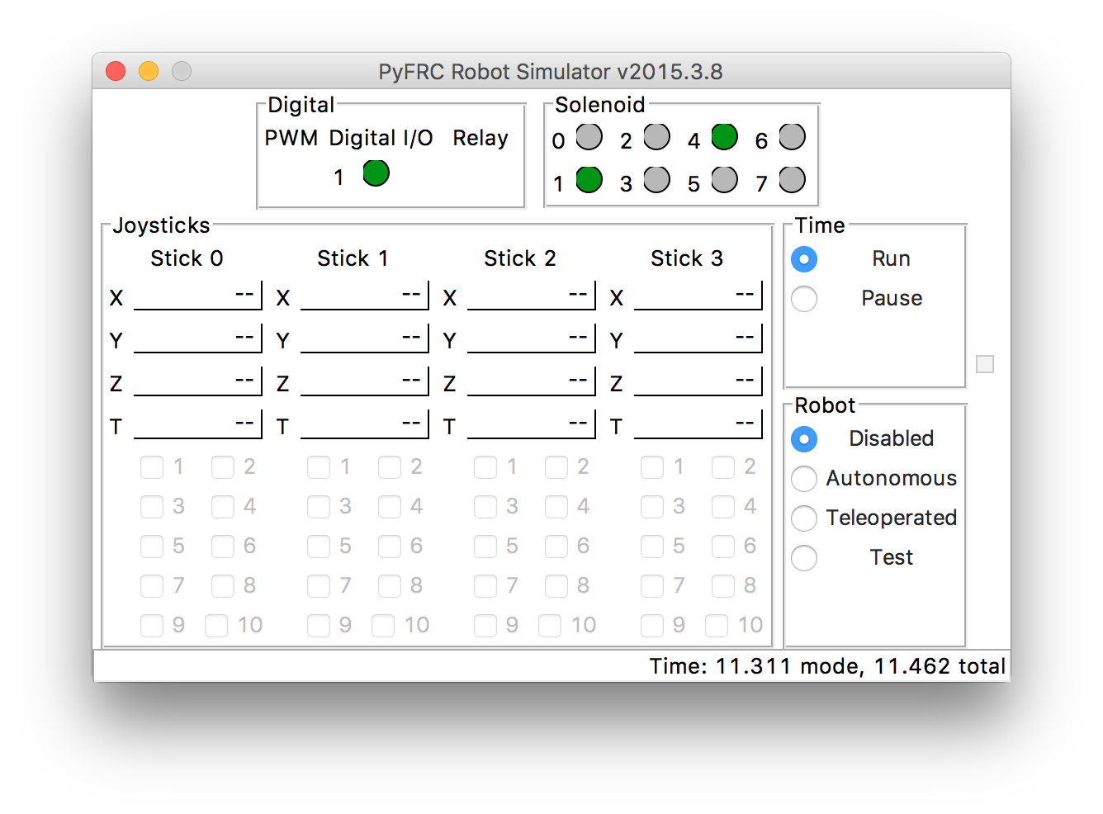
The result

Slide 31
DEMO
Putting it all together

Slide 32
Demo
A small snippet of code that:
Runs on a RoboRIO
Runs in simulation
Connects to a webpage

Slide 33
Demo
This is the robot code that does the work
sd = wpilib.SmartDashboard sensor = wpilib.AnalogInput(2) ... sd.putDouble('sensor', sensor.getVoltage())

Slide 34
Demo
Let’s make a webpage!
Javascript to interact with pynetworktables2js
var nt = NetworkTables; var key= '/SmartDashboard/sensorDegrees’ nt.addKeyListener(key, onValueChanged, true); function onValueChanged(key, value, isNew) { // do something with it }

Slide 35
Encoder demo
Let’s run this code!

Slide 36
Want More?
pyfrc has ‘physics’ support
Allows you to adjust various robot objects on the fly to make the simulation more useful
There might be a web-based simulator in 2017
There are more pyfrc samples on github
https://github.com/robotpy/pyfrc/tree/master/samples

Slide 37
Want More?
This presentation + code available online
https://github.com/virtuald/frc-robotpy-workshop
https://github.com/frc2423/encoder-demo

Slide 38
Learn RobotPy
Anatomy of a robot
http://robotpy.readthedocs.io/en/latest/guide/anatomy.html
pyrobottraining
https://github.com/robotpy/pyrobottraining

Slide 39
Learn Python
Code Academy
http://www.codecademy.com/tracks/python
Wikibooks Python Tutorial
https://en.wikibooks.org/wiki/Non-Programmer’s_Tutorial_for_Python_3
Official Python Tutorial
https://docs.python.org/3.5/tutorial/

Slide 40
Resources
RobotPy mailing list
https://groups.google.com/forum/#!forum/robotpy
ChiefDelphi Forums
http://www.chiefdelphi.com/forums/forumdisplay.php?f=187

Slide 41
Code Links
RobotPy github site
https://github.com/robotpy
pyfrc documentation
http://pyfrc.readthedocs.io/
Team 1418’s 2015 code
https://github.com/frc1418/2015

Slide 42

One more thing…
Publicly editable repository of information related to FIRST Robotics
Technical topics
Non-technical
Team pages
Add content to your team’s page!
https://firstwiki.github.io

Slide 43
Questions
???

Slide 44
Special Thanks
Team 1418 Programming Team
Tim Winters for python tutorial help

