Slide 1
VIRTUAL HERBAL GARDEN
CSE7101- Capstone Project
Review-2
Batch Number: CSG_4
Under the Supervision of,
Mr. Arunkumar K. Bhavikatti
Assistant Professor
School of Computer Science and Engineering
Presidency University
Roll Number | Student Name
20221CIT0124 | SAISHREE N
20221CIT0126 | SHREYA A J
20221CIT0130 | NITHYA H D
Name of the Program: : Computer Science Engineering (Internet of things)
Name of the HoD : Dr. Anandaraj S.P
Name of the Program Project Coordinator: Dr. Sharmasth Vali
Name of the School Project Coordinators: Dr. Sampath A K , Dr. Geetha A

Slide 2
Content
Abstract
Literature Survey
Objectives
Existing Methods and Drawbacks
Proposed Method & Feasibility Study
Architecture Diagram
Modules
Hardware and Software Details
Github Link
Timeline (Gantt Chart)
References

Slide 3
Abstract
Virtual Herbal Garden is a web-based project designed to create an interactive and educational platform showcasing medicinal plants from AYUSH systems (Ayurveda, Yoga & Naturopathy, Unani, Siddha, Homeopathy).
Built with a React frontend, Node.js backend, and MongoDB Atlas database, it offers features like plant search, categorization, image-based identification, and AR/3D visualization.
The project bridges traditional knowledge with digital tools, raising awareness, accessibility, and conservation of medicinal plants, while providing scope for future integration in healthcare education.Limitations

Slide 4
Objectives
Build an interactive Virtual Herbal Garden showcasing medicinal plants from AYUSH systems (Ayurveda, Yoga, Unani, Siddha, Homeopathy).
Provide plant search & filtering by medicinal use, region, and system of medicine.
Integrate multimedia elements (images, videos, 3D/AR models) for immersive learning.
Support user-friendly accessibility with multilingual content (English + Indian languages).
Deploy a scalable, web-based system using React (frontend), Node.js/Express (backend), and MongoDB Atlas (database).
Enhance user engagement with quizzes, guided tours, and interactive plant identification.

Slide 5
ALGORITHM DETAILS
1. Backend Layer (Data Handling + API)
  Algorithms here handle data organization and retrieval:
  CRUD Operations on MongoDB for plant data.
  Search & Filtering Algorithms
    Text-based string matching (case-insensitive substring search).
    Tokenization + keyword matching (for scientific vs. common names).
  Recommendation Algorithm
    Content-based filtering: “Show plants with similar properties/uses.”
  .

Slide 6
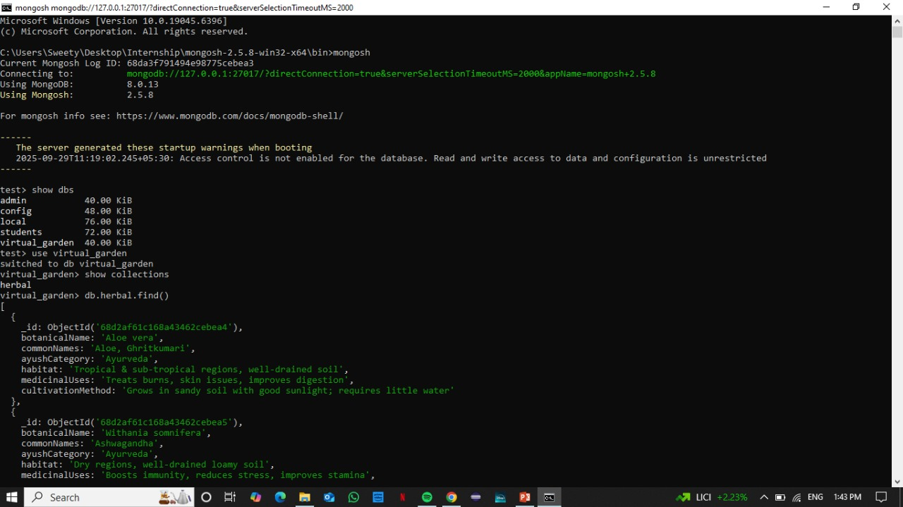
Pseudo-code
Database

Slide 7
ALGORITHM DETAILS
2. Frontend Layer (UI/UX + Learning Modules)
Algorithms here focus on user interaction and learning:
Search Ranking Algorithm
  Rank plants by relevance score (matches in common name > properties > systems).
Filter Combination
  Boolean logic: (Plant matches query) AND (Plant selected systems).
Gamification Algorithms
  Points & progress tracking → simple cumulative scoring.
Animation/Interaction Algorithms
  Framer Motion easing functions for smooth transitions.

Slide 8
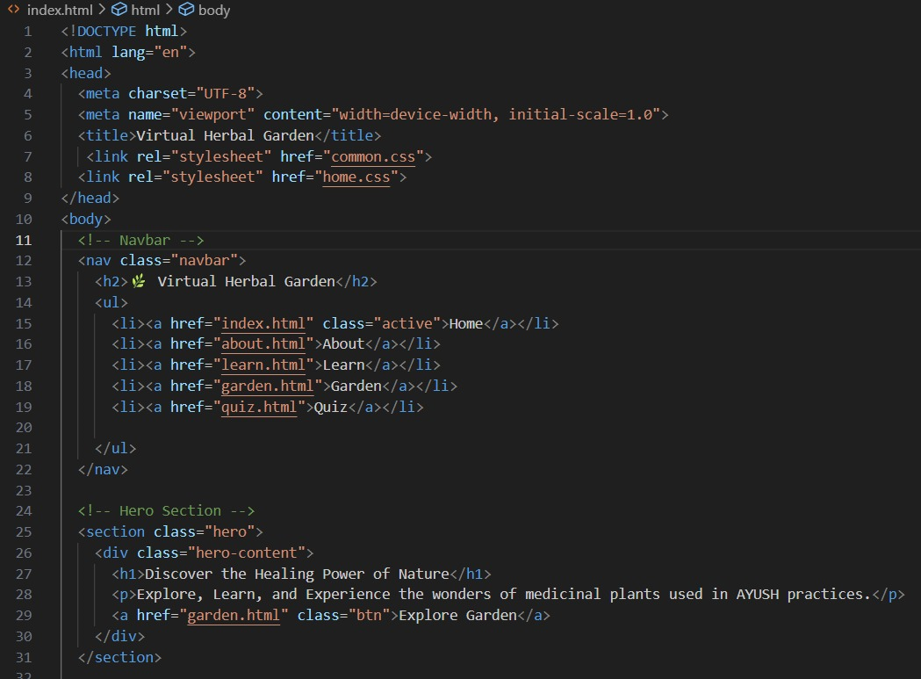
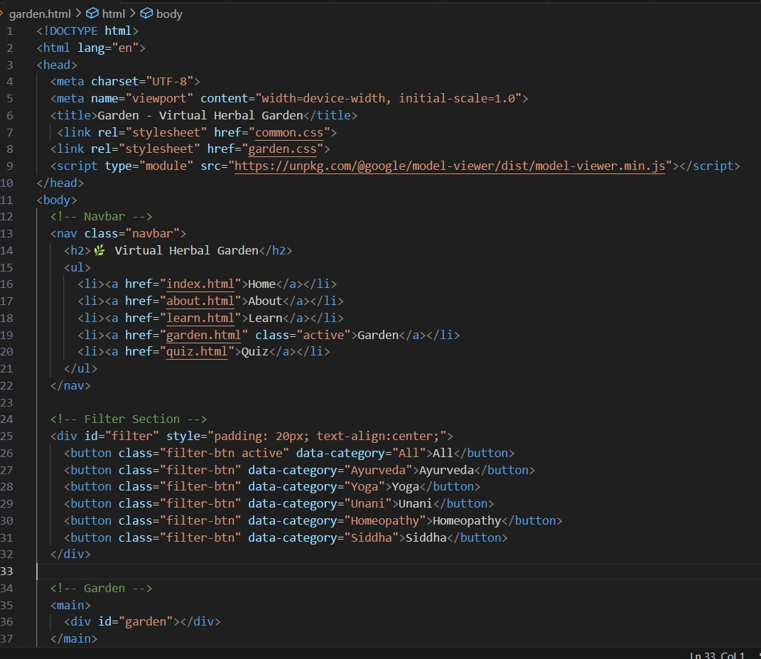
Pseudo-code
Main page
Filter page

Slide 9
ALGORITHM DETAILS
3. Educational / Knowledge Layer
To make it immersive and useful:
  Quiz Evaluation Algorithm
    Multiple-choice → deterministic scoring.
  Recommendation for Next Lesson
    Simple rule-based sequencing (unlock next module after completing current).

Slide 10
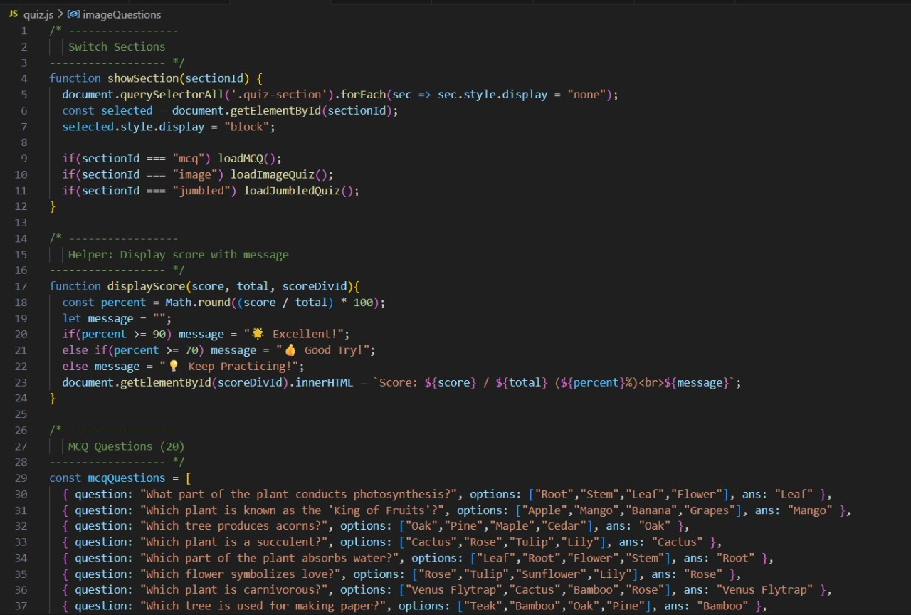
Pseudo-code
Quiz page

Slide 11

Source code details
Filtering code implementation

Slide 12
Modules
Module | Functionality
User Module | User login, registration, profile management, and personalized plant bookmarks..
Frontend Module (React) | Interactive UI, plant visualization, search/filter, and 3D/AR view integration.
Backend Module (Node.js + Express.js) | Handles APIs, authentication, CRUD operations for plant data.
Database Module (MongoDB Atlas) | Stores plant details, images, multimedia, and user data.
Search & Filter Module | Allows filtering by medicinal use, plant type, or region.

Slide 13
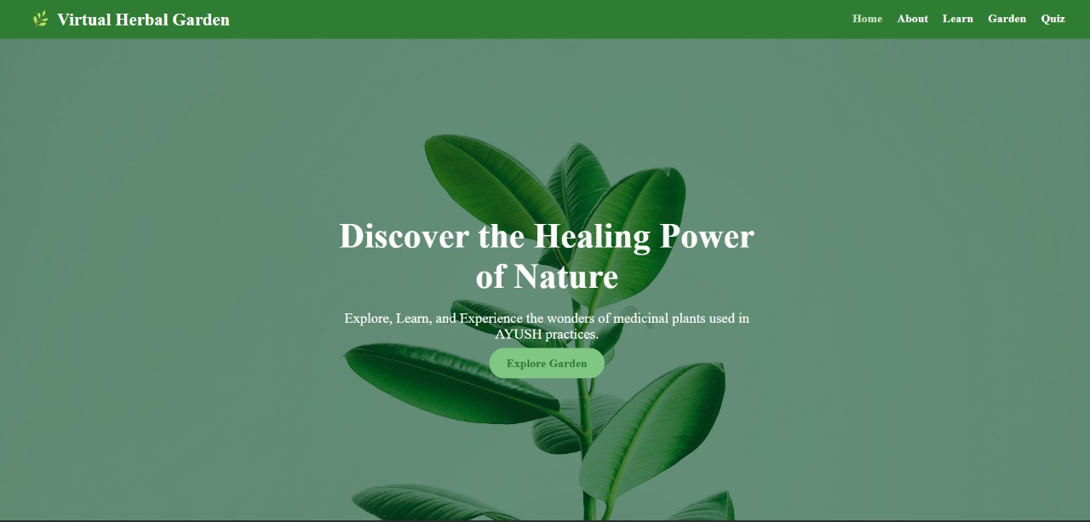
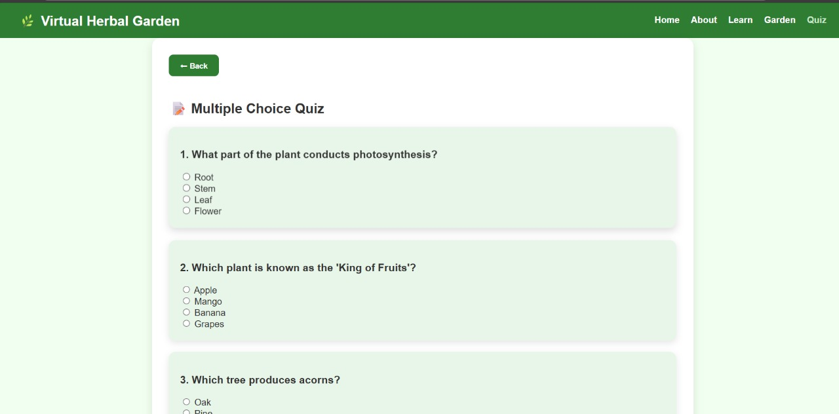
Code implementation
Home page
Quiz page

Slide 14
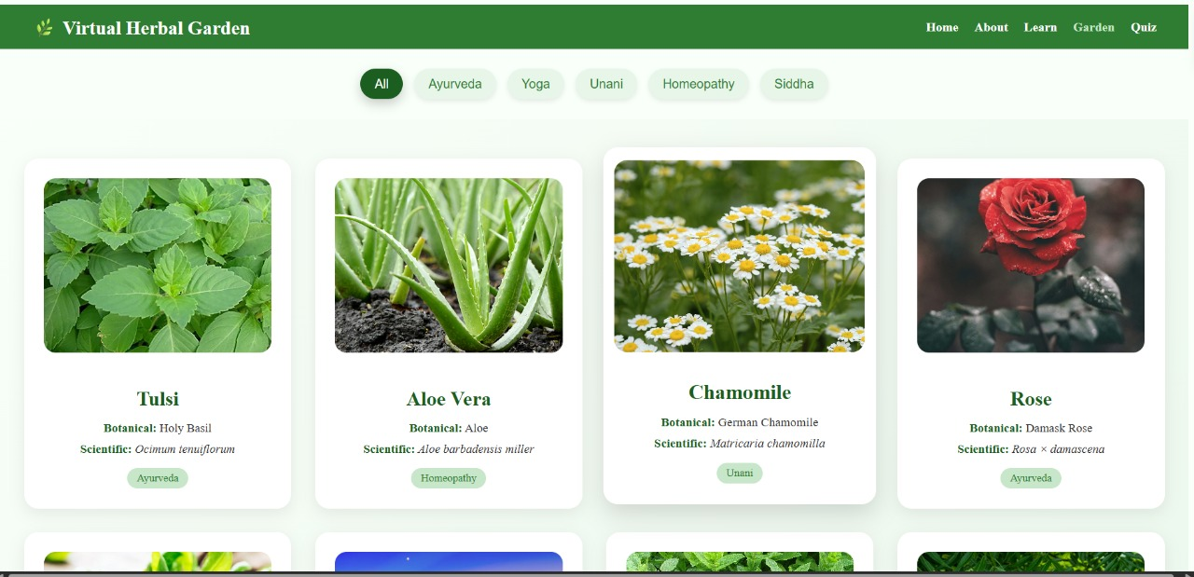
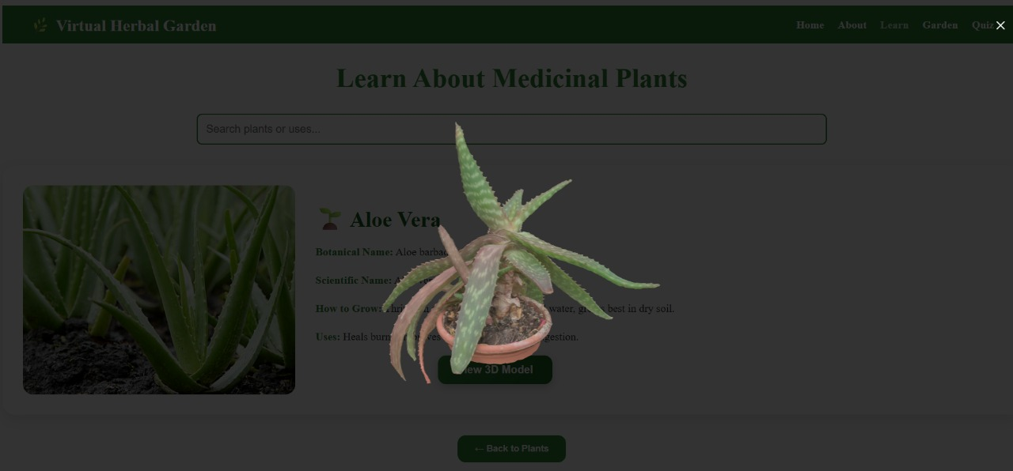
Code implementation
Filter page
3D model

Slide 15
Existing Methods and Drawbacks
Resources | Existing Methods | Drawbacks
Traditional Herbal Gardens (Physical) | Preserve plant biodiversity | Limited reach, not interactive or accessible remotely.
Digital Herbal Databases (IMPPAT, NMPB) | Provide structured medicinal plant information | Text-heavy, lack interactive features or visualization.
Plant Identification Apps (PlantSnap, LeafSnap) | Image recognition for plants | General use, not AYUSH/medicinal plant-specific.
AR/VR Educational Tools | Immersive plant exploration | Limited datasets, often commercial/non-medical focus.
Gap Identified | Few integrated systems combining AYUSH knowledge | Interactive multimedia + accessibility is not present at once.

Slide 16
Proposed Method & Feasibility Study
Proposed Method
Build a website to showcase medicinal plants with details, images, and search/filter options.
Provide multilingual support and easy navigation.
Justification
Makes herbal knowledge accessible and engaging.
Helps students, researchers, and the public learn easily.
Feasibility
Uses MERN stack (open-source, low cost).
Needs only basic cloud hosting, no heavy resources.

Slide 17
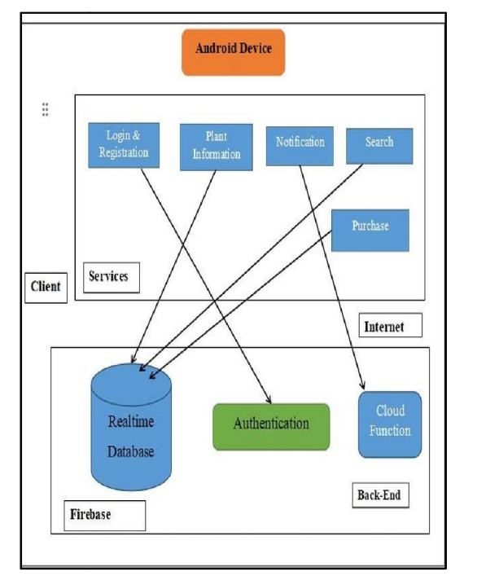
Architecture Diagram

Slide 18
Hardware and Software Details
1. Software Requirements
  Frontend:
  – Frameworks/Languages: React.js, HTML5, CSS3, JavaScript
  – UI/UX Tools: Figma / Adobe XD (for designing interfaces)
  Backend:
  – Programming Language / Runtime: Node.js
  – Framework: Express.js
  – API Security: HTTPS (SSL/TLS)
  Database:
  – Cloud NoSQL Database: MongoDB Atlas
  Tools / DevOps:
  – Version Control: Git, GitHub
  – API Testing:Postman

Slide 19
2. Hardware Requirements
Development Machine:
– Processor: Intel i3 / Ryzen 3 or higher
– RAM: Minimum 8 GB (recommended 16 GB for 3D assets)
– Storage: Minimum 15 GB free (SSD preferred)
– Internet: Stable connection for cloud DB and deployment access
End Users:
– Desktop / Laptop / Smartphone
– Modern web browser (Chrome / Edge)
– Internet connection to access the virtual garden web application

Slide 20
Github Link
The Github link provided should have public access permission.
Github Link
https://github.com/virtualherbalgarden4-bot/virtual-herbal-garden

Slide 21
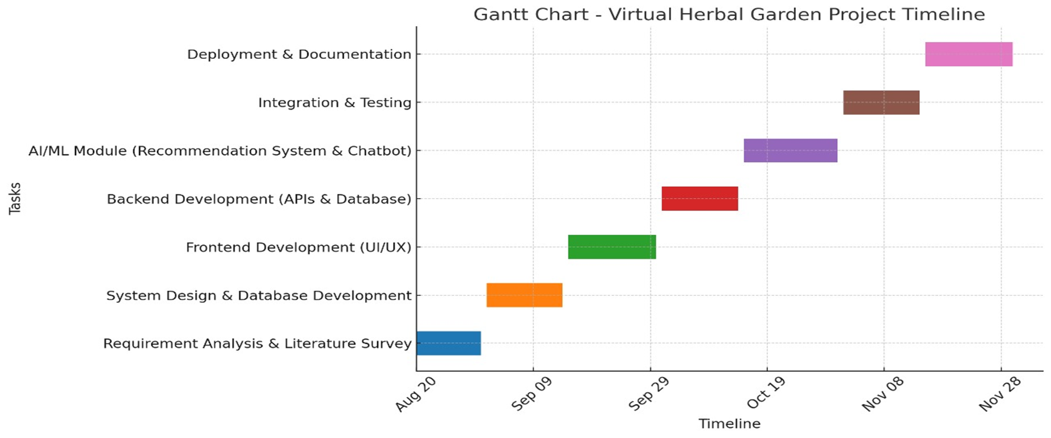
Timeline (Gantt Chart)

Slide 22
References
REFERENCE BOOKS
The book Gallery of Medicinal Plants (Dravyaguna Vigyan) was authored by Monika Sharma and Subash Sahu in 2022, published by Chaukhambha, and it can be accessed on Google Books.
The World Herbal Encyclopedia (WHE) was prepared under the guidance of Acharya Balkrishna at the Patanjali Research Foundation in Haridwar around 2023, and more details are available on the Patanjali Research Foundation website.
The article ARVeda: AI and augmented reality based herbal knowledge preservation was authored by P. Panche, A. Patil, and S. Kharade and published in the International Journal of Advanced Computer Engineering; it can be found here.
The paper Herb Quest: Digital Vault of Medicinal Plants used in AYUSH was written by M. Prabu, R. Kumar, and A. Sharma, published in the IvySci Journal of Innovative Research in 2025, and is available through iManager Publications.
The study Traditional herbal knowledge in Urgam Valley, Uttarakhand: An ethnobotanical study was authored by R. Singh, D. Rawat, and M. Joshi, and published in the Journal of Ethnobiology and Ethnomedicine; a closely related version of this work can be accessed here.

Slide 23
References
REFERENCE WEBSITES
Government of India, “Traditional Knowledge Digital Library (TKDL),” [Online]. Available: https://share.google/HoyCCmKZCRoHYfiya.
AYUSH Research Portal, Ministry of AYUSH, Govt. of India, [Online]. Available: https://dx.doi.org/10.48175/ijarsct-23945.
Engineers Planet, “Virtual Herbal Garden for AYUSH – Project Abstract,” [Online]. Available: https://engineersplanet.com/abstracts/virtual-herbal-garden-for-ayush.
Devfolio, “Virtual Herbal Garden Project,” [Online]. Available: https://devfolio.co/projects/virtual-herbal-garden-510e.
Abarajitha et al., “AYUSH–SIH Project: Interactive Virtual Herbal Garden,” GitHub Repository, 2023. [Online]. Available: https://github.com/Abarajitha123/AYUSH--SIH-Project.

Slide 24


