Slide 1
Virtual Herbal Garden
CSE7101- Capstone Project
Review-1
Batch Number: PSCS_433
Under the Supervision of,
Mr. Arunkumar K. Bhavikatti
Assistant Professor
School of Computer Science and Engineering
Presidency University
Roll Number | Student Name
20221CIT0124 20221CIT0126 20221CIT0130 | Saishree N Shreya A J Nithya H D
Name of the Program: Computer Science Engineering (Internet of things)
Name of the HoD: Dr. Anandaraj S.P
Name of the Program Project Coordinator: Dr. Sharmasth Vali
Name of the School Project Coordinators: Dr. Sampath A K , Dr. Geetha A

Slide 2
Problem Statement Number: PSCS_433
Organization: Presidency University
Category (Hardware / Software / Both) :Software
Problem Description:
To develop a technical solution for providing digital access to AYUSH medicinal
plant knowledge, enabling students and users from any location to explore and
learn traditionally preserved herbal information which is currently limited to
physical gardens and local institutions.

Slide 3
Content:
Problem Statement
Objectives
Background and Related work for title Selection
Analysis of Problem Statement
Innovation or Novel Contributions
Git-hub Link
Timeline of the Project
References

Slide 4
Problem Statement:
The AYUSH sector relies heavily on medicinal plants and herbs, which form the backbone of traditional healing practices. However, physical gardens that are not accessible to everyone. A Virtual Herbal Garden will bridge this gap by offering a digital platform where users can explore, learn, and understand the significance of various medicinal plants from the comfort of their homes.
This platform should make the knowledge of medicinal plants accessible to a wider audience, promoting awareness and understanding of traditional herbal practices.
Expected Outcome: The expected outcome is a comprehensive Virtual Herbal Garden that serves as a valuable educational tool for students, practitioners, and enthusiasts of the AYUSH sector.

Slide 5
OBJECTIVES:
To develop an interactive web-based platform that showcases medicinal plants used in AYUSH systems.
To provide detailed information about each plant, including botanical details, medicinal uses and cultivation practices.
To enhance learning through 3D models, multimedia content and guided virtual tours.
To enable users to easily search, filter, bookmark and explore plants in an engaging and user-friendly manner.

Slide 6
Analysis of Problem Statement:
Technology Stack Components:
Frontend:
React.js – Component-based UI development
HTML5 & CSS3 – Structure and styling of the user interface
UI/UX Tools (Figma / Adobe XD) – For designing interactive and user-friendly screens
Backend:
Node.js – Server-side runtime environment
Express.js – Web framework for building RESTful APIs and handling requests
Database:
MongoDB Atlas (Cloud) – NoSQL database to store plant information, multimedia paths, user bookmarks, and tour content

Slide 7
Analysis of Problem Statement (contd...)
Software and Hardware Requirements:
1. Software Requirements
  Frontend:
  – Frameworks/Languages: React.js, HTML5, CSS3, JavaScript
  – UI/UX Tools: Figma / Adobe XD (for designing interfaces)
  Backend:
  – Programming Language / Runtime: Node.js
  – Framework: Express.js
  – API Security: JWT, HTTPS (SSL/TLS)
  Database:
  – Cloud NoSQL Database: MongoDB Atlas
  Tools / DevOps:
  – Version Control: Git, GitHub
  – API Testing: Postman
  – Deployment Platforms: Netlify (Frontend), Render / Railway / Heroku (Backend)

Slide 8
Analysis of Problem Statement (contd...)
2. Hardware Requirements
Development Machine:
– Processor: Intel i3 / Ryzen 3 or higher
– RAM: Minimum 8 GB (recommended 16 GB for 3D assets)
– Storage: Minimum 50 GB free (SSD preferred)
– Internet: Stable connection for cloud DB and deployment access
End Users:
– Desktop / Laptop / Smartphone
– Modern web browser (Chrome / Edge)
– Internet connection to access the virtual garden web application

Slide 9
Github Link:
The Github link provided should have public access permission.
Github Link
https://github.com/virtualherbalgarden4-bot/virtual-herbal-garden

Slide 10
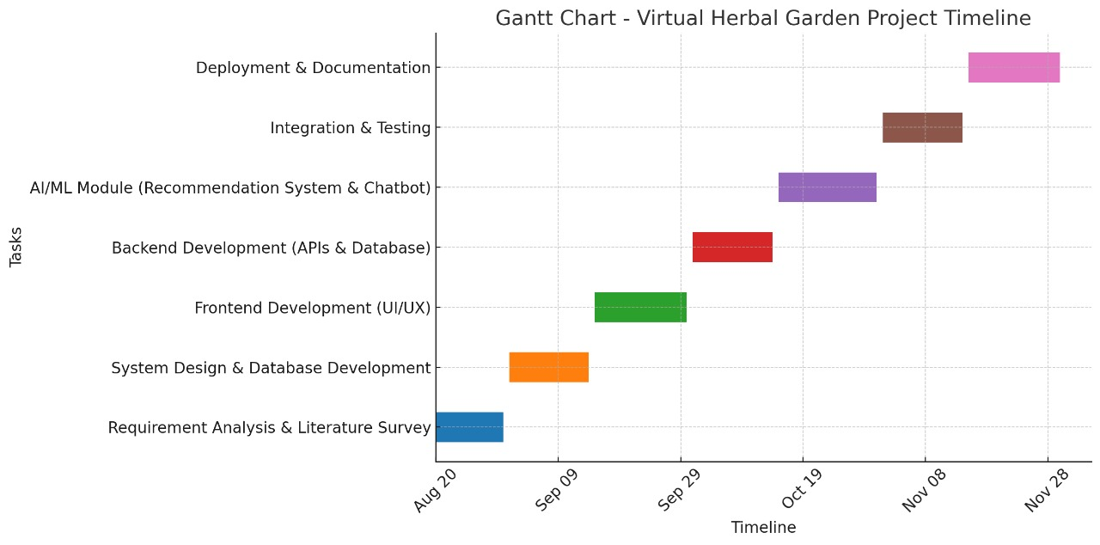
Timeline of the Project (Gantt Chart):

Slide 11
References (IEEE Paper format)
  [1]. A. Kumar, B. R. Patel, and C. Zhang, “Plant disease identification using convolutional neural networks,” IEEE Access, vol. 9, pp. 34567–34578, Mar. 2021.
  [2]. J. Smith, “Deep learning in agricultural systems,” IEEE Transactions on Neural Networks and Learning Systems, vol. 32, no. 7, pp. 1234–1245, Jul. 2021.

Slide 12


