Slide 1
Conversational Image Recognition Chatbot
CSE7101- Capstone Project
Review-2
Batch Number: CSG_4
Under the Supervision of,
Mr. Arunkumar K. Bhavikatti
Assistant Professor
School of Computer Science and Engineering
Presidency University
Roll Number | Student Name
20221CIT0124 | SAISHREE N
20221CIT0126 | SHREYA A J
20221CIT0130 | NITHYA H D
Name of the Program: : Computer Science Engineering (Internet of things)
Name of the HoD: Dr. Anandaraj S.P
Name of the Program Project Coordinator: Dr. Sharmasth Vali
Name of the School Project Coordinators: Dr. Sampath A K , Dr. Geetha A

Slide 2
Content
Abstract
Literature Survey
Objectives
Existing Methods and Drawbacks
Proposed Method & Feasibility Study
Architecture Diagram
Modules
Hardware and Software Details
Github Link
Timeline (Gantt Chart)
References

Slide 3
Abstract
Virtual Herbal Garden is a web-based project designed to create an interactive and educational platform showcasing medicinal plants from AYUSH systems (Ayurveda, Yoga & Naturopathy, Unani, Siddha, Homeopathy).
Built with a React frontend, Node.js backend, and MongoDB Atlas database, it offers features like plant search, categorization, image-based identification, and AR/3D visualization.
The project bridges traditional knowledge with digital tools, raising awareness, accessibility, and conservation of medicinal plants, while providing scope for future integration in healthcare education.

Slide 4
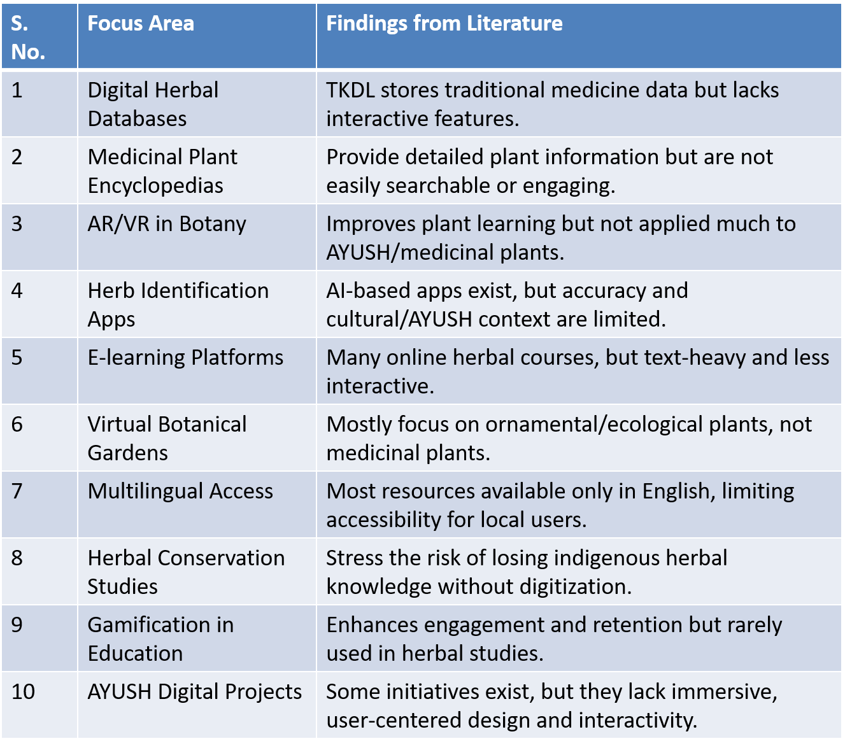
Literature Survey

Slide 5
Objectives
Build an interactive Virtual Herbal Garden showcasing medicinal plants from AYUSH systems (Ayurveda, Yoga, Unani, Siddha, Homeopathy).
Provide plant search & filtering by medicinal use, region, and system of medicine.
Integrate multimedia elements (images, videos, 3D/AR models) for immersive learning.
Support user-friendly accessibility with multilingual content (English + Indian languages).
Deploy a scalable, web-based system using React (frontend), Node.js/Express (backend), and MongoDB Atlas (database).
Enhance user engagement with quizzes, guided tours, and interactive plant identification.

Slide 6
Existing Methods and Drawbacks
Traditional Herbal Gardens (Physical)
✅ Preserve plant biodiversity
❌ Limited reach, not interactive or accessible remotely
Digital Herbal Databases (IMPPAT, NMPB)
✅ Provide structured medicinal plant information
❌ Text-heavy, lack interactive features or visualization
Plant Identification Apps (PlantSnap, LeafSnap)
✅ Image recognition for plants
❌ General use, not AYUSH/medicinal plant-specific
AR/VR Educational Tools
✅ Immersive plant exploration
❌ Limited datasets, often commercial/non-medical focus
Gap Identified
❌ Few integrated systems combining AYUSH knowledge + interactive multimedia + accessibility.

Slide 7
Proposed Method & Feasibility Study
Proposed Method
Build a website to showcase medicinal plants with details, images, and search/filter options.
Provide multilingual support and easy navigation.
Justification
Makes herbal knowledge accessible and engaging.
Helps students, researchers, and the public learn easily.
Feasibility
Uses MERN stack (open-source, low cost).
Needs only basic cloud hosting, no heavy resources.

Slide 8
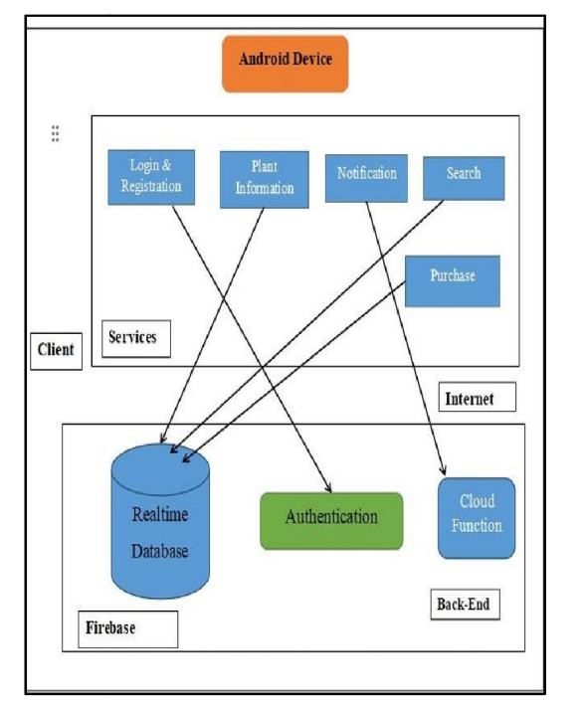
Architecture Diagram

Slide 9
Modules
Module | Functionality
User Module | User login, registration, profile management, and personalized plant bookmarks..
Frontend Module (React) | Interactive UI, plant visualization, search/filter, and 3D/AR view integration.
Backend Module (Node.js + Express.js) | Handles APIs, authentication, CRUD operations for plant data.
Database Module (MongoDB Atlas) | Stores plant details, images, multimedia, and user data.
Search & Filter Module | Allows filtering by medicinal use, plant type, or region.

Slide 10
Hardware and Software Details
Area | Technology / Tools | Purpose / Role
Frontend | React.js, HTML, CSS | Build responsive UI, plant models, and interactive visuals.
Backend | Node.js, Express.js | API creation, server logic, and handling database queries.
Database | MongoDB Atlas (Cloud DB) | Persistent storage of plant information, images, and user details.
Hardware | Basic server/PC with internet | Suitable for hosting frontend/backend; no high GPU required.

Slide 11
Github Link
The Github link provided should have public access permission.
Github Link
https://github.com/virtualherbalgarden4-bot/virtual-herbal-garden

Slide 12
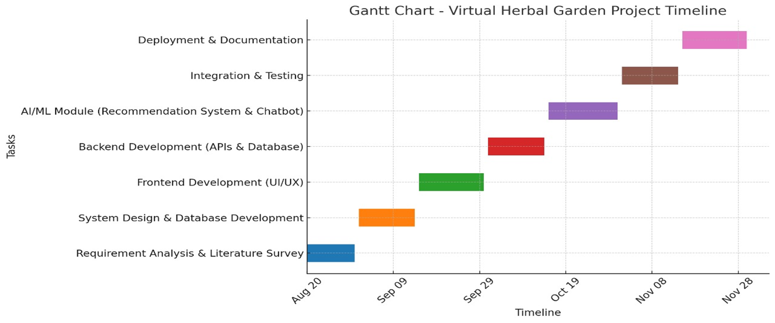
Timeline (Gantt Chart)

Slide 13
References
M. Sharma and S. Sahu, Gallery of Medicinal Plants (Dravyaguna Vigyan), Delhi: Chaukhambha, 2022.
A. Balkrishna, World Herbal Encyclopedia (WHE), Patanjali Research Foundation, Haridwar, 2023.
P. Panche, A. Patil, and S. Kharade, “ARVeda: AI and augmented reality based herbal knowledge preservation,” Int. J. Adv. Comput. Eng.
M. Prabu, R. Kumar, and A. Sharma, “Herb Quest: Digital vault of medicinal plants used in AYUSH,” IvySci Journal of Innovative Research.
R. Singh, D. Rawat, and M. Joshi, “Traditional herbal knowledge in Urgam Valley, Uttarakhand: An ethnobotanical study,” J. Ethnobiol. Ethnomed.

Slide 14
References
Government of India, “Traditional Knowledge Digital Library (TKDL),” [Online]. Available: https://share.google/HoyCCmKZCRoHYfiya.
AYUSH Research Portal, Ministry of AYUSH, Govt. of India, [Online]. Available: https://dx.doi.org/10.48175/ijarsct-23945.
Engineers Planet, “Virtual Herbal Garden for AYUSH – Project Abstract,” [Online]. Available: https://engineersplanet.com/abstracts/virtual-herbal-garden-for-ayush.
Devfolio, “Virtual Herbal Garden Project,” [Online]. Available: https://devfolio.co/projects/virtual-herbal-garden-510e.
Abarajitha et al., “AYUSH–SIH Project: Interactive Virtual Herbal Garden,” GitHub Repository, 2023. [Online]. Available: https://github.com/Abarajitha123/AYUSH--SIH-Project.

Slide 15


