Slide 1
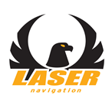
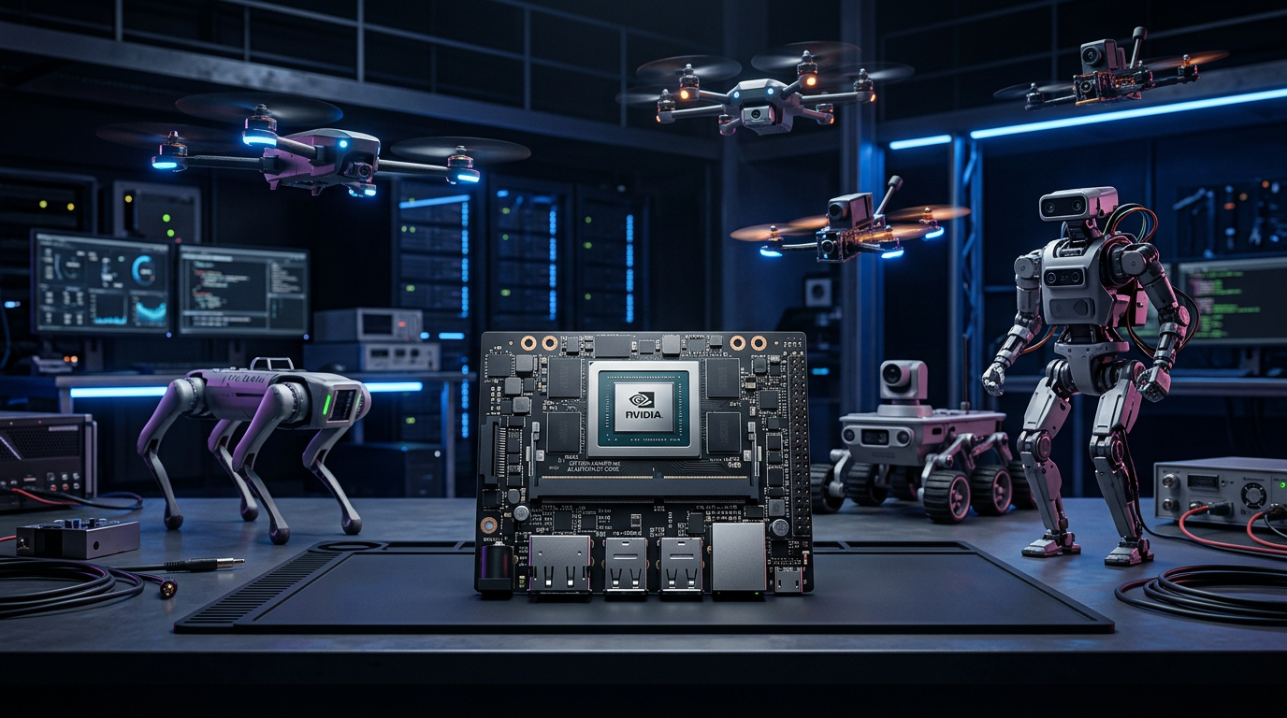
UNIVERSAL NEURO-ADAPTIVE
AI AUTOPILOT
A universal autopilot architecture for heterogeneous
vehicles and robots, with an embedded neural
inference module and a learned actuation policy
Roberto Navoni
Patent Pending — Application No. 102026000009919 — Filing 2026
Laser Navigation S.R.L.

Slide 2
What the patent covers
The patent describes an embedded universal neuro-adaptive autopilot, able to control any vehicle or robot — drones, rovers, bipeds, quadrupeds, ROVs, robot arms — with a single hardware platform and a neural policy learned through Reinforcement Learning.
The neural network replaces the traditional static mixer matrix, removing manual tuning of dozens of PID parameters and the need for dedicated firmware for every platform.
The system includes an embedded GPU/NPU/TPU module with at least 4 TOPS INT8 and 4 GB of LPDDR5 memory, a hybrid Safety Supervisor with deterministic PID fallback, and a modular multi-module architecture interconnected over a bidirectional CAN bus.
Laser Navigation S.R.L. — Via Matteotti 34, 24054 Calcio (BG) — Italia

Slide 3
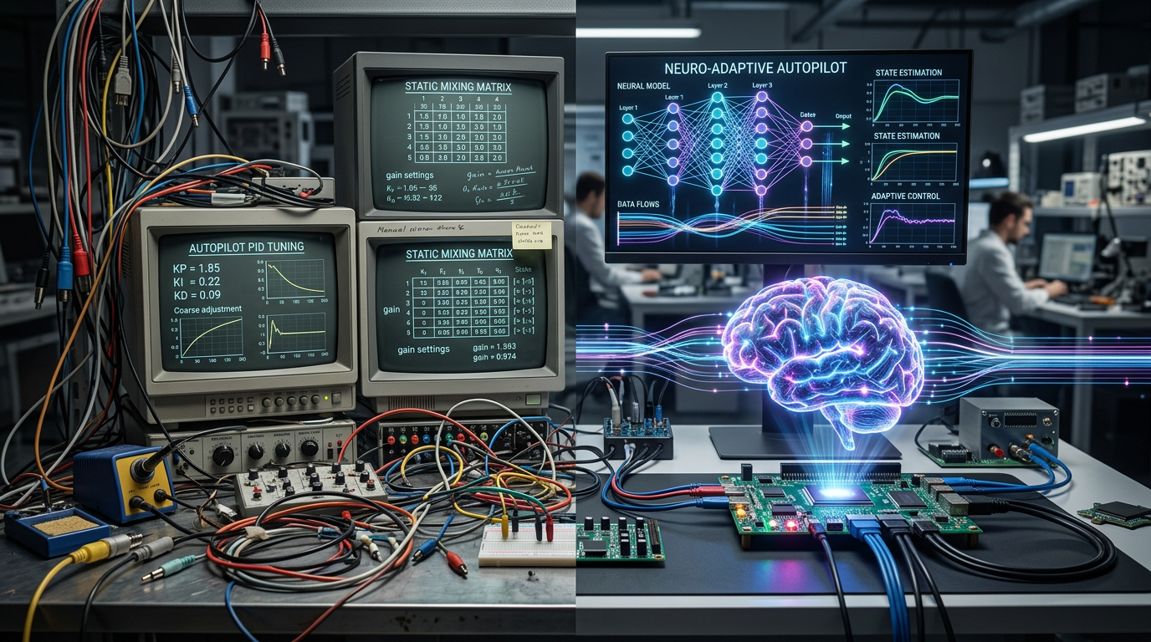
The problem: limits of the classical autopilot
Traditional autopilots use a static mixer matrix: a fixed mapping from control commands onto actuators. That matrix is specific to each robot geometry and requires manual tuning of 40+ PID parameters per platform.
Every new robot needs dedicated firmware and explicit inverse kinematics for articulated machines. There is no adaptation to faults, wind, wear or payload changes.
Operational data collected in the field is not used to improve performance. The result is a rigid, expensive, non-scalable approach.
Laser Navigation S.R.L. — Via Matteotti 34, 24054 Calcio (BG) — Italia

Slide 4
The solution: a neuro-adaptive autopilot
Learned neural policy · Universal · Modular · Safe

Slide 5
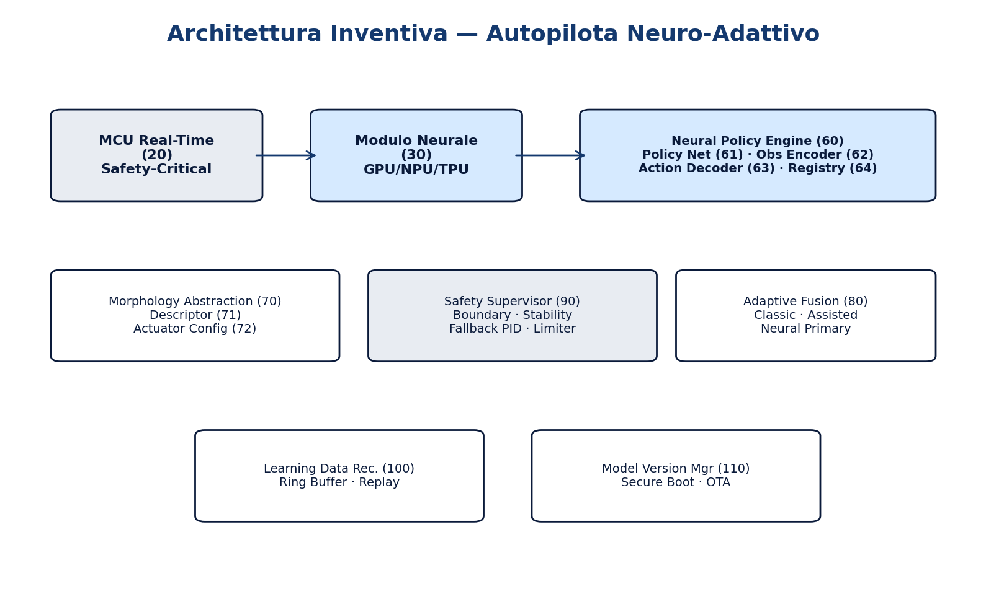
Hybrid hardware architecture
Safety-critical MCU (20): dual-core real-time processor running FreeRTOS, a deterministic Safety Supervisor, PID fallback, hardware watchdog and actuator I/O.
Embedded neural module (30): GPU/NPU/TPU with at least 4 TOPS INT8, 4 GB LPDDR5, secure storage for signed neural policies, and an optimized inference runtime.
Interconnect bus (140): PCIe 4.0, SPI, DMA shared memory and CAN FD for minimum-latency traffic between MCU and neural module. Sensor Interface (40) and Actuation Interface (50) for IMU, GNSS RTK, barometer, optical flow, encoders and force/torque.
Laser Navigation S.R.L. — Via Matteotti 34, 24054 Calcio (BG) — Italia

Slide 6
Neural Policy Engine (60)
▸ Control Policy Network (61)
▸ Observation Encoder (62)
INT8-quantized neural network (MLP, CNN+LSTM, GRU, Transformer) that produces commands for N actuators. It replaces the static mixer matrix with a learned non-linear policy.
Builds the observation vector: inertial state, navigation (position, velocity, heading), actuator state, a history of at least 5 issued commands with positions, feedback, targets and tracking errors, operational context and morphological info.
▸ Action Decoder (63)
▸ Policy Registry (64)
Maps network output onto physical actuator channels: saturation, format conversion (PWM, DShot, CAN/UAVCAN, I2C, UART, SPI, GPIO) and limit validation.
Library of pre-trained policies, one per morphological class. Automatic selection from the identified robot. Hot-swap of the policy with no system reboot.
Laser Navigation S.R.L. — Via Matteotti 34, 24054 Calcio (BG) — Italia

Slide 7
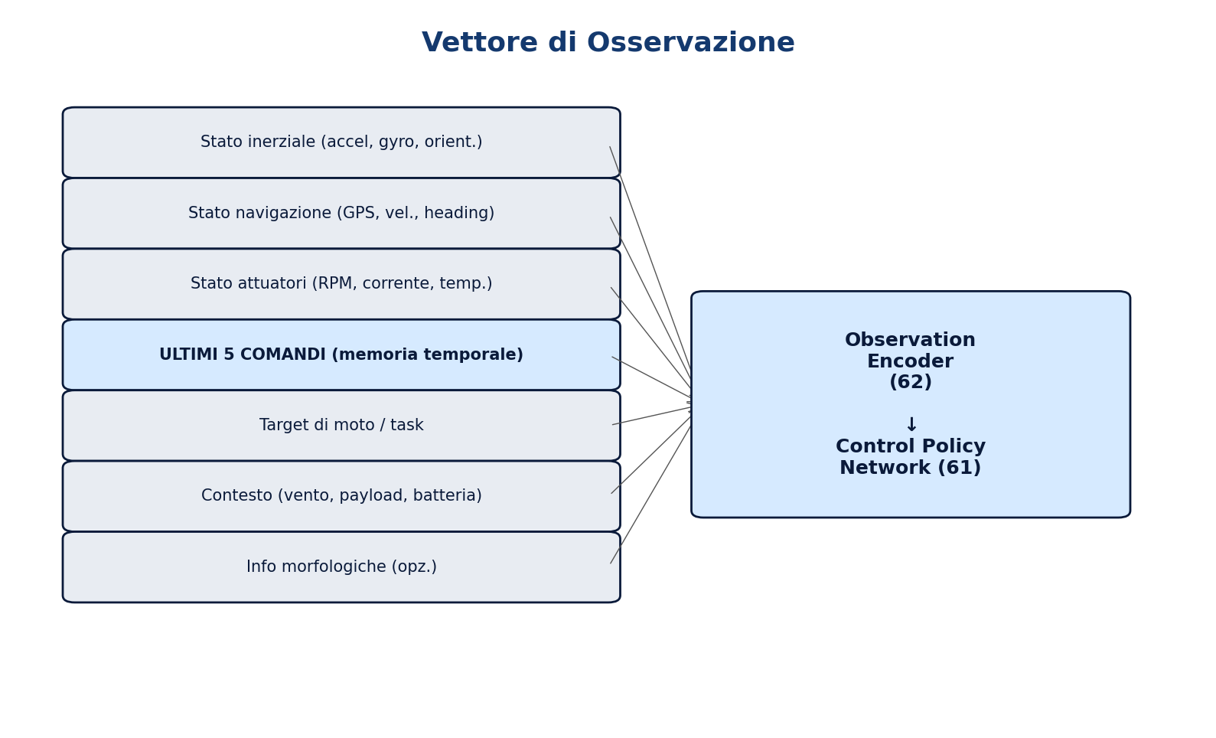
Observation vector: network input
▸ Inertial state: 3-axis accelerations, gyros, orientation quaternions, vibration indicators
▸ Navigation state: position, velocity, heading, trajectory error (from Neural State Estimator 160)
▸ Actuator state: RPM, current, temperature, torque, fault flags per actuator
▸ History of at least 5 issued commands: actuator positions, forwarded commands, associated feedback, motion targets, tracking errors — short-term dynamic memory
▸ Motion targets: 6DoF, trajectory, balance, manipulation
▸ Context: estimated wind, terrain, payload, battery, temperature
▸ Optional morphological information for cross-robot transfer
Laser Navigation S.R.L. — Via Matteotti 34, 24054 Calcio (BG) — Italia

Slide 8

Modular multi-module architecture
Bidirectional CAN bus (200) · Power bus (210) · Shared real-time state

Slide 9
Inter-module modular architecture
The autopilot system may comprise several autopilot modules interconnected by a bidirectional communication bus (200), CAN or equivalent, and a power bus (210) for energy distribution.
Each module shares its internal states in real time (observation vector, network outputs, actuator state, diagnostics) with every other module on the bus.
This architecture enables complex multi-segment robots: a quadruped with a manipulator arm can use one autopilot module for locomotion and a second for manipulation, coordinated through shared state.
Laser Navigation S.R.L. — Via Matteotti 34, 24054 Calcio (BG) — Italia

Slide 10
Four operating modes — Adaptive Control Fusion (80)
▸ 1. Classic Only (81)
▸ 2. Neural Assisted (82)
EKF → PID → static mixer matrix. Active at boot, in fallback, or when the neural module is unavailable.
The network suggests corrections, adapts PID gains dynamically, improves the EKF estimate and optimizes actuator allocation.
▸ 3. Neural Primary (83)
▸ 4. Policy Switching (84)
The network generates actuation commands directly. The Safety Supervisor checks them in real time. Classical PID as fallback.
Identifies the robot morphology and loads the matching policy from the Policy Registry (64). Cross-platform universality.
Laser Navigation S.R.L. — Via Matteotti 34, 24054 Calcio (BG) — Italia

Slide 11
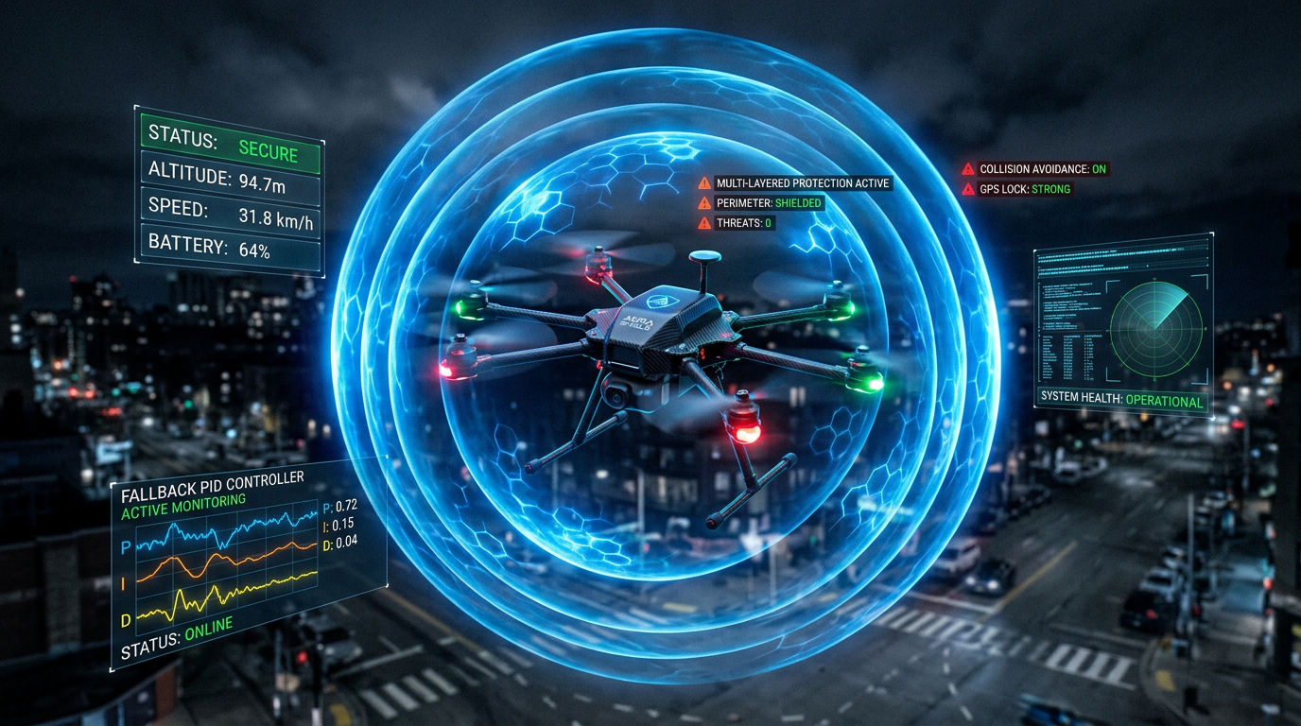
Safety Supervisor (90) — hybrid safety
▸ Boundary Checker (91): physical limits, flight envelope, geofence, joint limits
▸ Stability Predictor (92): 50 ms look-ahead of future state, detection of imminent instability
▸ PID Fallback Controller (93): always ready for instant takeover, executed on the real-time MCU
▸ Consensus Validator (94): neural vs classical comparison, majority vote on diverging outputs
▸ Output Limiter (95): rate limiting and final saturation
▸ Anomaly Detector (180): anomalies on sensor data and behaviour patterns
The Safety Supervisor is deterministic, runs on the MCU (20), and engages on faults, timeouts and sensor degradation.
Laser Navigation S.R.L. — Via Matteotti 34, 24054 Calcio (BG) — Italia

Slide 12
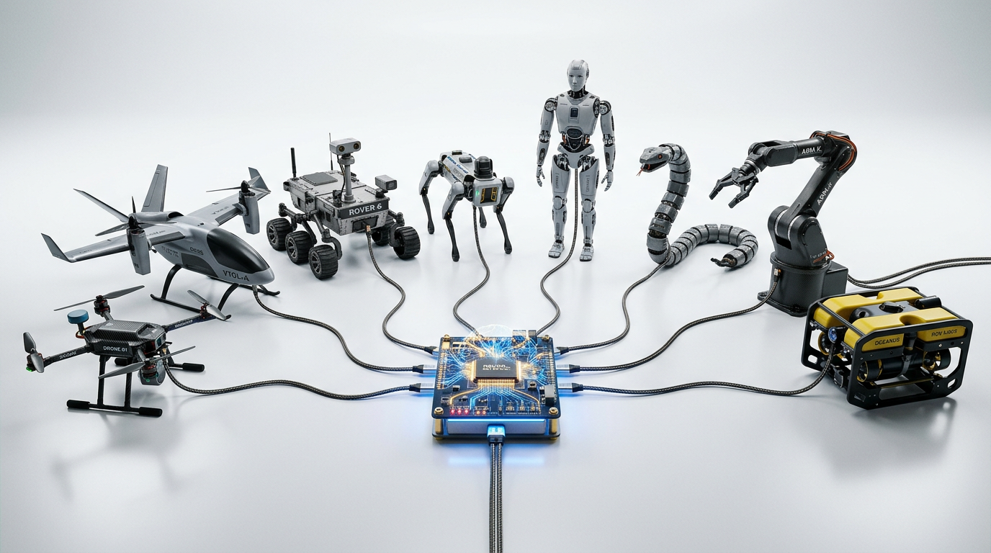
Inverse-kinematics bypass
On articulated robots (bipeds, quadrupeds, arms) a classical autopilot needs an explicit inverse-kinematics module: a complex mathematical transform from desired trajectories into joint commands.
With a learned neural policy the network maps observations to joint commands directly during simulation training. Inverse kinematics is encoded implicitly in the network weights.
Benefit: balance, locomotion, manipulation and gait are learned end-to-end, without explicit geometric algorithms. The system adapts automatically to uneven terrain, asymmetric payloads and joint wear.
Laser Navigation S.R.L. — Via Matteotti 34, 24054 Calcio (BG) — Italia

Slide 13
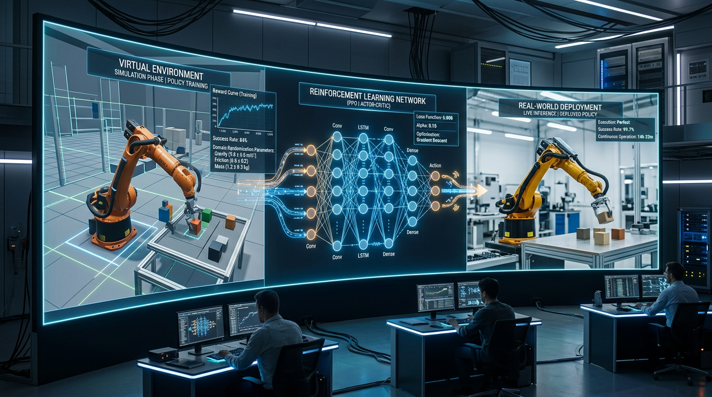
Training and continuous improvement
Simulation · Reinforcement Learning · Domain Randomization · OTA

Slide 14
RL training pipeline
Neural policies are trained entirely in simulation with Reinforcement Learning algorithms (PPO, SAC, TD3 or equivalent), in environments such as Isaac Gym or Gazebo.
Domain randomization: mass, inertia, friction, wind, delays, faults and sensor noise are randomized so the policy is robust in the real world (sim-to-real transfer).
Pipeline: training → automatic validation → cryptographic signature → OTA deploy onto the neural module (30). Real operational data is logged (Data Manager 100) and reused for replay and continuous retraining.
Communication Layer (120): RC, WiFi, LoRa, LTE/5G, Ethernet, with ECC links and cloud sync for distributed fleet learning.
Laser Navigation S.R.L. — Via Matteotti 34, 24054 Calcio (BG) — Italia

Slide 15
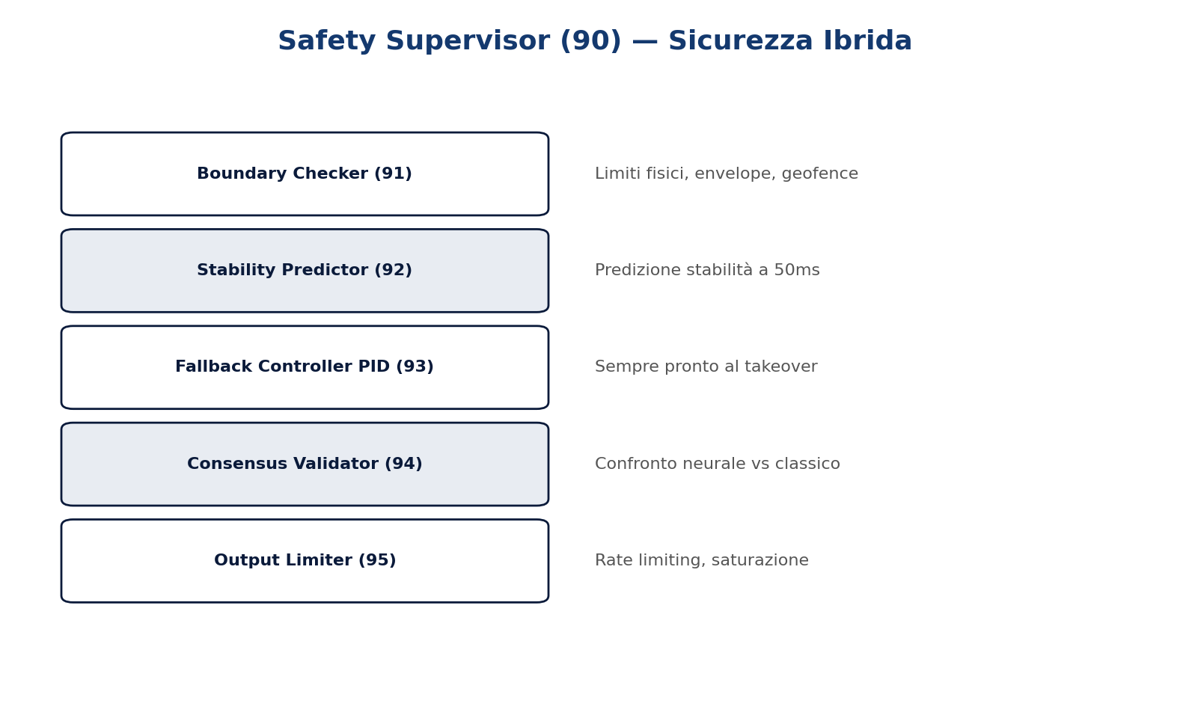
Neural State Estimator (160) and Anomaly Detector (180)
The Neural State Estimator (160) is an auxiliary network that improves inertial and navigational state estimation: it learns to fuse sensors more robustly than a classical EKF, estimating biases and latent states.
It supplies the main network with a navigation state covering position, velocity and heading at higher accuracy, especially in GNSS-denied conditions.
The Anomaly Detector (180) continuously monitors sensor and behaviour patterns, detecting sensor faults, abnormal vibration or actuation degradation, and informs the Safety Supervisor (90).
Laser Navigation S.R.L. — Via Matteotti 34, 24054 Calcio (BG) — Italia

Slide 16
Morphological abstraction: one platform, every robot
The same hardware and the same software architecture control any robot: quadrotor, hexacopter, VTOL, rover, boat, underwater ROV, humanoid biped, quadruped, snake-like robot, industrial arm, and hybrid configurations.
The Policy Registry (64) holds a library of pre-trained policies, one per morphological class. At start-up or in operation the system identifies the morphology (hardware descriptor or automatic identification) and loads the matching policy with a hot-swap and no reboot. This universality cuts development cost sharply.
Laser Navigation S.R.L. — Via Matteotti 34, 24054 Calcio (BG) — Italia

Slide 17
Neural-network output modes
▸ A — Direct Actuation
Direct PWM/DShot commands, duty cycle, thrust, servo/joint setpoints
▸ B — Intermediate Control
Pseudo-forces/torques, intermediate commands, adaptive actuator allocation
▸ C — Adaptive PID
Predicted Kp/Ki/Kd per axis, dynamic gain scheduling, context reaction
▸ D — State Estimation
EKF correction, bias estimate, latent-state prediction, partial replacement
▸ E — Fault-aware
Fault reconfiguration, command redistribution, graceful degradation
▸ F — Hybrid Mode
Weighted mix of neural and classical outputs according to confidence
Laser Navigation S.R.L. — Via Matteotti 34, 24054 Calcio (BG) — Italia

Slide 18
Competitive advantages
▸ Cross-morphology universality
The same hardware controls drones, rovers, bipeds, robot arms and any robot
▸ No static mixer
The learned neural policy replaces the mixer matrix and removes manual tuning
▸ Adaptive and fault-tolerant
Adapts to faults, wind, wear and variable payload; automatic graceful degradation
▸ Hybrid safety
Deterministic Safety Supervisor on the MCU with PID fallback always armed
▸ Modular architecture
Multi-module interconnection over CAN bus (200) and power bus (210)
▸ Continuous improvement
Logging → Replay → Retraining → OTA: real data improves performance
▸ No explicit inverse kinematics
The network learns balance, locomotion and manipulation end-to-end
Laser Navigation S.R.L. — Via Matteotti 34, 24054 Calcio (BG) — Italia

Slide 19
Foundational prior art — Cogito patent
▸ IT 102018000009442 / EP 3867841 B1 — Cogito
System for controlling and managing an environmental process using artificial-intelligence techniques → Foundation for the Safety Supervisor, Anomaly Detector, Neural State Estimator, Digital Twin and AI orchestration
Laser Navigation S.R.L. — Via Matteotti 34, 24054 Calcio (BG) — Italia

Slide 20
Industrial applications and scenarios
▸ Drones: flight, surveillance, delivery, inspection, agriculture
▸ Quadruped and biped robots: autonomous locomotion, manipulation, adaptive balance
▸ Ground and marine rovers: off-road navigation, exploration, transport
▸ Underwater ROVs: seabed inspection, offshore maintenance
▸ Industrial robot arms: adaptive manipulation, assembly, welding
▸ VTOL and aircraft: learned hover-to-cruise transition
▸ Hybrid multi-module setups: quadruped+arm, rover+manipulator, complex humanoid
▸ Fleet learning: distributed improvement across fleets
Laser Navigation S.R.L. — Via Matteotti 34, 24054 Calcio (BG) — Italia

Slide 21
IN SUMMARY
An embedded universal neuro-adaptive autopilot: a single hardware platform controls drones, rovers, bipeds, quadrupeds, robot arms, ROVs and any morphology, replacing the static mixer matrix and manual tuning with a neural policy learned through Reinforcement Learning.
Modular multi-module architecture interconnected by a bidirectional CAN bus (200) and a power bus (210), with real-time shared state. Hybrid deterministic Safety Supervisor with PID fallback, Policy Registry for hot-swap without reboot, inverse-kinematics bypass, and continuous OTA improvement.
Patent Pending — Application No. 102026000009919 — Filing 2026
Laser Navigation S.R.L. — Via Matteotti 34, 24054 Calcio (BG) — Roberto Navoni

