Slide 1

Assignment 5: Final Project Report
Stanley Tran

Slide 2
Agenda
Problem Setup & Dataset and Data Processing
Task 1
Task 2
Interesting Findings
Comparison of N values for FFNN and LSTM (Task 1 vs Task 2)
Lesson Learned and Personal Insights
Future Improvements

Slide 3
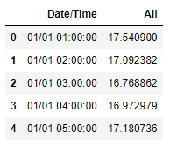
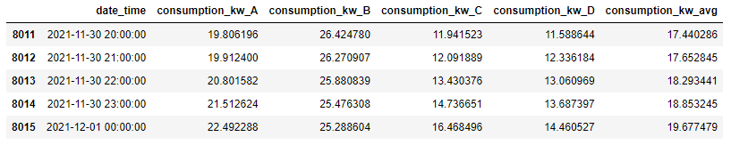
Electric load forecasting Problem setup & dataset and data processing
Aim to investigate short-term load forecasting with low data regime
Task 1: Use two-day data of house A as the training set and December data of house A as the testing set
Task 2: Free to use data sets for house A, B, C and D as the training set and December data of house A as the testing set
Use MAE and MAPE to evaluate model
Before | After

Slide 4
Task 1: Model Architecture
Model | Parameters/Layers | N | MAPE | MAE
Feedforward Neural Network | - Sequential model - Input Layer - Dense (2, ReLu) - Dense (1) - Optimizer = Adam - Loss = MSE - Epoch = 50 | 4 | 1.02044764 | 29.1942868
LSTM | - Sequential model - LSTM (100, ReLu) - Features = 1 - Dense (1) - Optimizer = Adam - Loss = MSE - Epoch = 50 | 4 | 0.1140467 | 2.87331990
Linear Regression | - p = 4 - h = 1 | N/A | 0.06105799 | 1.63641042
Naïve Approach Y(t)=y(t+1) | N/A | N/A | 0.2679398 | 7.8936696
ARIMA | - ARIMA(3,1,2) - Autoregression = 3 - Difference order = 1 - Moving average = 2 | N/A | 0.2606731 | 7.5781299

Slide 5
Task 2: Model Architecture
Use the average consumption KW of house A, B, C and D as the training set
Model | Parameters/Layers | N | MAPE | MAE
Feedforward Neural Network | - Sequential model - Input Layer - Dense (2, ReLu) - Dense (1) - Optimizer = Adam - Loss = MSE - Epoch = 50 | 4 | 0.05249354 | 1.38620784
LSTM | - Sequential model - LSTM (100, ReLu) - Features = 1 - Dense (1) - Optimizer = Adam - Loss = MSE - Epoch = 50 | 4 | 0.0452657 | 1.2042182
Linear Regression | - p = 4 - h = 1 | N/A | 0.03013256 | 0.8075804
Naïve Approach Y(t)=y(t+1) | N/A | N/A | 0.32109527 | 9.8317127
ARIMA | - ARIMA(3,1,2) - Autoregression = 3 - Difference order = 1 - Moving average = 2 | N/A | 0.31071046 | 9.4776781

Slide 6
Interesting Findings

Slide 7
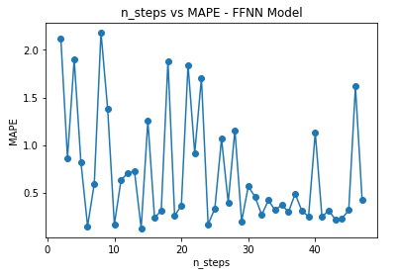
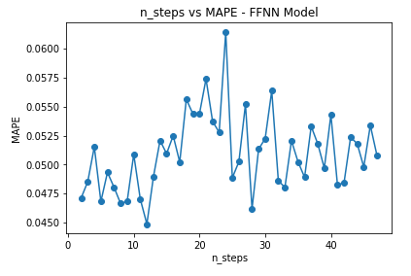
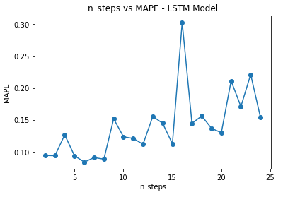
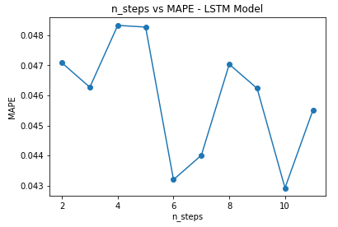
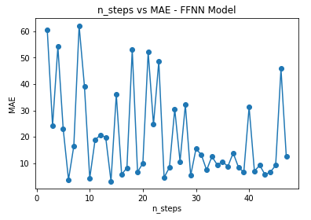
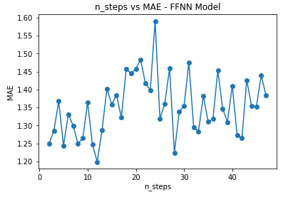
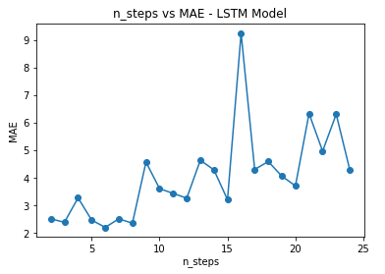
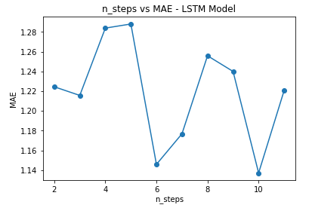
Comparison of N values for FFNN and LSTM (Task 1 vs Task 2)
Feedforward Neural Network model (Task 1) | Feedforward Neural Network model (Task 2) | LSTM model (Task 1) | LSTM model (Task 2)

Slide 8
Lesson Learned and Personal Insights
All the work (choice of architecture/parameters) is very experimental
Deep learning models are not repeatable, not replicable and not reproducible
Results are random and change in every training even though we keep the same parameters
More data helps in improving the results of the models (especially the Deep Learning models)
Statistical models (e.g., Linear models, ARIMA,…) are replicable and reproducible. However, more data doesn’t necessarily mean that it can improve the results of the models

Slide 9
Future improvements
Try another approach instead of using the average values for the training set in task 2
Evaluate and check if the data is meaningful for the predictions (e.g. maybe simply using only House B data to train the models)
Try different algorithms and try more different hyperparameters

