Slide 1

Kubernetes Policy Management with Kyverno
by Stanley Tran
Github: virtualspark/kyverno (github.com)

Slide 2

Agenda
What is Kyverno?
How does Kyverno work?
Kyverno Policy Structure
Demo
References

Slide 3

What is Kyverno?
Policy engine designed specifically for Kubernetes
Allows cluster administrators to manage environment specific configurations independently of workload configurations
Supports validating, mutating and generating any configuration data based on customizable policies
Can be used to scan existing workloads for best practices
Can be used to enforce best practices by blocking or mutating API requests
In other words, solves Kubernetes security management challenges and help secure Kubernetes clusters with policies

Slide 4
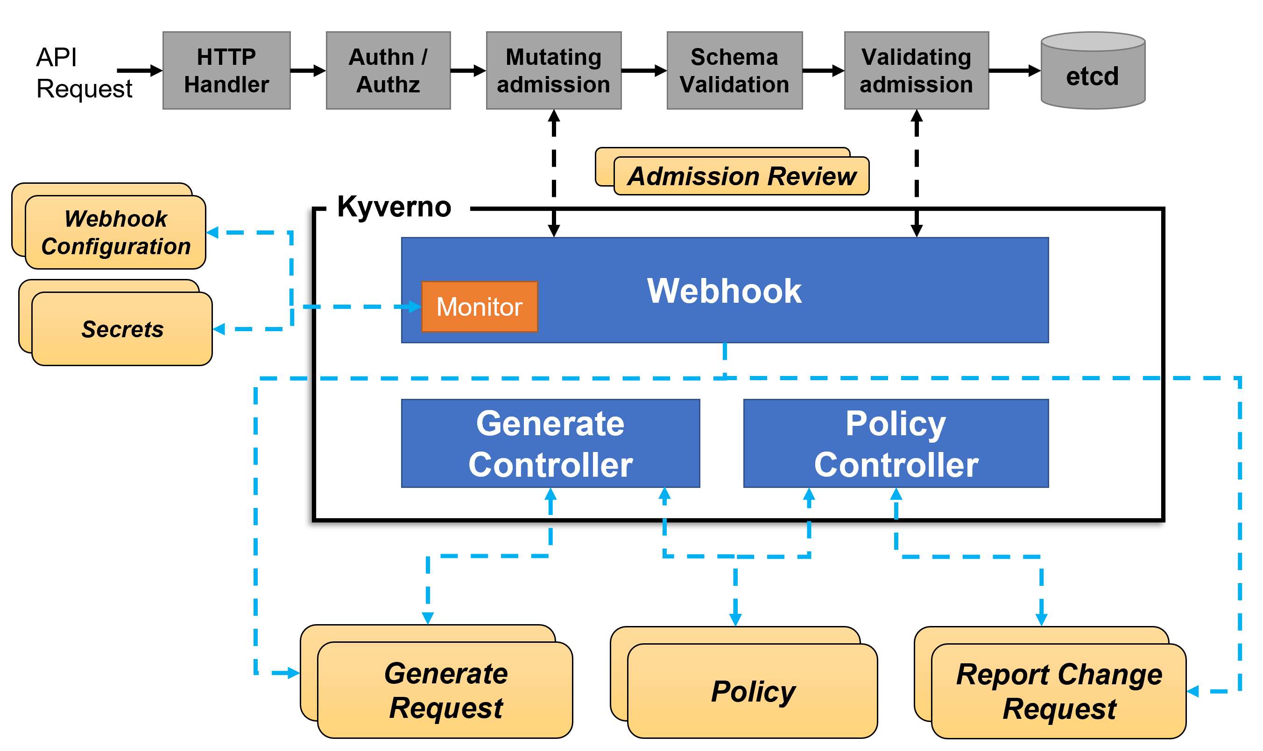
How does Kyverno work?
Runs as a dynamic admission controller in a Kubernetes cluster
Receives validating and mutating admission webhook HTTP callbacks from the kube-apiserver
Applies matching policies to return results that enforce admission policies or reject requests
Webhook handles AdmissionReview requests for Kubernetes API servier
Its Monitor component creates and manages required configurations
PolicyController watches policy resources and initiates background scans based on the configured scan interval
GenerateController manages the lifecyle of generated resources

Slide 5
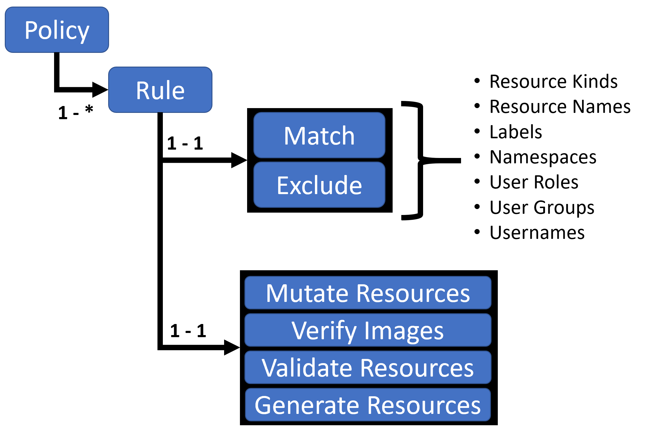
Kyverno Policy Structure
Kyverno policy is a collection of rules
Each rule consists of a match clause, an optional exclude clause, and one of a validate, generate or mutate clause
Examples: Match based on namespaces, labels, or exclude based on roles, usernames and more
Policies can be defined in two levels:
Cluster-wide resources (ClusterPolicy)
Namespaced resources (Policy)
Link: https://kyverno.io/policies/

Slide 6
Demo
Kyverno Installation using Helm
Apply some policies
restrict_image_registries (Restrict Image Registries | Kyverno)
disallow_default_namespace (Disallow Default Namespace | Kyverno)
require_drop_all (Drop All Capabilities | Kyverno)

Slide 7

References
Documentation on Kyverno
https://kyverno.io/docs/
YouTube videos
https://www.youtube.com/watch?v=8fgrjBnxqi0&t=5s
https://www.youtube.com/watch?v=DREjzfTzNpA

