Slide 1
“Simulation of Windmill”
Presented By
Some Aditya Mandal
Under the Guidance of
Prof. NAGASHREE N & Prof. SRINIVASULU
Assistant Professor
DEPARTMENT OF COMPUTER SCIENCE & ENGINEERING
ACHARYA INSTITUTE OF TECHNOLOGY
BENGALURU-107

Slide 2

AGENDA
Abstract
Introduction
Requirements
Design
Implementation
Snapshots
Conclusion
Future Enhancement
Bibliography

Slide 3
ABSTRACT :
In this project we designed the simulation of windmill using OpenGL. We used transformation functions like translate and rotate functions to design blades of the windmill. We used many OpenGL inbuilt function to design the structure of windmill.
This project consist of many user defined function such as increasing windmill fan speed, decreasing windmill fan speed, side views, front and back views, custom angle of rotation of entire windmill structure
It provides several options which can be interacted through menus. The user can also interact with program through mouse, keyboard functions
We can rotate the entire windmill with respect to its axis using the arrow keys of keyboard. It can be rotate through 360⁰.

Slide 4
Introduction :
In this project we designed the simulation of windmill using OpenGL. We used transformation functions like translate and rotate functions to design blades of the windmill. We used many OpenGL inbuilt function to design the structure of windmill.
This project consist of many user defined function such as increasing windmill fan speed, decreasing windmill fan speed, side views, front and back views, custom angle of rotation of entire windmill structure.
It provides several options which can be interacted through menus. The user can also interact with program through mouse, keyboard functions

Slide 5
Cont…
The options provided by the menu are views like side view, back view, front view, custom view. Using mouse, if we click left side it rotates to left and on successive clicking speed increases, if we click right button speed decreases and on successive clicking, it turns rotating towards right and vice versa.
We can rotate the entire windmill with respect to its axis using the arrow keys of keyboard. It can be rotate through 360⁰

Slide 6
Requirements :
Hardware requirements
Processor : Pentium Processor
Processor Speed : 333 MHz
RAM : 32 MB or Higher
Graphics Card : 512MB
Monitor : Color
Keyboard : Low Profile, Dispatchable Type
I/O Parts : Mouse, Monitor
Software requirements
Operating System : Windows 98/XP or Higher
Programming Language : C,C++
Microsoft Visual Studio 2005 or higher: This Software package containing visual basics in c++ language is required.
Toolkit : GLUT Toolkit, VC++

Slide 7
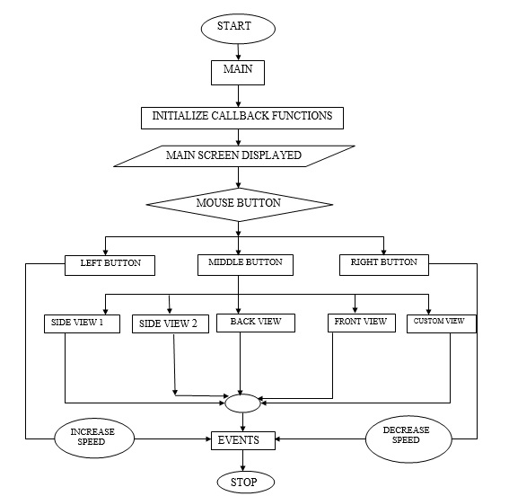
Design :
The Middle Mouse Button displays the menu .
The Left Mouse Button increases the wheel speed
The Right Mouse Button decreases the wheel speed

Slide 8
User defined functions :
The user defined functions used to implement the gaming application are:
Change_view(void)
This function is used to change the view
initialize_menu(void)
This function used to initialize the menu which provides the options such as the back view, front view, custom view.

Slide 9
Cont…
void spin(void)
Used to spin the windmill in any direction
void special (int, int , int )
Used to change the camera angle clockwise and anti-clockwise direction.
Mouse_button(int,int,int)
This function used to assign the mount buttons with their respective functions,

Slide 10
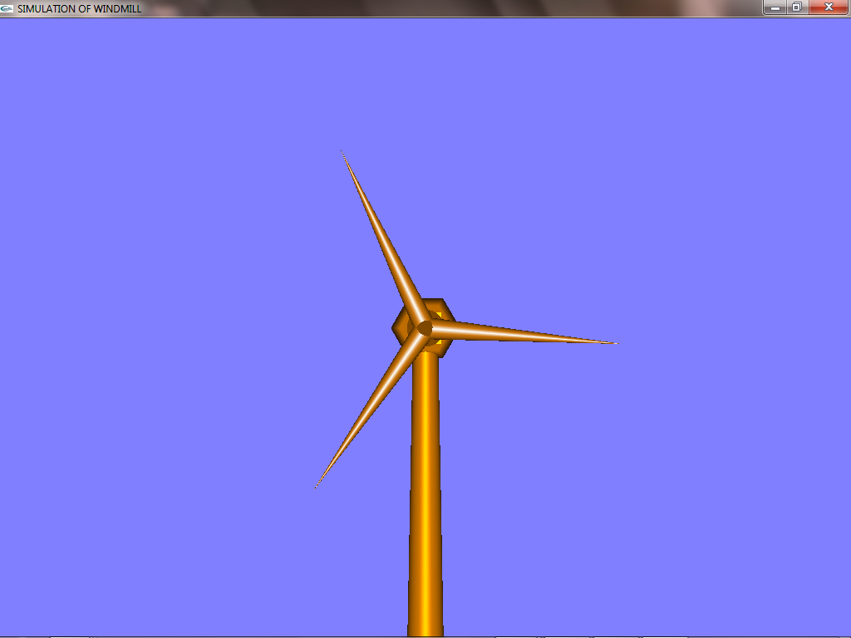
Snapshots :
Initial window to select the menu.

Slide 11
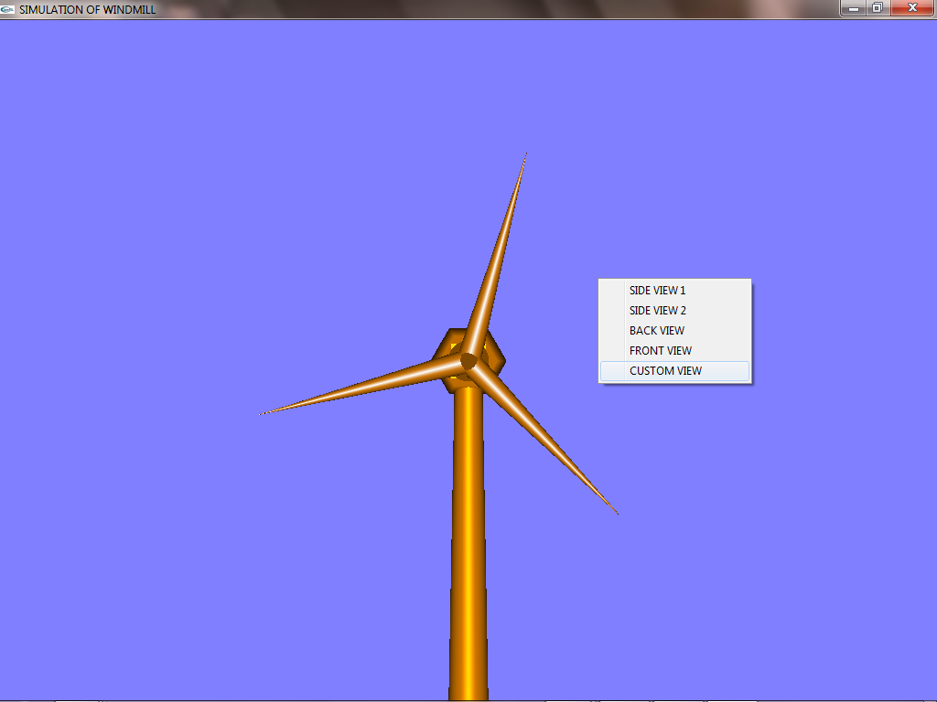
Cont…
Window displaying the Menu on click of Middle Mouse Button

Slide 12
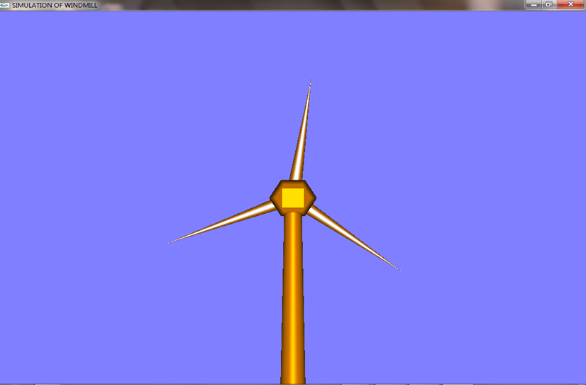
Cont…
Window displaying the Back View

Slide 13
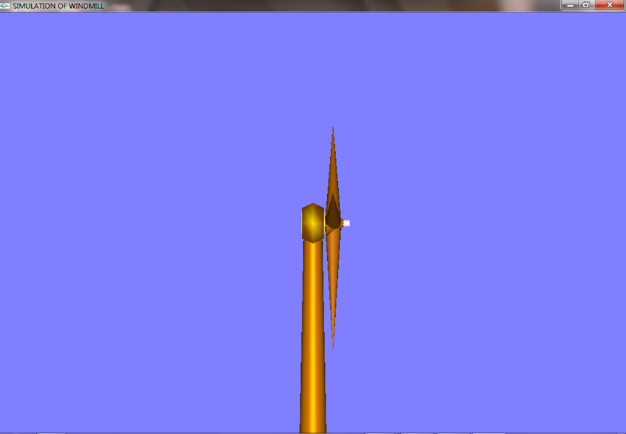
Cont…
Window displaying Side View

Slide 14
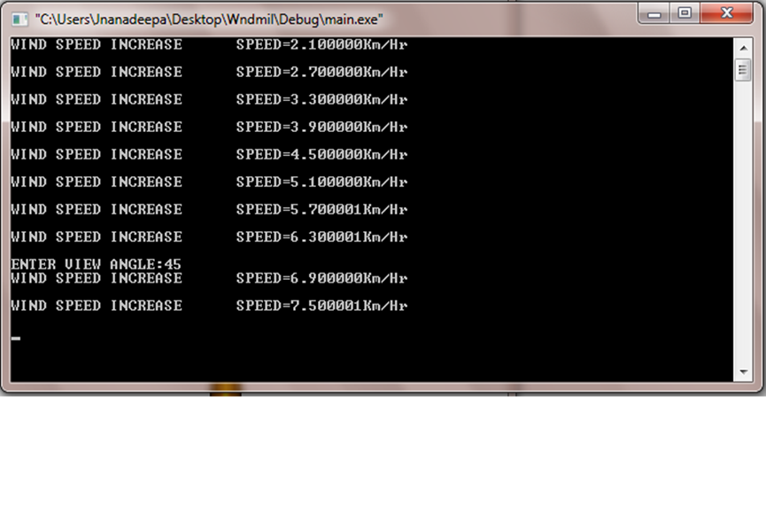
Cont...
Window to display the speed of wheel on click of LMB and RMB

Slide 15
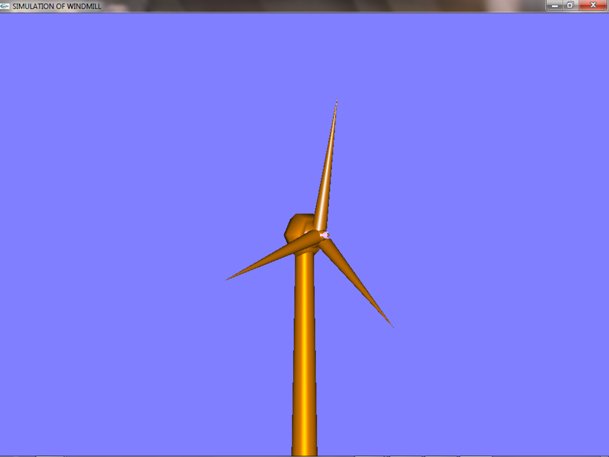
Cont..
Free Movement of Windmill Structure using Arrow Keys

Slide 16
Conclusion :
Simulation of Windmill is a designed and implemented using a graphics software system called OpenGL which has became a widely accepted standard for developing graphic application. Using openGL functions user can create geometrical objects and can use translation, rotation, scaling with respect to the co-ordinate system.
The project Visual Transformation Techniques using openGL is based on Rotation and Translation processes using shading effects and is demonstrated using Visual C++.
The development of the Simulation of Windmill project has given us a good exposure to OpenGL by which we have learnt some of the technique which help in development of animated pictures, gaming. Hence it is helpful for us even to take up this field as our career too and develop some other features in OpenGL and provide as a token of contribution to the graphics world.
Simulation of Windmill consist of many user defined function such as increasing windmill fan speed, decreasing windmill fan speed, side views, front and back views, custom angle of rotation of entire windmill structure. All these function makes this project an example of animation in OpenGL.

Slide 17
Future Enhancement :
This project has been designed using C++, which works on the windows platform. The project can be designed using other languages and better graphical interfaces. The following features could have been incorporated.
Circular and priority queues can be implemented.
Different shading effects can be added.
We can give transparency and fogging to the objects.

Slide 18
Bibliography :
Edward Angel:
Interactive Computer Graphics: A Top-Down Approach with OpenGL
F.S. Hill, Jr.:
Computer Graphics Using OpenGL
Donald Hearn and Pauline Baker:
Computer Graphics- OpenGL Version
Richard S. Wright, Jr. and Michael Sweet:
The OpenGL Super Bible
Dave Shreiner, Mason Woo, Jackie Neider and Tom Davis:
OpenGL Programming Guide
Shalini Govil-Pai:
Principles of Computer Graphics: Theory and Practice Using OpenGL
Websites:
http://www.OpenGl.org
www.opengl.org
www.sourcecode.com

Slide 19
THANK YOU

Slide 20
?

