Slide 1
BINGHAMTON UNIVERSITY | DEPARTMENT OF INFORMATION SYSTEMS
Vendor Performance
Analysis
An End-to-End Business Intelligence Project
Viranchi Ravindra More
Master's in Information Systems | Binghamton University | Spring 2026
github.com/viru9192/Vendor-Performance-Analysis
Project Progress Review
Notes:
Hello Professor, My name is Viranchi More and today I'll walk you through my Vendor Performance Analysis project, a complete, end-to-end business intelligence solution I built from raw transactional data all the way to an interactive Power BI dashboard. I'll then share what I'm currently working on, and where I plan to go next. Let's get into it.

Slide 2





Today's Roadmap
01
What I Built
Vendor Performance Analysis | the end-to-end BI project
02
Key Findings
EDA, correlations, profitability analysis & bulk purchasing
03
Dashboard
Interactive Power BI dashboard built for business decision-makers
04
What I'm Learning Now
DataCamp Data Science track + Deloitte Forage certification
05
Future Plans
Advanced ML projects, portfolio, and career targets
Notes:
Before diving in, here's the structure of the PPT. We'll move through the project problem, data, findings, and the dashboard. then I'll share what I'm actively learning right now, and my plans for the upcoming semester. The main idea to present, what I did, what I'm doing, and what will be the next.

Slide 3





The Business Problem
W H A T I B U I L T
Why This Project?
Identify underperforming brands
Retail and wholesale businesses lose profitability through inefficient pricing, poor inventory turnover, and over-reliance on a small set of vendors.
The goal was to build a data-driven intelligence system to surface these risks and give decision-makers clear, actionable guidance.
Determine top vendor contributions
Analyze bulk purchasing impact
Assess inventory turnover efficiency
Compare high vs low vendor profitability
Dataset: 10,692 raw records → 8,564 after cleaning | Tools: Python · SQL · Power BI
Notes:
The core business problem is straightforward: Most of companies are sitting on rich transaction data but don't have the tools to act on it. Without vendor analysis, we will get dead inventory, over-dependence on a few suppliers, and also missed margin opportunities. I structured the project around five concrete business questions and each one maps directly to a decision a manager or CFO would need to make.
About the dataset: I started with 10,692 raw records, and after cleaning invalid entries, worked with 8,564 quality records across 119 vendors.

Slide 4
Dataset & Tools
W H A T I B U I L T
8,564
18
119
Records Analyzed
Feature Columns
Vendors Evaluated
10,692 raw → cleaned
incl. derived KPIs
unique vendors in data
Tech Stack
Python
SQL
Power BI
Pandas · NumPy · Scipy
Matplotlib · Seaborn
SQLite via Python
Interactive dashboard
Data cleaning, EDA, KPI engineering, statistical testing
Data extraction, aggregation, and complex groupings
KPI cards, vendor charts, filters that built for business users
Notes:
This is a quick representation of the numbers where I'm showing 8,564 because that's the count after data cleaning, which is the final dataset I actually ran my analysis on. The raw data had 10,692 rows, but removing negative profits, zero-sale records, and undefined margins brought it to 8,564 reliable records. 18 columns includes both original fields and the KPIs I have created, like Stock Turnover and Unsold Inventory Value. And 119 is the exact number of unique vendors in the cleaned dataset.

Slide 5
Data Processing & Approach
W H A T I B U I L T
1
Data Cleaning
Removed records with GrossProfit ≤ 0, ProfitMargin ≤ 0, and TotalSalesQuantity = 0 → 10,692 raw → 8,564 clean
2
Feature Engineering
Created KPIs not in raw data: UnitPurchasePrice, UnsoldInventoryValue, OrderSize buckets (small/medium/large), Purchase Contribution %
3
Vendor Segmentation
Grouped vendors by order volume tiers and ranked by TotalPurchaseDollars, GrossProfit, and StockTurnover
4
Statistical Testing
T-test (Welch) on profit margins of top vs low vendors, H₀ rejected, p < 0.0001, confirming distinct profitability models
KPIs Created: Sell-Through Rate · Stock Turnover · Gross Profit · Vendor Contribution % · Unsold Inventory Capital
Notes:
As this is the real-world data the data wan not clean. The most important task was to identify the cleaning criteria: I removed records with zero sales (inventory that was never sold), negative profit (loss transactions), and undefined margins. That took us from 10,692 to 8,564 rows.
Feature engineering was equally important, the KPIs I created don't exist in the raw data, they were derived. For example, Unsold Inventory Value is calculated as: (Purchase Qty minus Sales Qty) multiplied by Purchase Price.
The statistical test at the end is what elevates this from a descriptive dashboard to validated analytical findings.

Slide 6
Key Findings
H I G H - L E V E L B U S I N E S S S N A P S H O T
$441M
$307M
$134M
38.7%
$2.71M
Total Sales
Total Purchases
Gross Profit
Profit Margin
Unsold Capital
Notes:
These five numbers set the stage. We're analyzing nearly half a billion dollars in sales across 119 vendors. The 38.7% gross margin is healthy, but the $2.71M in unsold inventory is a red flag as we can say that's capital locked in slow-moving stock. The bar chart shows the top 5 vendors by sales value, and the pie shows how concentrated purchasing is: just three vendors account for about half of all purchase dollars. That concentration is a supply chain risk we'll see in the next slide.

Slide 7

Four Critical Discoveries
R E S E A R C H F I N D I N G S
198 High-Margin, Low-Sales Brands
Top 10 Vendors = 65.69% of Purchases
Profitable per unit but under-promoted. Targeted campaigns and pricing tweaks can unlock revenue without sacrificing margins.
Heavy concentration risk. Diversifying the vendor portfolio is critical to protect supply chain resilience.
Bulk Buying Cuts Unit Cost by 72%
$2.71M Unsold Inventory Capital
Large orders drop avg unit price from $39.07 → $10.78. Consolidating purchase volumes yields significant unit cost savings.
Low-turnover vendors lock up working capital. Demand forecasting and clearance initiatives would free up cash flow.
Notes:
These are the four headline findings. Each one is directly actionable. The 198 high-margin brands are a growth lever and they're profitable but invisible.
The 65.69% vendor concentration is a strategic risk flagged for leadership.
The 72% cost reduction from bulk buying is proven from data and not estimated.
And the $2.71M in unsold capital is sitting idle when it could be reinvested.
I want to emphasize that these aren't just observations and the recommendations section of the report maps each finding to a specific business action.

Slide 8
Profitability Paradox: Low Vendors Win on Margin
R E S E A R C H F I N D I N G S
Top Vendors
Low Vendors
Key Insight
31.18%
41.57%
Low-volume vendors are 10+ percentage points more profitable per unit, a strategic opportunity to scale them up with targeted support and pricing refinement.
Avg Profit Margin
Avg Profit Margin
95% CI: (30.74 – 31.61)
95% CI: (40.50 – 42.64)
High volume, lower margin
Low volume, higher margin
Statistical Validation:
T-test confirmed the profit margin gap is statistically significant (T = -17.67, p < 0.0001, H₀ rejected). The two groups operate under genuinely distinct profitability models.
Correlation Highlights
Purchase Qty vs Sales Qty: 0.999 i.e. near-perfect demand alignment
Purchase Price vs Sales $: -0.012 i.e. demand is largely price-insensitive
Profit Margin vs Sales Price: -0.179 i.e. higher price ≠ higher margin
Notes:
This is one of the most counter-intuitive findings in the project. We would expect that biggest vendors, i.e. the ones generating the most revenue to also be the most profitable. But the data says otherwise. Low-volume vendors average 41.57% margin versus 31.18% for top vendors i.e. a gap of over 10 percentage points. This is statistically confirmed with a T-statistic of -17.67 and p-value essentially zero. The 95% confidence intervals don't overlap at all, meaning this difference is real, not noise. The implication for business strategy is clear: there's an opportunity to selectively grow low-volume, high-margin vendors with targeted investment.

Slide 9
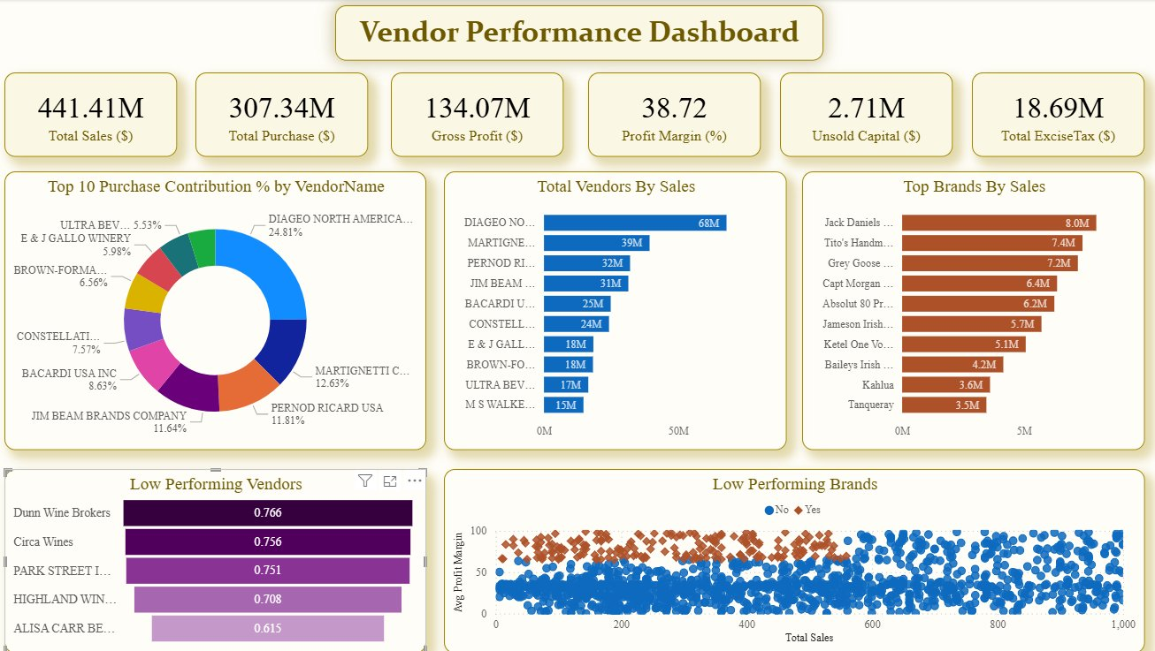
Power BI Dashboard
V I S U A L I Z A T I O N
Dashboard Features
6 KPI cards at-a-glance
Top 10 vendors by purchase %
Sales performance by brand
Low-performing vendor flags
Scatter: profit vs sales
Dynamic filters & drill-downs
Built for business users - no Python or SQL knowledge required to extract insights
Notes:
The dashboard is the deliverable that a business user would actually see this. I designed it with a manager in mind, someone who needs answers fast without writing a single line of code. At the top you get a snapshot of the six most important KPIs. Below that, the vendor contribution donut chart immediately surfaces concentration risk. The bar charts rank vendors and brands by sales. And the scatter plot in the bottom right maps profit margin against total sales, low-margin, high-volume clusters stand out instantly. Every element is interactive: we can filter by vendor, brand, or category.

Slide 10
Business Impact
S O W H A T ?
Smarter Vendor Selection
Unlock $2.71M in Capital
Data-backed vendor ranking by profitability and reliability that replaces gut-feel procurement with evidence-based decisions
Unsold inventory identified vendor-by-vendor and actionable targets for clearance pricing or reduced replenishment orders
72% Unit Cost Reduction
Diversify Supply Chain Risk
Proven from data: bulk order consolidation drops avg unit price from $39.07 to $10.78 and renegotiate volume thresholds now
65.69% of purchases concentrated in 10 vendors, a strategic roadmap to diversify and protect against disruption
Notes:
This slide answers the 'so what?' question. Every finding maps to a real business outcome. Better vendor selection saves procurement cost. Unlocking the $2.71M in unsold inventory frees working capital that can be reinvested. The 72% cost reduction is a validated argument for renegotiating purchase contracts. And addressing the vendor concentration risk protects the business against supply chain risks.
This is the difference between a data project that sits in a report and one that changes how a company operates.

Slide 11
Challenges & Learnings
W H A T I L E A R N E D
⚠
Data Quality Issues
Negative profits, zero-sales records, infinite profit margins and each required a deliberate cleaning decision, not just a one-line filter
✓ Real data is always messy. The cleaning helps me to shape the conclusions that can be draw.
⚠
Large Dataset Handling
10,692 records across 17+ columns with complex vendor-brand aggregations and naive loops were too slow
✓ Mastered vectorized Pandas operations and efficient SQL groupings to process data at scale.
⚠
Business Context Translation
Statistical outputs (T-stats, confidence intervals, correlation matrices) needed to become business language
✓ Analytics only has impact when communicated clearly to a non-technical audience, also the dashboards and plain-language recommendations matter as much as the math.
Notes:
I want to be transparent about what was hard. The data quality issues took more time than any single analysis step, every cleaning decision is a judgment call that affects results downstream. The large dataset pushed me to write better code and vectorized operations instead of row-by-row loops.
But the most lasting learning was the third one: the gap between producing a correct statistical result and communicating it in a way that drives a business decision. That's a skill I'm actively developing through this project and through the DataCamp track.

Slide 12
Currently Learning
W H A T I ' M D O I N G N O W
DataCamp Career Track
Forage Certification
Associate Data Scientist in Python
Deloitte Australia – Data Analytics Job Simulation
1. Python Fundamentals & Data Manipulation
Credential ID: zYdNZK576XoNHmgAt
2. Exploratory Data Analysis
Data Forensics
3. Statistical Thinking & Hypothesis Testing
Analyzed business data to identify discrepancies and support evidence-based recommendations
4. Supervised Learning with scikit-learn
Data Visualization
Designed Tableau dashboards to communicate complex findings clearly to stakeholders
5. Unsupervised Learning & Clustering
Business Insights
6. Machine Learning & Model Evaluation
Translated raw data into strategic recommendations aligned with client objectives
7. Data Communication & Storytelling
Technical Reporting
Produced professional reports combining quantitative analysis with narrative
app.datacamp.com/learn/career-tracks/associate-data-scientist-in-python
Skills: Data wrangling · Tableau · Business analysis · Client communication
Notes:
While finishing the vendor analysis project, I've been investing in two parallel learning tracks. The DataCamp Associate Data Scientist program builds exactly the skills I saw gaps in during this project and learning, particularly predictive modeling and ML pipelines. I'm currently completed module three.
Also the Deloitte Forage simulation was valuable for a different reason: it put me in a real consulting scenario with real business constraints and a real deliverable. Both will be feeding directly into my next set of projects.

Slide 13
Looking Ahead
N E X T S E M E S T E R P L A N S
Next 3 Months
3 – 6 Months
Career Target
Complete DataCamp Associate Data Scientist track
Build 2–3 portfolio projects combining ML + data engineering
Roles: Data Analyst / Junior Data Scientist
Add ML layer to this project (predictive inventory management)
Launch personal portfolio website with documented repos
Target: consulting firms, tech, and financial institutions
Deep dive into supervised & unsupervised ML techniques
Pursue DataCamp Professional Data Scientist credential
Full time applications actively underway
Notes:
My roadmap is deliberate. In the near term I want to extend this project with a machine learning layer, turning the descriptive vendor analysis into a predictive one, forecasting which products are at risk of becoming slow-moving inventory before it happens. By mid-year I want a valuable projects for my personal portfolio that shows both breadth and depth.
My career target is Data Analyst or Data Scientist roles, with a preference for organizations where I can make the impact with data which directly drives business decisions, not just reporting.

Slide 14
Thank You
I'm happy to answer any questions about the project, the data, or the methodology.
Viranchi Ravindra More
Master's in Information Systems | Binghamton University
github.com/viru9192/Vendor-Performance-Analysis
Credential: Deloitte Data Analytics Job Simulation (Forage) | ID: zYdNZK576XoNHmgAt
Notes:
To wrap up: this project started with a real business problem and ends with a fully deployed BI solution backed by statistical validation and clear recommendations. I'm proud of what I built, and equally excited about what comes next. Thank you for your time — I'm happy to take any questions on the methodology, the findings, or anything I've shared today.

