Slide 1

A Mathematical Modelling Study of the Effects of Air Expansion in the Brain on the Intracranial Pressure
Viruj, Bala Soupramanien
Supervisor: Dr. Ooi Ean Hin
Moderator: Dr. Chiew Yeong Shiong

Slide 2
Contents
Project objectives
Background
Previous studies
Methodology
Results
Conclusion

Slide 3
Project Objectives
Mathematically model the intracranial system to include intracranial air
Investigate the effects of altitude change on the system
Investigate the effects of temperature change on the system

Slide 4
Background

Slide 5
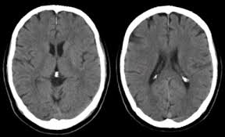
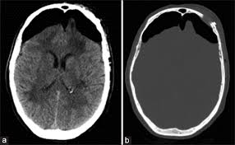
Pneumocephalus
A collection of intracranial gas
Traumatic pneumocephalus:
Severe head injuries
Nontraumatic pneumocephalus:
Extracranial infections
Performing Valsalva manoeuvres
Barotrauma
Post-craniotomy

Slide 6
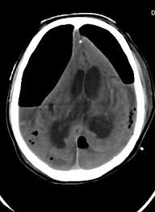

Dangers of Pneumocephalus
< 1500 mm Hg (200 kPa); air $⟹$ ideal gas
Gas trapped in body cavities will expand
Decrease in pressure (Boyle-Mariotte’s law)
Increase in temperature (Charles’ law)
Rate of intracranial air accumulation continuously increase
Can cause mass effect on brain
Intracranial pressure rises

Slide 7
Intracranial Pressure
Pressure the cranium exerts on intracranial compartments
Monroe-Kellie hypothesis:
Cranium consists of brain parenchyma, cerebral blood and cerebrospinal fluid
Various mechanisms to maintain stable intracranial pressure
Cerebral autoregulation:
Shifting cerebrospinal fluid into spinal compartment
Increased absorption rate of cerebrospinal fluid
Cerebral blood displacement out of the cranium

Slide 8

Previous Studies
Modelling of intracranial system
Marmarou et al. (1978)
Meier et al. (1999)
Lakin et al. (2003)
Eklund et al. (2007)
Modelling of intracranial system including intracranial air
Anderson et al. (2003)
Mathematical studies $⟹$ non-invasive

Slide 9
Methodology

Slide 10
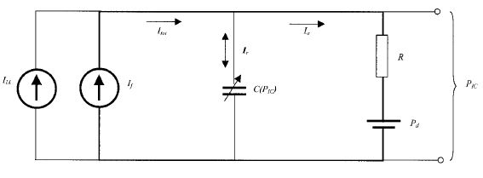
Model Schematics
I_{tot}
I_{a}
I_{r}
R
I_{IA}
I_{f}
C(P_{IC})
P_{IC}
P_{d}
Analogous electrical system describing the hydrodynamic system
Anderson, N., Grip, H., Lindvall, P., Koskinen, L., Brandstrom, H., Malam, J., & Eklund, A. (2003). Air Transport of Patients with Intracranial Air: Computer Model of Pressure Effects. Aviation, Space And Environmental Medicine, Vol. 74(2), 138-144.

Slide 11


Anderson et al. (2003) Model
$$\frac{dP_{IC}}{dt}=\frac{KP_{IC}}{R}(R\frac{dV_{IA}}{dt}+P_{{IC}_{r}}−P_{IC})$$
Intracranial air pressure varies with:
Atmospheric pressure (75-100 kPa)
Intracranial pressure (1-3 kPa)
Intracranial air pressure $⟺$ Atmospheric pressure
$⟹$ Linear approximation

Slide 12
Assumptions
Hydrodynamic equilibrium between pressure and flow
Re-absorption of air rate negligible
Fluid accumulation from tissue swelling negligible
Rapid cabin decompression not considered
Only cabin compression
Compared to inputs

Slide 13






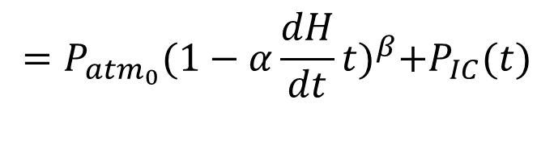
Mathematical Formulation of System
$$C=\frac{dV_{IC}}{dP_{IC}}$$
$$=\frac{1}{KP_{IC}}$$
$$K=\frac{1}{0.4343PVI}$$
$$\frac{dP_{IC}}{dt}=\frac{KP_{IC}}{R}(R\frac{dV_{IA}}{dt}+P_{{IC}_{r}}−P_{IC})$$
For changing ambient pressure – Boyle-Mariotte’s law:
$V_{IA}\left(t\right)=\frac{V_{{IA}_{0}}P_{{IA}_{0}}}{P_{IA}(t)}⇒\frac{dV_{IA}}{dt}=−\frac{V_{{IA}_{0}}P_{{IA}_{0}}}{P_{IA}^{2}}$ $\frac{dP_{IA}}{dt}$
$P_{IA}\left(t\right)=P_{atm}\left(t\right)+P_{IC}\left(t\right)$
$P_{atm}\left(H\right)=P_{{atm}_{0}}{(1−αH)}^{β}$
For changing ambient temperature – Charles’ law
$V_{IA}\left(t\right)=\frac{V_{{IA}_{0}}}{T_{i}}T_{IA}(t)⇒\frac{dV_{IA}}{dt}$= $\frac{V_{{IA}_{0}}}{T_{i}}$ $\frac{dT_{IA}}{dt}$
$$=P_{{atm}_{0}}{(1−α\frac{dH}{dt}t)}^{β}+P_{IC}(t)$$

Slide 14
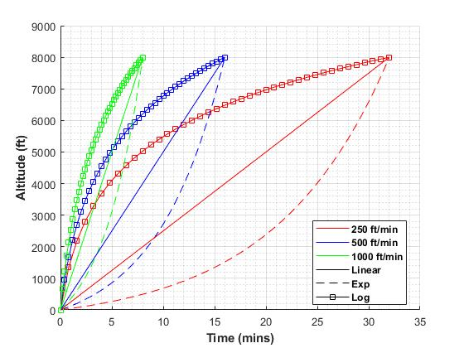

Parameter Selection Effects of Altitude Change on System
$$H=\frac{dH}{dt}t$$
$$H=X\ln{(t + 1)}$$
$$H=Ye^{(Zt −1)}$$
Parameter values for model
Parameter | Value
P_{ICr} | 10 and 20 mm Hg
PVI | 12.6 ml
R | 16.1 mm Hg ml⁻¹ min⁻¹
V_{IA0} | 10, 20 and 30 ml
dH/dt | 250, 500 and 1000 ft min⁻¹
X | 2288, 2824 and 3641
Y | 141.49, 223.04 and 375.23
Z | 0.0015, 0.0026 and 0.0042
Linear, logarithmic and exponential functions of altitude with time

Slide 15
Parameter Selection Effects of Temperature Change on System
Time rate of temperature change for all initial volumes and temperature
 | 18 | 21 | 24
10 | 3.54 | 2.97 | 2.45
20 | 2.32 | 1.95 | 1.58
30 | 1.25 | 1.05 | 0.85
T_{i} (°C)
V_{IA0} (ml)
Fong, K. (2010). Surgeons use cold to suspend life. [online] BBC News. Available at: https://www.bbc.com/news/health-11389464.

Slide 16
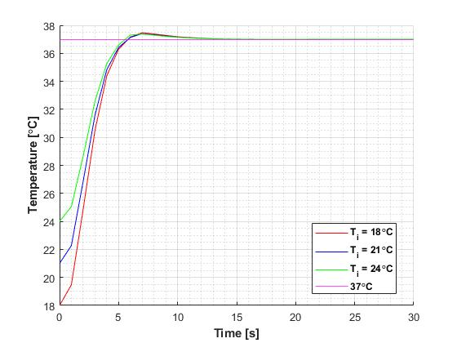
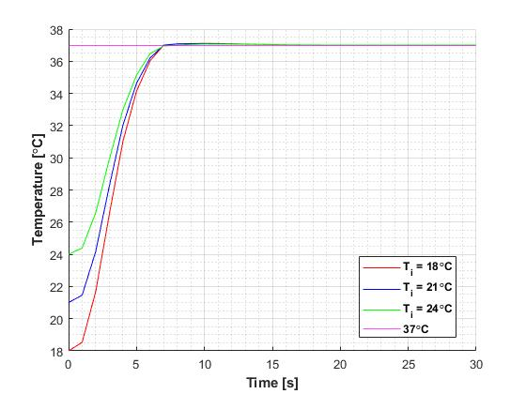
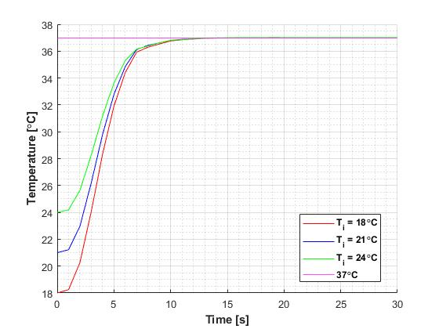
Parameter Selection Effects of Temperature Change on System
(a) 10 ml
(b) 20 ml
(c) 30 ml
(a) 10 ml
(b) 20 ml
(c) 30 ml
Change in body temperature with time for all initial volumes and temperature

Slide 17
Results
Effects of Changing Ambient Pressure

Slide 18
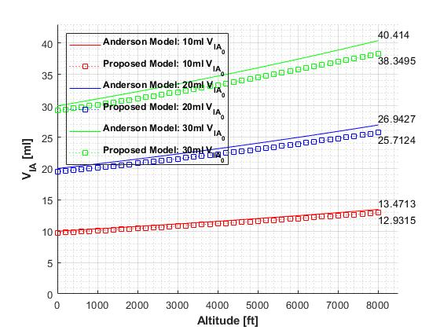
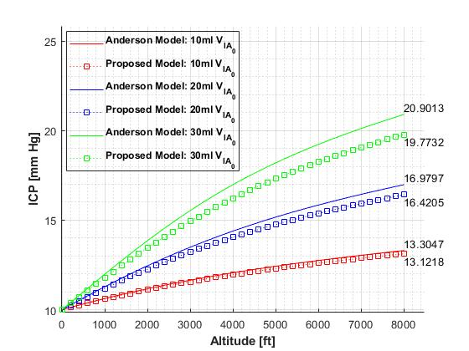
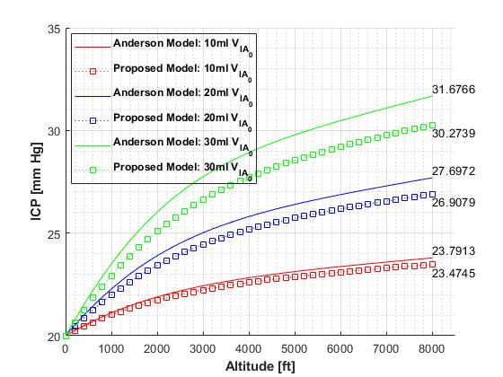
Constant Ascension Rates
Change in intracranial air volume during ascent at 500 ft min⁻¹, simulated for three initial volumes
(a)
(b)
Change in intracranial pressure during ascent at 500 ft min⁻¹ simulated for three initial volumes for (a) 10 mm Hg and (b) 20 mm Hg resting pressure

Slide 19
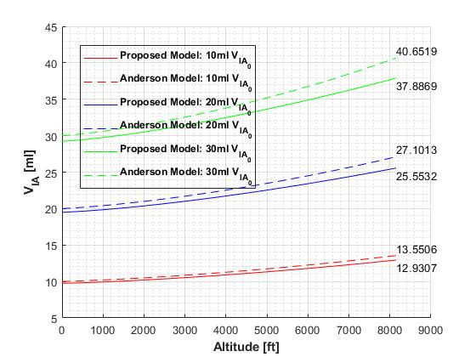
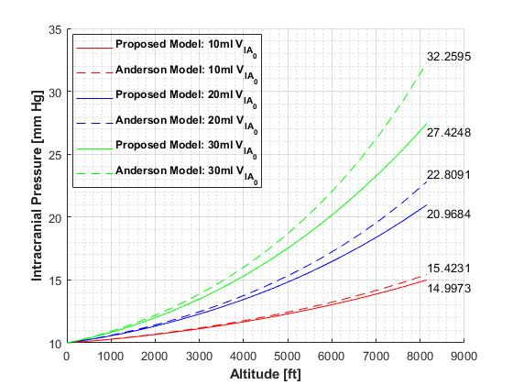
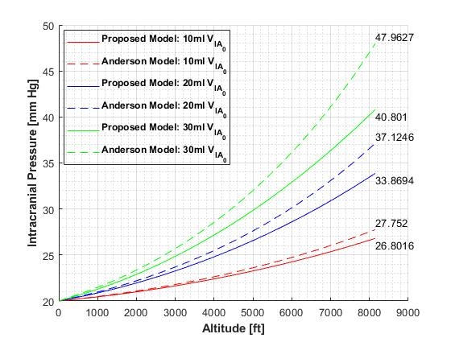
Exponential Ascension
Change in intracranial air volume during exponential ascent, simulated for three initial volumes
(a)
(b)
Change in intracranial pressure during exponential ascent, simulated for three initial volumes for (a) 10 mm Hg and (b) 20 mm Hg resting pressure

Slide 20
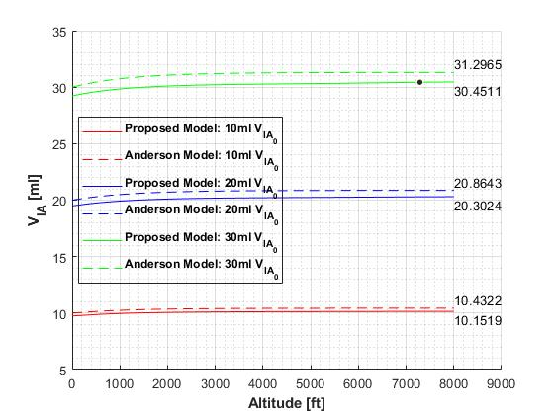
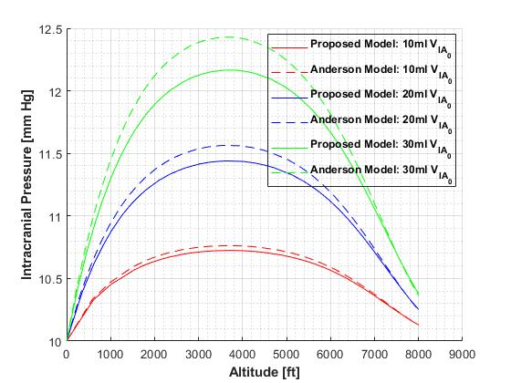
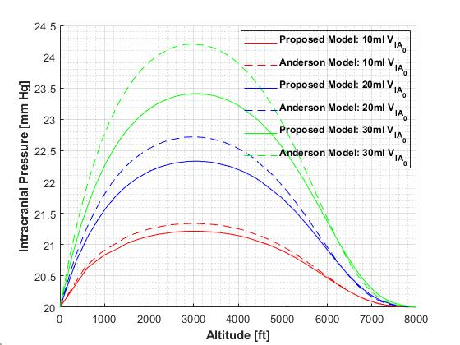
Logarithmic Ascension
Change in intracranial air volume during logarithmic ascent, simulated for three initial volumes
(a)
(b)
Change in intracranial pressure during logarithmic ascent, simulated for three initial volumes for (a) 10 mm Hg and (b) 20 mm Hg resting pressure

Slide 21
Results
Effects of Changing Ambient Temperature

Slide 22
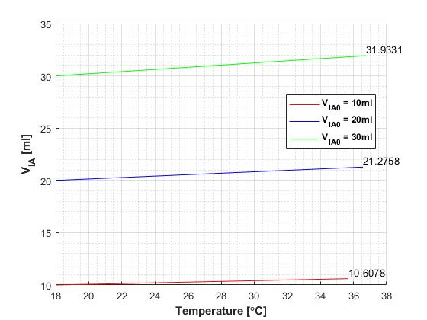
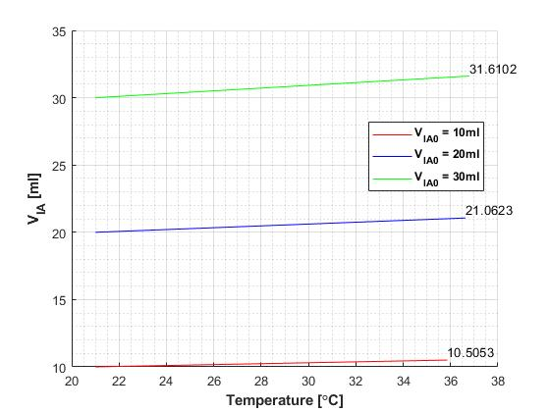
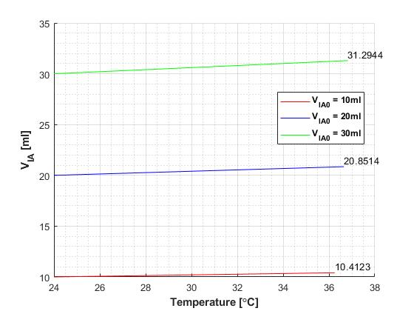
Change in Intracranial Air Volume
(a)
(b)
(c)
Change in intracranial air volume with change in temperature simulated with three initial volumes and (a) 18 °C, (b) 21 °C and (c) 24 °C, initial temperatures

Slide 23
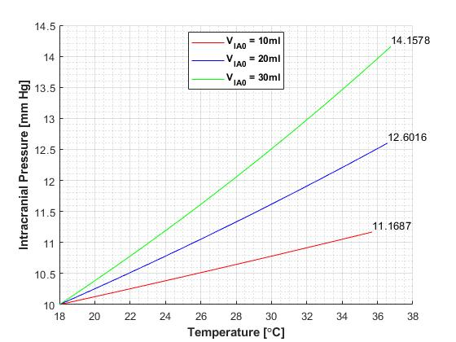
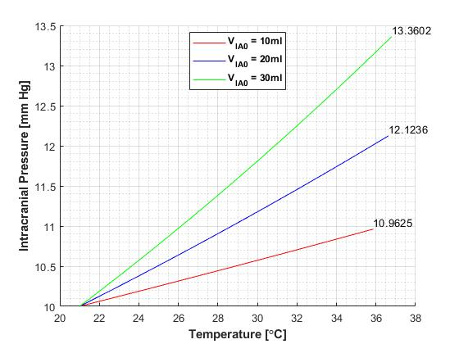
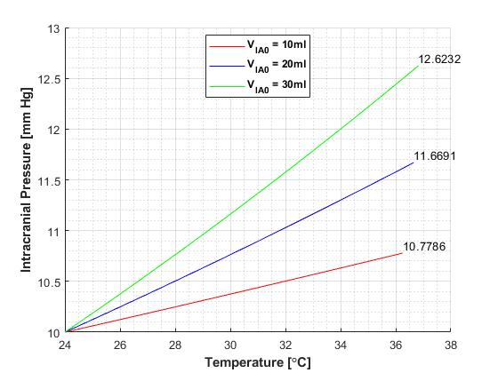
Change in Intracranial Pressure
(a)
(b)
(c)
Change in intracranial pressure with change in temperature simulated with three initial volumes, 10 mm Hg resting pressure and (a) 18 °C, (b) 21 °C and (c) 24 °C, initial temperatures

Slide 24
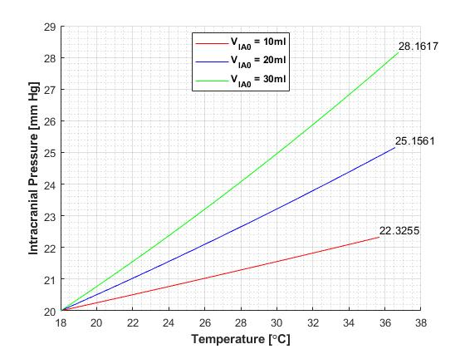
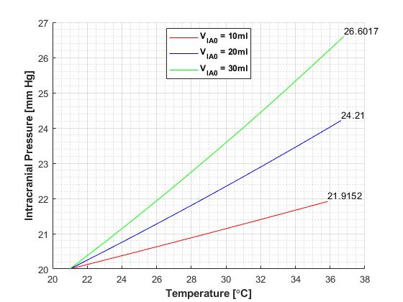
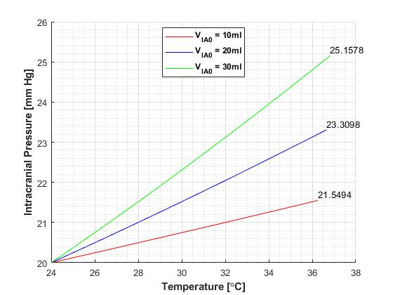
Change in Intracranial Pressure
(a)
(b)
(c)
Change in intracranial pressure with change in temperature simulated with three initial volumes, 20 mm Hg resting pressure and (a) 18 °C, (b) 21 °C and (c) 24 °C, initial temperatures

Slide 25
Conclusion
Revision of model proposed by Anderson et al. (2003)
Intracranial pressure depends on ascension rates and rate of temperature change
Intracranial pressure can reach high levels
High initial intracranial air volume
High ascension rate
Low initial temperature

Slide 26
References
Anderson, N., Grip, H., Lindvall, P., Koskinen, L., Brandstrom, H., Malam, J., & Eklund, A. (2003). Air Transport of Patients with Intracranial Air: Computer Model of Pressure Effects. Aviation, Space And Environmental Medicine, Vol. 74(2), 138-144.
Eklund, A., Smielewski, P., Chambers, I., Alperin, N., Malm, J., Czosnyka, M., & Marmarou, A. (2007). Assessment of cerebrospinal fluid outflow resistance. Medical & Biological Engineering & Computing, 45(8), 719-735.
Fong, K. (2010). Surgeons use cold to suspend life. [online] BBC News. Available at: https://www.bbc.com/news/health-11389464.
Lakin, W.D., Stevens, S.A., Tranmer, B.I. and Penar, P.L., 2003. A whole-body mathematical model for intracranial pressure dynamics. Journal of mathematical biology, 46(4), pp.347-383.
Marmarou, A., Shulman, K., & Rosende, R. (1978). A nonlinear analysis of the cerebrospinal fluid system and intracranial pressure dynamics. Journal Of Neurosurgery, 48(3), 332-344.
Meier, U., Zeilinger, F.S. and Kintzel, D., 1999. Diagnostic in normal pressure hydrocephalus: A mathematical model for determination of the ICP-dependent resistance and compliance. Acta neurochirurgica, 141(9), pp.941-948.
Peterson, E., Kent, B., & Cone, W. (1944). Intracranial pressure in the human subject at altitude. Archives of Neurology and Psychiatry, 52(6), 520.

Slide 27
Thank You

