Slide 1

Day -4
User Creation in MongoDB

Slide 2


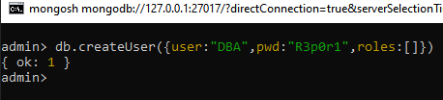
Create an admin user:
use admin
db.createUser({
user: "admin",
pwd: "yourpassword",
roles: [ { role: "userAdminAnyDatabase", db: "admin" }, "readWriteAnyDatabase" ]
})
Note : The user exists, but has no privileges, so if you enable --auth, the user won’t be able to do
anything until you assign roles using db.grantRolesToUser().
Below is list of common built-in roles in MongoDB, grouped by their purpose:
Database user roles
db.createUser({
user: "admin",
pwd: "securePassword123",
roles: [ ]
})
Role | Description
read | Read-only access to data
readWrite | Read and write access to data
Database Administrator roles
Role | Description
dbAdmin | Can view and modify database metadata (e.g., indexes, stats)
userAdmin | Can create and manage users in the current database
dbOwner | Full access to a single database (includes all above roles)

Slide 3
Cluster Administration Roles
Role | Description
clusterAdmin | Full control over the cluster
clusterManager | Manage and monitor the cluster (no user creation)
clusterMonitor | Read-only access to monitoring and diagnostics
hostManager | Manage server configuration and monitoring
Backup & Restore Roles
Role | Description
backup | Read access to all data for backups
restore | Write access for restoring data
List of Roles to see
use admin
db.runCommand({ rolesInfo: 1, showBuiltinRoles: true })
All database roles (must be in admin DB)
Role | Description
readAnyDatabase | Read-only access to all databases
readWriteAnyDatabase | Read/write access to all databases
userAdminAnyDatabase | Manage users on all databases
dbAdminAnyDatabase | Database admin access to all databases

Slide 4
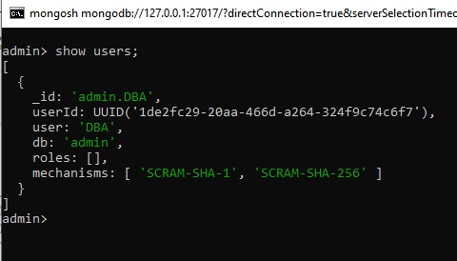
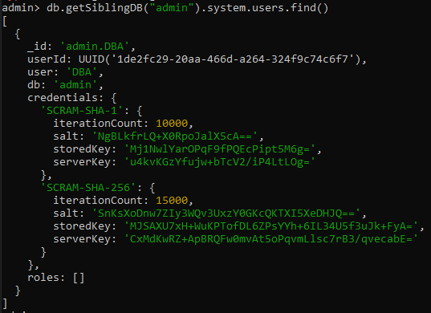
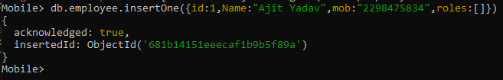
Let’s do practicle
to see the user list
in this we can see list of all user in all db
Create a user in different database

Slide 5
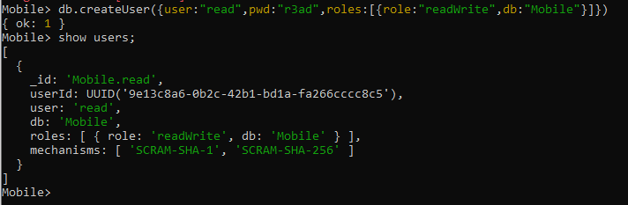
Here i create a user in mobile db with readwrite permisson

