Slide 1
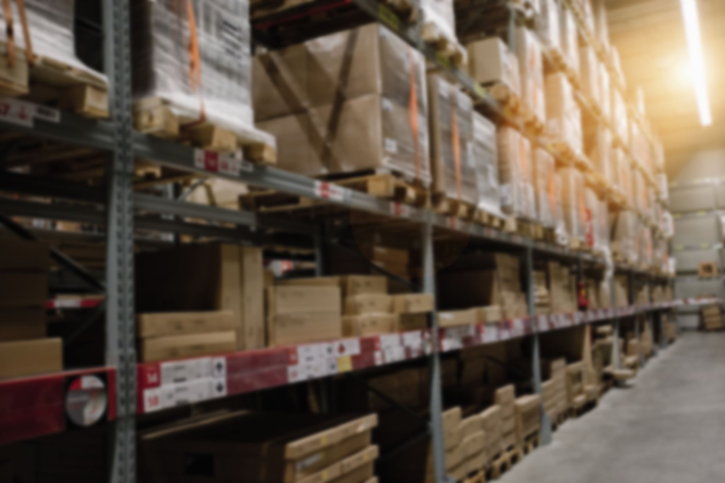
Comprehensive Overview of Supply Chain Management Systems with Key Figures
Exploring essentials, technology, and performance improvements

Slide 2
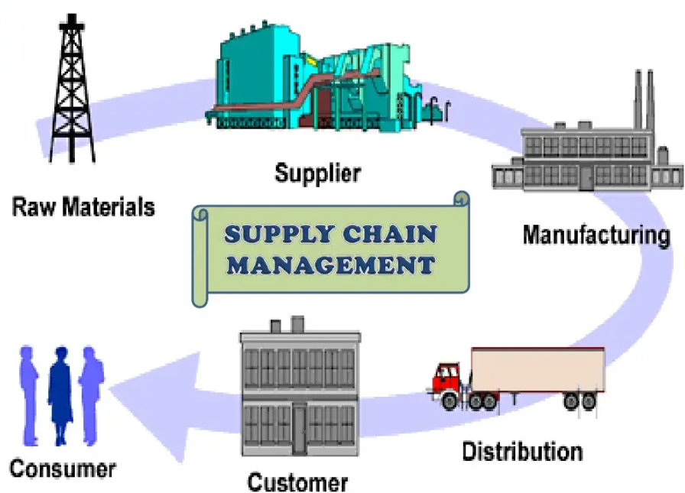
Agenda Highlights
Foundations of Supply Chain Management Systems
Major Processes in Supply Chain Management
Technology and Digital Transformation in Supply Chains
Performance Measurement and Optimization

Slide 3
Foundations of Supply Chain Management Systems

Slide 4
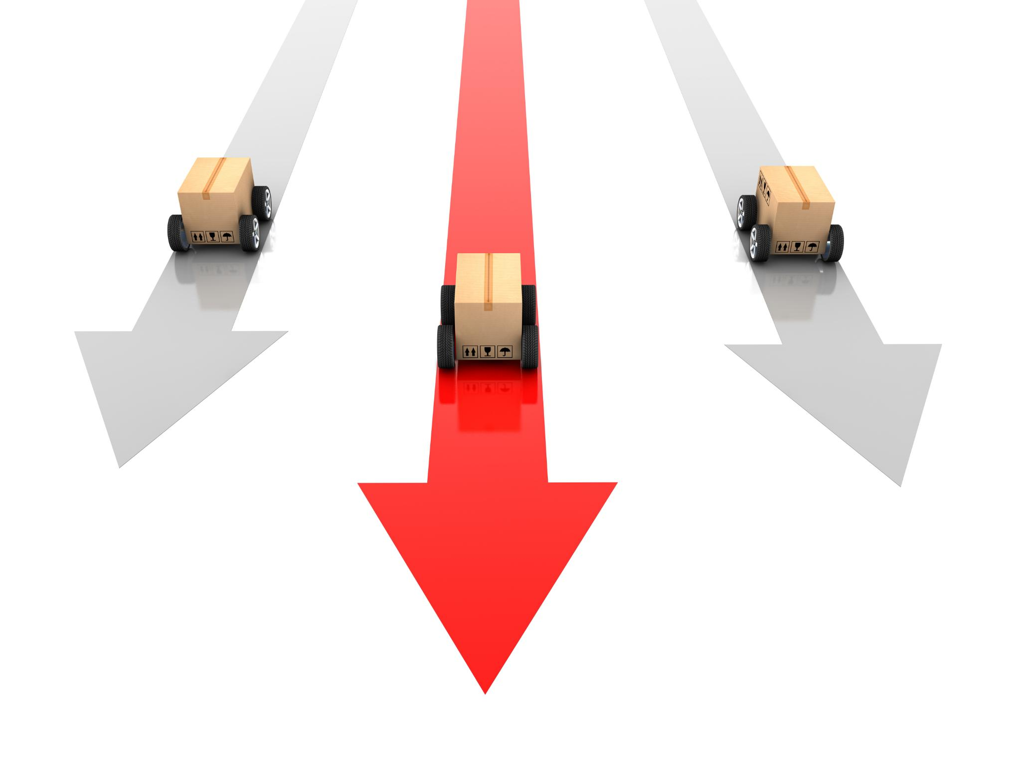
Definition and Core Concepts of Supply Chain Management
Supply Chain Coordination
Supply chain management coordinates the flow of goods, information, and finances from suppliers to customers.
Core Supply Chain Activities
Core activities include sourcing, production, distribution, and logistics to fulfill customer demands effectively.

Slide 5
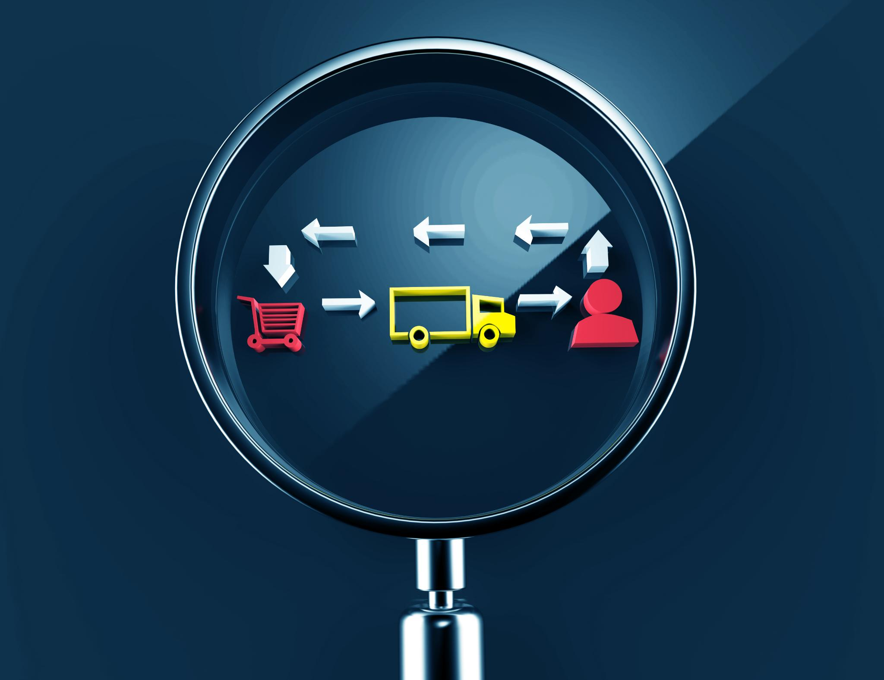
Key Objectives and Components
Primary Objectives
Optimize costs, improve efficiency, enhance customer satisfaction, and maintain operational flexibility.
Core Components
Key components include procurement, manufacturing, inventory management, transportation, and information systems.

Slide 6
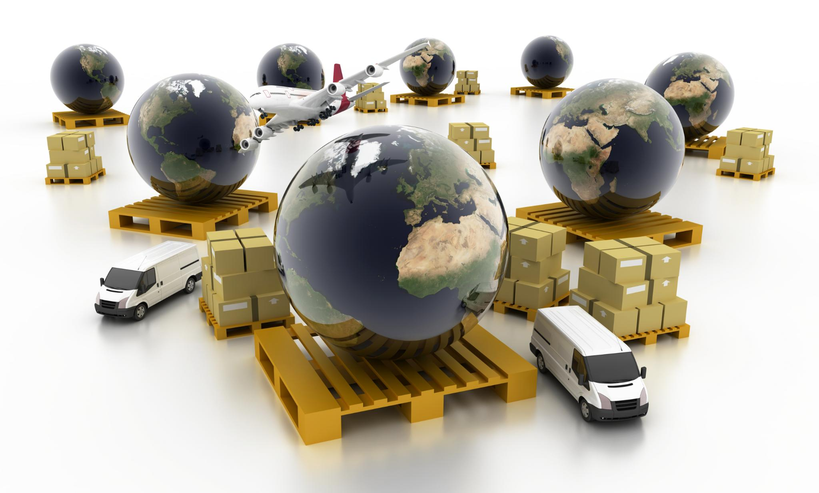
The Role of Supply Chain Systems in Modern Businesses
Integration and Coordination
Supply chain systems integrate all activities, ensuring smooth coordination for improved business competitiveness.
Global Product Movement
Products move seamlessly from worldwide suppliers to retail stores, illustrating efficient global supply chains.

Slide 7
Major Processes in Supply Chain Management
Notes:
This section explores the crucial processes of procurement, production, inventory control, logistics, distribution, delivery, and reverse logistics, with supporting visual aids such as process flow diagrams and network maps.

Slide 8
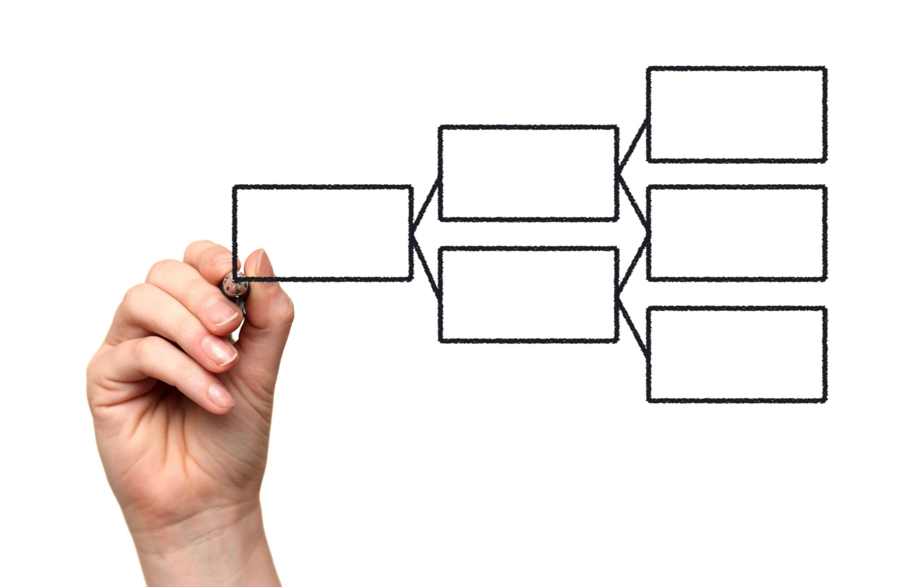
Procurement and Supplier Management
Supplier Selection
Procurement begins with identifying and selecting suitable suppliers to meet business needs effectively.
Order Fulfillment
Managing the ordering process ensures timely delivery and quality of goods and services from suppliers.
Performance Evaluation
Ongoing assessment of supplier performance helps maintain standards and improve procurement outcomes.

Slide 9
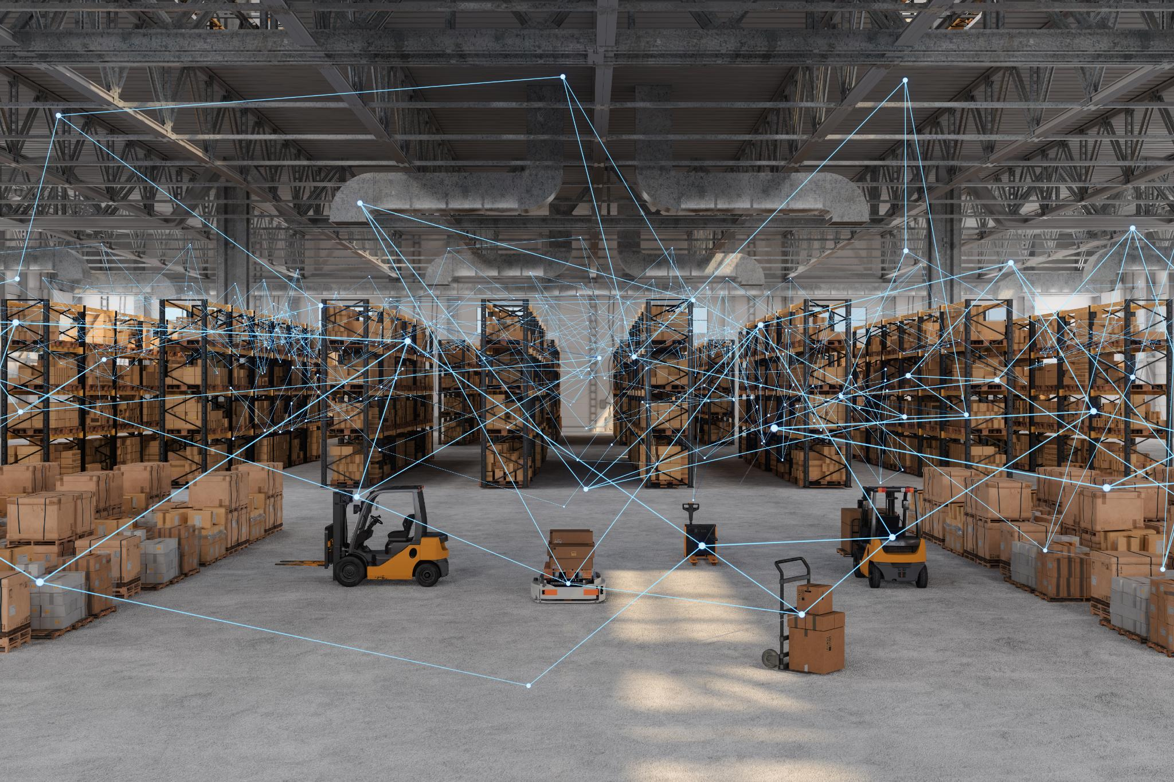
Production, Inventory, and Logistics
Production Planning
Production planning coordinates manufacturing processes to optimize resource use and meet demand efficiently.
Inventory Management
Inventory management tracks and controls stock levels to prevent shortages or excess inventory.
Logistics and Distribution
Logistics ensures timely transportation and distribution of products through a network of warehouses.

Slide 10
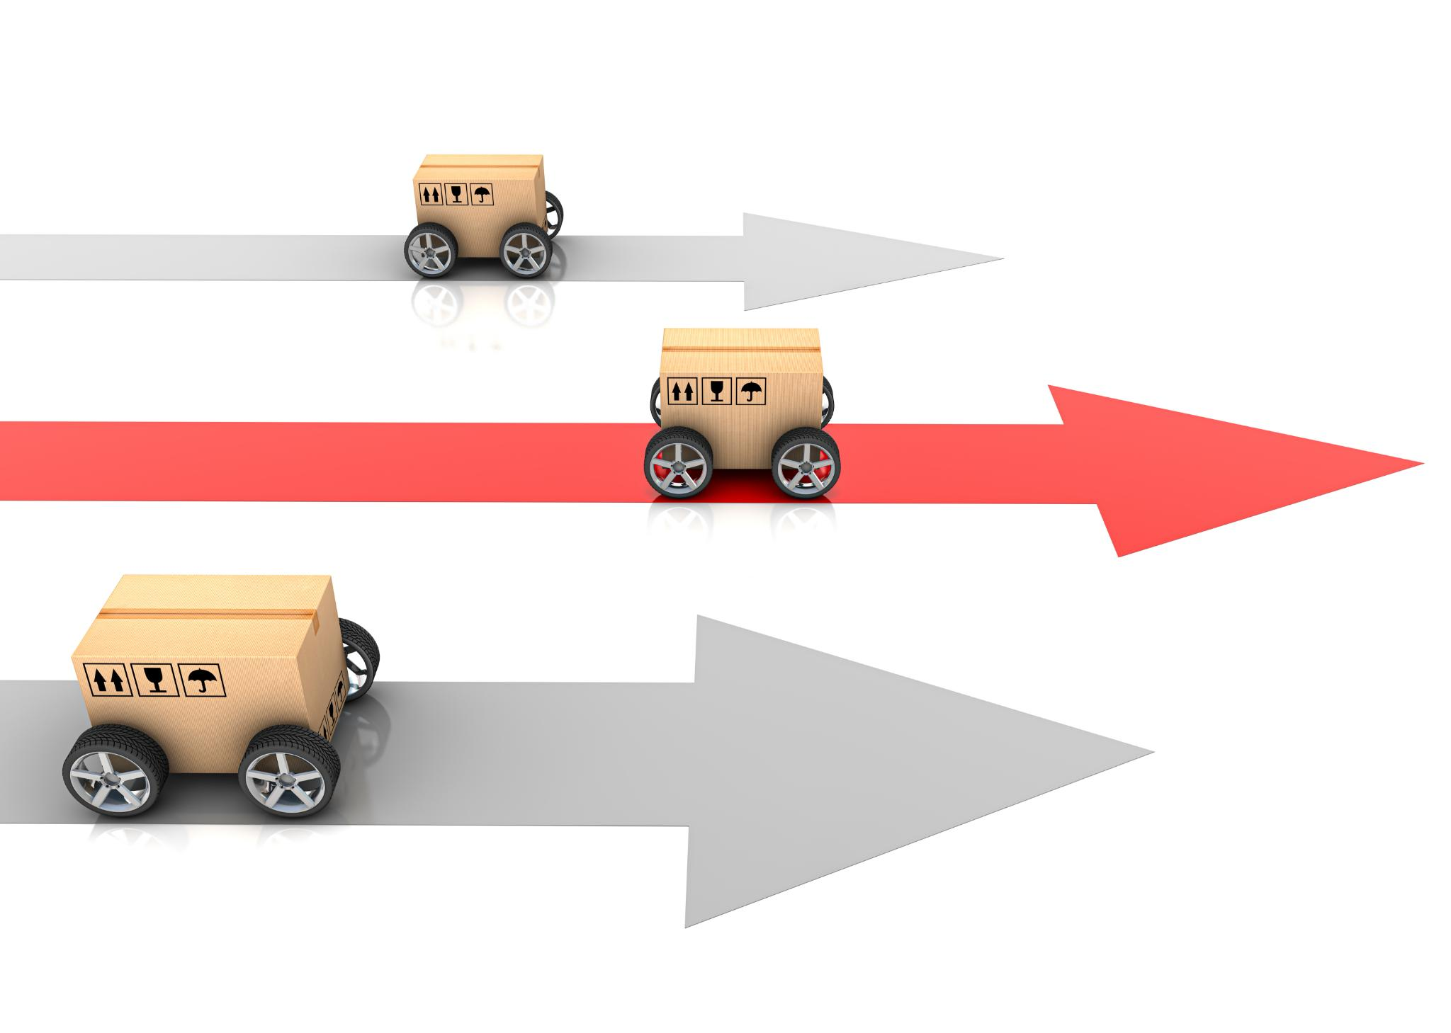
Distribution, Delivery, and Reverse Logistics
Product Distribution
Distribution involves delivering products efficiently to customers through various channels and transportation modes.
Reverse Logistics
Reverse logistics manages product returns, recycling, and disposal to ensure sustainability and resource recovery.
Distribution Network Mapping
A distribution network map shows the pathways goods take from suppliers to final customer destinations across multiple channels.

Slide 11
Technology and Digital Transformation in Supply Chains

Slide 12

Integration of IT Systems: ERP, SCM Software
ERP System Integration
ERP software centralizes core business processes, enabling seamless data exchange and management across departments.
SCM Software Role
Supply Chain Management software optimizes logistics, procurement, and inventory by integrating supply chain activities.
System Architecture and Data Flow
The integrated system architecture highlights key modules and data flows, ensuring efficient communication across IT environments.

Slide 13
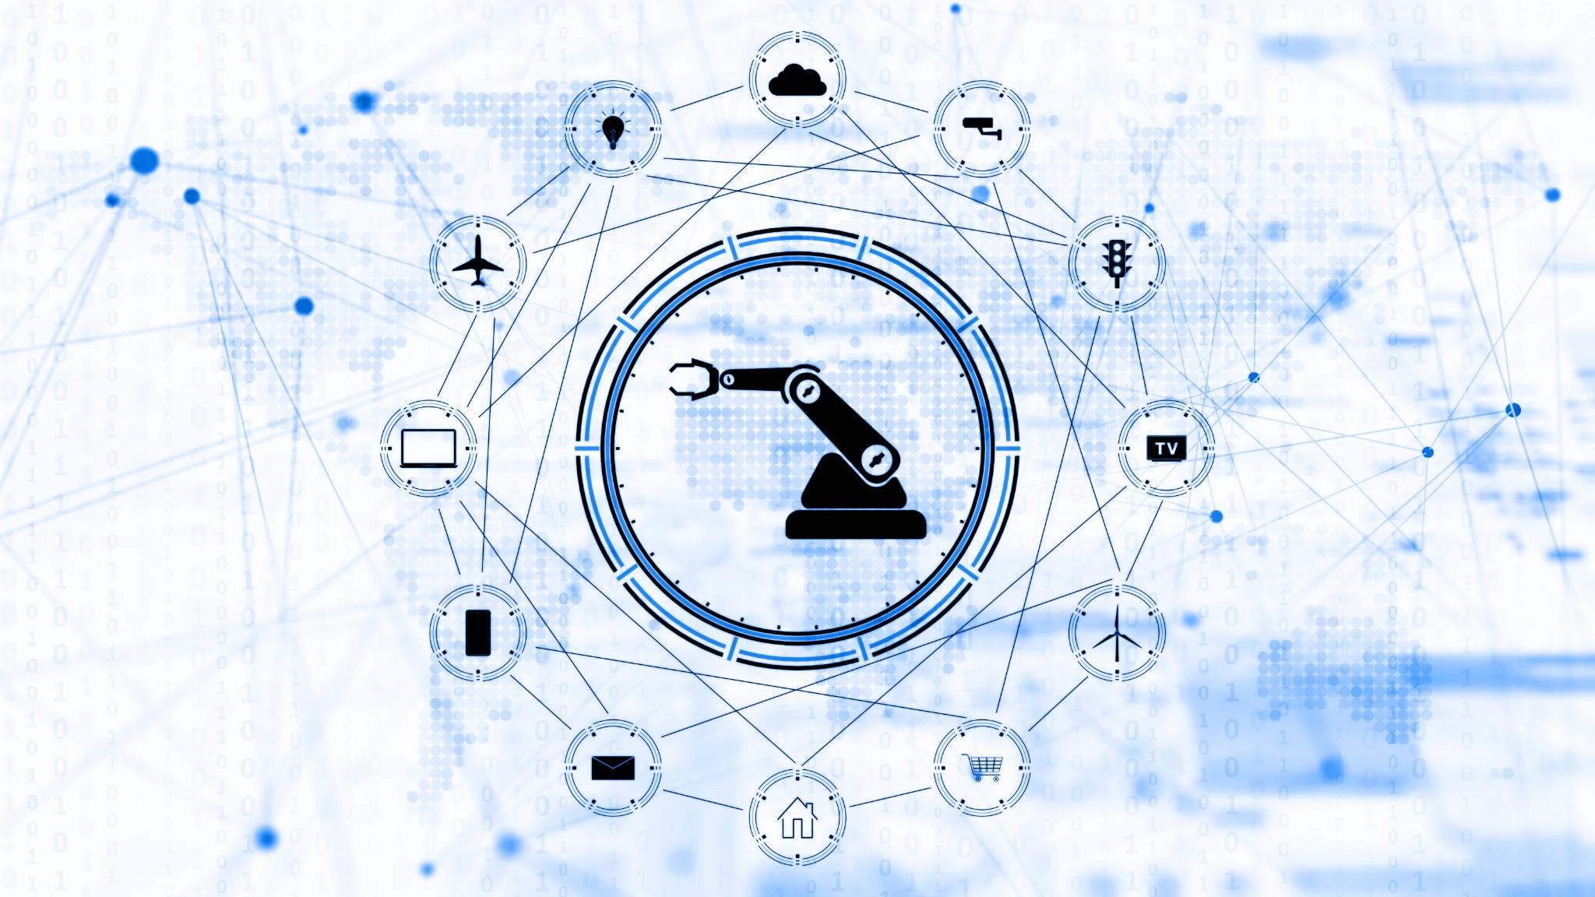
Automation, IoT, and Data Analytics
Real-Time Data Collection
IoT devices enable continuous real-time data collection to monitor operations and improve efficiency.
Enhanced Decision-Making
Data analytics processes collected data to support smarter, faster business decisions.
Automated Supply Chain
Automation integrates with IoT to streamline supply chain operations and increase productivity.

Slide 14

Blockchain and Emerging Technologies
Transparency and Security
Blockchain creates immutable records that enhance transparency and security in supply chain management.
Transaction Validation
Transaction validation ensures accuracy and trustworthiness of supply chain data through decentralized consensus.
Smart Contracts
Smart contracts automate agreements and processes, improving efficiency in supply chain operations.
Traceability Features
Blockchain technology enables precise traceability of products across the entire supply chain.

Slide 15
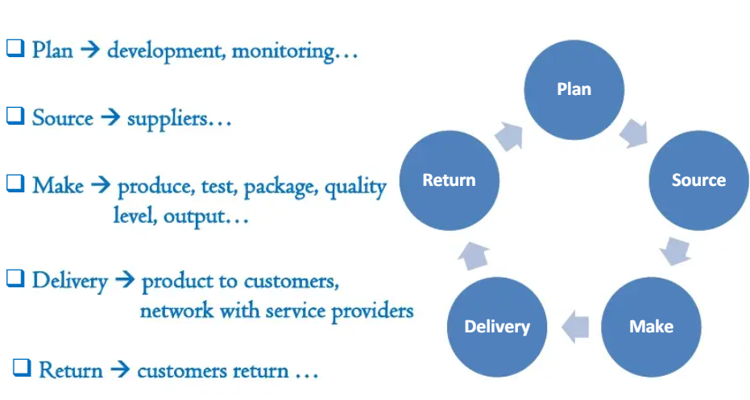
The Process :

Slide 16
Performance Measurement and Optimization

Slide 17
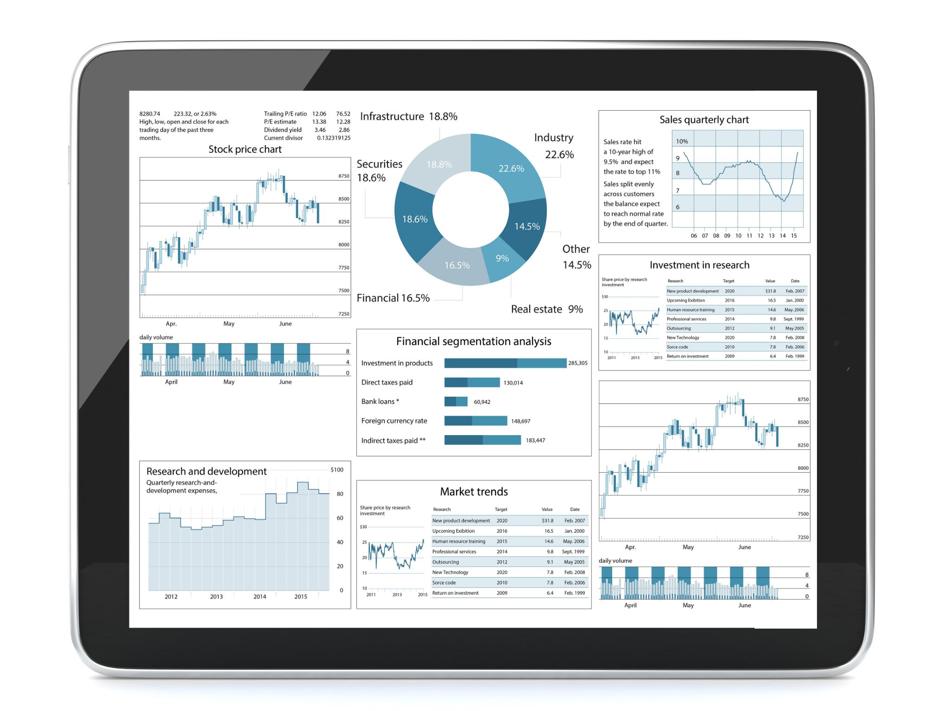
Key Performance Indicators (KPIs) in Supply Chain Management
Delivery Time Metrics
Delivery time KPIs measure the speed and reliability of product shipments in the supply chain.
Inventory Turnover
Inventory turnover KPIs track how frequently inventory is sold and replaced within a period.
Cost Efficiency
Cost efficiency KPIs monitor the expenses involved in supply chain operations to optimize spending.

Slide 18
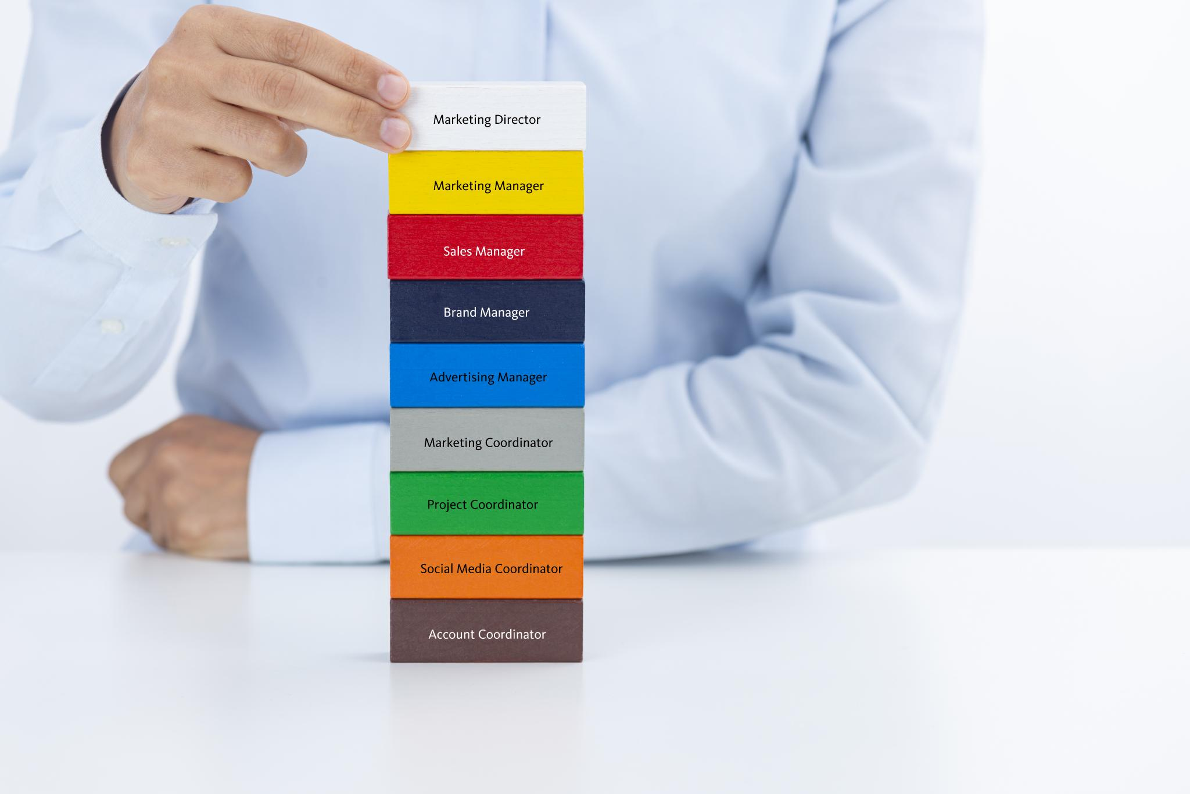
Risk Management and Resilience Strategies
Importance of Risk Identification
Identifying risks early is crucial to enhance supply chain resilience and prevent disruptions effectively.
Risk Assessment Matrix
A risk assessment matrix classifies risks by their impact and likelihood, prioritizing areas for strategic focus.
Strategic Risk Mitigation
Using risk classification to guide mitigation strategies helps maintain supply chain continuity and resilience.

Slide 19

Continuous Improvement and Lean Practices
Lean Methodologies Overview
Lean focuses on minimizing waste and maximizing efficiency in all processes.
Value Stream Mapping
Value stream mapping analyzes the flow of materials and information to identify improvement opportunities.

Slide 20
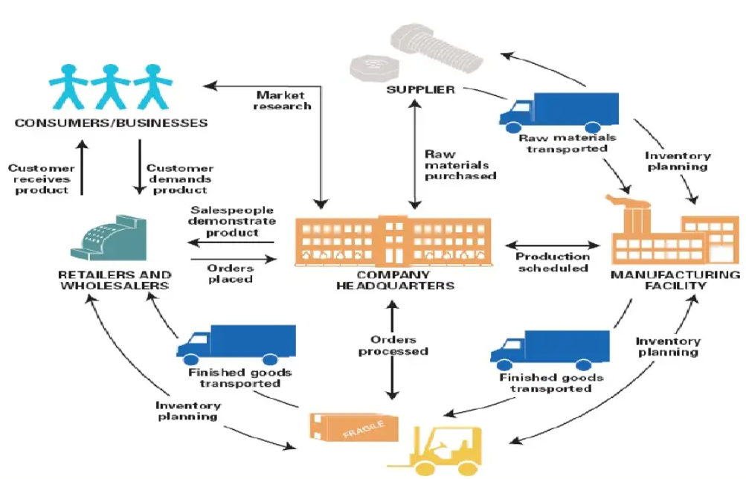
Supply Chain Analytics System
Notes:
Supply Chain Analytics System using Prophet,FastAPI, React & MongoDB

Slide 21
Supply Chain Analytics System
Prophet
FastAPI
React
MongoDB
Notes:
Supply Chain Analytics System using Prophet,FastAPI, React & MongoDB

Slide 22
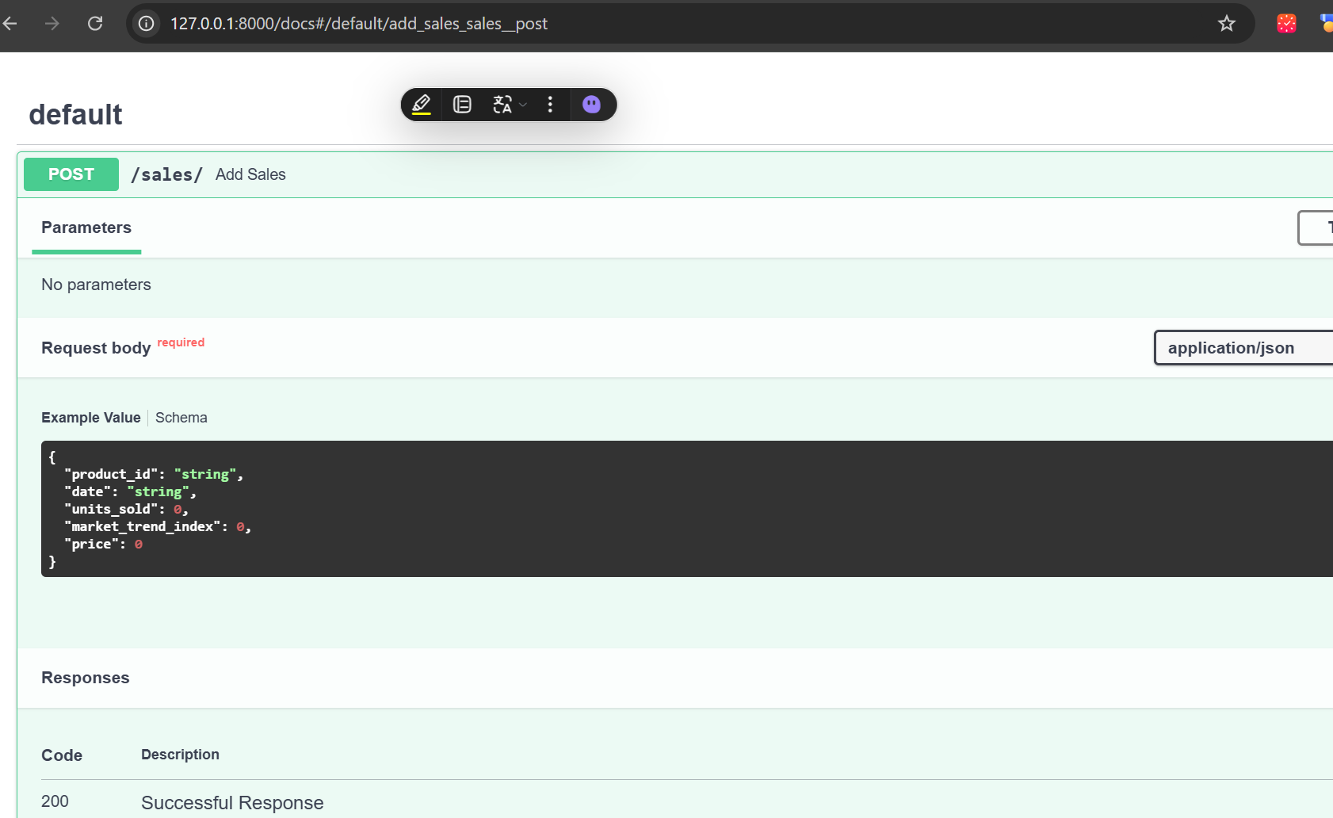
Supply Chain Analytics System
Prophet
FastAPI
React
MongoDB
Notes:
Supply Chain Analytics System using Prophet,FastAPI, React & MongoDB

