Slide 1
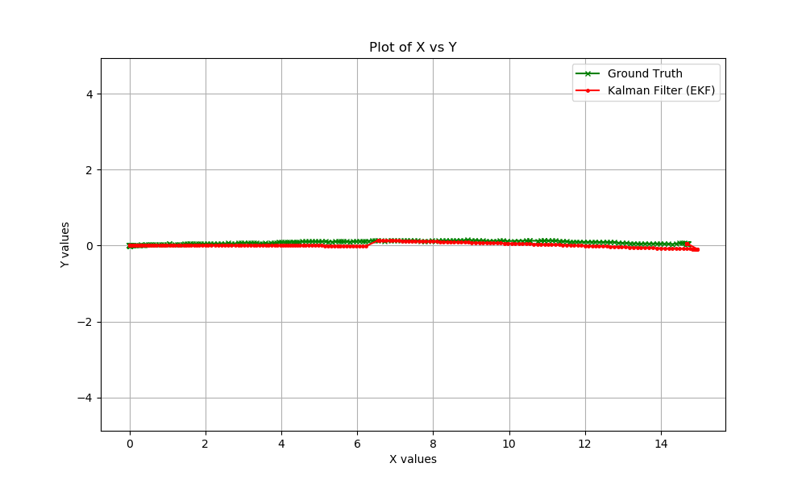
Run: 1 straight line

Slide 2
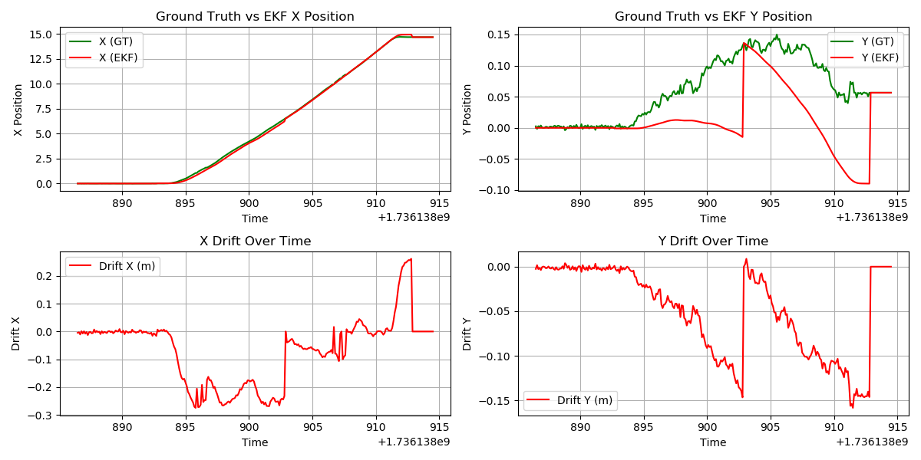
Run: 1 straight line

Slide 3
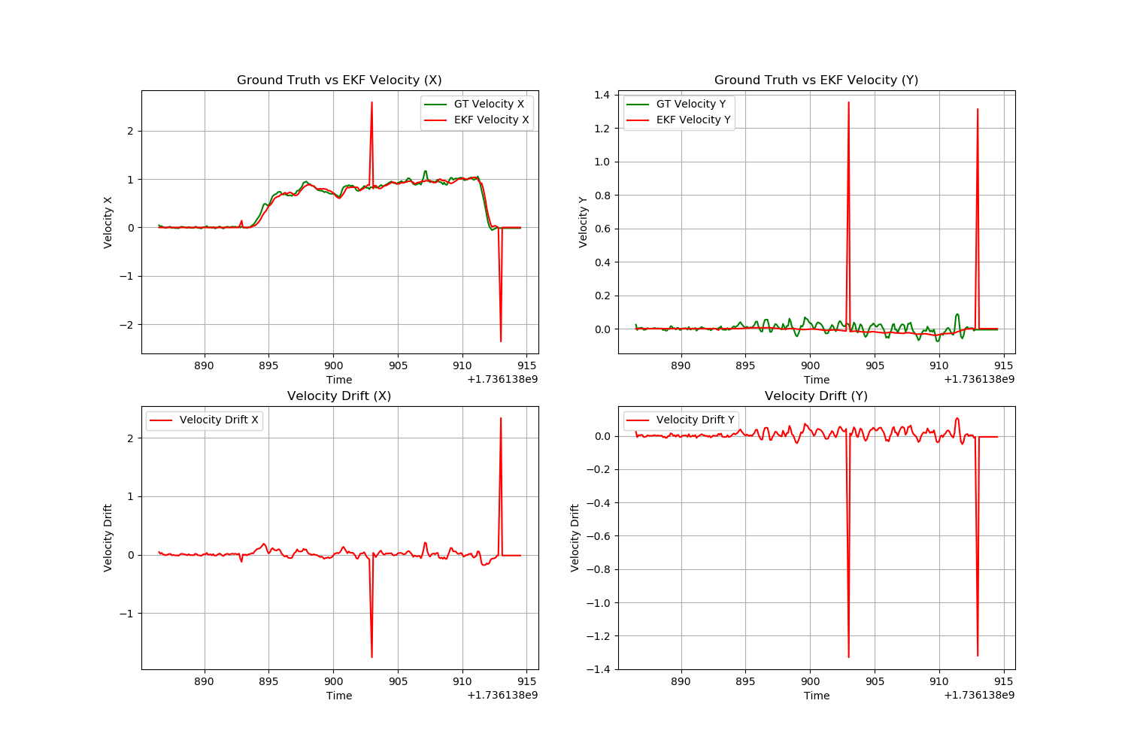
Run: 1 straight line

Slide 4
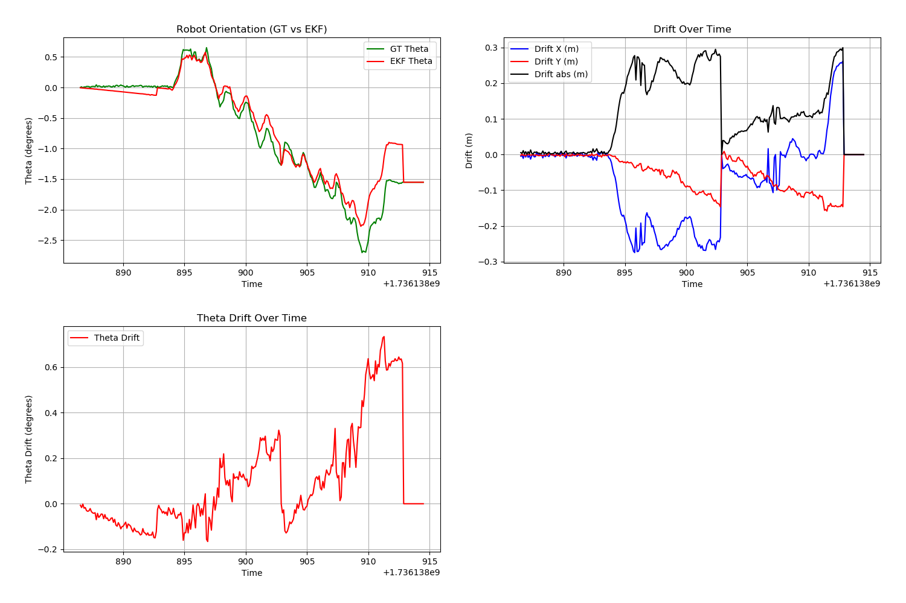
Run: 1 straight line

Slide 5
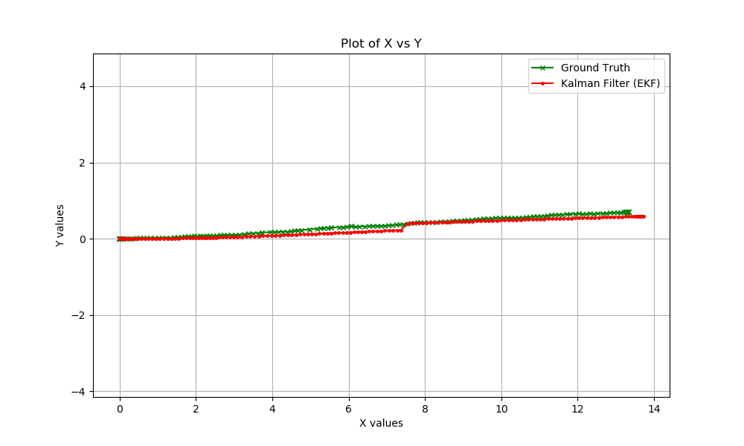
Run: 2 straight line

Slide 6
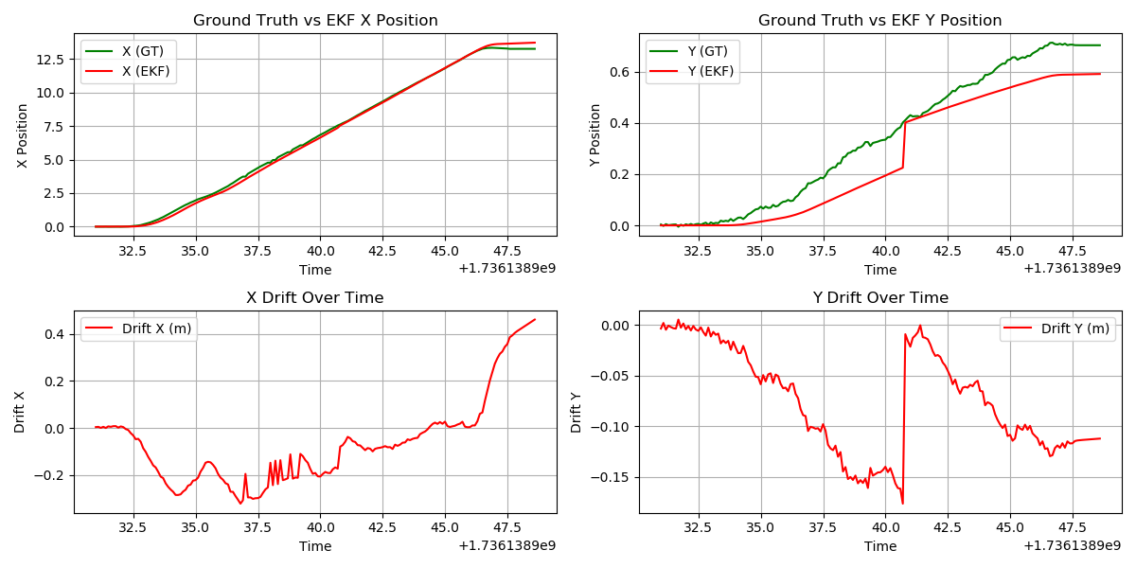
Run: 2 straight line

Slide 7
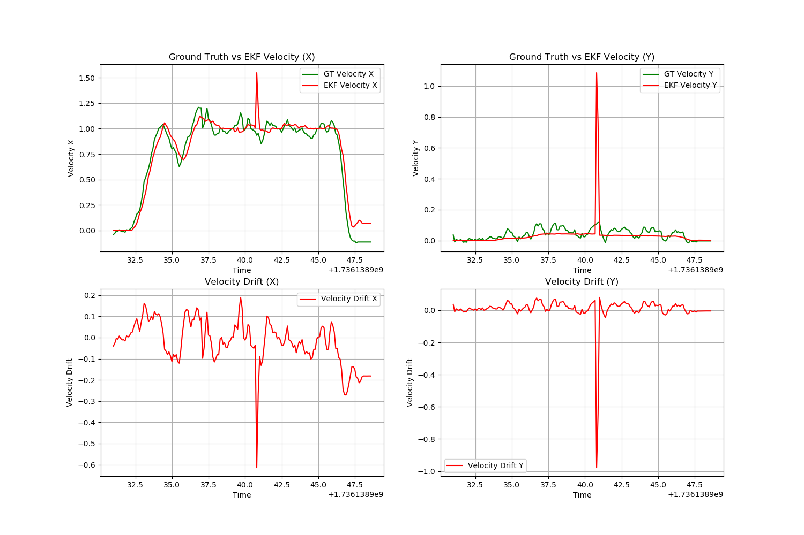
Run: 2 straight line

Slide 8
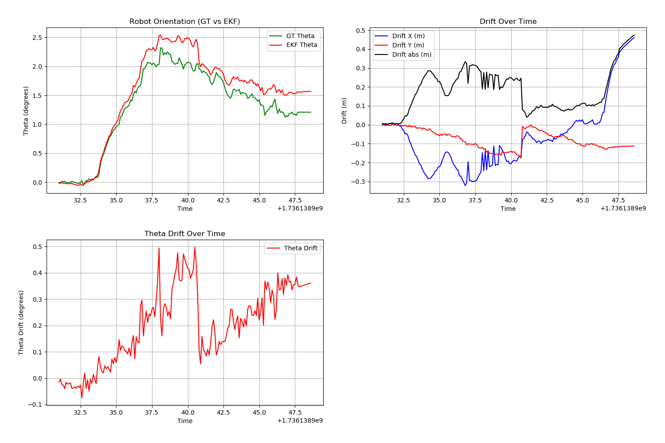
Run: 2 straight line

Slide 9
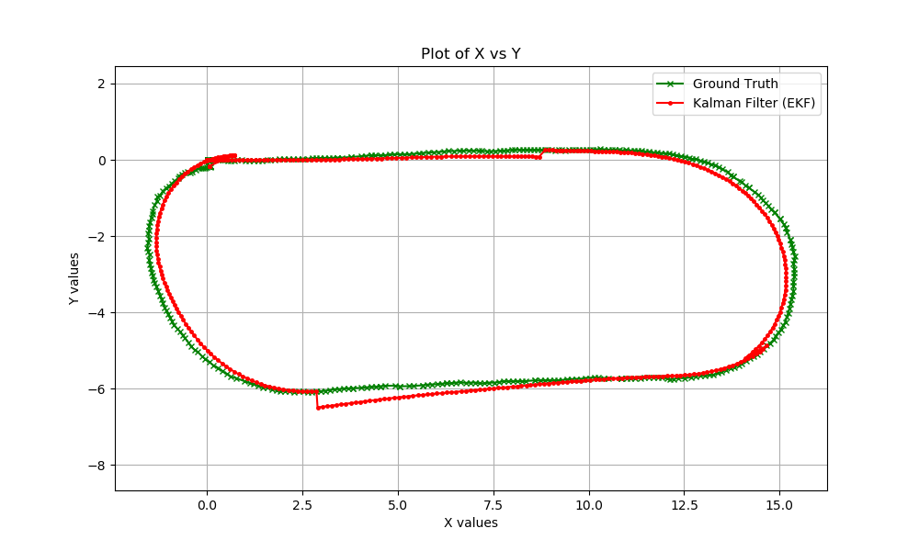
Run: 3 Closed Loop

Slide 10
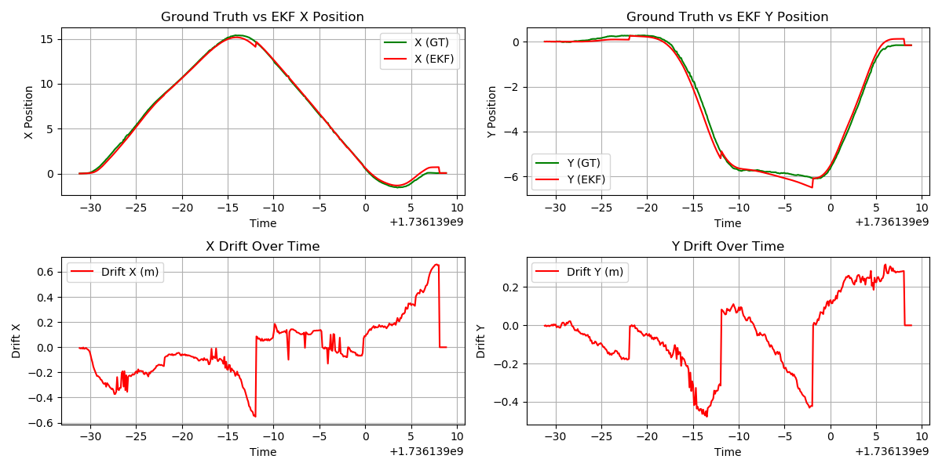
Run: 3 Closed Loop

Slide 11
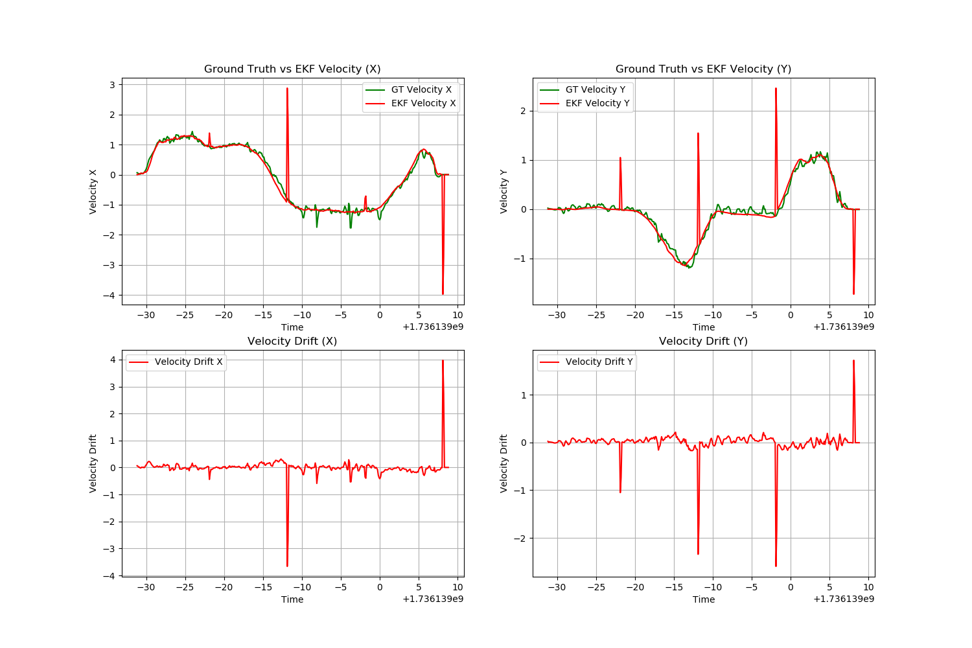
Run: 3 Closed Loop

Slide 12
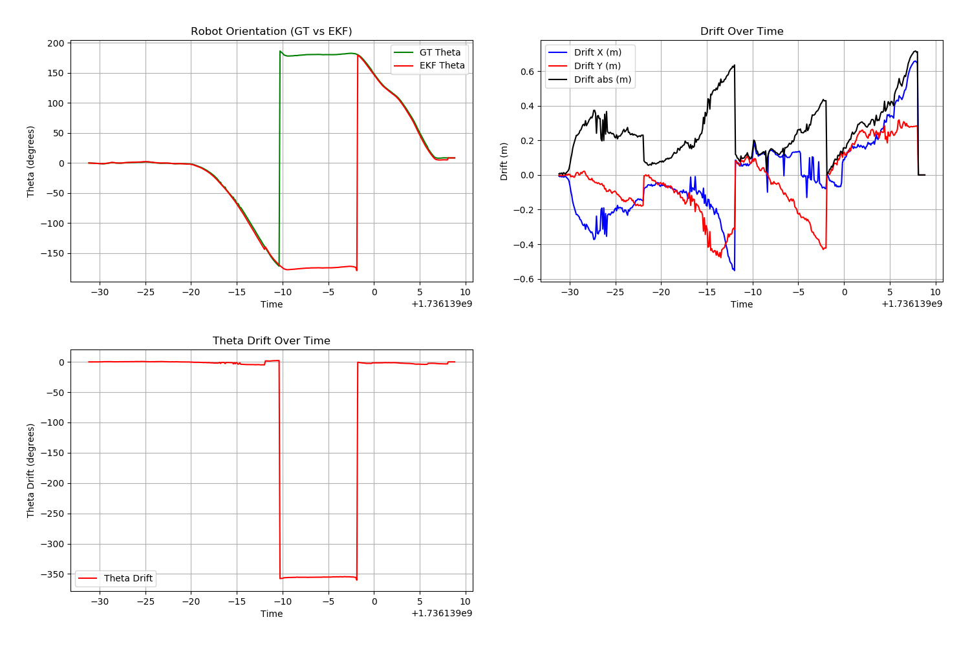
Run: 3 Closed Loop

Slide 13
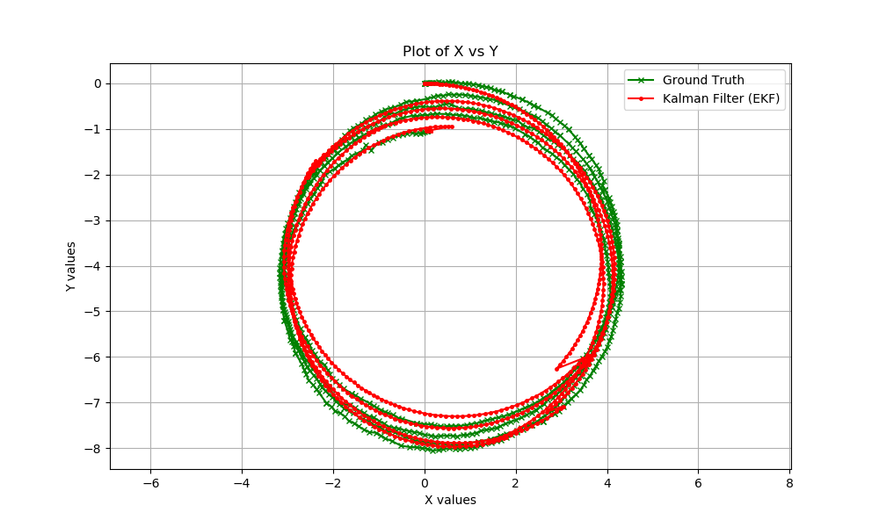
Run: 4 Closed Loop

Slide 14
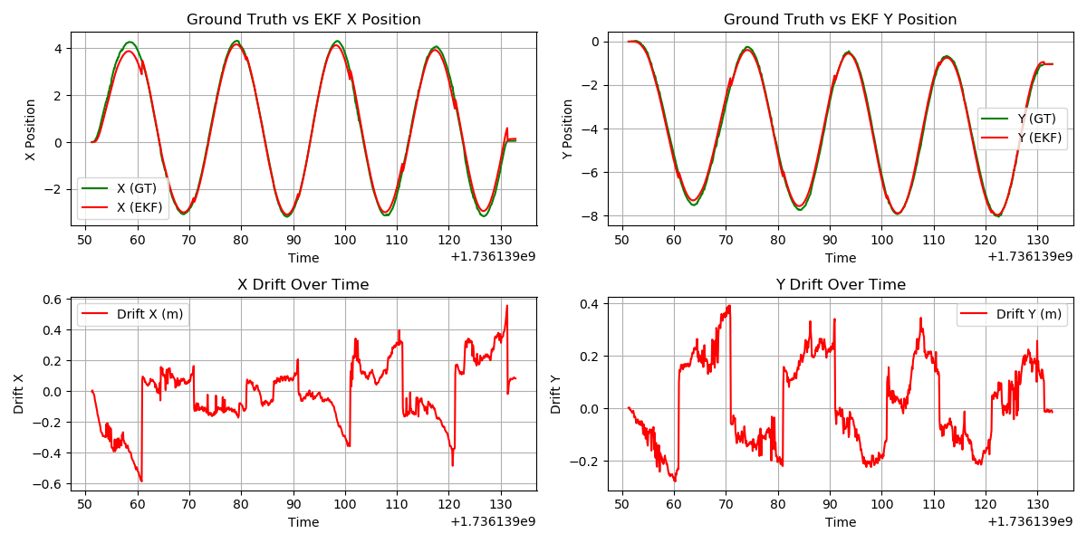
Run: 4 Closed Loop

Slide 15
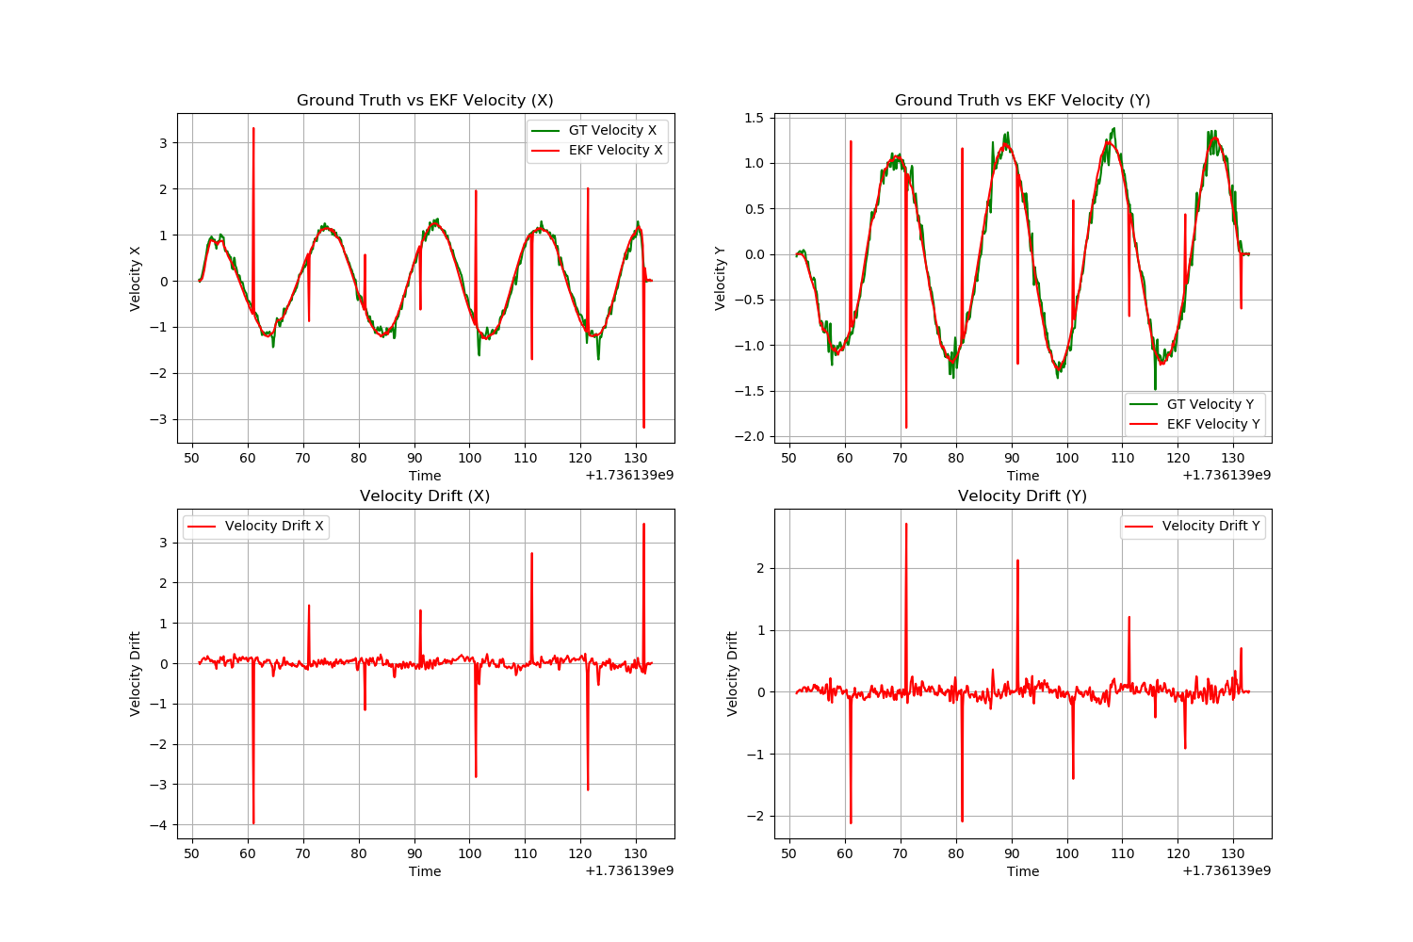
Run: 4 Closed Loop

Slide 16
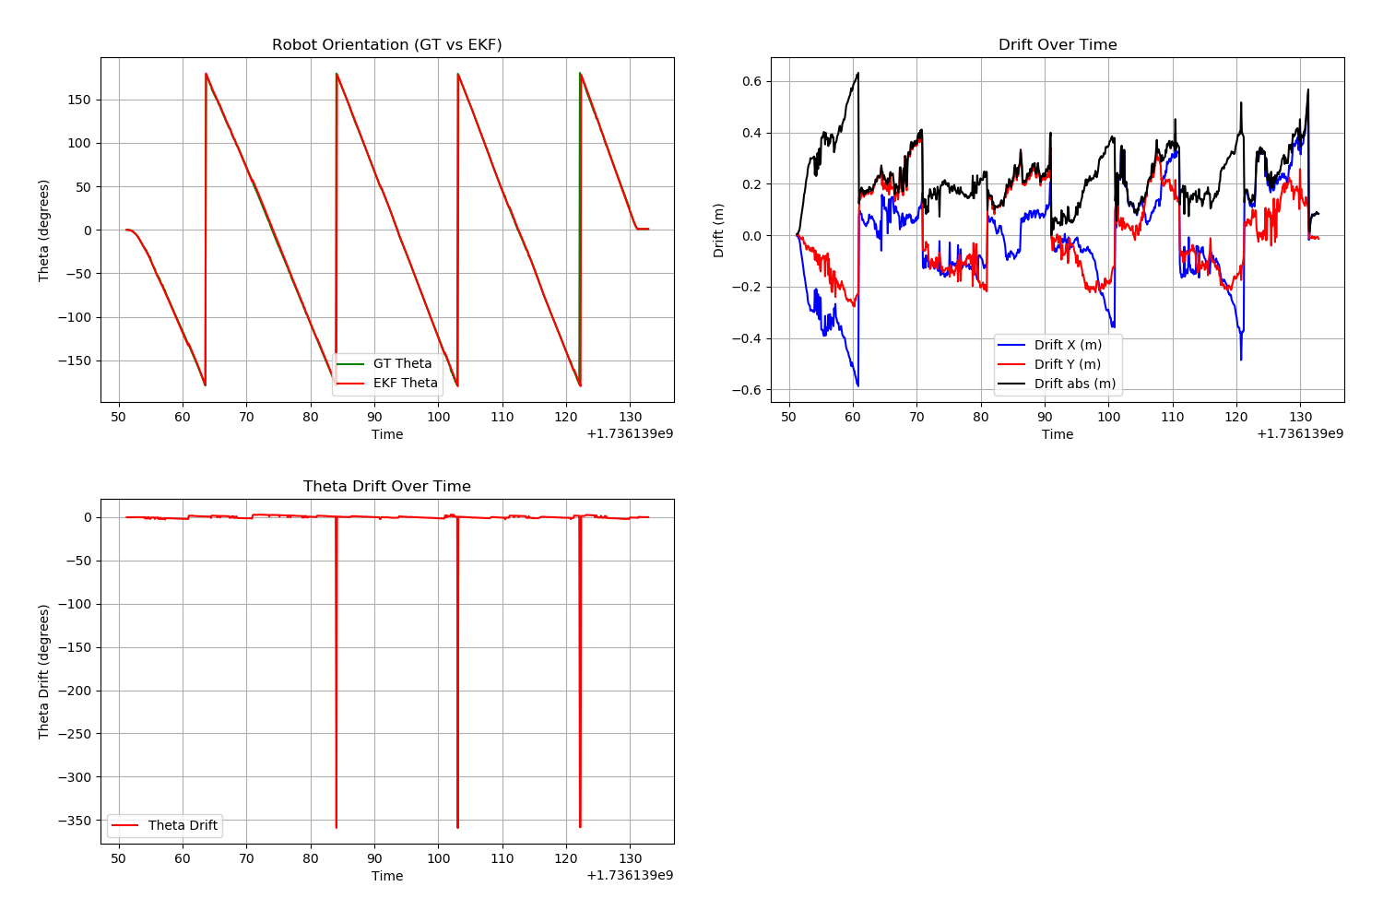
Run: 4 Closed Loop

Slide 17
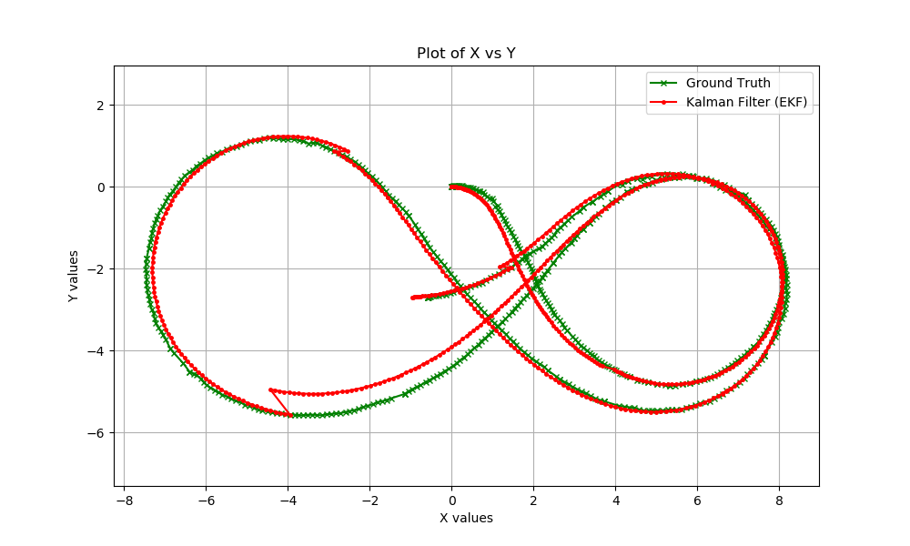
Run: 5 Figure 8

Slide 18
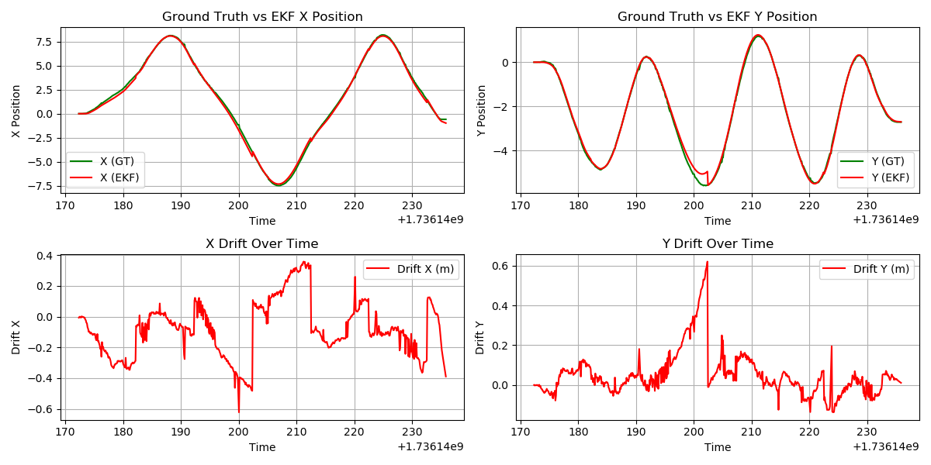
Run: 5 Figure 8

Slide 19
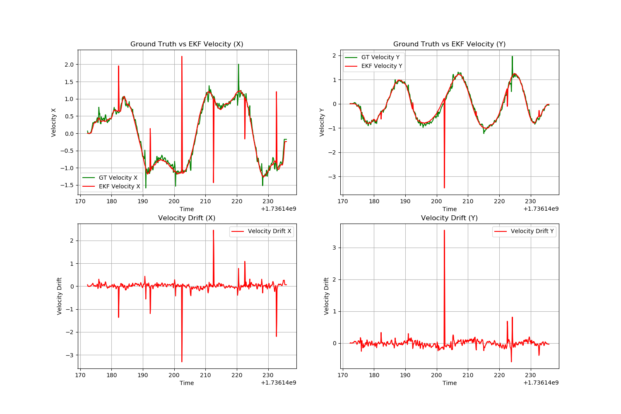
Run: 5 Figure 8

Slide 20
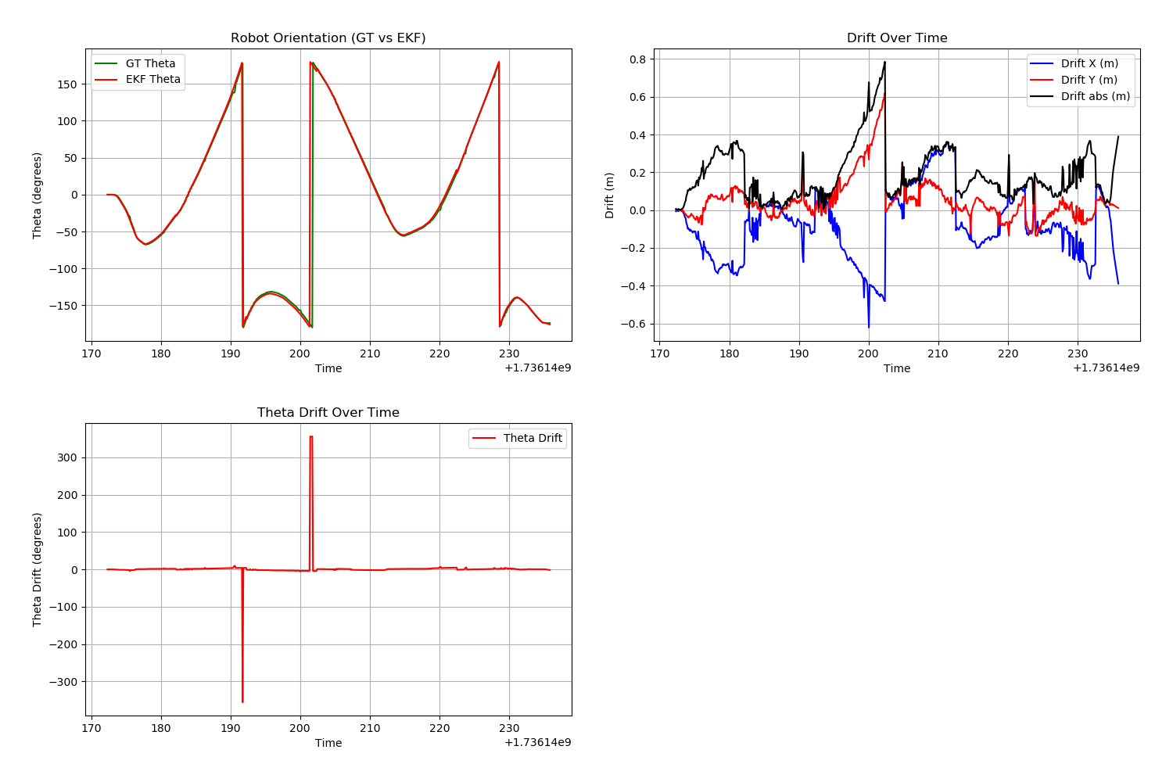
Run: 5 Figure 8

Slide 21
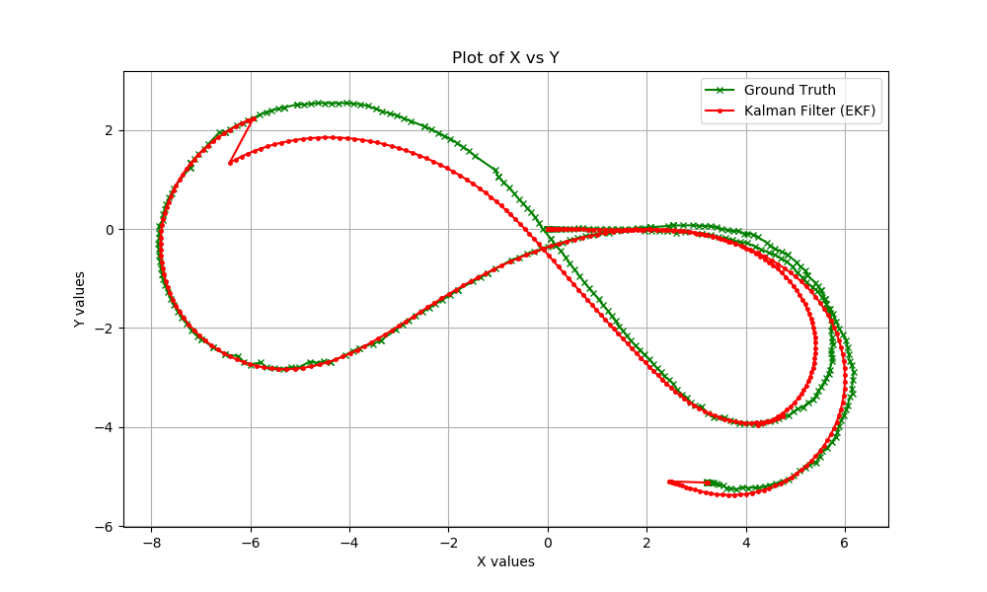
Run: 6 Figure 8

Slide 22
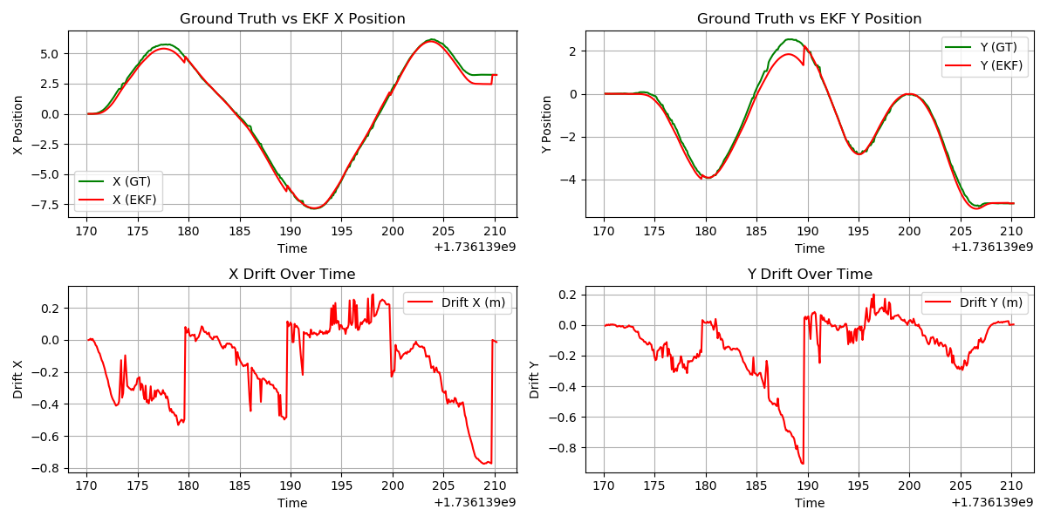
Run: 6 Figure 8

Slide 23
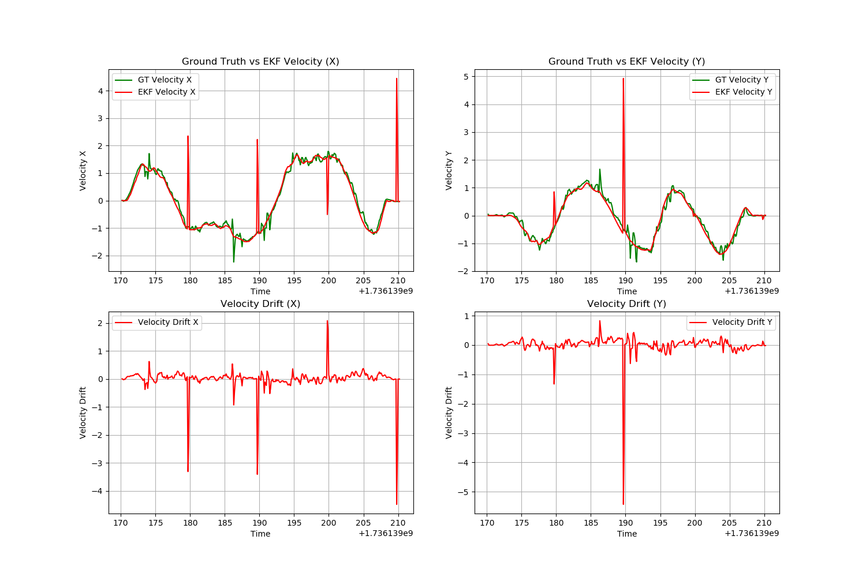
Run: 6 Figure 8

Slide 24
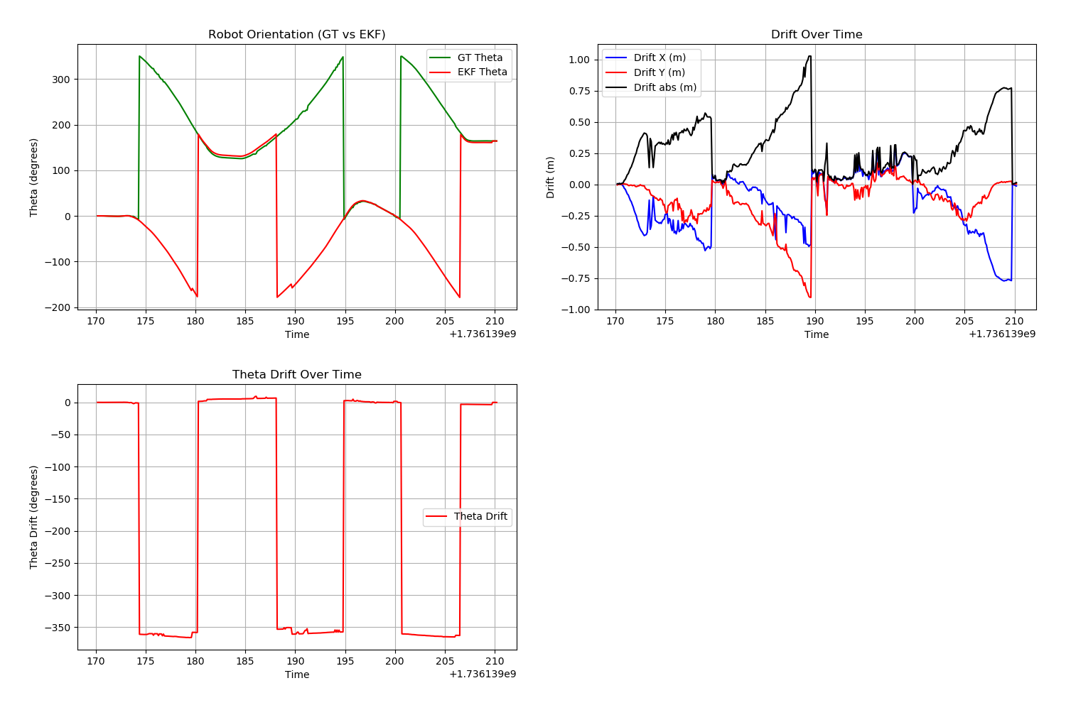
Run: 6 Figure 8

Slide 25
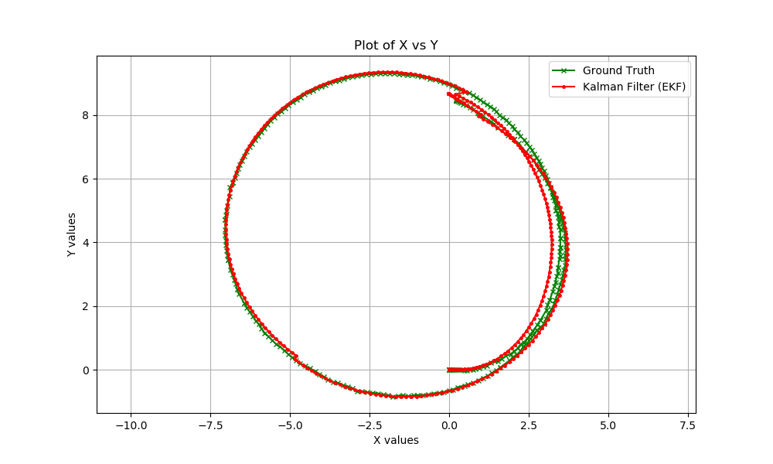
Run: 7 Closed Loop

Slide 26
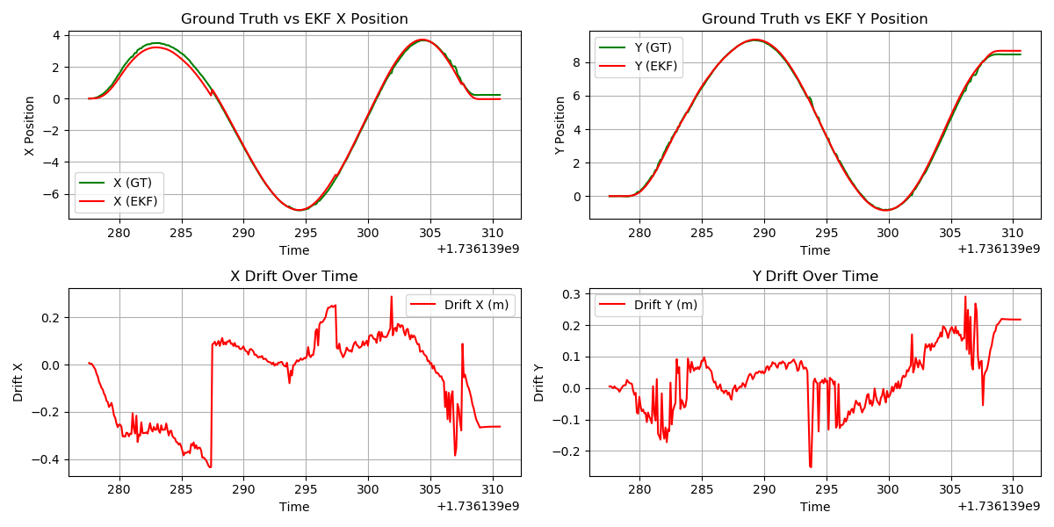
Run: 7 Closed Loop

Slide 27
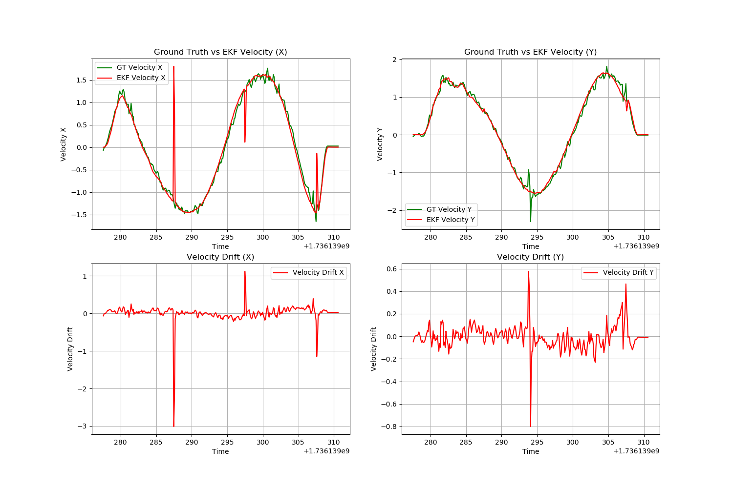
Run: 7 Closed Loop

Slide 28
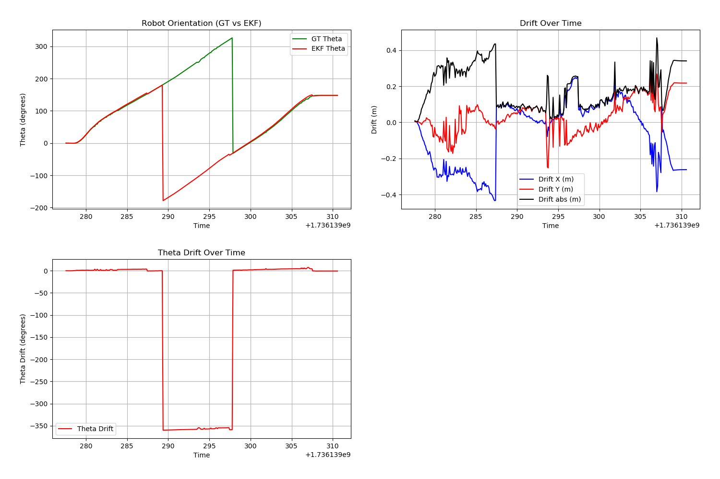
Run: 7 Closed Loop

Slide 29
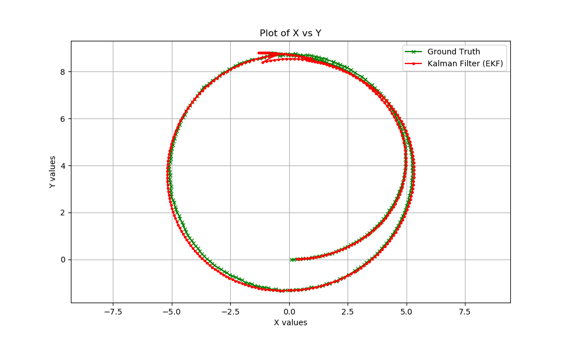
Run: 8 Closed Loop

Slide 30
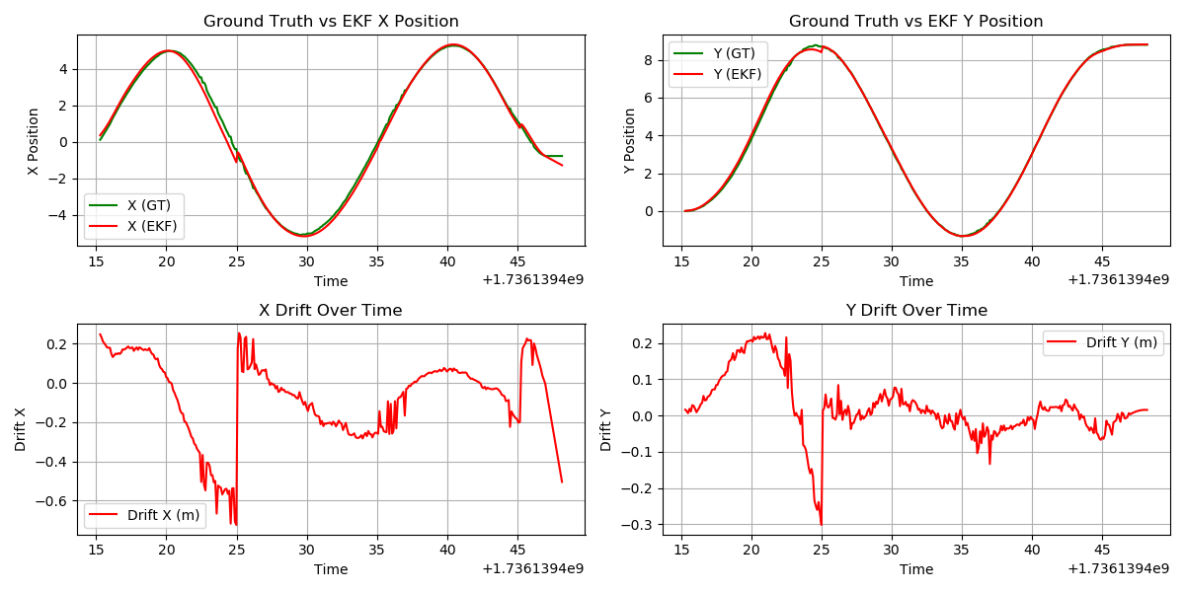
Run: 8 Closed Loop

Slide 31
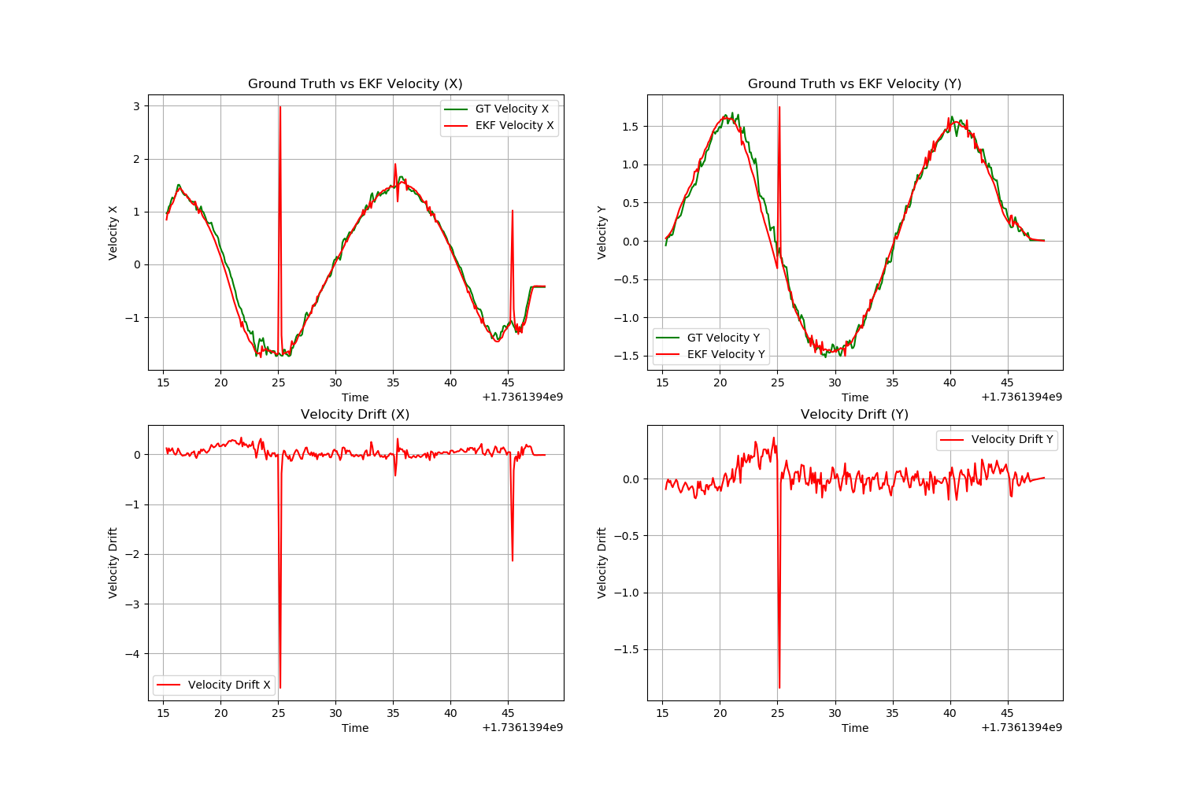
Run: 8 Closed Loop

Slide 32
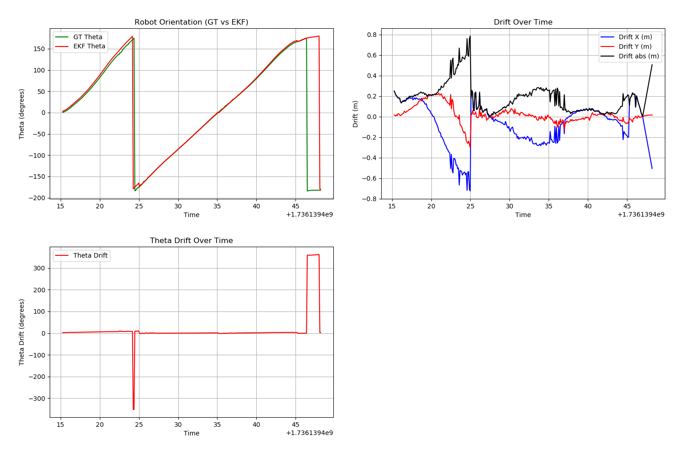
Run: 8 Closed Loop

Slide 33
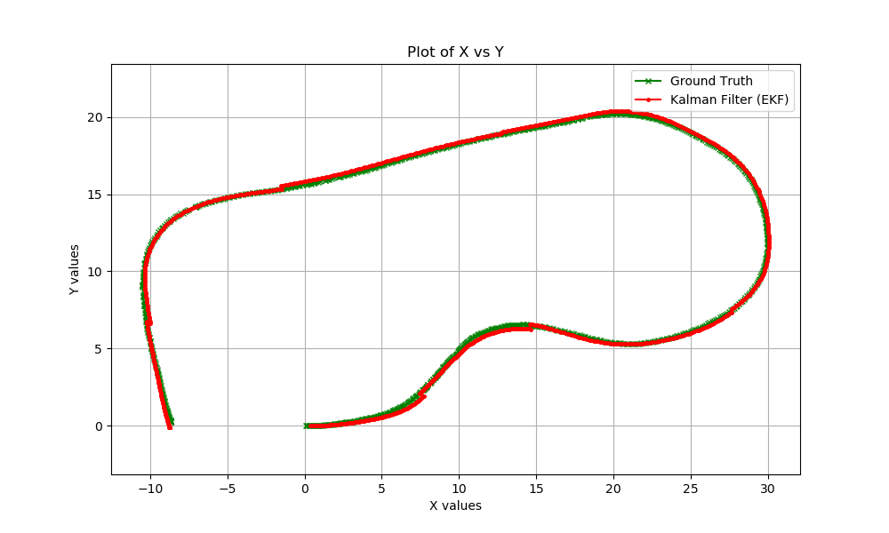
Run: 9 Arbitrary Path

Slide 34
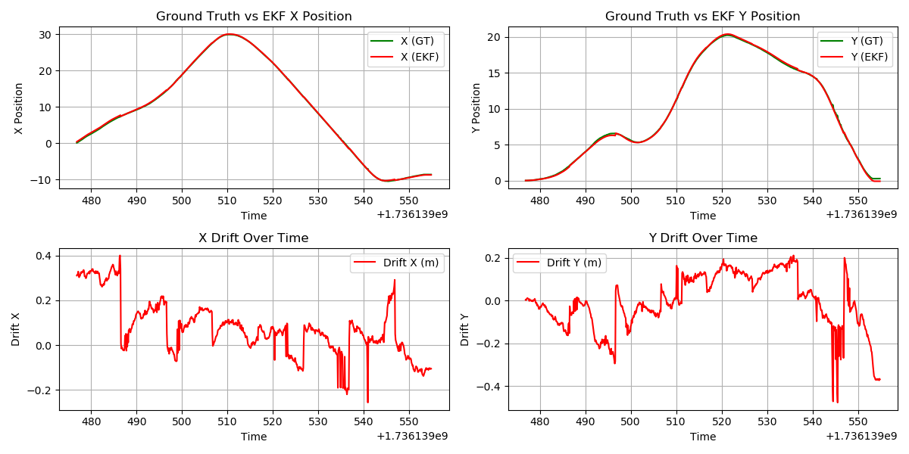
Run: 9 Arbitrary Path

Slide 35
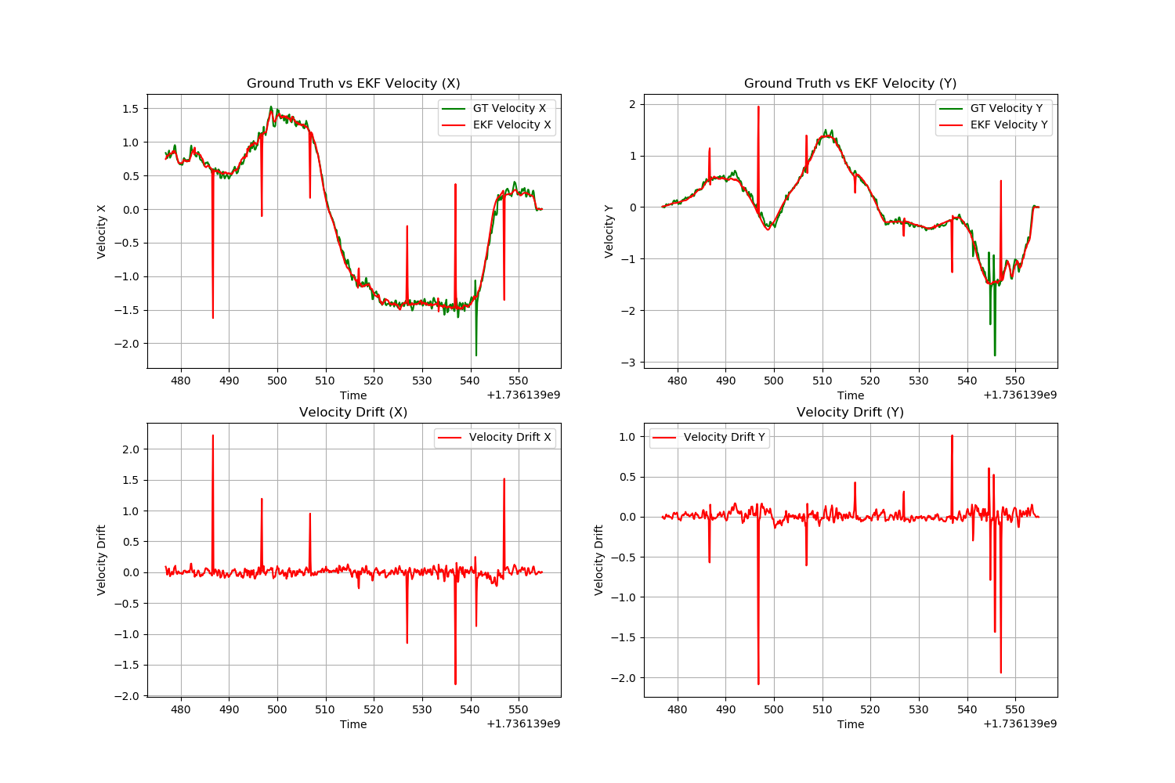
Run: 9 Arbitrary Path

Slide 36
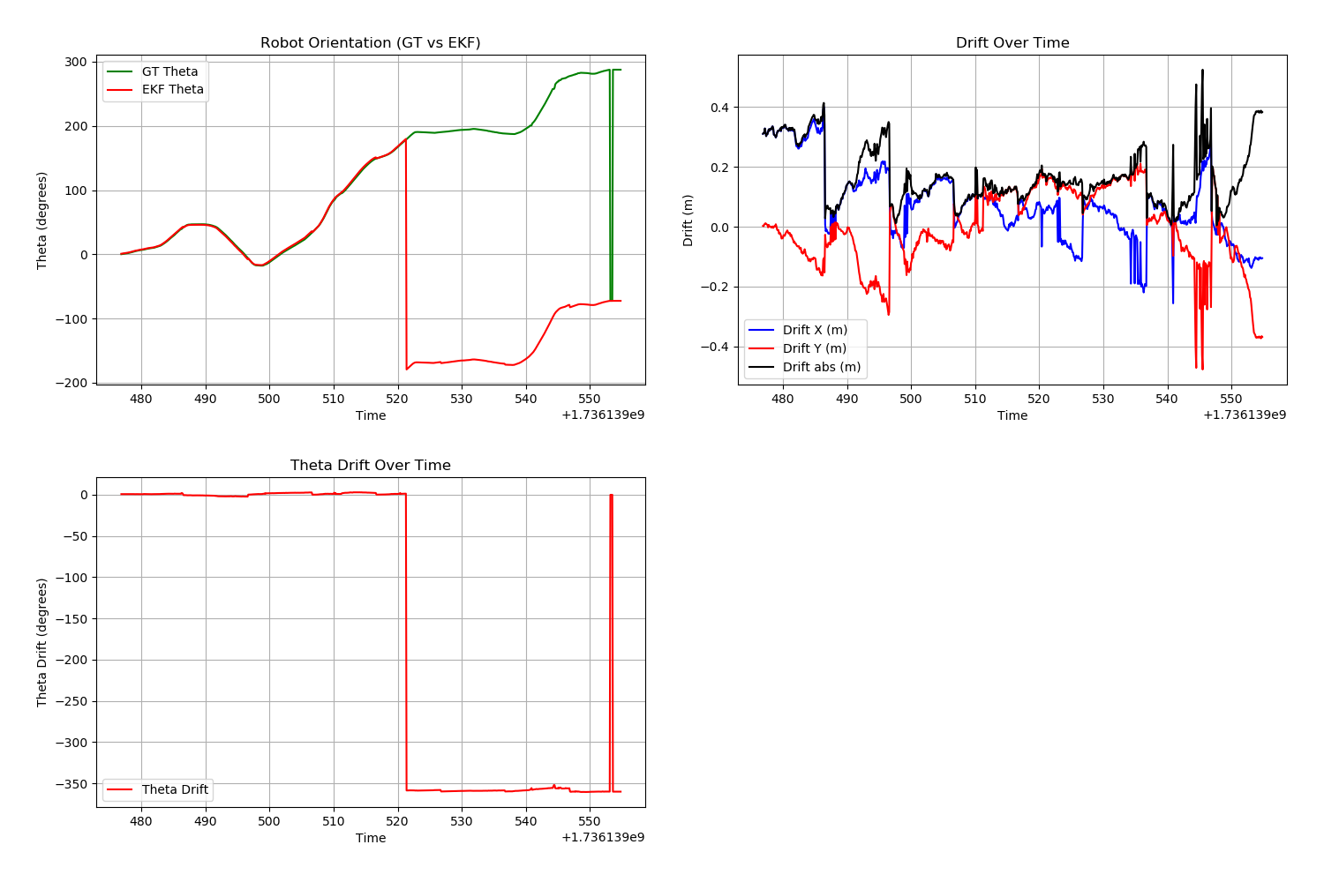
Run: 9 Arbitrary Path

