Slide 1


Grooming the Hairball - How to Tidy up Network Visualizations?
Hans-Jörg Schulz¹, Christophe Hurter²
VIS Tutorial 2013
University of Rostock, Rostock, Germany
French Civil Aviation University, ENAC, Toulouse, France

Slide 2
INTRODUCTION
Speakers: Hans-Jörg Schulz & Christophe Hurter

Slide 3
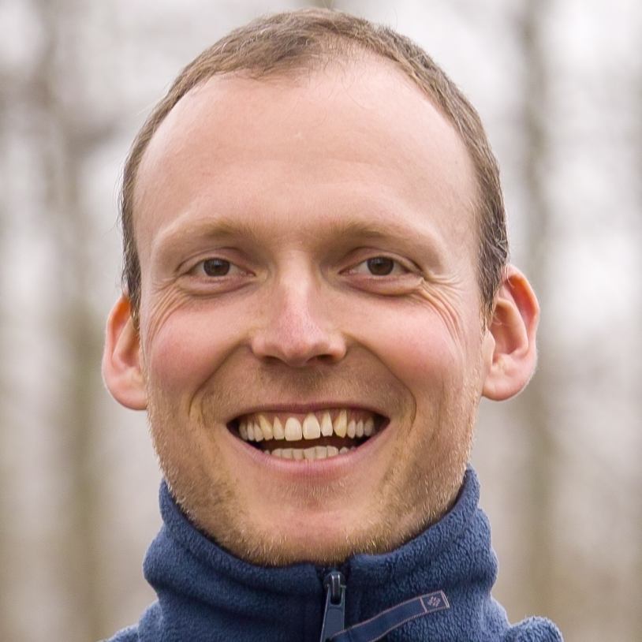
About the Speakers: Hans-Jörg Schulz
PhD in 2010 @ Rostock
Thesis on Graph Visualization
Now PostDoc @ Rostock
Fields of Research:
Design Spaces
Vis. of Heterogeneous Data
Vis. for the Life Sciences
Graph & Tree Visualization

Slide 4
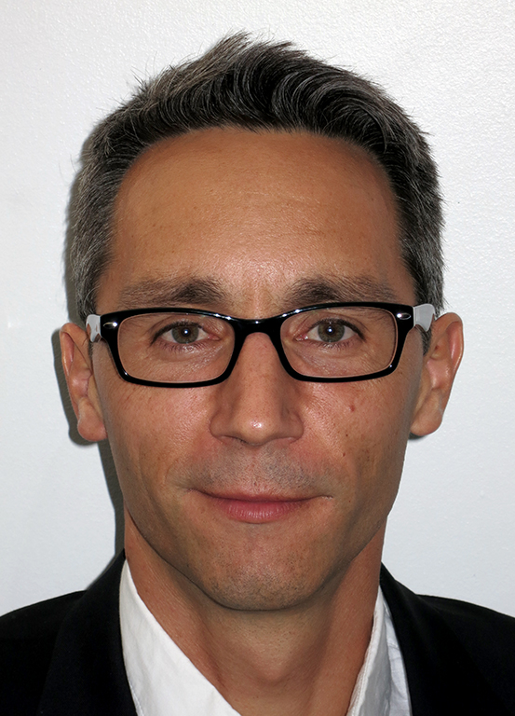
About the Speakers: Christophe Hurter
PhD in 2010 @ University of Toulouse
Thesis on Multivariate data exploration
Now Assistant Professor @ ENAC, French Civil Aviation University
Fields of Research:
Multivariate data exploration
GP-GPU techniques
Information visualization
Trajectory exploration

Slide 5
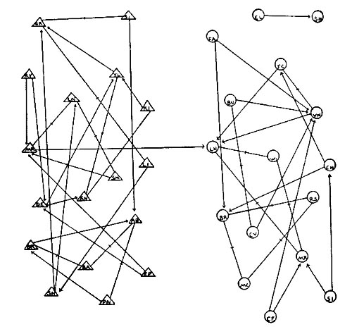
About the Tutorial Topic
Node-link diagrams for network data
often attributed to Moreno for depicting social networks
[source: Freeman 2000]
Notes:
Jacob Moreno

Slide 6
About the Tutorial Topic
Node-link diagrams for network data
often attributed to Moreno for depicting social networks
but instances of earlier examples exist (e.g., family trees ) that go back as far as the 13th century
(obviously) still hand-drawn back then
[source: Kruja et al. 2001]

Slide 7
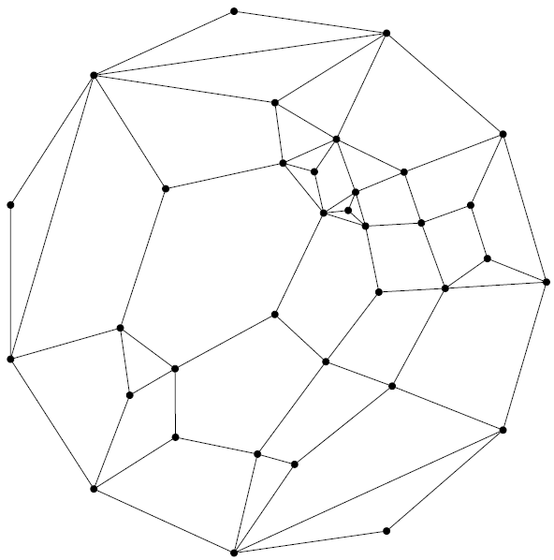
About the Tutorial Topic
Node-link diagrams for network data
often attributed to Moreno for depicting social networks
but instances of earlier examples exist (e.g., family trees ) that go back as far as the 13th century
(obviously) still hand-drawn back then
first automated layout routines appeared in the 1960‘s – e.g., [Tutte 1963]
[source: Eades+Hong 2012]

Slide 8
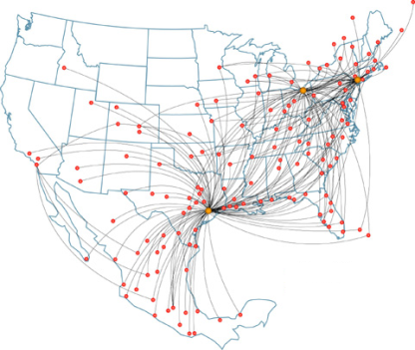
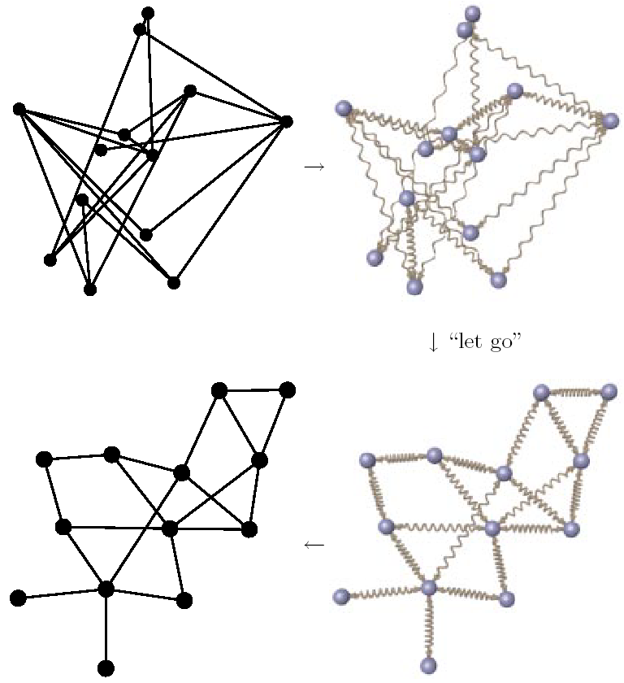
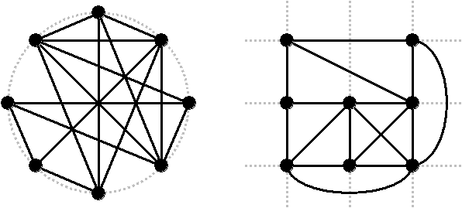
About the Tutorial Topic
Classifications of Node-link diagrams
By degrees of freedom of the nodes
Free
Styled
Fixed
[adapted from: Schulz+Schumann 2006]

Slide 9
About the Tutorial Topic
Classifications of Node-link diagrams
By degrees of freedom of the edges
Straight
Polyline/ Orthogonal
Spline
Arc
[adapted from: Gansner 2013, Dagstuhl talk]

Slide 10
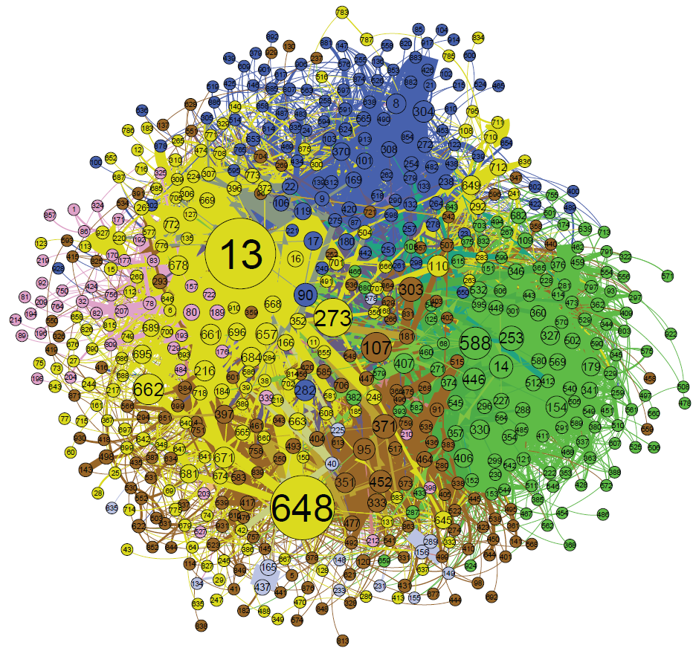
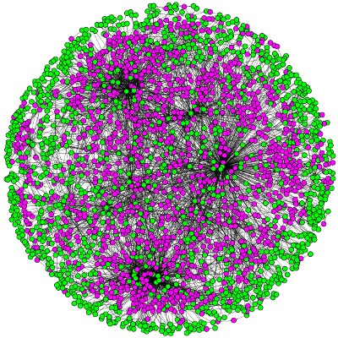
About the Tutorial Topic
But, Node-Link-Layouts usually don’t scale!
Blog network visualized with Gephi [source: learningfrontiers.eu]
E. coli metabolic network visualized with Cytoscape [source: kavrakilab.org]

Slide 11
About the Tutorial Topic
A Conceptual Framework to Solve this Problem
Network Simplification
WHEN?
Data Level (Filtering)
Geometry Level (Mapping)
Image Level (Rendering)
Detection
Determine where clutter occurs
Reduction
Remove the detected clutter by simplifying the network
HOW?
Interaction
Interactively refine the result

Slide 12
About the Tutorial Topic
A Conceptual Framework to Solve this Problem
Network Simplification
WHEN?
Data Level (Filtering)
Geometry Level (Mapping)
Image Level (Rendering)
Detection
Simplify the network before the actual layout starts
Simplify the network during the layout computation
Simplify the network after the layout has been generated
HOW?
Reduction
Interaction

Slide 13
About the Tutorial Topic
A Conceptual Framework to Solve this Problem
Network Simplification Examples
WHEN?
Data Level (Filtering)
Geometry Level (Mapping)
Image Level (Rendering)
Detection
Compute DoI values for elements
Determine con-fluence of edges
Register overplot-ting in each Pixel
HOW?
Reduction
Contract elements with low DoIs
Bundle edges with high pairwise confl.
Merge overplotted Pixels into a splat
Interaction
Adjust DoI threshold to steer the degree of reduction
Use lens to locally un-bundle edges for detailed inspection
Adapt the range of influence of the splat function (σ)

Slide 14
About the Tutorial Structure
Tentative Schedule:
0. Introduction (you’re listening to it right now) 8:30-8:45 (≈ 20 minutes)
Node Set Simplification 8:45-10:00 (≈ 70 minutes)
Edge Set Simplification 10:00-10:10 (≈ 10 minutes) 10:10-10:30 coffee break 10:30-11:35 (≈ 65 minutes)
Applications & Open Research Questions 11:35-12:10 (≈ 35 minutes)

Slide 15
About the Tutorial Structure
If you have remarks or questions please feel free to ask them on the spot!
Download this Slide Deck + the Literature List @
http://tinyurl.com/tutorial2013

