Slide 1


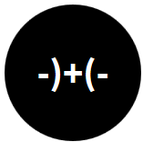
Opening the Black Box of Interaction in Visualization
Hans-Jörg Schulz¹, Tatiana v. Landesberger², Dominikus Baur³
VIS Tutorial 2014
D .MINIK.US
Fraunhofer IGD, Rostock, Germany
TU Darmstadt, Darmstadt, Germany
Dominikus Baur Interfacery

Slide 2
Part II: Interaction Architecture
Speaker: Hans-Jörg Schulz

Slide 3

Interaction Architecture





Slide 4
Interaction Architecture
What happens between the computer receives an input and sends off an output?
Designer’s Perspective – Interaction Models (UML, UAN,…)
User’s Perspective – History and Interruption Management
Software Engineer’s Perspective – Patterns for Interactive Software (MVC, DCI,…)

Slide 5
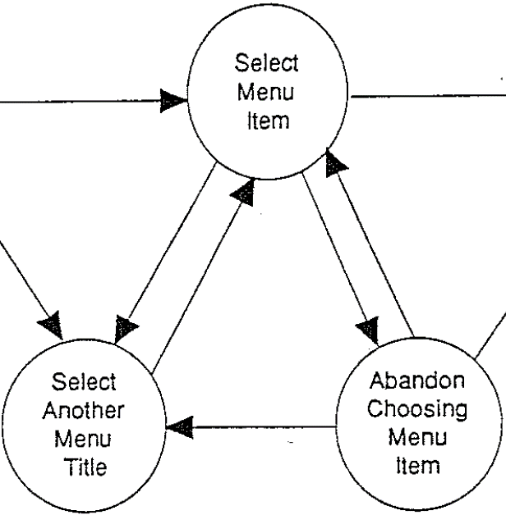
Interaction Models
Designer’s Perspective

Slide 6
Interaction Models
Why do we need to model interaction?
to capture requirements (when the user does this, then the system should do that)
to develop by
to evaluate against
to build workflows for passing on interaction knowledge and providing user guidance
to automatically generate UIs

Slide 7
Types of Interaction Models
What is modeled?
Extent: Single Action or whole Workflow
Granularity: Concrete Events or General Task

Slide 8
EXTENT
…
ACTIVITY
TASK
GRANULARITY
INTERACTION 1
INTERACTION n
ACTION
COMPUTATION
REACTION
ACTION
COMPUTATION
REACTION
E₁
E_{n}
0₁
0_{n}
M
R
E₁
E_{n}
0₁
0_{n}
M
R
Events
Operations
Mapping/ Rendering
Events
Operations
Mapping/ Rendering
…

Slide 9
Types of Interaction Models
What is modeled?
Extent: Single Action or whole Workflow
Granularity: Concrete Events or General Task
How is it modeled?
Diagrammatically: Sequence/Activity Diagram
Symbolically: Notations

Slide 10
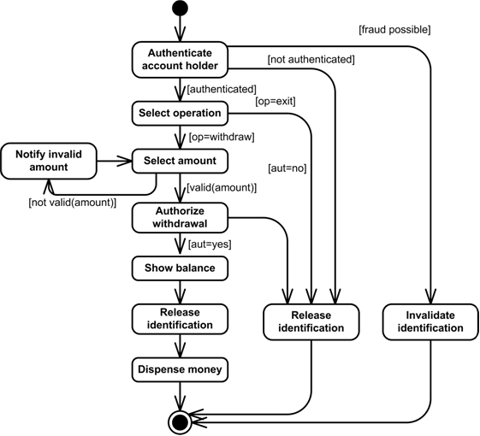
Diagrammatic Models (UML)
Activity Diagrams
State/Transition Diagram
Models the logical flow (of interaction)
Focus on which activities can be performed in which order and under which constraints […]
Overview character -> shows the whole flow
Image taken from Garcia et al. 2003

Slide 11
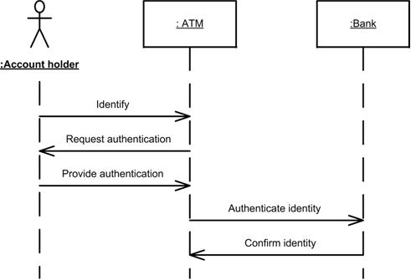
Diagrammatic Models (UML)
Sequence Diagrams
Lifeline Diagram
Models interaction between components as event sequences
Each sequence can be seen as a path through the activity diagram
Detail character -> shows one flow
TIME
Image taken from Garcia et al. 2003

Slide 12
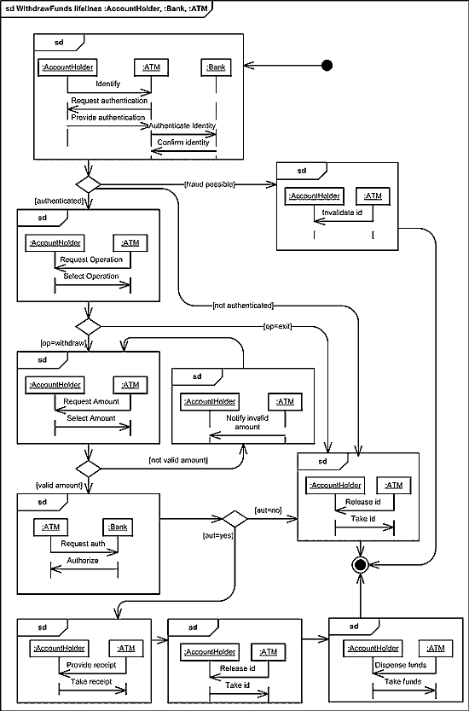
Diagrammatic Models (UML)
Interaction Overview Diagrams
Nested/Compounded Diagram
Combines Activity and Sequence Diagrams by embedding interaction for each activity
Compartmentalization of Sequence Diagram
Overview & Detail character combined -> somewhat crowded
Image taken from Garcia et al. 2003

Slide 13
Symbolic Models
Notations (Task Design Space)
Design Dimensions
Exploratory Analysis hypothesis generation through undirected search
Confirmatory Analysis hypothesis testing through directed search
Presentation communication of confirmed analysis results
WHY?
GOAL
HOW?
Design Choices
WHAT?
WHERE?
adapted from Schulz et al. 2013

Slide 14
Symbolic Models
Notations (Task Design Space)
Design Dimensions
Navigation changes the scope or granularity of the data
(Re-)organization adjusts the data by reducing or enriching it
Relation puts data in context by seeking similarities or differences
WHY?
GOAL
HOW?
MEANS
Design Choices
WHAT?
WHERE?
adapted from Schulz et al. 2013

Slide 15
Symbolic Models
Notations (Task Design Space)
Design Dimensions
WHY?
GOAL
Low-level Characteristics observations about data objects and data values visual literacy
High-level Characteristics complex patterns in the data visual analysis
HOW?
MEANS
Design Choices
WHAT?
CHARACTERISTICS
WHERE?
adapted from Schulz et al. 2013

Slide 16
Symbolic Models
Notations (Task Design Space)
Design Dimensions
Attribute Relations linking data objects to their attribute values – in particular:
Temporal Relations
Spatial Relations
Structural Relations linking data objects with each other
WHY?
GOAL
HOW?
MEANS
Design Choices
WHAT?
CHARACTERISTICS
WHERE?
TARGET
adapted from Schulz et al. 2013

Slide 17
Symbolic Models
Notations (Task Design Space)
Design Dimensions
WHY?
GOAL
Single Instance for highlighting details
Multiple Instances for showing data in context
All Instances for getting a complete overview
HOW?
MEANS
Design Choices
WHAT?
CHARACTERISTICS
WHERE?
TARGET
CARDINALITY
adapted from Schulz et al. 2013

Slide 18
Symbolic Models
Notations (Task Design Space)
Example: undirected search for a trend among all available temperature attribute values
(exploration, navigation(search), high-level(trend), attribute(temperature), all)
Presentation
Relation
High-Level
Structure
All
adapted from Schulz et al. 2013
Confirmation
(Re-)organization
Multiple
Exploration
Navigation
Low-Level
Attributes
Single
GOAL
MEANS
CHARACTERISTICS
TARGET
CARDINALITY

Slide 19
Symbolic Models
Notations (Task Design Space)
Example: undirected search for a trend among all available temperature attribute values
(exploration, navigation(search), high-level(trend), attribute(temperature), all)
Presentation
Relation
High-Level
Structure
All
adapted from Schulz et al. 2013
Confirmation
(Re-)organization
Multiple
Exploration
Navigation
Low-Level
Attributes
Single
GOAL
MEANS
CHARACTERISTICS
TARGET
CARDINALITY

Slide 20
Symbolic Models
Notations (Task Design Space)
Example: undirected search for a trend among all available temperature attribute values
(exploration, navigation(search), high-level(trend), attribute(temperature), all)
Presentation
Relation
High-Level
Structure
All
adapted from Schulz et al. 2013
Confirmation
(Re-)organization
Multiple
Exploration
Navigation
Low-Level
Attributes
Single
GOAL
MEANS
CHARACTERISTICS
TARGET
CARDINALITY

Slide 21
Symbolic Models
Notations (Task Design Space)
Example: undirected search for a trend among all available temperature attribute values
(exploration, navigation(search), high-level(trend), attribute(temperature), all)
Presentation
Relation
High-Level
Structure
All
adapted from Schulz et al. 2013
Confirmation
(Re-)organization
Multiple
Exploration
Navigation
Low-Level
Attributes
Single
GOAL
MEANS
CHARACTERISTICS
TARGET
CARDINALITY

Slide 22
Symbolic Models
Notations (Task Design Space)
Example: undirected search for a trend among all available temperature attribute values
(exploration, navigation(search), high-level(trend), attribute(temperature), all)
Presentation
Relation
High-Level
Structure
All
adapted from Schulz et al. 2013
Confirmation
(Re-)organization
Multiple
Exploration
Navigation
Low-Level
Attributes
Single
GOAL
MEANS
CHARACTERISTICS
TARGET
CARDINALITY

Slide 23
Symbolic Models
Notations (Task Design Space)
Example: undirected search for a trend among all available temperature attribute values
(exploration, navigation(search), high-level(trend), attribute(temperature), all)
Presentation
Relation
High-Level
Structure
All
adapted from Schulz et al. 2013
Confirmation
(Re-)organization
Multiple
Exploration
Navigation
Low-Level
Attributes
Single
GOAL
MEANS
CHARACTERISTICS
TARGET
CARDINALITY

Slide 24
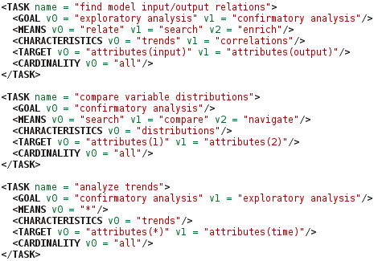
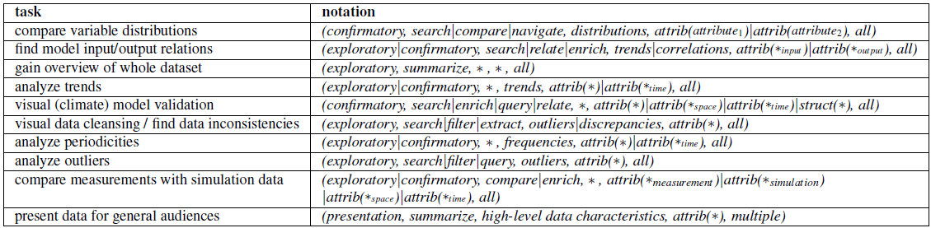
Symbolic Models
Notations (Task Design Space) – Domain-Specific Examples
[Schulz et al. 2013]

Slide 25
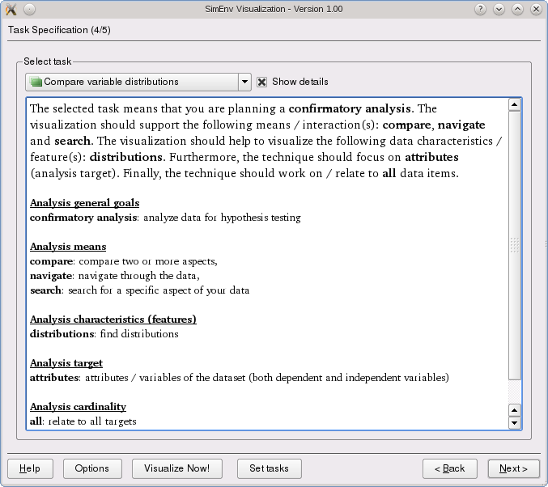
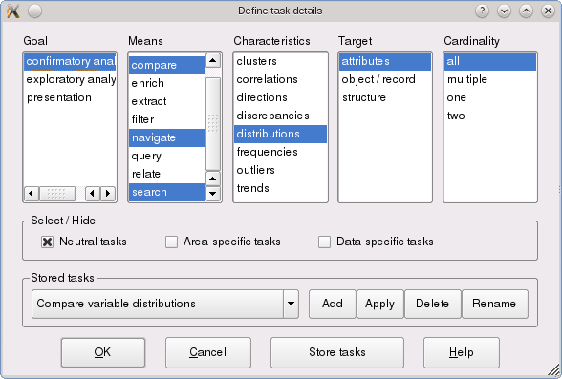
Symbolic Models
[Schulz et al. 2013]

Slide 26
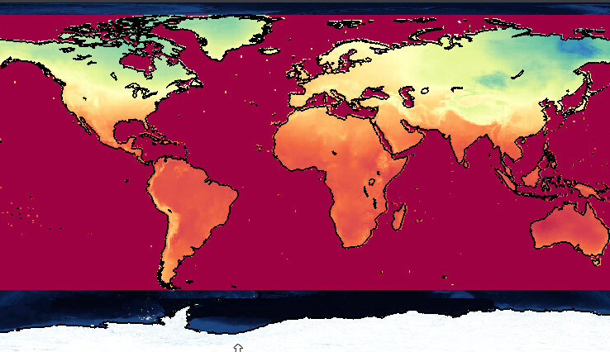
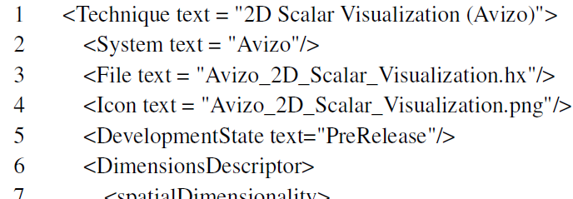
Symbolic Models
[Schulz et al. 2013]

Slide 27
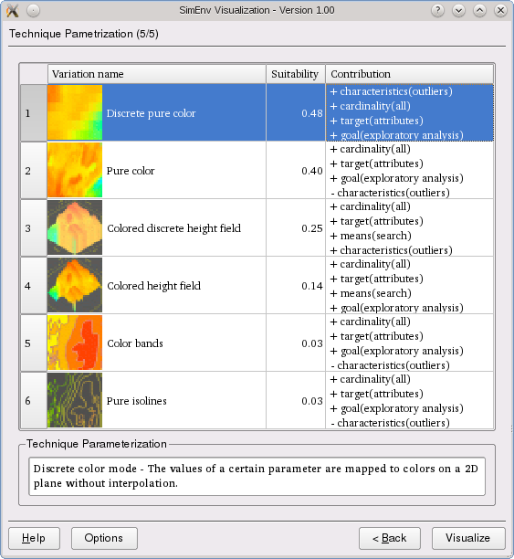
Symbolic Models
[Schulz et al. 2013]

Slide 28
Symbolic Models
Notations (UAN – User Action Notation)
ACTION
FEEDBACK
~ move cursor
Xv depress button “X”
X^ release button “X”
Xv^ click button “X”
( ) grouping of actions
* performed 0 or more times
+ performed 1 or more times
{ } enclosed action is optional
¥ for all
! highlight object
-! dehighlight object
!-! blink object
(!-!)^{n} blink object n times
X > ~ object follows cursor
@x,y at point x,y
display(X) show object X
erase(X) hide object X
outline(X) outline object X
adapted from [Hartson et al. 1990]
And some more…

Slide 29
Symbolic Models
Notations (UAN – User Action Notation)
TASK: move a file icon
USER ACTIONS | INTERFACE FEEDBACK | INTERFACE STATE | COMPUTATION
~[file icon] Mv | file_icon-!: file_icon! ¥file_icon‘!: file_icon‘-! | selected = file
~[x,y]* ~[x‘,y‘] | outline(file_icon) > ~
M^ | @x‘,y‘ display(file_icon) |  | location(file_icon) = x‘,y‘
adapted from [Hartson et al. 1990]

Slide 30
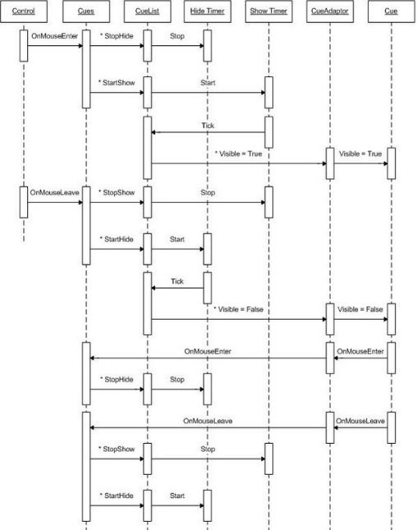
Combining the What and the How
We can use these diagrams (and notations) on all levels of granularity!
Image source Mark Belton 2006, http://www.codeproject.com/Articles/13027/
Image taken from Garcia et al. 2005

Slide 31
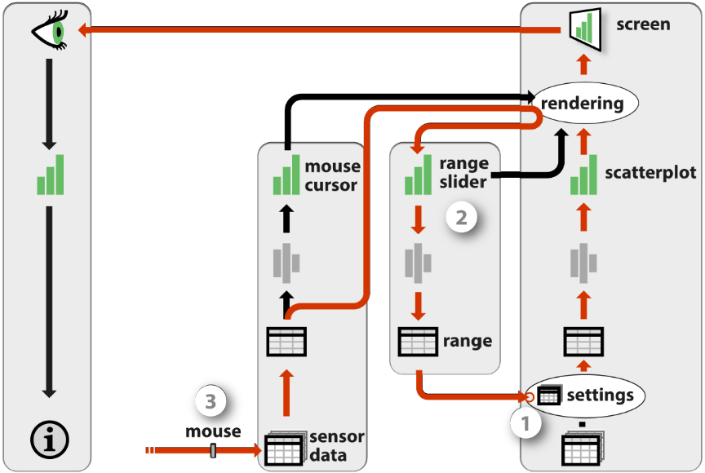
Combining the What and the How
Example 1: An Extended Infovis Pipeline
Source: [Jansen + Dragicevic 2013]

Slide 32

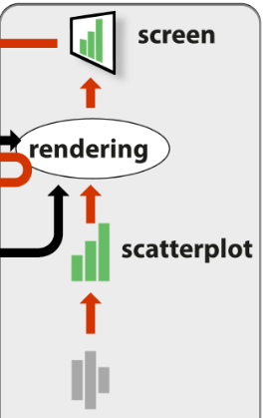
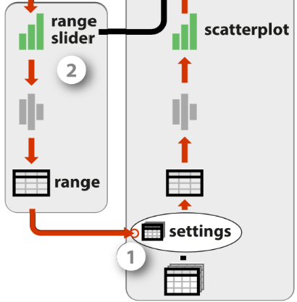
Combining the What and the How
Example 1: An Extended Infovis Pipeline
INTERACTION 1
ACTION
COMPUTATION
REACTION
E₁
E_{n}
0₁
0_{n}
M
R

Slide 33
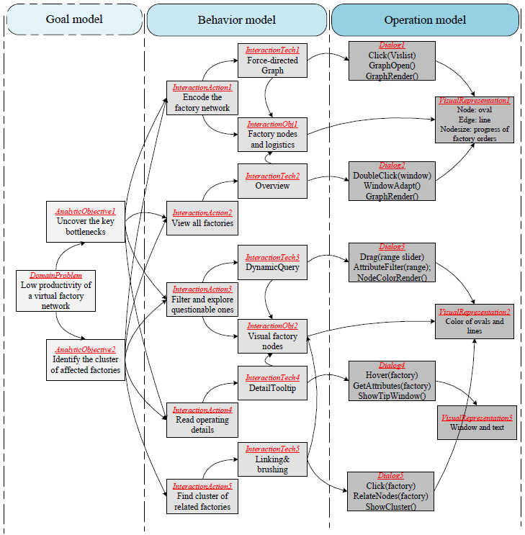
Combining the What and the How
Example 2: Multilevel Interaction Model
Source: [Ren et al. 2013]

Slide 34




Combining the What and the How
Example 2: Multilevel Interaction Model
ACTIVITY
TASK
INTERACTION 1
ACTION
COMPUTATION
REACTION
E₁
E_{n}
0₁
0_{n}
M
R

Slide 35
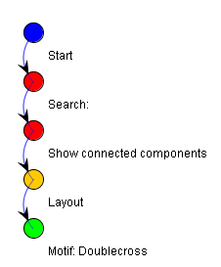
History and Interruption Management
User’s Perspective

Slide 36
History Management
Interaction History
“Keep a history of actions to support undo, replay, and progressive refinement.”
-- Ben Shneiderman 1996
Three aspects:
Recording history (logging)
Utilizing the current history (undo/redo)
Utilizing a collection of histories (guidance)

Slide 37
History Management: 1. Recording Interaction History
Approaches differ in:
What is captured (actions vs. states) -> states easier to log, actions allow more diverse use
How the information is aligned (linear vs. branching time)
Which and how many levels of detail are captured (low vs. mid vs. high) -> highly problematic to discern when one action ends and the next begins -> use of taxonomy/ontology can help to define actions more clearly
Scope (local vs. global) -> from system-wide logging (e.g., Glass box by Cowley et al.) to object-specific logging (e.g., per spreadsheet or per cell)
adapted from Heer et al. 2008

Slide 38
History Management: 2. Utilizing the Current History
Operations on the history:
Reflect: passively show the history as it evolves alongside the visualization
Replay: recap the history for presentation/validation purposes
Retrace: undo/redo an action or reestablish a prior state
Reuse: reapply a sequence of actions like a makro
Reconfigure: selective undo/redo, reordering, refining, reparametrization
Report: annotate, share

Slide 39

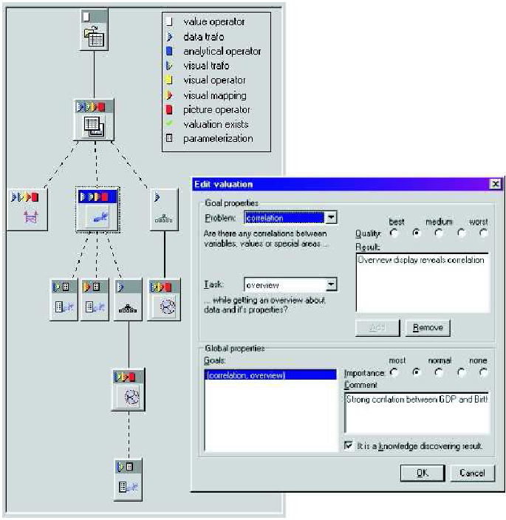
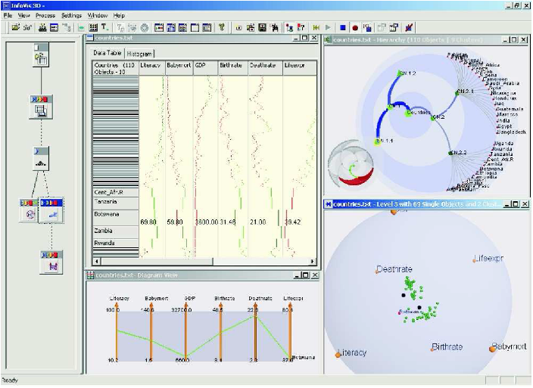
History Management
1_history.avi
Example for History Management
Image source Kreuseler et al. 2004

Slide 40
History Management: 3. Utilizing a Collection of Histories
Analyze/mine past histories to provide guidance:
Guidance context: prior knowledge of the user -> nothing, goal (desired final state), path (activity sequence), full
Guidance domain: the matter on which guidance shall be provided -> data, views, infrastructure, users
Guidance target: how the aim or goal of the guidance is declared -> direct (directed search), indirect (query by example), inverse indirect (discover the unexpected)
Guidance degree: how much freedom to deviate is still allowed -> orienteering -> steering -> storytelling -> animated animation
taken from Schulz et al. 2014

Slide 41
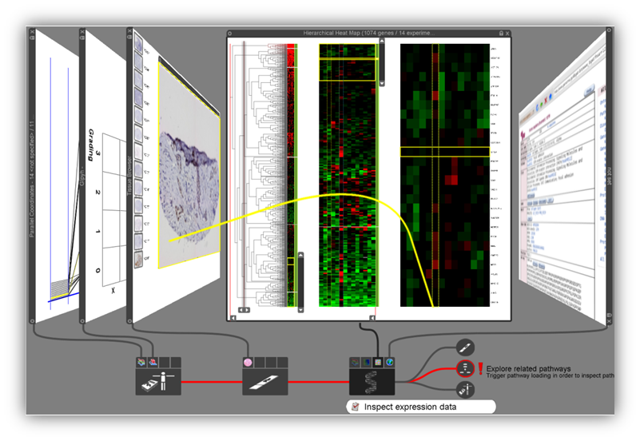
History Management
2_guidance.mp4
Example for Guidance:
Image source: Streit et al. 2012

Slide 42
Interruption Management
Who interrupts whom?


user interrupts computational task
concurrent task interrupts comp. task


collaborator interrupts user
computational task interrupts user

Slide 43
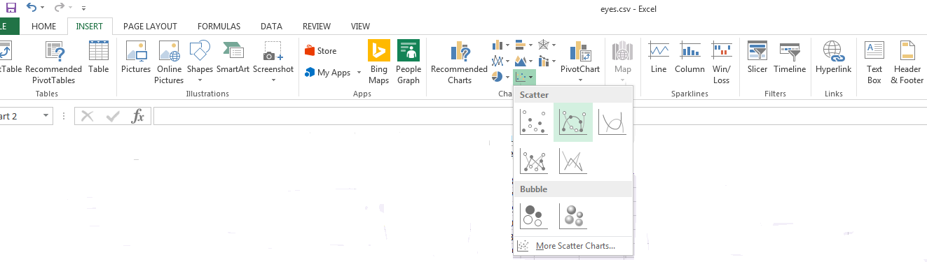
Mixed-Initiative Interaction: Who Starts/Leads the Communication?
MS Excel 2013 Charting Menu

Interaction lead by the User

Slide 44
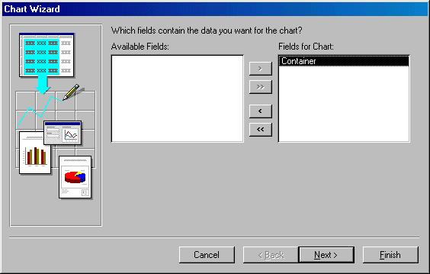
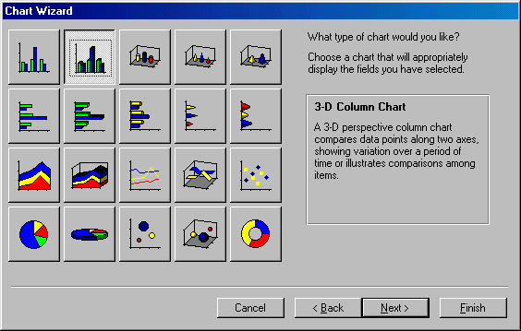
Mixed-Initiative Interaction: Who Starts/Leads the Communication?

Interaction lead by the Computer
MS Access 2003 Charting Wizard

Slide 45
Interruption Management
Possible Interruption Responses
Oblivious dismissal -> interruption goes unnoticed
Unintentional dismissal -> interruption is noticed, but its significance w.r.t. the current task not evaluated/understood
Intentional dismissal -> interruption is deemed less important than the ongoing task -> interruption queued for later, ongoing task resumed
Preemptive integration -> interruption is deemed more important than the ongoing task -> remainder of ongoing task is queued, start work on interruption
Intentional integration -> interruption and ongoing task are subsequently worked on together
source: McFarlane + Latorella 2002

Slide 46
Interruption Management
Common Interruption Management Strategies
Immediate interruption -> e.g., error messages (BSOD, Browser 404,…)
Negotiated interruption -> modeled after human-human interruption strategies: alert to interruption, but let the user accept, decline, or ignore it
Mediated interruption -> aims to predict the user‘s interruptability (e.g., by determining the current cognitive load of the screen content) and time interruptions accordingly
Scheduled interruption -> the user specifies in advance which interruptions are permitted – e.g., for the next 2 hours only interruptions that can be handled within 1 minute are allowed
source: McFarlane + Latorella 2002

Slide 47
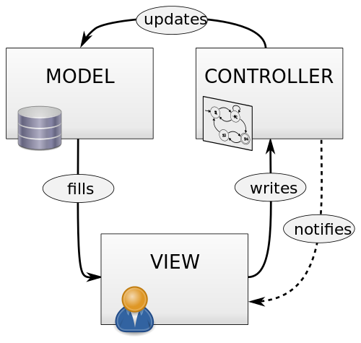
Patterns for interactive Software
Software Engineer’s Perspective

Slide 48
Patterns for Interactive Software
Functional: Decoupling into Model-View-Controller
Logical: Decoupling into Data-Context-Interaction
Technical: Decoupling into Threads




Slide 49
The Model-View-Controller Pattern
invented by Trygve Reenskaug in 1978/79 at Xerox PARC
de-facto standard for implementing UIs
decoupling allows, for example, for syncing multiple views via a single model

Controller
manipulates
uses
Model
View
updates
sees

Slide 50
The Data-Context-Interaction Pattern
invented by Trygve Reenskaug around 2006
helps mainly to untangle the model into
Data: the pure data with base functionality
Context: the processes/workflows in which the data is used
Interaction: the roles the data plays in the processes -> same data can assume different roles -> for each, role-specific functionality is added to the data
decouples data from behavior (roles) -> data objects can play many roles over their lifetime -> while roles persist only for the duration of the process

Slide 51
A Multi-Threaded Architecture for Continuous Interaction
Discrete interaction = click, key stroke, etc.
Continuous interaction = drag slider/layout back and forth -> must be sped-up to be interactive (10-20 frames/sec)
Bottleneck @ Retrieval/Computing: precompute affected pixels/objects for each pixel of a slider [Tanin et al. 1996]
Bottleneck @ Networking/Rendering: progressive output with constant refinement – e.g., progressive vis. [Stolper et al. 2014], per-iteration vis. [Choo et al. 2014], online vis. [Angelini et al. 2014]
For both: limit distance the user is allowed to travel per time interval w.r.t. available hardware [Chan et al. 2008]

Slide 52
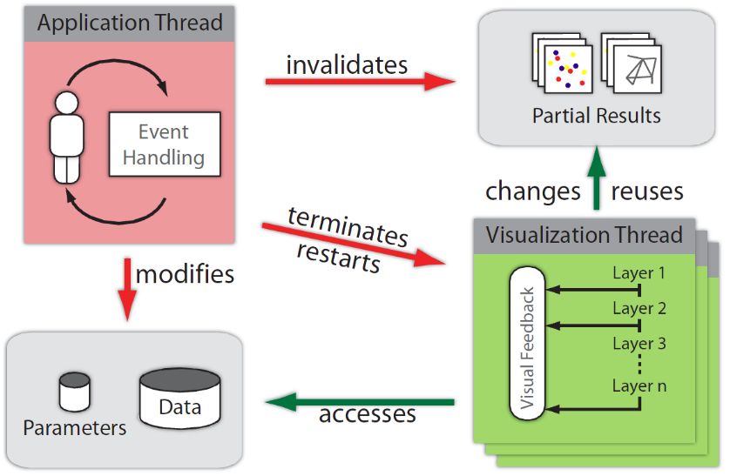
A Multi-Threaded Architecture for Continuous Interaction
Step 1: One Thread per View
Separate Application thread and Visualization thread(s)
Each View gets its own Visualization thread
Visualization thread progressively refines the view until finished or cancelled
Use Early Thread Termination
image source [Piringer et al. 2009]

Slide 53
A Multi-Threaded Architecture for Continuous Interaction
Step 2: Multiple Threads per View by Layering
Common Layering Mechanisms (from Piringer et al.):
Semantic layers: background (map, grid,…), coordinate axes, data items, labels,… -> sort by decreasing relevance or increasing effort
Incremental layers: sampled data items – e.g., every 100th, every 10th, and finally every item
Level-of-Detail layers: on data level – clusters, subclusters,… on image level – first without anti-aliasing at low resolution, then with anti-aliasing at high resolution -> here: layers get replaced, not blended onto drawn ones

Slide 54
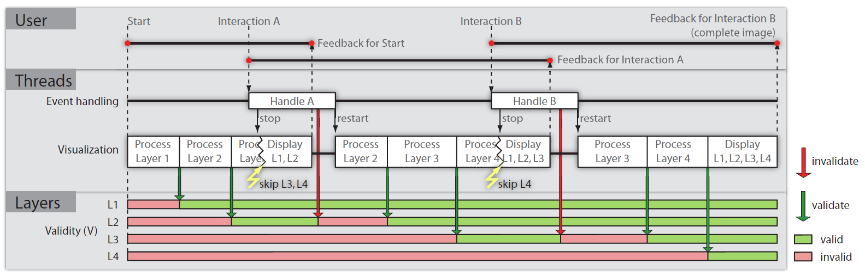
A Multi-Threaded Architecture for Continuous Interaction
Step 2: Multiple Threads per View by Layering
Layered Visualizations allow for reuse of already drawn elements
Picture source: [Piringer et al. 2009]

Slide 55
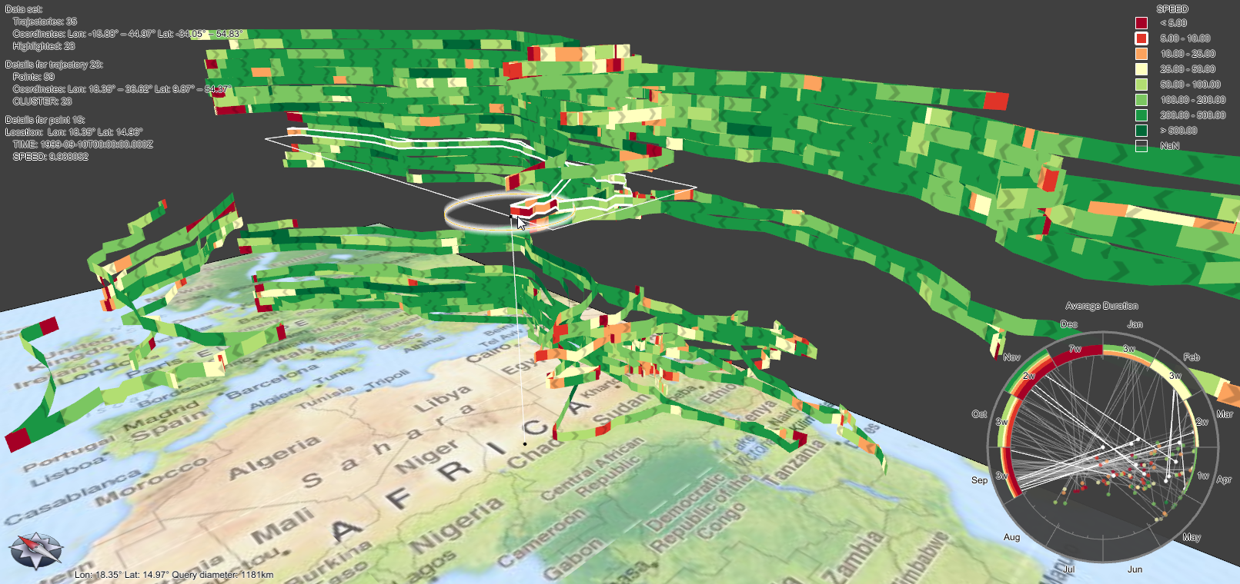
Interactive Visualization in Action
A short practical interlude:
Christian Tominski, University of Rostock, Germany

