Slide 1


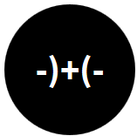
Opening the Black Box of Interaction in Visualization
Hans-Jörg Schulz¹, Tatiana v. Landesberger², Dominikus Baur³
VIS Tutorial 2014
D .MINIK.US
Fraunhofer IGD, Rostock, Germany
TU Darmstadt, Darmstadt, Germany
Dominikus Baur Interfacery

Slide 2
SUMMARY and Open challenges

Slide 3
Interaction as Communication
INTERFERENCE

INPUT DEVICE / UI

INPUT
OUTPUT
VISUALIZATION
INTERACTION VOCABULARY
VISUAL VOCABULARY

Slide 4
Open Challenge #1: Interference
Signals coming too fast: Interruption
Interruption management techniques for Visual Analysis are currently unexplored (possible Interruptions, Responses, Strategies)
Signals coming too slow: Delay
Progressive Visualization/Visual Analytics
No signals coming at all: Deadlock? -> Timeout?

Slide 5
Norman’s Model of Interaction
8. Take further action
(compare outcome with goal)

EXECUTION
EVALUATION
1. Establish a goal (Why?)
2. Form intention/identify task (What?)
3. Specify action sequence (How?)
7. Evaluate the outcome
(Why?)
6. Interpret the system’s state
(What?)
5. Perceive the state of the system (How?)
Execution/ Evaluation loop

4. Execute action
[Norman88]
Notes:
Execution: 1. Goal - The user first establishes a goal or an outcome of their ensuing actions. 2. Intention - The user now asserts their intention of manipulating the system by formulating an abstract set of goals to achieve a desired outcome. 3. Sequencing - The abstract set of goals are now related to the real abilities of the system. These abilities are then sequenced into a proper order. 4. Execute Action - The sequence of actions are then executed in the order they were intended. Evaluation: 5. Perceive - The user acknowledges that the system has changed state. 6. Interpret - The user interprets what has changed in the system so that they might inspect and evaluate that variable. 7. Evaluate - The user evaluates the system to ensure the desired results were acheived. 8. - Based on the evaluation of the user, further action can be taken. This action defines the loop.
1 forming the goal (identifying an ill-defined task, or goal, motivating use of the visualization),
2 forming the intention (identifying a well-defined task, or objective, that can support the goal),
3 specifying the action (identifying a system function, or operator, that may support the objective),
4 executing the action (evoking the operator on the operand),
5 perceiving the state of the system (seeing the change to the operand caused by the operator),
6 interpreting the state of the system (understanding the meaning of this change), and
7 evaluating the outcome (comparing this new meaning to the initial goal to see if the goal has been achieved).
Practical Application: A system must recognize a users expectations. Because Norman's model is so basic, it helps define exactly what the system should mirror at each step. The computer will abstract the following as - 1. Goal - Window (or Command Line) defines the available Commands. The Goal is how that command changes the system's state. 2. Intention - The intention is the class library the Algorithm is employing. This is inferred judgement of how the user wants their data processed and finally displayed. 3. Sequencing - Algorithm may choose to sequence multiple events using a BOTS/Service Handler. 4. Execute - The BOT/Service returns to the correct DOM object. 5. Perceive - Results are Printed to the Report object for visual display. 6. Interpret - A help file provides an analysis of system state variables. This is a way to help a user understand what has happened to their system. 7. Evaluate - A user continuously browses the web and may never stop and so the evaluation of a system in "webspace" is never complete. Evaluation is an update to the persons XML userver data. The system is then paused. 8. Execution/Evaluation Loop - This loop is either paused by the user by no action or it is continued by the Services Construct.
Norman, Donald (1988). "Preface to the 2002 Edition". The Design of Everyday Things. New York: Basic Books. ISBN 978-0-465-06710-7.

Slide 6
Norman’s Model of Interaction
8. Take further action
(compare outcome with goal)

EXECUTION
EVALUATION
1. Establish a goal (Why?)
2. Form intention/identify task (What?)
3. Specify action sequence (How?)
7. Evaluate the outcome
(Why?)
6. Interpret the system’s state
(What?)
5. Perceive the state of the system (How?)
Execution/ Evaluation loop
VISUALIZATION PIPELINE
CLICKS
PIXELS
Notes:
Execution: 1. Goal - The user first establishes a goal or an outcome of their ensuing actions. 2. Intention - The user now asserts their intention of manipulating the system by formulating an abstract set of goals to achieve a desired outcome. 3. Sequencing - The abstract set of goals are now related to the real abilities of the system. These abilities are then sequenced into a proper order. 4. Execute Action - The sequence of actions are then executed in the order they were intended. Evaluation: 5. Perceive - The user acknowledges that the system has changed state. 6. Interpret - The user interprets what has changed in the system so that they might inspect and evaluate that variable. 7. Evaluate - The user evaluates the system to ensure the desired results were acheived. 8. - Based on the evaluation of the user, further action can be taken. This action defines the loop.
1 forming the goal (identifying an ill-defined task, or goal, motivating use of the visualization),
2 forming the intention (identifying a well-defined task, or objective, that can support the goal),
3 specifying the action (identifying a system function, or operator, that may support the objective),
4 executing the action (evoking the operator on the operand),
5 perceiving the state of the system (seeing the change to the operand caused by the operator),
6 interpreting the state of the system (understanding the meaning of this change), and
7 evaluating the outcome (comparing this new meaning to the initial goal to see if the goal has been achieved).
Practical Application: A system must recognize a users expectations. Because Norman's model is so basic, it helps define exactly what the system should mirror at each step. The computer will abstract the following as - 1. Goal - Window (or Command Line) defines the available Commands. The Goal is how that command changes the system's state. 2. Intention - The intention is the class library the Algorithm is employing. This is inferred judgement of how the user wants their data processed and finally displayed. 3. Sequencing - Algorithm may choose to sequence multiple events using a BOTS/Service Handler. 4. Execute - The BOT/Service returns to the correct DOM object. 5. Perceive - Results are Printed to the Report object for visual display. 6. Interpret - A help file provides an analysis of system state variables. This is a way to help a user understand what has happened to their system. 7. Evaluate - A user continuously browses the web and may never stop and so the evaluation of a system in "webspace" is never complete. Evaluation is an update to the persons XML userver data. The system is then paused. 8. Execution/Evaluation Loop - This loop is either paused by the user by no action or it is continued by the Services Construct.
Norman, Donald (1988). "Preface to the 2002 Edition". The Design of Everyday Things. New York: Basic Books. ISBN 978-0-465-06710-7.

Slide 7
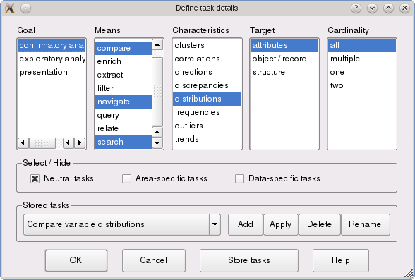
Norman’s Model of Interaction
8. Take further action
(compare outcome with goal)

EXECUTION
EVALUATION
7. Evaluate the outcome
(Why?)
6. Interpret the system’s state
(What?)
5. Perceive the state of the system (How?)
VISUALIZATION PIPELINE
PIXELS
Notes:
Execution: 1. Goal - The user first establishes a goal or an outcome of their ensuing actions. 2. Intention - The user now asserts their intention of manipulating the system by formulating an abstract set of goals to achieve a desired outcome. 3. Sequencing - The abstract set of goals are now related to the real abilities of the system. These abilities are then sequenced into a proper order. 4. Execute Action - The sequence of actions are then executed in the order they were intended. Evaluation: 5. Perceive - The user acknowledges that the system has changed state. 6. Interpret - The user interprets what has changed in the system so that they might inspect and evaluate that variable. 7. Evaluate - The user evaluates the system to ensure the desired results were acheived. 8. - Based on the evaluation of the user, further action can be taken. This action defines the loop.
1 forming the goal (identifying an ill-defined task, or goal, motivating use of the visualization),
2 forming the intention (identifying a well-defined task, or objective, that can support the goal),
3 specifying the action (identifying a system function, or operator, that may support the objective),
4 executing the action (evoking the operator on the operand),
5 perceiving the state of the system (seeing the change to the operand caused by the operator),
6 interpreting the state of the system (understanding the meaning of this change), and
7 evaluating the outcome (comparing this new meaning to the initial goal to see if the goal has been achieved).
Practical Application: A system must recognize a users expectations. Because Norman's model is so basic, it helps define exactly what the system should mirror at each step. The computer will abstract the following as - 1. Goal - Window (or Command Line) defines the available Commands. The Goal is how that command changes the system's state. 2. Intention - The intention is the class library the Algorithm is employing. This is inferred judgement of how the user wants their data processed and finally displayed. 3. Sequencing - Algorithm may choose to sequence multiple events using a BOTS/Service Handler. 4. Execute - The BOT/Service returns to the correct DOM object. 5. Perceive - Results are Printed to the Report object for visual display. 6. Interpret - A help file provides an analysis of system state variables. This is a way to help a user understand what has happened to their system. 7. Evaluate - A user continuously browses the web and may never stop and so the evaluation of a system in "webspace" is never complete. Evaluation is an update to the persons XML userver data. The system is then paused. 8. Execution/Evaluation Loop - This loop is either paused by the user by no action or it is continued by the Services Construct.
Norman, Donald (1988). "Preface to the 2002 Edition". The Design of Everyday Things. New York: Basic Books. ISBN 978-0-465-06710-7.

Slide 8
Open Challenge #2: Supporting the Evaluation Side of a Visualization

EXECUTION
EVALUATION
7. Evaluate the outcome
(Why?)
6. Interpret the system’s state
(What?)
5. Perceive the state of the system (How?)
?
VISUALIZATION PIPELINE
Notes:
Execution: 1. Goal - The user first establishes a goal or an outcome of their ensuing actions. 2. Intention - The user now asserts their intention of manipulating the system by formulating an abstract set of goals to achieve a desired outcome. 3. Sequencing - The abstract set of goals are now related to the real abilities of the system. These abilities are then sequenced into a proper order. 4. Execute Action - The sequence of actions are then executed in the order they were intended. Evaluation: 5. Perceive - The user acknowledges that the system has changed state. 6. Interpret - The user interprets what has changed in the system so that they might inspect and evaluate that variable. 7. Evaluate - The user evaluates the system to ensure the desired results were acheived. 8. - Based on the evaluation of the user, further action can be taken. This action defines the loop.
1 forming the goal (identifying an ill-defined task, or goal, motivating use of the visualization),
2 forming the intention (identifying a well-defined task, or objective, that can support the goal),
3 specifying the action (identifying a system function, or operator, that may support the objective),
4 executing the action (evoking the operator on the operand),
5 perceiving the state of the system (seeing the change to the operand caused by the operator),
6 interpreting the state of the system (understanding the meaning of this change), and
7 evaluating the outcome (comparing this new meaning to the initial goal to see if the goal has been achieved).
Practical Application: A system must recognize a users expectations. Because Norman's model is so basic, it helps define exactly what the system should mirror at each step. The computer will abstract the following as - 1. Goal - Window (or Command Line) defines the available Commands. The Goal is how that command changes the system's state. 2. Intention - The intention is the class library the Algorithm is employing. This is inferred judgement of how the user wants their data processed and finally displayed. 3. Sequencing - Algorithm may choose to sequence multiple events using a BOTS/Service Handler. 4. Execute - The BOT/Service returns to the correct DOM object. 5. Perceive - Results are Printed to the Report object for visual display. 6. Interpret - A help file provides an analysis of system state variables. This is a way to help a user understand what has happened to their system. 7. Evaluate - A user continuously browses the web and may never stop and so the evaluation of a system in "webspace" is never complete. Evaluation is an update to the persons XML userver data. The system is then paused. 8. Execution/Evaluation Loop - This loop is either paused by the user by no action or it is continued by the Services Construct.
Norman, Donald (1988). "Preface to the 2002 Edition". The Design of Everyday Things. New York: Basic Books. ISBN 978-0-465-06710-7.

Slide 9
Types of Interaction Models
What is modeled?
Extent: Single Action or whole Workflow
Granularity: Concrete Events or General Task
How is it modeled?
Diagrammatically: Sequence/Activity Diagram
Symbolically: Notations

Slide 10
Open Challenge #3: How to Model Undirected, Explorative Processes?
Shown approaches work well for rather linear, streamlined processes.
-> the more flexibility is incorporated, the more effort is required and the less expressive it becomes
Possible solution: Declarative approaches that do not define permissible actions, but permissible states through constraints & artifacts
-> see [Pesic et al. 2007] – DECLARE: Full Support for Loosely-Structured Processes or [v.d.Aalst et al. 2009] – Declarative workflows: Balancing between flexibility and support

Slide 11
History Management
Three aspects:
Recording history (logging)
Utilizing the current history (undo/redo)
Utilizing a collection of histories (guidance)
Principal problem: no agreed-upon way to store and share histories/provenance information!

Slide 12

Open Challenge #4: Storing Histories
Possible Solution: Embedding History in Visual Result
The PNG standard allows for defining and including custom data chunks. -> Make each exported screenshot from a “provenance-enabled” vis tool include its visualization history.
VS.
URI
what your OS, browser, and image processing app sees
what “provenance-enabled” tools see

Slide 13
GOAL
Visual
Representation /
Encoding
Data
Presentation
Architecture
Interaction
METAPHOR
Notes:
and this is metaphor in the context of our interaction design process. everything should be built on metaphor.

Slide 14
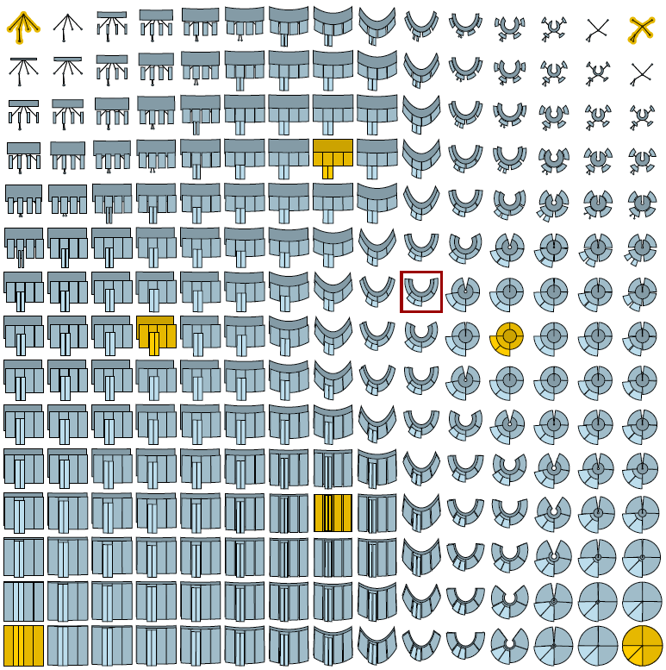
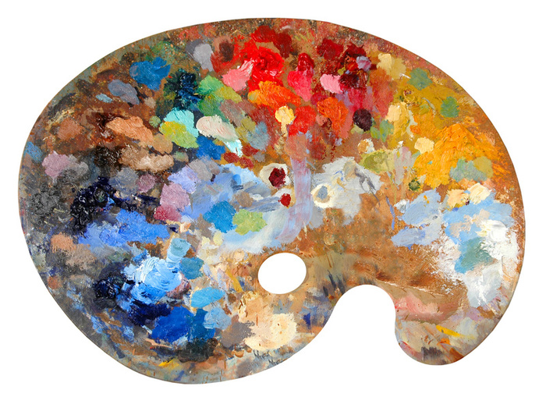
Open Challenge #5: Specific Metaphors for Interactive Visualization
Visualization-specific metaphors aside the rubber sheet
Source: Schulz+Hadlak (unpublished)
Image source: http://www.pinotspalette.com

Slide 15
Metaphors: Benefits & Caveats
Pro:
clear entry point
solves problems of discoverability and orientation
Con:
too strict adherence, lose benefits of digital medium
users expectations are created by metaphor

Slide 16
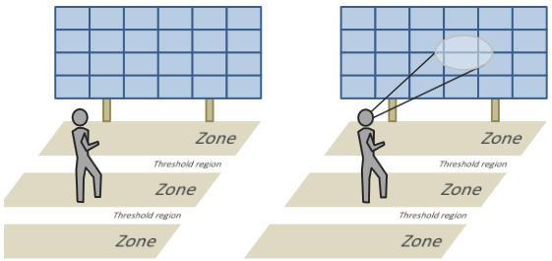
Open Challenge #6: Interaction Vocabulary for new Devices
What is the HOVER on touch devices?
What happens when you PINCH a bar chart?
Vocabulary for Physical Navigation?
Source: Lehmann et al. 2011

Slide 17
Make sure to get the Tutorial Materials!
Download this Slide Deck + the Literature List @
http://tinyurl.com/tutorial2014
Contact us in case of questions or further ideas!
Tatiana v. Landesberger: ttekusov@gris.tu-darmstadt.de Hans-Jörg Schulz: contact@hjschulz.net Dominikus Baur: do@minik.us

