Slide 1
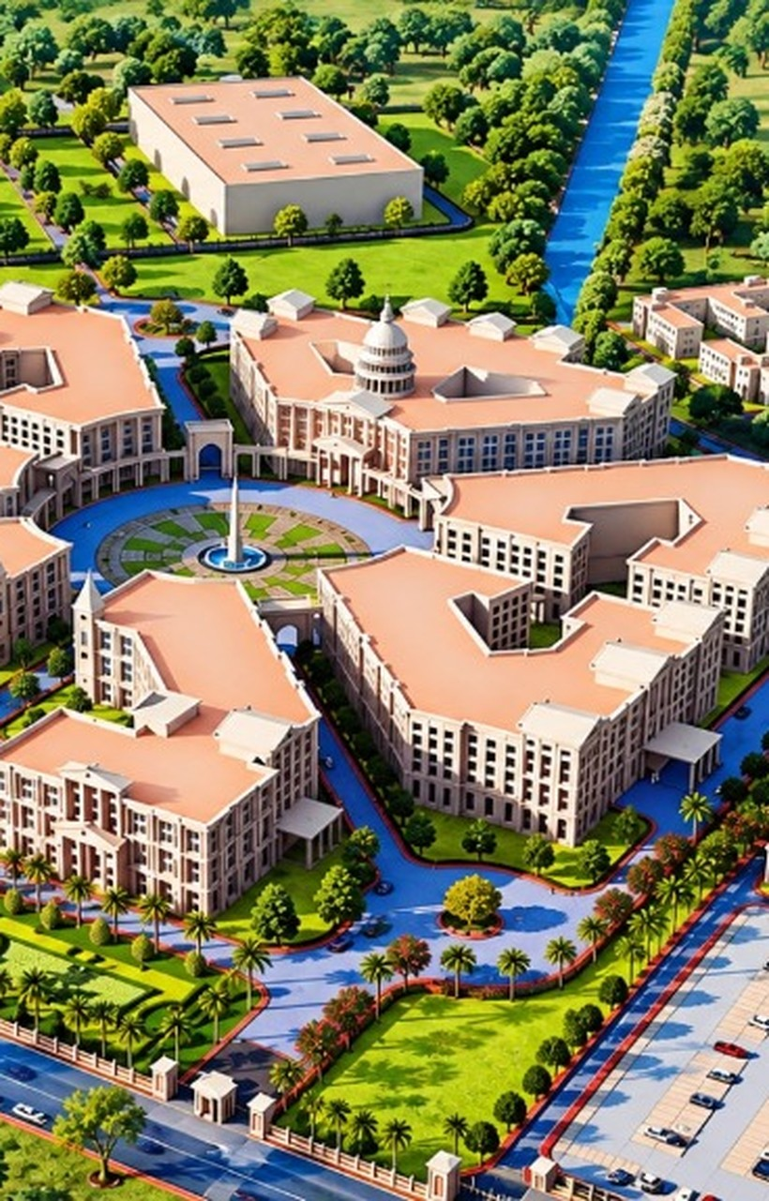



EcoVerse AI
FINAL SUBMISSION | AI FOR SUSTAINABLE CAMPUSES
Turning campus sustainability observations into accountable, measurable action
Computer Vision
Digital Twin
Generative AI
6 tracks | 3 roles | 1 closed-loop platform | live cloud sync
Notes:
EcoVerse AI is a closed-loop campus sustainability platform. This update covers the version now running on Supabase and Vercel, with the CDSIMER campus as the demo site.

Slide 2



Campuses see waste. Nobody owns the fix
PROBLEM STATEMENT 02
AI-Powered Sustainable Campus
Computer Vision
Digital Twin
Design a Digital Twin of a college campus that integrates Computer Vision and sensor data to detect issues such as waste accumulation, energy wastage, water leakage, and inefficient resource usage. Generative AI should generate actionable recommendations and sustainability reports.
GenAI
Campus
Someone notices
Report goes nowhere
Fix never verified
›
›
A leaking valve, lights on in an empty lab, an overflowing bin.
No classification, no routing, no named owner to act on it.
Nobody confirms it worked, so the same hotspots keep returning.
THE SAME WASTE, ACROSS EVERY RESOURCE
15 L/min
10% or 100%
0% occupancy
water lost to one stuck flush valve (demo ticket ECO-2026-0104)
bins get collected on rigid truck rounds, regardless of fullness
labs still lit up with nobody inside
Notes:
Problem statement 02. The pattern is the same for water, energy and waste: someone sees it, nobody owns it, and nobody verifies the fix. The three numbers are from the demo data.

Slide 3
One loop: perceive, understand, act
→
→
PERCEIVE
UNDERSTAND
ACT
Computer Vision
Digital Twin
Generative AI
Reads photos of leaks, lit empty rooms, contaminated bins and e-waste, then suggests a category and urgency.
2D map of 9 campus buildings with live-style telemetry: kW load, airflow (CFM), bin fill level, open tickets.
Auto-routes to the right department, tracks technician proof and admin verification, models what-if savings, answers via Copilot.
The outcome: every issue gets a category, an owner, photo proof of the repair, and an admin-verified close.
Notes:
Perceive with computer vision, understand with the digital twin, act through routing, technician work, admin verification and the Copilot.

Slide 4






Six tracks, one platform
01
02
03
Smart Waste Digital Twin
AI Sustainable Campus
Energy Optimization
Bin fill sensing, 2D bin map, dynamic dispatch for bins over 80%.
Flagship: student, technician and admin lifecycle with CV, routing and photo proof.
Load curves, vacancy lighting audit, what-if savings.
04
05
06
Green Building Digital Twin
Carbon Footprint Intelligence
Smart Recycling Assistant
Room floorplans, airflow balanced to headcount.
Scope 1/2/3 accounting, documented factors, net-zero paths.
Material classifier, cleaning guides, hazardous-battery warnings.
Shared engine: one report model, one routing layer, one digital twin, one Copilot, one cloud data store.
Notes:
Six hackathon tracks share a single engine. Track 02 is the flagship and the one used for the live demo.

Slide 5



The flagship: report to verified fix
Submit + photo
AI classifies + routes
Acknowledged
In progress
Proof photo
Admin verifies
Resolved
If the proof fails, the admin requests rework and the ticket returns to In Progress. Every transition is written to the audit history.
AUTO-ROUTING RULES
THREE ROLES, ONE TICKET
Water
Plumbing & Water Resources
Student / Faculty
Reports with photo evidence and tracks status live.
Energy
Electrical & Energy Optimization
Waste
Housekeeping & Circular Waste
Technician
Acknowledges, starts work, uploads a device photo as proof with a resolution note.
Biodiversity
Gardening & Campus Biodiversity
Administrator
Maintenance
Integrated Facilities & Civil Infra
Inspects the proof, then approves or sends back for rework. Prints PDF audit reports.
Notes:
The big change from the previous version: the student no longer closes the ticket. The technician uploads photo proof, and the administrator approves it (Resolved) or requests rework (back to In Progress).

Slide 6
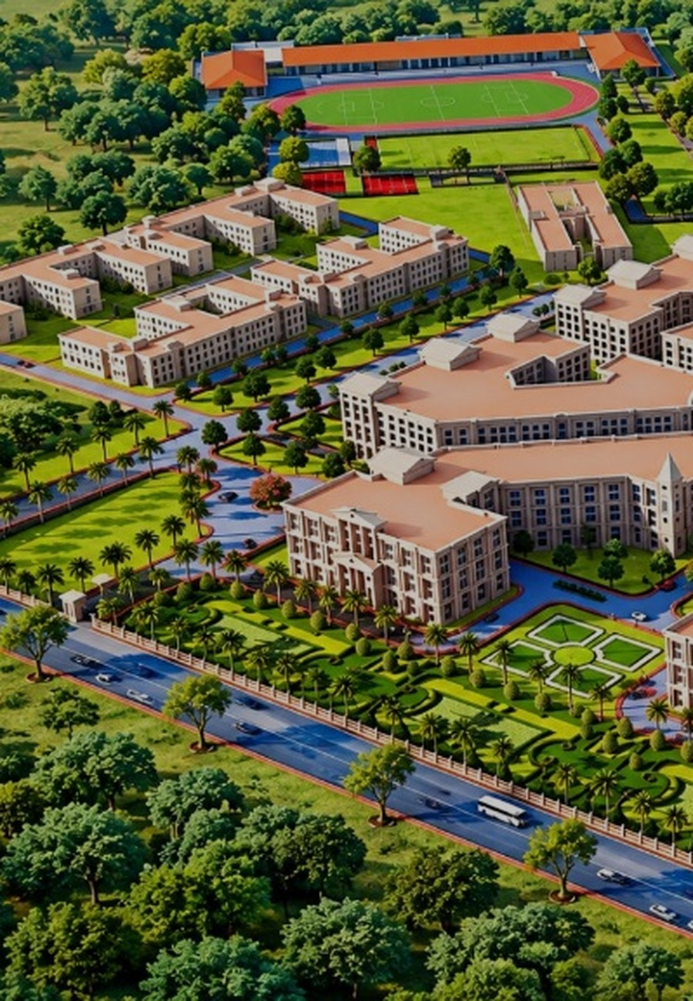



A live digital twin of the campus
TELEMETRY LAYERS
Active Issues
90 CFM
Vacant rooms drop to eco-standby airflow; occupied labs run 380 to 940 CFM (Track 04).
Smart Bins
Energy Heatmap
> 80%
Bin fullness that triggers a collection dispatch, replacing rigid truck rounds (Track 01).
Solar Arrays & AQI
9 blocks
Tickets, bins, kW load and solar readings all tie back to the same building.
Interactive 2D campus map with Aerial and Blueprint views. Click a building such as School of Engineering to inspect its kW draw, bins and active tickets.
Notes:
The twin now shows nine CDSIMER campus blocks. Layers: active issues, smart bins, energy heatmap, solar arrays and AQI. Telemetry is simulated demo data.

Slide 7
What-if engines price the payoff
Track 03: hourly campus load (kW), baseline vs optimized
Track 05: baseline 2,370 MT CO2e
Energy levers: LED retrofit, HVAC deadband, motion sensors (capped at 38% savings)
Carbon levers: Solar PPA, EV shuttles, compost diversion, boiler efficiency
Inputs: Simulated baselines; factors from EPA eGRID, IPCC, EPA WARM
Notes:
Both what-if engines are unchanged from the previous version. The energy model caps savings at 38 percent. The carbon baseline is 640 + 1,250 + 480 = 2,370 MT CO2e.

Slide 8
Architecture and stack
WORKING IN THE DEMO
BUILT, NOT YET WIRED IN
3 roles
React 18 + TypeScript
App state
FastAPI + Pydantic
→
→
Student, Technician, Admin via one-click login
Vite 5, Tailwind, Router v6, Recharts, Lucide
React Context, rule-based AI engines, light/dark theme
6 endpoints: reports, status, departments, health, Copilot
↓
PostgreSQL schema
Fallback: local demo mode
or
Supabase (shared cloud data)
15 legacy tables; the live demo uses the 2 Supabase tables instead
If Supabase keys are missing, data stays in browser localStorage
2 Postgres tables (reports, bins), Realtime channel, public evidence photo bucket
DEPLOYED ON
DESIGN CHOICES THAT MATTER
Vercel (Vite build), with Supabase keys supplied as environment variables
1
One typed report model (9 statuses, 6 categories) drives every track
2
Routing is a rule table, so departments are configurable, not hard-coded
3
Writes are serialized per record, with a visible sync status: local, connecting, live or error
Notes:
What changed here: Supabase is now wired in. Reports, work-order history and bin readings are stored as JSON rows with Realtime updates, and evidence photos go to a storage bucket. FastAPI and the 15-table schema still exist in the repo but the frontend does not call them.

Slide 9



Judge walkthrough: five minutes
1
2
3
4
5
Report
Fix
Verify
Explore
Ask
As Student, open Report, add a photo or sample evidence, submit. Get an ECO ID, CV category and auto-assignment.
Switch to Technician. Acknowledge, Start Work, then Finish Work with a device photo as proof.
Switch to Administrator. Inspect the proof, then Approve to reach RESOLVED, or request rework.
Open the Digital Twin. Toggle layers, click School of Engineering for kW and tickets.
Open EcoVerse Copilot. Try "most common issues" or "status of ECO-2026-0104".
Login is one click per role, no password. Open the site on two devices to watch reports and bin changes sync live.
Notes:
Report as Student, fix as Technician with a proof photo, verify as Administrator. Then show the twin and the Copilot. If time permits, open the site on a phone to show live sync.

Slide 10



Where we are, and what is next
WORKING TODAY
SIMULATED TODAY
NEXT
Full 3-role lifecycle: technician photo proof, admin verify or rework
Reports and bins shared across devices via Supabase Realtime
Admin workflow dashboard with print-to-PDF audit report
Six track UIs, interactive twin, what-if simulators
CV is keyword matching on the photo, not a trained model
Telemetry and AI confidence scores are demo data
Copilot is rule-based, not an LLM
Role login is one-click and the database is open-edit by design
Real auth and role-based access
Train a real classifier on labelled campus images
Ingest real IoT sensor feeds
LLM-backed Copilot with tool access
EcoVerse AI
Thank You
Notes:
Be upfront about what is simulated. The cloud sync is real, but the CV model, telemetry, Copilot and role login are demo-grade. Next step is real auth and a trained classifier.

