Slide 1
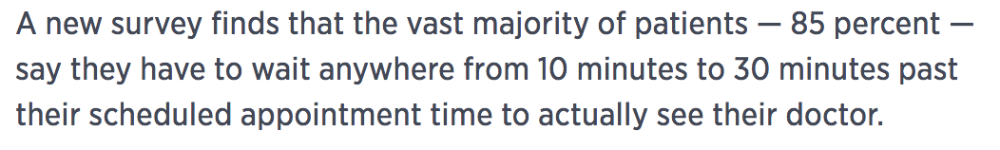
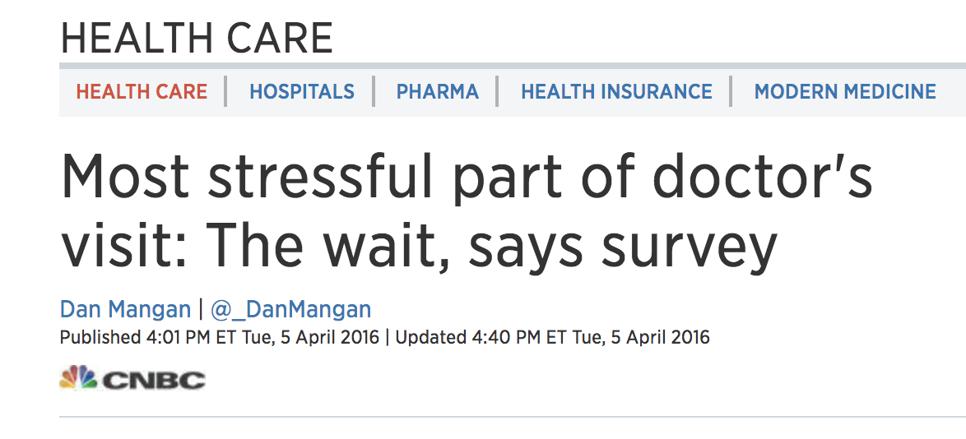
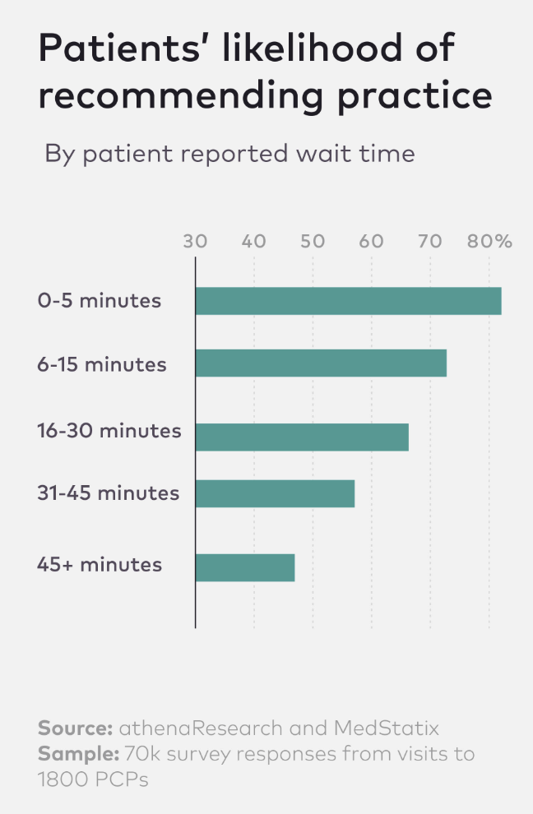
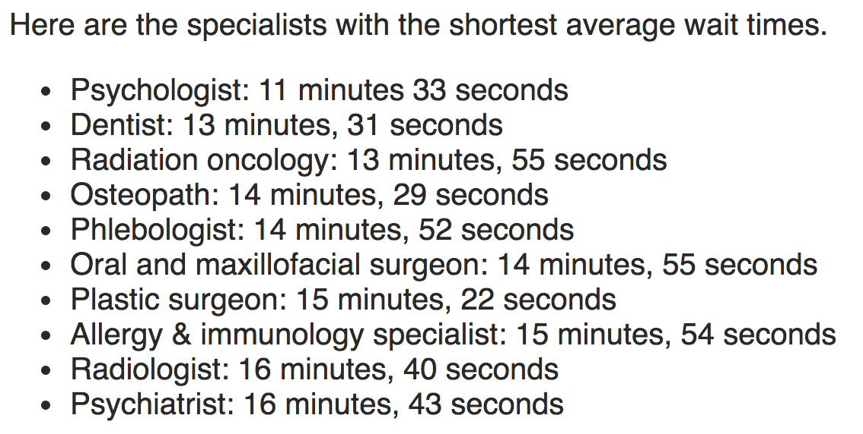

Slide 2
patientce “less wait time, more free time”
Intern ShipIT
John Bisognano: Lights On
Cameron Jump: Synapse
Visaal Ambalam: PowerCharts
Connor Begansky: Scheduling
07/20/2018

