Slide 1
Analyzing the Coffee Landscape:
New York City (NYC)
Author: Visaj Nirav Shah September 2020

Slide 2
Problem Statement
Analyze neighborhood clusters of New York City (NYC), USA based on the number of coffeehouses and cafes present, the ratings, pricing and number of likes of the stores.

Slide 3
Purpose
NYC is the financial capital of United States of America (USA), a popular tourist destination, has a huge population, and houses offices of important international institutions and major corporate headquarters. In such a landscape, coffeehouses are a crucial part of everyday life. People socialize in coffee shops, hold informal group meetings, relax after a long day, and so on. Hence, it is imperative to analyze the coffee scene in such a city where millions depend on a cup of fresh brew.

Slide 4
Target Audience
Major Coffeehouse and Cafe Chains
Prospective Franchisees and Coffeehouse Owners
Offices and Public Places
Tourists and Residents

Slide 5
Data
Places API - Foursquare Developers
Features like Venue Ratings, Venue Likes, Venue Price Tier, and so on can be obtained from here.
2014 New York City Neighborhood Names
The information regarding the neighborhoods of NYC and their location can be obtained from here.

Slide 6
Methodology

Slide 7
Getting the Neighborhoods of New York City
After downloading the dataset from the source mentioned before, the obtained JSON response is converted into a Pandas DataFrame named NYNghbor.
NYNghbor contains the Latitude, Longitude and Borough details of the neighborhoods.

Slide 8
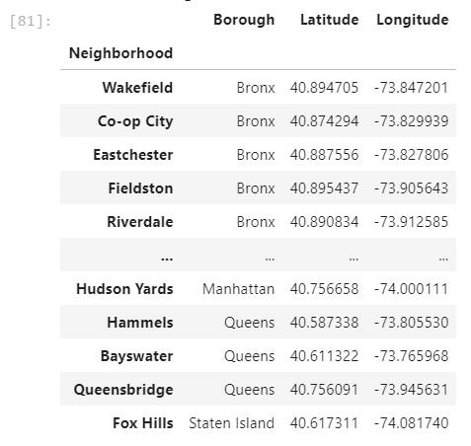
NYNghbor

Slide 9
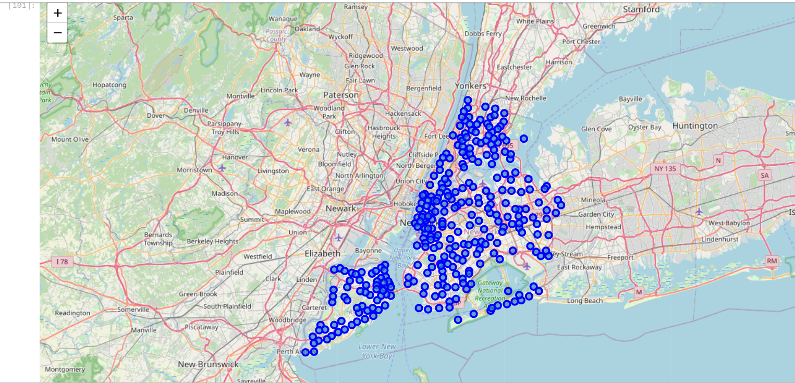
Neighborhoods Visualized on NYC Map

Slide 10
Getting Venues Information
We now use the Foursquare API to get details of various places in these neighborhoods. We will make a call to this API and then store the JSON response in a DataFrame NYVenues.

Slide 11
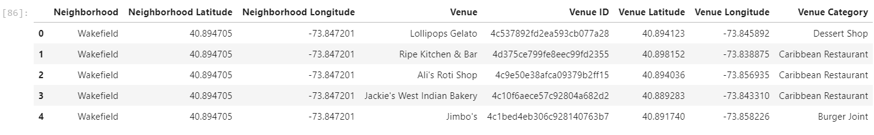
NYVenues.head()

Slide 12
Filtering out Coffee shops and Cafes
NYVenues.loc[NYVenues['Venue Category'].str.contains('Coffee')]
NYVenues.loc[NYVenues['Venue Category'] == 'Cafe']

Slide 13
Now we make API calls to Foursquare API for getting individual details like ratings, price tier, likes, etc. of each coffee location. All these details will be stored in a DataFrame coffee.

Slide 14
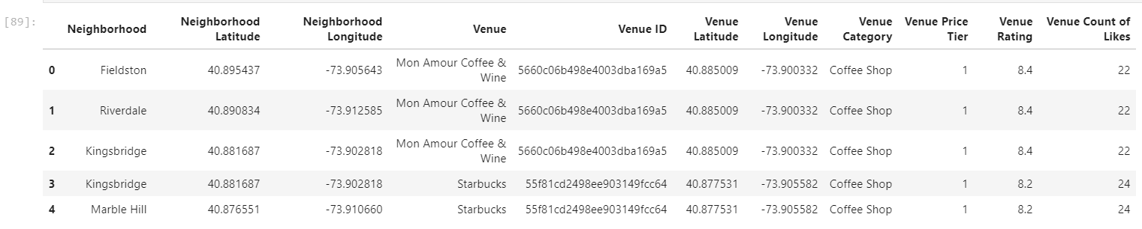
coffee.head()

Slide 15
Grouped by Neighborhoods Data
We observe that there are 214 neighborhoods in coffee. We will be clustering these 214 neighborhoods. To get details for each neighborhood, we create a DataFrame NYNghborCoffee.

Slide 16
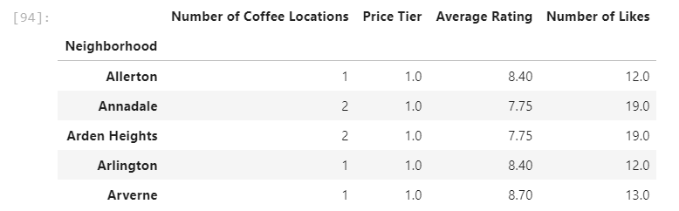
NYNghborCoffee.head()

Slide 17
Clustering
For clustering, we will use the k-means algorithm. We will implement the algorithm using scikit-learn library available for Python.
To determine the perfect k (i.e. the number of clusters), we loop through a reasonable range of k values. Here, this range is [2, 10].

Slide 18
Elbow Method
For each k, we plot the SSE (i.e. Sum of Squared Distance) and then using the Elbow Method, we determine the required k.
According to the Elbow Method, the best k is the one after which the SSE vs. k plot is almost linear and has very little change in slope.
For better results, we will standardize the data before calculating the SSE. This means the mean of each column will be 0 and the standard deviation will be 1.

Slide 19
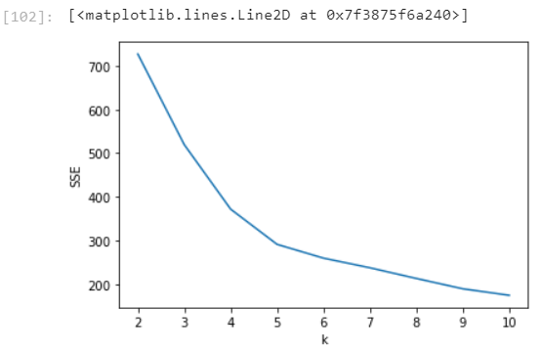
Plot for Elbow Method

Slide 20
After looking at this plot, we can clearly say that k = 5 is a reasonable choice for number of clusters. We run the k-means algorithm for our data keeping k = 5.

Slide 21
Results

Slide 22
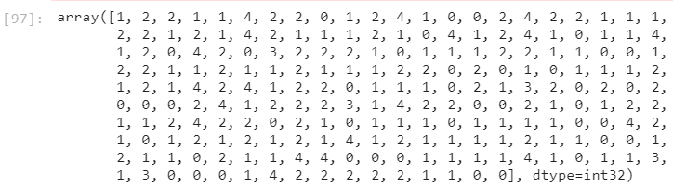
Output of k-means clustering

Slide 23
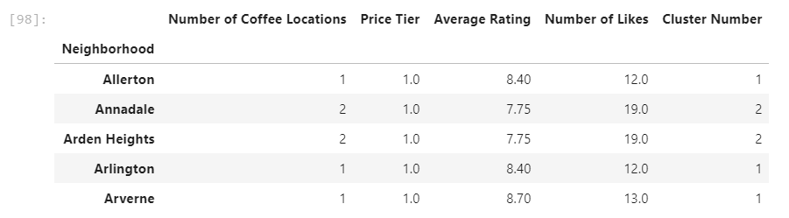
NYNghborCoffee.head() after adding Cluster Num

Slide 24
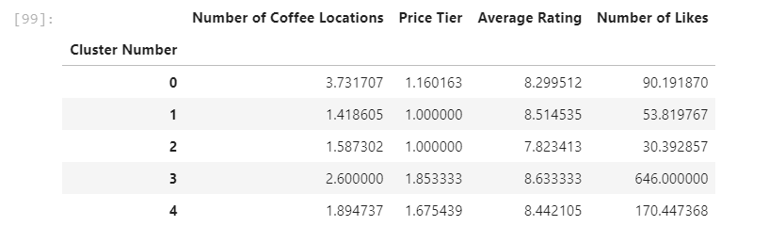
Description of Each Cluster

Slide 25
Discussion

Slide 26
Cluster 3
Cluster 3 has the best coffee places in the city. With highest number of likes and highest average rating, these locations are extremely popular. The stores in this cluster are a bit pricey, but they serve products worth the price given the popularity and demand. Dicult for new stores to make a mark since there is little scope of improving customer experience.

Slide 27
Cluster 4
Cluster 4 is again a coffee-friendly cluster but with reduced number of locations. The density of stores is less, but customers have vouched for the quality of service (high ratings and number of likes). This cluster is a good choice for newcomers in the business who plan to start a non-franchise store. Given the demand but less number of locations, newcomers stand a good chance of attracting customers.

Slide 28
Cluster 0
Cluster 0 is not a good place for new businesses. The density of stores is very high as compared to others and popularity is low. The ratings and number of likes are lower than Cluster 3 and 4. Possible reasons for low popularity could include unsatisfactory service and products, or inherent nature of locations such that the demand for coffee is less. In either case, rather than new stores opening, some of the old ones may be pulling down the shutters forever. One possibility for high number of stores and low demand could mean that there are a lot of corporate coffee shops meaning the ones managed by companies exclusively for their employees and clients.

Slide 29
Cluster 1
Cluster 1 has a low density of stores but positive ratings. Given the low number of likes, one can deduce that not many are coffee-consumers, but those who do, have good options available. One could consider opening a store here since there is a demand (specific audience) but the number of options are really less. So, there is a high probability that people are willing to test new options and possibly make a shift. If you come up with some unique feature for your store, it could generate interest among both, regular customers, and new customers.

Slide 30
Cluster 2
Cluster 2 is clearly not a good place to open a coffee shop, or the best if you are a risk-taker and want to risk entering a completely new domain. These neighborhoods have very few stores, but since there are few people to drink, there are not many changes taking place in the landscape. Given the low ratings, people are probably not happy with their current options, so new stores could stand a chance of attracting the crowd, but they need to be really good to get people to drink coffee.

Slide 31
Conclusion

Slide 32
Possible Improvements and Future Scope
Clearly, this is not an exhaustive model for analysis. Some other factors which can be included are area of each neighborhood, population of individual neighborhood, real estate prices, on-field public response, and so on.
This study could be expanded to other major cities across the world as well. This should be of help, especially to multinational companies. Detailed analysis for entire countries can help them understand the soft spots of their business model and market.

Slide 33
All in all, after looking at the results and analyzing the process, one can decide on a location depending on their requirements. After understanding the Coffee landscape, people are now equipped to make intelligent business decisions and churn out maximum profits depending on the objectives. Also, as explained at the beginning, this study can empower tourists and citizens too, not only businesses.

Slide 34
Thank You

