Slide 1
PEER-TO-PEER LOAN TRACKER

Slide 2
CREDIQUEST
ARCHANA K (23i307)
DHARSHINI V (23z318)
KEERTHANA R (23d215)
VISALAKSHI SP (23l151)

Slide 3
PROBLEM STATEMENT
The Peer-to-Peer Loan Tracker with Interest Calculations is a solid project that combines basic finance management features with loan tracking.

Slide 4
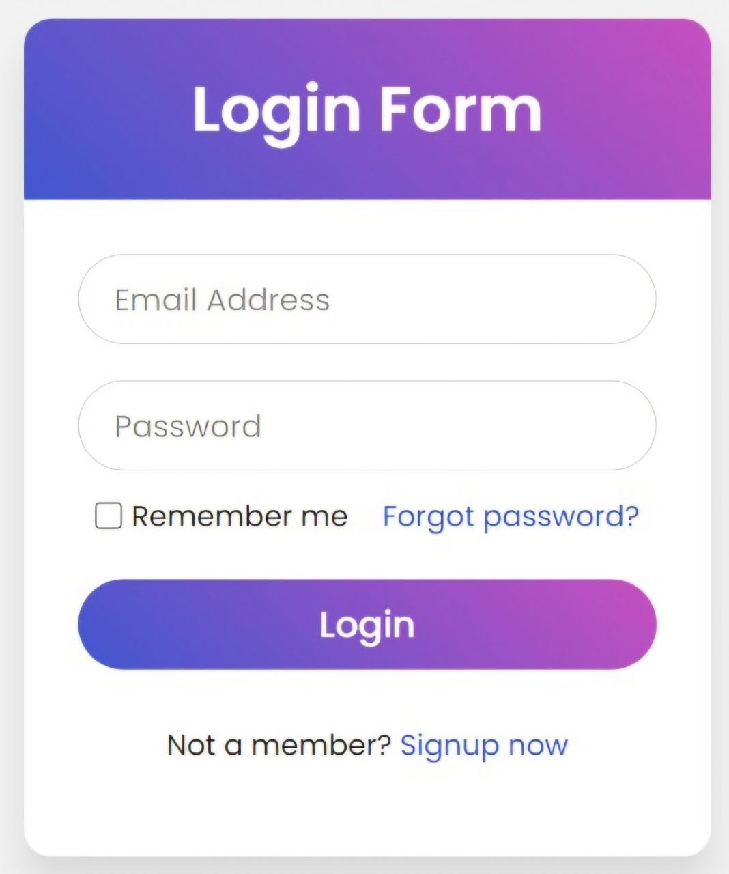
1. USER LOGIN : Our platform features separate logins for borrowers and lenders, ensuring confidential access. Borrowers view loan applications, repayment schedules, and balances, while lenders access investment portfolios and loan performance. This dual-login approach streamlines navigation and enhances security for specialized user experiences.

Slide 5
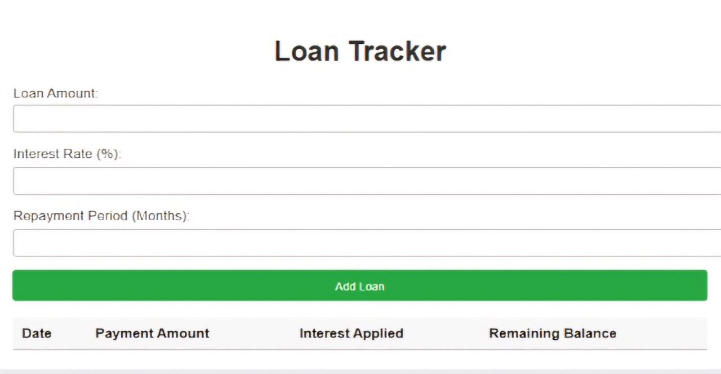
2. Loan Logging : - Users input details like loan amount, interest rate, and repayment period. - Implementation: Use forms to allow users to input and store data in a database or in-memory storage (e.g., SQLite for simplicity).

Slide 6
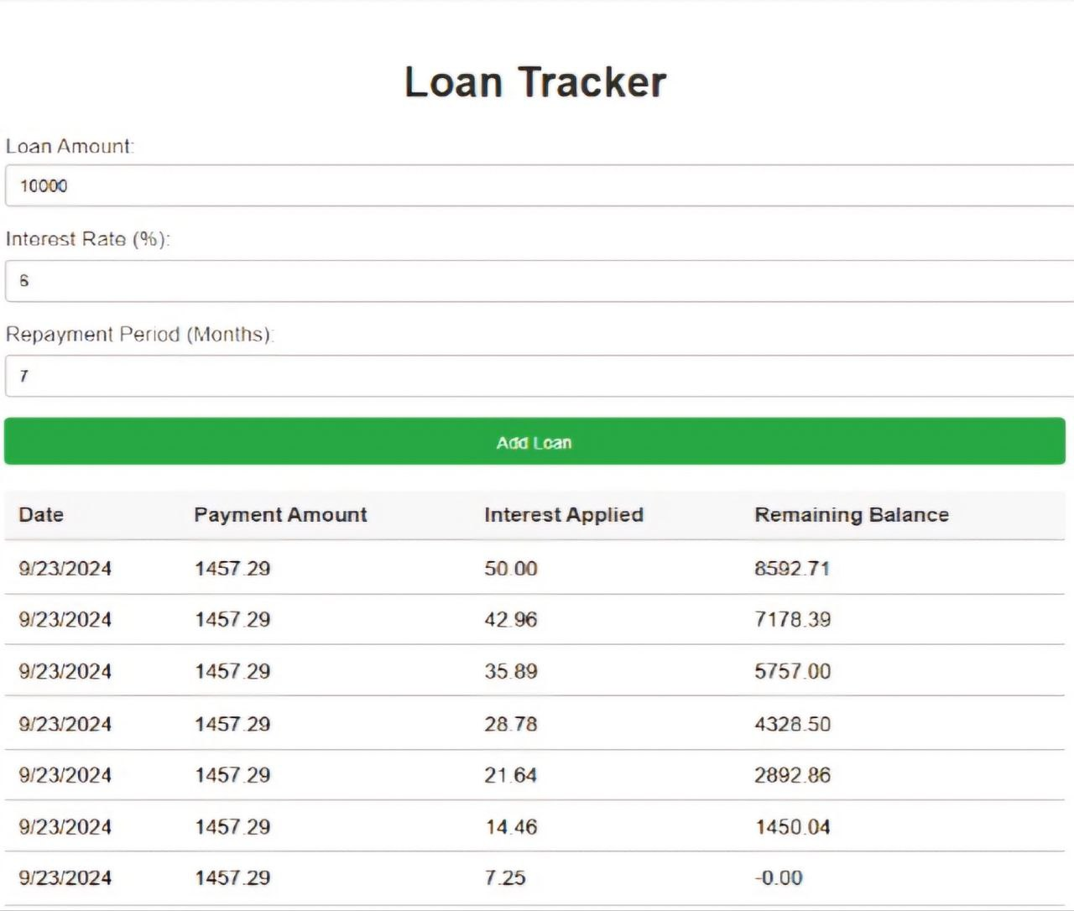
INTEREST CALCULATION

Slide 7
2. Repayment Tracker: Track partial or full payments and show the remaining balance. FEATURES: Add Expense: This allows you to enter the date, description, amount, payee, and mode of payment (cash, etc.) and save the expense. Delete Expense: You can remove a selected expense from the tracker. Clear Fields in Data Entry Frame: Clears the current form inputs for ease of re-entry. Edit Selected Expense: Enables modification of previously recorded expenses. Convert Expense to a Sentence: Likely converts the details of an expense into a readable sentence format. View Selected Expense's Details: Displays further details about the selected expense. Delete All Expenses: Option to remove all expenses listed in the tracker. The table lists each expense with columns for date, payee, description, amount, and payment mode.

Slide 8
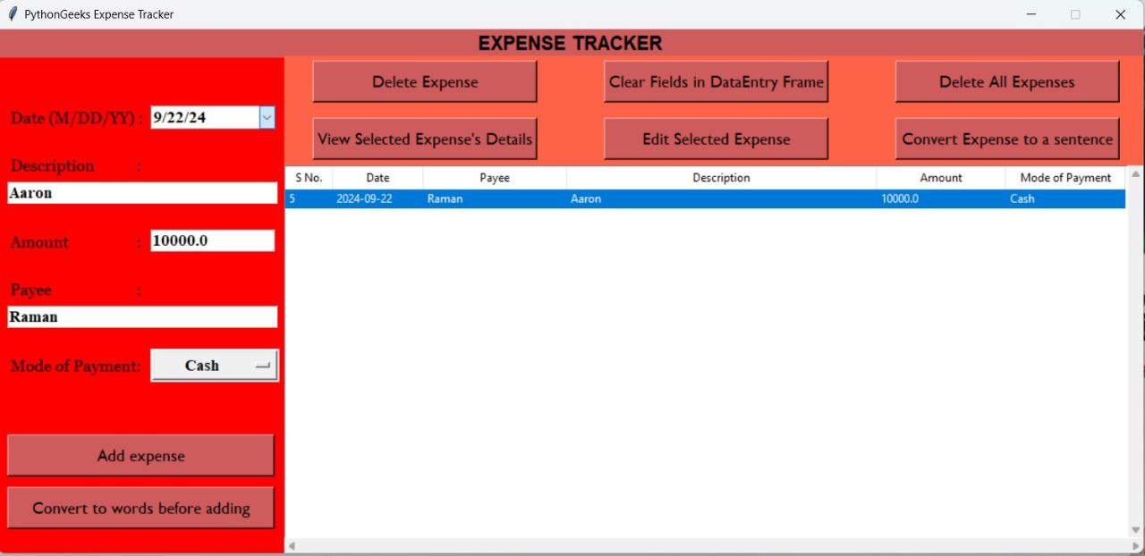
ILLUSTRATION

Slide 9
TECHNOLOGIES USED:
FRONTEND DEVELOPMENT – HTML, CSS and JAVASCRIPT
CONNECTIVITY – MYSQL
BACKEND – PYTHON
DATABASE – SQLite

Slide 10

Thank you

