Slide 1

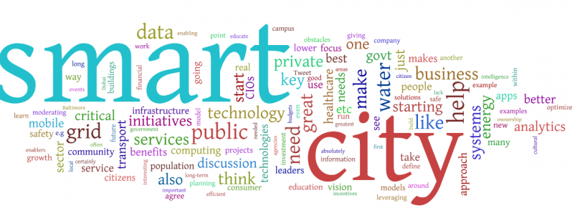
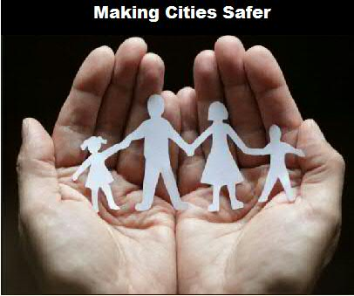
SentiSafe
HSBC Brainiacs
Shruthi,Harika,Visa,Madhavi,Sunitha

Slide 2

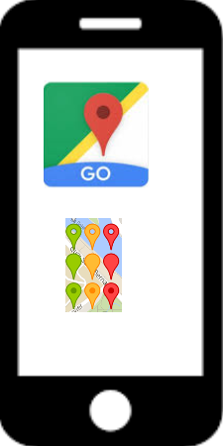



Need of the hour…. Safety & Security - Can we make our city a better place to live in ??
What we need
Proposed Solution
Tremendous need for a technological solution to pre determine the security condition of an area by individuals.
Identifying a common source of crime data repository across the city which can be used to analyze any pattern/sequence of crime.
An intelligent system that can predict crime way ahead of time before an unfortunate event occurs.
Identifies the secure and non-secure areas in the city for individuals to take precautionary measures.
Predict type of crime in the future based on the past trend which could help the law enforcement team to identify policies and programs to prevent crime
This solution can also be leveraged as a plugin for all the apps which uses google maps and the model can be extended in other areas such as food safety, health safety, school safety.
Alerts user for safety issues
Phone with sentisafe plugin

Slide 3
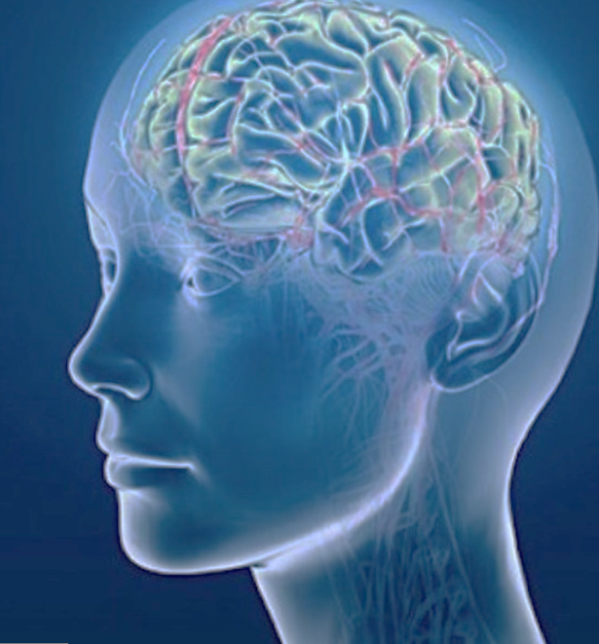

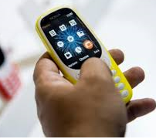

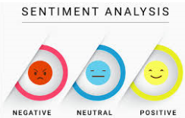

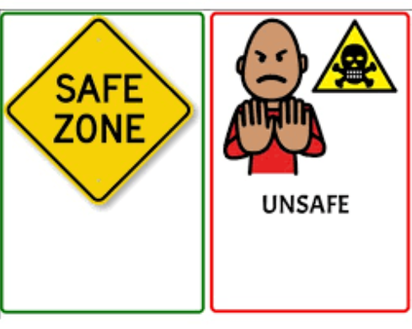

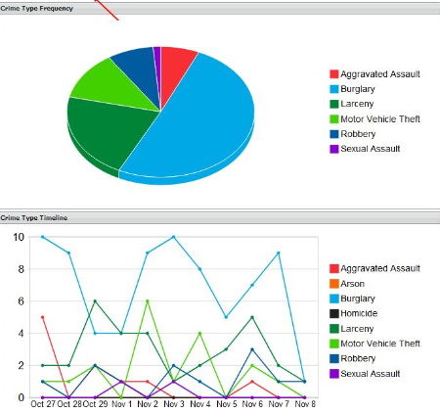


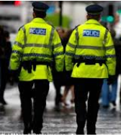

Travelling alone
or with family
AI Model
SentiSafe App/Plugin
Tensor Flow Deep Learning Neural Networks
Need to know if
The place is safe ???
Train
Test
Sentiment Analysis
AndroidStudio
Data Studio

Slide 4









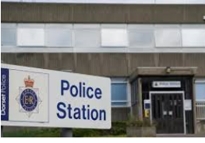










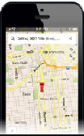
Architectural Flow
Artificial Intelligence Model

