Slide 1
VISALI V S
PSG Institute Of Technology and Applied Research
B.E Computer Science and Engineering, 3rd year.
Reg No : 715521104055
Email ID : visali.vs.4903@gmail.com
NM ID: 8EBC389C096B7D6B9FE4F6295B8516F7

Slide 2
PROJECT TITLE
FASHION IMAGE GENERATION WITH DC-GAN

Slide 3


AGENDA
Problem Statement
Project Overview
End Users
Solution & Value Proposition
Modelling Approach
Results
Conclusion
3/21/2024 Annual Review

Slide 4

PROBLEM STATEMENT
Online fashion retailers often face the challenge of creating diverse and appealing product catalogs to attract and engage customers. Manual creation of product images is time-consuming and expensive, limiting the scalability and variety of the catalog. To address this challenge, the retailer seeks an automated solution for generating realistic fashion images that accurately represent the product offerings.
3/21/2024 Annual Review

Slide 5

PROJECT OVERVIEW
Fashion MNIST Generation with GANs aims to generate realistic fashion item images. Using the Fashion MNIST dataset, a GAN model is trained with a generator and discriminator. Initial attempts with a simple GAN may face mode collapse and produce low-quality images. Addressing these, a Deep Convolutional GAN (DCGAN) architecture is employed, yielding higher-quality and diverse images. Evaluation centers on image quality and training convergence. Future steps involve optimizing the model and exploring applications like data augmentation and fashion design.

Slide 6

WHO ARE THE END USERS?
Fashion Designers and Retailers: To visualize new designs and trends before production.
Online Marketplaces: Enhancing product displays with realistic images.
Fashion Enthusiasts and Consumers: For virtual try-on experiences and personalized styling.
Content Creators: Generating fashion-related visual content for media, advertising, and social platforms.
Researchers and Developers: Exploring advancements in generative modeling and image synthesis.

Slide 7
YOUR SOLUTION AND ITS VALUE PROPOSITION
Solution Overview:
Fashion Image Generation using DC-GAN employs Deep Convolutional Generative Adversarial Networks (DC-GANs) to automatically create fashion images from noise inputs. This advanced technology revolutionizes the fashion industry by enabling the generation of diverse and realistic images, transforming the design process and enhancing marketing efforts.
Value Proposition:
Streamlined Design Process: Provides designers with a powerful tool to visualize new designs quickly and efficiently, accelerating the creative process.
Enhanced Marketing Efforts: Enables retailers and online marketplaces to showcase products effectively, improving engagement and conversion rates.
Virtual Try-On Experiences: Enhances the shopping experience by allowing consumers to virtually try on clothing items before purchase, increasing confidence and reducing returns.
Innovation and Business Growth: Fosters innovation in fashion design and retail, driving business growth through improved product visualization and customer engagement.

Slide 8

THE WOW IN YOUR SOLUTION
Unprecedented Creativity: The solution autonomously generates diverse and photorealistic fashion images, demonstrating an unparalleled level of creativity.
Efficiency Boost: By providing designers with a rapid visualization tool, it significantly accelerates the design process, allowing for quicker iterations and innovations.
Immersive Shopping Experience: Integration of virtual try-on experiences enhances the shopping journey, offering customers a unique and immersive way to interact with products before making purchase decisions.

Slide 9
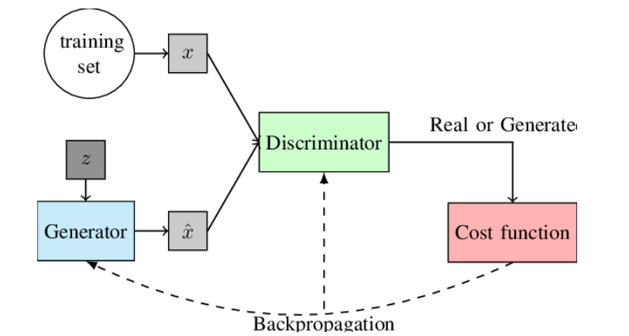
MODELLING
Generator Architecture:
Dense Layers: Initiated with dense layers to map random noise into a higher-dimensional space.
Reshaping: Reshapes the output to a format suitable for convolutional operations.
Transposed Convolution: Utilizes transposed convolutional layers to upsample the data, gradually generating high-resolution images.
Batch Normalization: Incorporates batch normalization to stabilize training by normalizing the activations.

Slide 10
MODELLING…
Discriminator Architecture:
Convolutional Layers: Employs convolutional layers to extract hierarchical features from images.
Dropout: Introduces dropout layers to prevent overfitting by randomly deactivating neurons during training.
Flattening: Flattens the output to a 1D vector for classification.
Binary Classification: Utilizes a final dense layer with a sigmoid activation function for binary classification (real or fake).

Slide 11
MODELLING…
Training Process:
Adversarial Training: Adopts an adversarial training scheme where the generator learns to generate realistic images to fool the discriminator, while the discriminator learns to distinguish between real and generated images.
Optimization: Employs the Adam optimizer for both the generator and discriminator with binary cross-entropy loss.
Batch Processing: Trains the models using mini-batch gradient descent to improve convergence speed and stability.
Regularization: Implements dropout regularization in the discriminator to prevent overfitting.

Slide 12
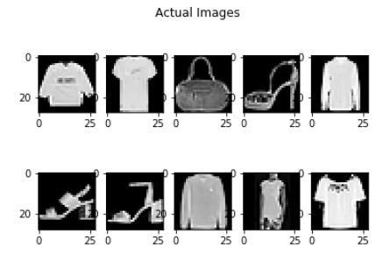
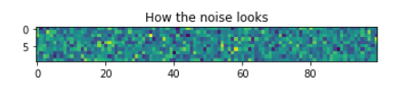
RESULTS

Slide 13
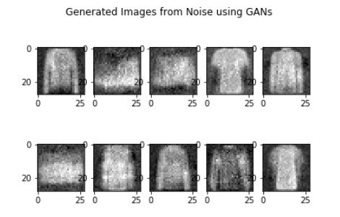
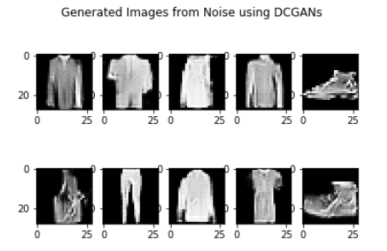
RESULTS

Slide 14
CONCLUSION
This project showcases the effective utilization of a Generative Adversarial Network (GAN) to generate fashion images from the Fashion MNIST dataset. By training a generator to produce images and a discriminator to distinguish real from fake ones, the team achieved a diverse array of fashion items. Through optimization of model architecture and training parameters, significant reductions in training time were achieved without compromising image quality. The GAN demonstrates its capacity to efficiently generate realistic fashion images, hinting at its potential for applications in fashion design and image synthesis.
REFERENCES
https://en.wikipedia.org/wiki/Generative_adversarial_network
https://keras.io/
https://www.kaggle.com/datasets/zalando-research/fashionmnist

