Slide 1
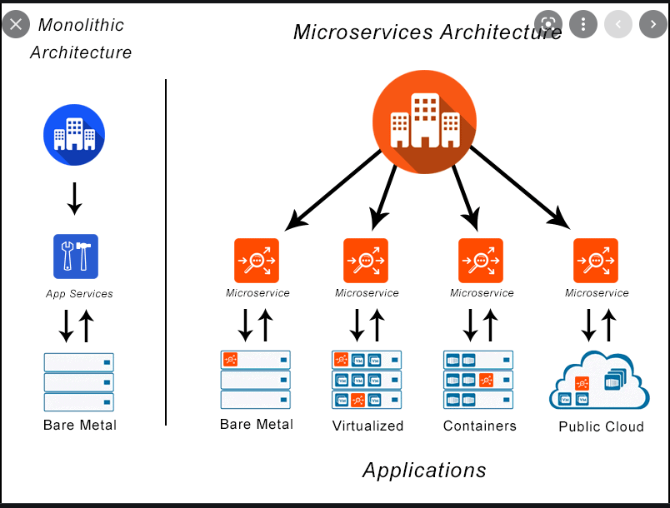

Slide 2
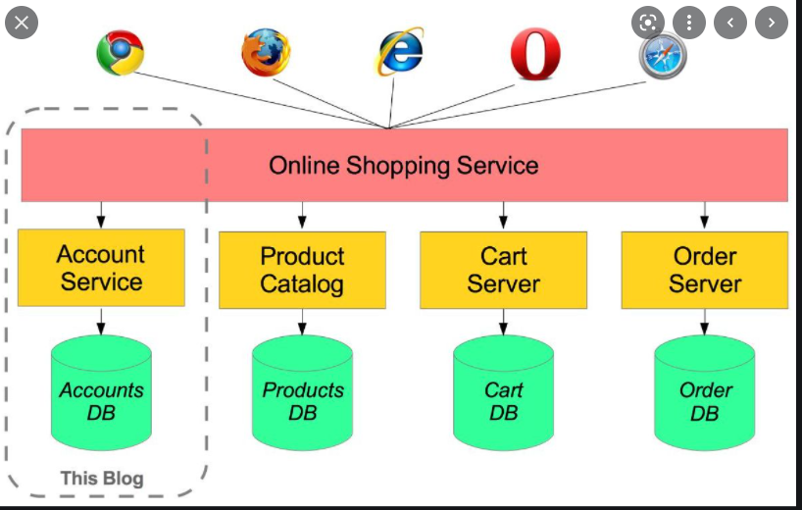

Slide 3
HDD
CPU
RAM
server1
server2
server3
Vertical Scaling
HORIZONTAL SCALING

Slide 4
Functional Requirement
NFR : Non Functional Requirement
Response Time (the home page should load in < 3s time)
Availability – 99.9%
Scalability – if I give more infrastructure it should be able to take more loads i.e more users
Maintainability
Number of users
Total user -> Active User ->Concurrent User

Slide 5
Employee ID
id
Employee Name
Employee
Project id
Project
id
Project Name
1. Get Me List of all employee with the assigned project and technology
JAYANTA | OSS | JAVA
MOUMITA | NSS | .Net
Technology Id
2. Get Me details of a particular employee
Technology
id
EMP01 | JAYANTA | OSS | JAVA
name
3 APIS 1) /employees/ 2) /employees/{id} 3) /employees/{empid}

