Slide 1
Assignment AnimalCLEF25 @ CVPR-FGVC & LifeCLEF Vișan Ionuț

Slide 2
Introduction
The AnimalCLEF 2025 challenge is a leading competition in the domain of computer vision and biodiversity informatics. It focuses on the fine-grained task of individual animal identification across multiple species, under real-world, unconstrained conditions.

Slide 3
Data Analysis
The main dataset is split into two main subsets:
Database – Contains labeled data about the individuals.
Query – Consists of images for identification, where the task is to determine whether the individual is known (present in the database) or new (not present in the database).
This dataset is all about individual animal identification of the following three species: loggerhead sea turtles (Zakynthos, Greece), salamanders (Czech Republic), Eurasian lynxes (Czech Republic).
The dataset contains 15209 images (database – 13074, query – 2135) and a metadata.csv file which contains multiple columns (image_id, identity, path, date, orientation, species, split, dataset).

Slide 4
Data Split
We will use the "database" dataset to train the model, as the "query" dataset does not contain labels and is intended for the evaluation of the results.
In this code, the dataset is split as follows:
1. Identify rare identities: All images whose identity appears only once (single-occurrence identities) are isolated into a separate subset (317).
2. Separate normal identities: Images belonging to identities that appear at least twice are separated for stratified sampling.
3. Stratified split: The normal identities are split into 80% training and 20% testing sets using train_test_split, with stratification based on the “identity” column to preserve the class distribution. A random seed (random_state=42) is set for reproducibility.
4. Training set: The training set consists of 80% of the normal identities plus all single-occurrence images.
5. Testing set: The testing set contains only the remaining 20% of the normal identities; single-occurrence identities are not included in the testing set.

Slide 5
Now we have (number of images):
Train set: 10522
Test set: 2552
Split ratio: 0.2425

Slide 6
WildLifeReID-10k
The WildlifeReID-10k dataset is a comprehensive benchmark for wildlife re-identification tasks, comprising over 214,000 images of 10,000 individual animals across approximately 33 species, including marine turtles, primates, birds, African herbivores, marine mammals, and domestic animals.
We will use also this dataset, which shares a similar structure with the previous one, and apply the same preprocessing strategy.
Train set: 112594 images
Test set: 27894 images
Split: 0.247

Slide 7
Related Work
As the competition is still in progress, there are currently few available notebooks or discussions showcasing strong-performing implementations.
I decided to directly explore an approach known for achieving remarkable results:
- ConvNeXt / ConvNeXt V2
- Swin / Swin V2
- Beit
- MaxViT
- MEGA (Moving Average Equipped Gated Attention)

Slide 8
Swin Large
We will fine-tune swin_large_patch4_window12_384 on AnimalCLEF dataset with the following configuration:
resize dimension = 384x384
augmentation = RandomResizedCrop, RandomHorizontalFlip, RandomRotation, ColorJitter, AutoAugment (ImageNet policy), RandomErasing
batch size = 16
model = “swin_large_patch4_window12_384”
epochs = 30
learning rate = 8e-5
weight decay = 0.01
scheduler = linear (with warmup – 0.1)

Slide 9
Best model saved at epoch 30 with Val Loss 1.1599 and Val Acc 0.7966.

Slide 10
MaxViT Large
We will fine-tune maxvit_xlarge_tf_384.in21k_ft_in1k on AnimalCLEF dataset with the following configuration:
resize dimension = 384x384
augmentation = RandomResizedCrop, RandomHorizontalFlip, RandomRotation, ColorJitter, AutoAugment (ImageNet policy), RandomErasing
batch size = 2
model = “maxvit_xlarge_tf_384.in21k_ft_in1k”
epochs = 30
learning rate = 4e-5
weight decay = 0.01
scheduler = linear (with warmup – 0.1)

Slide 11
Best model saved at epoch 28 with Val Loss 1.0749 and Val Acc 0.8029.

Slide 12
Fine-Tuning on WildlifeReID-10k
We will use a multi-stage fine-tuning approach to improve the performance of the convnext_xlarge.fb_in22k_ft_in1k_384 model on the AnimalCLEF dataset. First, we will fine-tune convnext_xlarge.fb_in22k_ft_in1k_384 on the WildlifeReID-10k dataset with the following configuration:
resize dimension = 384x384
augmentation = RandomResizedCrop, RandomHorizontalFlip, RandomRotation, ColorJitter, AutoAugment (ImageNet policy), RandomErasing
batch size = 8
model = “convnext_xlarge.fb_in22k_ft_in1k_384”
epochs = 10
learning rate = 8e-5
weight decay = 0.01
scheduler = linear (with warmup – 0.1)

Slide 13
Best model saved at epoch 10 with Val Loss 0.9513 and Val Acc 0.8440.

Slide 14
Fine-Tune Previous model on AnimalCLEF
We now build upon the previously trained model, already tailored to animal imagery and better aligned with our specific task, and proceed with further fine-tuning on the AnimalCLEF dataset.
resize dimension = 384x384
augmentation = RandomResizedCrop, RandomHorizontalFlip, RandomRotation, ColorJitter, AutoAugment (ImageNet policy), RandomErasing
batch size = 8
model = “convnext_xlarge.fb_in22k_ft_in1k_384”
epochs = 30
learning rate = 8e-5
weight decay = 0.01
scheduler = linear (with warmup – 0.1)

Slide 15
Best model saved at epoch 30 with Val Loss 0.7943 and Val Acc 0.8519.

Slide 16
Explore more into Previous model
To gain deeper insights into the model space outlined in Section 4.3.1. and to investigate potential performance improvements, we propose the following configuration:
resize dimension = 384x384
augmentation = RandomResizedCrop, RandomHorizontalFlip, RandomRotation, ColorJitter, AutoAugment (ImageNet policy), RandomErasing
batch size = 8
model = “convnext_xlarge.fb_in22k_ft_in1k_384”
epochs = 30
learning rate = 1e-5
weight decay = 0.01
scheduler = cosine (with warmup – 0.1)

Slide 17
Best model saved at epoch 27 with Val Loss 0.7979 and Val Acc 0.8546.

Slide 18
MegaDescriptor + MatchAliked
We construct a robust animal re-identification pipeline by combining global and local feature matching techniques within the WildFusion framework. Specifically, we use the MegaDescriptor (“hf-hub:BVRA/MegaDescriptor-L-384”) model for extracting deep global features and ALIKED features matched via LightGlue for fine-grained local correspondences.
Each similarity pipeline is calibrated using isotonic regression to convert raw similarity scores into reliable confidence estimates. The process involves three main datasets: a query set, a database set, and a calibration set (used to fine-tune the confidence scoring).
After calibration, WildFusion fuses the outputs from both global and local pipelines, prioritizing the global (MegaDescriptor) matcher, to compute similarity scores between query and database images. The highest-scoring matches are selected as predictions.

Slide 19
MegaDescriptor + MatchAliked
For the calibration process, we utilize two sources: 1,000 representative samples from the database dataset and the test set generated. To ensure a robust and well-generalized calibration, it is crucial that the selected images are as diverse as possible.
For similarity computation, we will consider two settings: one using a subset of 700 images and another leveraging the full set of available images. This dual approach enables the model to perform under both constrained conditions, where efficiency is prioritized, and unrestricted scenarios, where accuracy can be maximized.

Slide 20
Embeddings + Classifier
To enhance the performance of a general model, we will combine the strengths of all previously trained models to build a more robust and accurate classifier.
Embeddings are extracted by feeding images from the train and test datasets into pretrained models:
convnext_xlarge.fb_in22k_ft_in1k_384 (from previous milestone)
convnext_xlarge.fb_in22k_ft_in1k_384 (4.3.2.)
swin_large_patch4_window12_384 (from previous milestone)
swin_large_patch4_window12_384 (4.1.)
maxvit_xlarge_tf_384.in21k_ft_in1k (4.2.)
hf-hub:BVRA/MegaDescriptor-L-384 (4.4.)

Slide 21
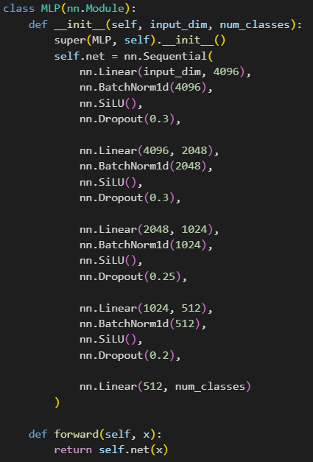
Embeddings + Classifier
If the output is multi-dimensional (e.g., feature maps), global average pooling is applied to reduce it to a fixed-size feature vector. These embeddings, along with their corresponding labels, are collected and saved as .npz files.
We then aggregate the embeddings into a rich, unified feature representation, followed by standardization and dimensionality reduction using StandardScaler and PCA, preserving 99% of the variance.
The training setup uses the AdamW optimizer with a learning rate of 5e-4, weight decay of 1e-2, a linear learning rate scheduler with warmup, cross-entropy loss, early stopping after 10 epochs of no improvement, and a maximum of 100 epochs.

Slide 22
The test loss reaches 0.7650 and the accuracy reaches 0.8746.

Slide 23
Ideas and models to mention
Several additional experiments were carried out using advanced architectures, including ConvNeXtV2-Huge (384 & 512), ConvNeXtV2-Large (384), SwinV2-Large, and BEiT-Large, along with various training configurations. However, these models underperformed compared to the best baselines, with test losses remaining above 1.1 and accuracies not exceeding 78%.
To further explore performance gains, I attempted to create a custom ensemble model by combining Swin-Large, ConvNeXt-XL, and BEiT-Large backbones. Their features were fused and passed through a fully connected classification head, but the model failed to deliver satisfactory results.
Another approach involved fine-tuning a multi-backbone architecture that fused normalized embeddings from ConvNeXt-XL, Swin-Large, and MaxViT, using a GLU-based classification head. Despite the architectural sophistication, this setup did not yield a meaningful performance boost over simpler models.

Slide 24
Ideas and models to mention
I also explored model ensembling techniques:
- A Model Soup approach averaged the weights of multiple ConvNeXt-XL models using a weighted strategy. While the fused model generalized reasonably well, it still did not outperform the best individual models.
- A soft ensemble was implemented by blending the output probabilities of ConvNeXt-XL and MaxViT using a weighted average. Although promising in theory, this method also failed to surpass the standalone models’ accuracy.
Additionally, I tested another approach by training an XGBoost classifier on the concatenated embeddings from ConvNeXt and MaxViT. After applying standard scaling and PCA for dimensionality reduction, the model trained and inferred rapidly. However, its performance remained slightly below that of the top-performing neural networks.
Lastly, I experimented with integrating auxiliary metadata, such as date and orientation, into the classification pipeline. The date field was transformed into features like year, month, and day, using normalized values or one-hot encoding. Orientation was treated as a categorical attribute and embedded similarly. These metadata features were concatenated with the visual embeddings prior to classification.

Slide 25
Submissions
The evaluation uses two metrics: BAKS (balanced accuracy on known samples) and BAUS (balanced accuracy on unknown samples). The final score is the geometric mean of BAKS and BAUS to prevent biased results from trivial predictions.
To determine whether an image belongs to a known class or should be classified as a "new individual," we will use a threshold.
After experimenting with all previously trained models across various threshold settings, I found that only a few consistently delivered strong performance. The most notable among them were:
ConvNeXt-XL (convnext_xlarge.fb_in22k_ft_in1k_384) from previous milestone
WildFusion (MegaDescriptor-L-384 + Aliked)

Slide 26
Submissions
Therefore, we devised a fusion strategy that combines the predictions and confidence scores from the following models:
1. ConvNeXt-XL (convnext_xlarge.fb_in22k_ft_in1k_384) from previous milestone
2. WildFusion 1 (MegaDescriptor-L-384 + Aliked) calibrated using the first 1,000 samples from the database set and computed similarities between all query and database images with a batch size B=700
3. WildFusion 2 (MegaDescriptor-L-384 + Aliked) calibrated using the test database dataset and computed similarities between all query images and the database images with a batch size B=None

Slide 27
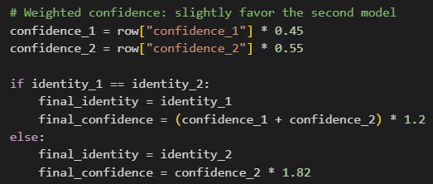
Submissions – fusion strategy
The predictions from the two WildFusion models were combined using a weighted strategy: confidences were scaled by 0.45 and 0.55 respectively, giving more weight to the second model (WildFusion 2). If both models predicted the same identity, their confidences were averaged and boosted by a factor of 1.2; if they disagreed, the second model’s prediction was selected and its confidence was amplified by 1.82. The final results, including the selected identity and corresponding confidence for each image, were saved to Combined WildFusion.

Slide 28
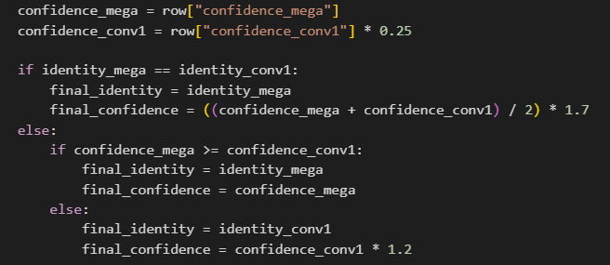
Submissions – fusion strategy
The predictions from the Combined WildFusion and ConvNeXt-XL models were integrated by comparing their predicted identities and confidence scores. The ConvNeXt-XL confidence was first scaled by 0.25. If both models predicted the same identity, their confidences were averaged and amplified by a factor of 1.7. If the predictions differed, the identity with the higher adjusted confidence was selected. If ConvNeXt-XL was selected, its confidence was further boosted by a factor of 1.2. The final predictions and confidence scores were saved to Submisson.

Slide 29
Submissions – fusion strategy
A confidence threshold of 0.45 is then applied to the Submission. Predictions with confidence scores below this threshold are reassigned the identity "new_individual". The final output, containing only the "image_id" and "identity" columns, is saved as the Final Submission.

Slide 30
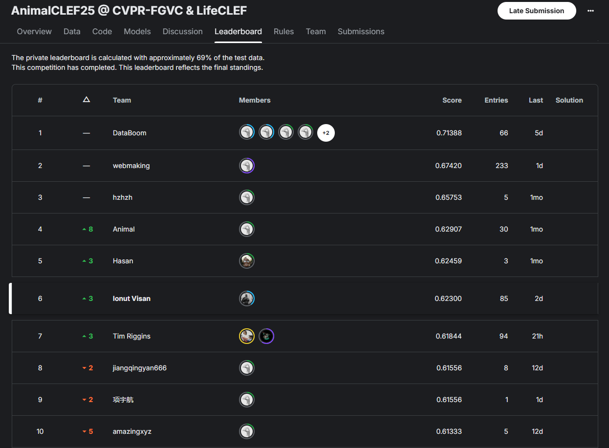
Submissions
After more than 85 submissions, Final Submission places us in 6th position out of 234 competitors, with a score of 0.60483 on private submission set.

Slide 31
Thanks for attention.

