Slide 1


SMART INDIA HACKATHON 2026
Belt Joint Rupture and Conveyor Belt Damages in Iron Ore Mining Industry
Problem Statement ID –26008
Problem Statement Title- Belt Joint Rupture & Damage in Iron Ore Mines
Theme- AI-Based Conveyor Belt Monitoring
PS Category- Hardware
Team ID- SIH26-A0H-T114
Team Name- Sergio

Slide 2
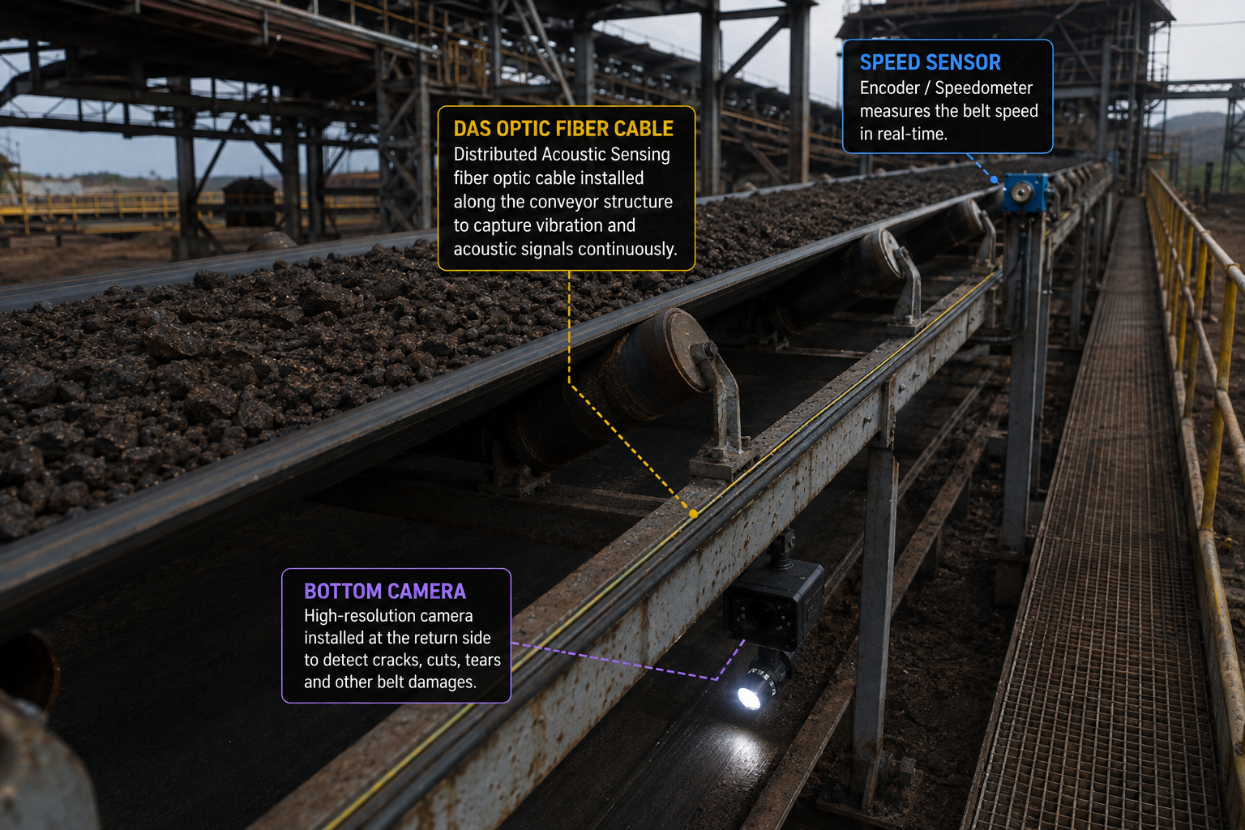
PROPOSED SOLUTION
OUR SOLUTION
PROBLEM AT HAND
Belt Joint Rupture :
Sudden failure of belt joints leads to unplanned downtime, material spillage, equipment damage and safety hazards.
Conveyor Belt Damages: Cracks, cuts, tears, and edge wear go undetected in time, resulting in costly breakdowns.
High Downtime & Losses: Unplanned shutdowns disrupt production and increase maintenance & operational costs significantly.
Safety Risks: Belt failures endanger workers and damage costly assets, affecting overall mine safety.
Key Features
111211
DAS + DTS :
Optical-fibre sensing line to detect the vibration and temperature.
Global-Shutter Area Camera “ETPL UA5MEAGV-50M” :
Placing a camera on the belt gives a clear view of cuts , tears and cracks.
Speed Sensor :
Real-time belt speed provides operating context for the AI model.
AI/ML +IoT :
Analyses sensor data alongside historical records to identify damage and predict failures
Why We Stand Out
Continuous Monitoring: DAS + DTS monitor the belt continuously.
Clear Damage Detection: Bottom camera detects cracks, cuts & tears.
Predictive AI: AI/ML predicts belt health and failure risk

Slide 3
TECHNICAL APPROACH
SENSOR UNIT :
DAS + DTS (Optical Fiber) provide distributed vibration and temperature monitoring along the conveyor.
Bottom-side camera captures the returning belt surface to detect cracks, cuts, tears and edge wear.
Speed sensor measures real-time belt speed for operational context.
DATA ACQUISITION :
Edge DAQ / Data Logger collects data from all sensors (DAS, DTS, Camera, Speed).
Time-synchronizes all inputs for accurate correlation.
Performs initial filtering, buffering and secure data transmission.
AI / ML ENGINE :
Multi-modal AI/ML model analyses fused sensor data and belt history.
Detects anomalies and assesses damage (location & severity).
Predicts rupture risk with a probability score.
IoT MONITORING :
Monitors the system in real time and displays its current condition as Normal, Warning, or Critical.
Allows users to check previous data, view trends, generate reports, and monitor the system remotely.
ALERTS & ACTION :
Instant alerts for abnormal conditions and high rupture risk . Maintenance recommendations for timely action. Planned maintenance reduces downtime and improves safety & asset protection.
FLOW CHART
Sensor Unit
Data Acquisition
AI/ML Engine
IoT Monitoring
Alert & Action

Slide 4
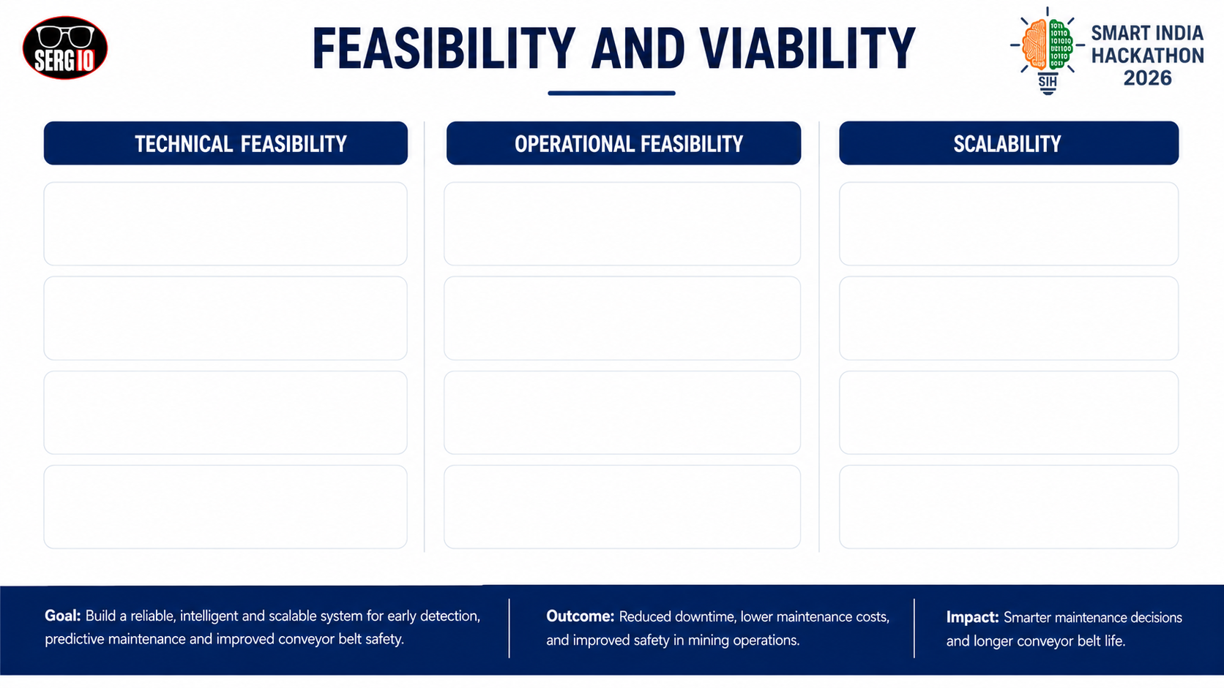
Distributed Sensing: DAS + DTS optical fibre enables long-range vibration and temperature monitoring.
Non-Intrusive Inspection: Bottom-side vision inspects the returning belt without interfering with ore transport.
Modular Deployment: Start with one critical conveyor and expand across the mine.
Multi-Modal Detection: Bottom-side camera and speed sensing complement fibre-based measurements.
Early Intervention: Abnormal conditions are identified before they develop into major failures.
Flexible Sensing: Additional sensors or data sources can be integrated when required.
Edge Integration: DAQ synchronizes and preprocesses sensor data before AI/ML analysis.
Centralized Visibility: IoT dashboard provides belt health, trends and alerts to maintenance teams.
Mine-Wide Monitoring: The same architecture can support multiple conveyor systems.
Predictive Analytics: AI/ML combines live signals with belt history for anomaly and failure prediction
Maintenance Support: Historical data helps prioritize inspections, repairs and component replacement.
Continuous Learning: Increasing belt-history data can improve AI/ML performance over time.
The cost of making a single prototype using indigenous products is around 33000/-
@SIH Idea submission- Template
4

Slide 5

IMPACT AND BENEFITS
SAFETY:
Early detection of belt damage reduces the risk of sudden belt failure.
Helps protect workers from hazards caused by belt rupture and material spillage.
Reduces risk of damage to conveyor equipment
REDUCED D0WNTIME :
Predictive detection enables maintenance before major failure.
Helps minimize unexpected conveyor shutdowns.
Supports planned maintenance instead of reactive maintenance.
COST MAINTANANCE:
Reduces maintenance and operational losses caused by major belt failures.
Early identification of damage can prevent escalation of small defects.
Improves utilization of existing conveyor infrastructure.
PRODUCTION BENEFITS:
Continuous monitoring improves conveyor availability.
Real-time belt health information supports faster maintenance decisions.
Helps maintain reliable material transportation in iron ore mines.
SAFETY
IMPACTS AND BENEFITS
REDUCED DOWNTIME
PRODUCTION BENEFITS
COST MAINTENANCE

Slide 6
RESEARCH AND REFERENCES
RESEARCH FOUNDATION
KEY RESEARCH PAPERS
DAS
Distributed acoustic sensing has been field-tested on mining conveyors for continuous vibration/fault monitoring.
Wijaya et al. (2022)
01
Automatic fault detection system for mining conveyor using distributed acoustic sensor.
Measurement, 187, 110330
VISION
Deep-learning computer vision can identify conveyor-belt damage such as cuts, tears and other defects.
Sahu et al. (2021)
02
Application of Lightweight Convolutional Neural Network for Damage Detection of Conveyor Belt.
Applied Sciences, 11(16), 7282
AI / ML
Machine-learning and digital-twin approaches support fault prediction and condition-based maintenance.
Pulcini & Modoni (2024)
03
Machine learning-based digital twin of a conveyor belt for predictive maintenance.
Int. J. Adv. Manuf. Technol., 133, 6095–6110
RESEARCH
GAP
Most approaches focus on a single sensing modality. Our opportunity is to fuse DAS + DTS + bottom-side vision + operational context for predictive belt health.
Rios-Colque et al. (2026)
04
Computer Vision-Based Techniques for Conveyor Belt Condition Monitoring: A Systematic Review.
Sensors, 26(8), 2527
RESEARCH → SENSOR FUSION → PREDICTIVE BELT MONITORING
@SIH Idea submission- Template
6

