Slide 1

SMART INDIA HACKATHON 2026
Problem Statement ID - SIH26008
Problem Statement Title - Belt Joint Rupture and Conveyor Belt Damages in Iron Ore Mining Industry: Intelligent Monitoring and Prediction of Conveyor Belt Joint Rupture and Damages in Iron Ore Mining Industry.
Theme - Smart Automation
PS Category - Hardware
Team ID - SIH26-A0H-T114
Team Name - Sergio

Slide 2
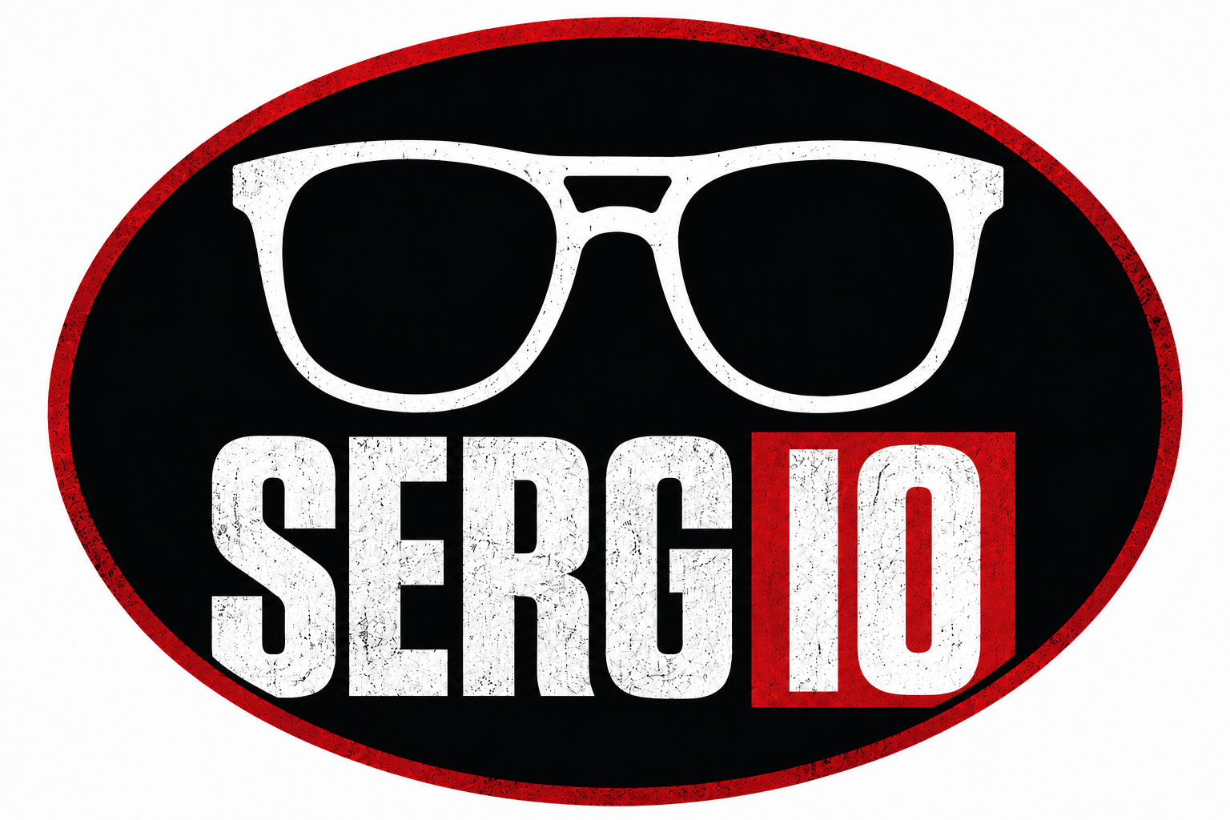
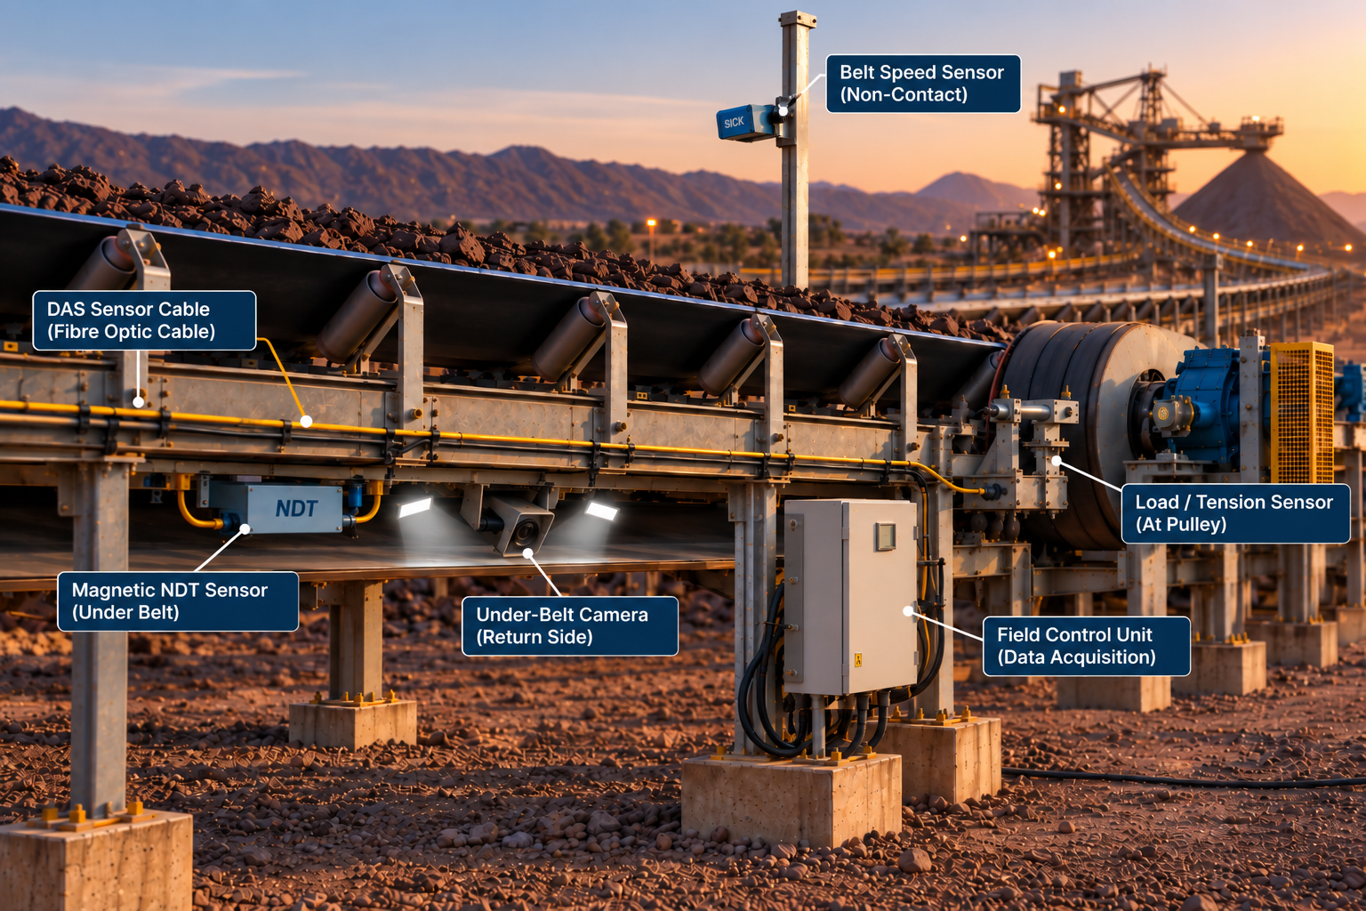
Intelligent AI-Based Monitoring and Prediction of Conveyor
Belt Failures in Iron Ore Mines
Our Idea:
An AI-powered multi-sensor system for continuous monitoring and prediction of conveyor belt and joint failures.
Combines camera vision, magnetic NDT, DAS, speed,slip and tension monitoring for comprehensive belt health assessment.
Uses live sensor data along with belt maintenance and operating history to predict developing failures.
Innovation / Uniqueness:
Integrated multi-technology monitoring instead of relying on a single inspection method.
Enables continuous monitoring of long-distance conveyors using distributed fibre-optic sensing.
Combines real-time sensor data + historical/maintenance data for predictive failure assessment.
User feedback corrects false AI detections, allowing the system to improve with operational data.
Proposed Solution:
Camera + Magnetic NDT detect visible and internal belt/splice damage.
DAS provides distributed monitoring and helps localize abnormal regions along long conveyors.
Encoder + non-contact speed sensing identifies belt slip, while load/tension monitoring tracks mechanical stress.
AI/ML fuses all parameters, detects anomalies and predicts failure risk.

Slide 3
TECHNICAL APPROACH
Monitoring Factor | Solution
Belt Joint / Splice Condition and Belt Body Condition | Detects cuts, cracks and internal splice damage using cameras and Magnetic NDT Sensors
Belt Speed & Slip | Monitors belt speed and detects slip using Encoder and Non Contact Speed Sensors
Mechanical Loading & Tension | Load Cell
Belt Alignment & Fault Location | Detects misalignment and locates faults by processing data from DAS
Operating Status and Start Stop Frequency | Monitors motor vibration and running/stopped status
Belt & Joint History | Uses historical data for trend analysis
Maintenance History | Analyses maintenance records
Sensor / Device | Purpose
Distributed Acoustic Sensing (DAS) | Vibration / acoustic monitoring (belt health, misalignment, impacts)
Industrial Camera (Computer Vision) | Detects cuts, tears and surface damages
Encoder and Non-contact Speed Sensor | Belt speed measurement
Load Cell | Mechanical loading and tension monitoring
Historical Database (Plant System) | Belt & joint history, past maintenance data
Magnetic NDT Sensor | Internal Splice/Cord Damage
Stage | Details
Data Fusion | Combine multi-sensor data; Time synchronization
Preprocessing | Noise filtering; Signal conditioning; Feature extraction; Data normalization
AI / ML Models | Anomaly detection; Fault classification; Severity estimation; Fault location estimation; Predictive insights
Processed Insights | Filter only relevant information
Database
Analysed results Fault events Trend data Historical records Maintenance data Reduced storage (no raw data)
Output | Details
Monitoring Dashboard (SCADA / IoT) | Real-time belt condition Trend analysis Reports
Alert & Notification | Early warning Critical fault alerts Location information
Data Validation & Error Rectification | Detect inconsistent sensor data Identify false/erroneous readings Validate data using multi-sensor correlation
Stages | Continuous Improvement (Feedback Loop)
Operational Feedback | New data; Actual fault events; Maintenance outcomes
Model Retraining | Improve accuracy; Adapt to new patterns; Update with latest data
Better Predictions | Higher reliability; Lower maintenance cost; Safer operations
Continuous Learning | Model Update and Continuous Learning

Slide 4
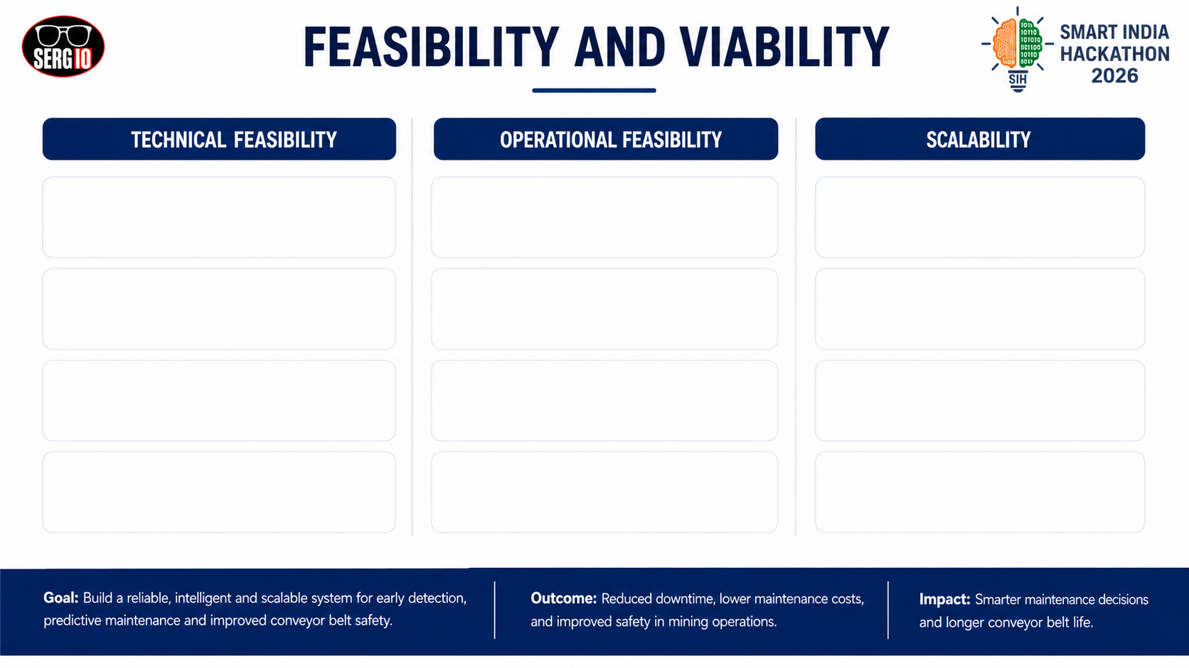
Proven Industrial Technologies: Uses machine vision, magnetic NDT, DAS, encoders and load/tension sensing based on established industrial monitoring principles.
Non-Intrusive Monitoring : Sensors continuously monitor belt and joint condition without interrupting material transportation.
Modular Mine-Wide Deployment : The same architecture can be expanded from one critical conveyor to multiple conveyors across a mine.
AI/ML Sensor Fusion : Combines multiple live sensor signals with belt, joint and maintenance history to identify abnormalities and predict failure risk.
Early Failure Warning : Detects abnormal conditions and developing damage before they progress into major conveyor failures.
Industry 4.0 Ready : Integrates IoT, AI/ML, real-time sensing and data analytics to transform conventional conveyor monitoring into a smart cyber-physical system.
Existing Infrastructure Integration :SCADA data can be incorporated without replacing the existing conveyor control system
Predictive Maintenance : AI-based health assessment helps maintenance teams plan inspections and repairs before unplanned breakdowns.
Indigenous Technology – Viksit Bharat 2047: Provides a pathway toward an India-developed predictive-maintenance solution for mining infrastructure, supporting technology.
Prototype-to-Field Validation : The system can be validated on a short conveyor section before deployment on long-distance mining conveyors.
Centralized Monitoring : IoT/SCADA dashboard provides belt health, fault location, alerts and historical trends in one platform.
SDG Alignment: Contributes to SDG 8 (Decent Work), SDG 9 (Industry & Innovation), SDG 12 (Responsible Production) and SDG 13 (Climate Action) through safer operations, technological innovation and improved resource efficiency.
@SIH Idea submission
4

Slide 5

IMPACT AND BENEFITS
Production, Safety & Maintenance Impact : Production Protection: Early detection of belt and splice deterioration prevents unexpected failures and the associated production losses.
Planned Maintenance : AI-based warnings allow repairs to be scheduled during planned shutdowns instead of emergency breakdowns.
Lower Maintenance Cost : Early intervention reduces secondary damage, emergency repair requirements and prolonged downtime.
Improved Safety & Reliability : Continuous monitoring reduces manual inspection requirements and provides early warning of hazardous belt conditions.
Example:NMDC Bailadila — Illustrative Cost–Impact
NMDC's Bailadila complex in Chhattisgarh is a suitable real-world reference because it is a major iron-ore mining operation with extensive conveyor infrastructure.Example assumption:2,500 TPH conveyor + NMDC iron-ore realization of approximately ₹4,700/t.
Parameter | Estimate
System installation | ₹30–40 lakh
Conveyor capacity | 2,500 TPH
Ore transported/hour | 2,500 tonnes
Sales value/hour* | ≈ ₹1.18 crore
12 h downtime avoided | ≈ ₹14.2 crore protected
24 h downtime avoided/year | ≈ ₹28.4 crore protected
Illustrative estimate only; actual savings depend on operating costs, profit margins and downtime recovery.
@SIH Idea submission

Slide 6
RESEARCH AND REFERENCES
No. | Research Paper | Source
1 | Automatic Fault Detection System for Mining Conveyor using Distributed Acoustic Sensor — Wijaya et al., Measurement, 2022
2 | Deep Learning-Based Damage Detection of Mining Conveyor Belt — Zhang et al., Measurement, 2021
3 | Magnetic Methods in Monitoring Changes of the Technical Condition of Splices in Steel Cord Conveyor Belts — Kozłowski et al., Engineering Failure Analysis, 2019
4 | A Diagnostics of Conveyor Belt Splices — Kozłowski et al., Applied Sciences, 2020
5 | Identification of Damage Development in the Core of Steel Cord Belts with the Diagnostic System — Błażej et al., Scientific Reports, 2021
6 | Research on the Working Condition Monitoring and Protecting System for Mine Belt Conveyor — Huang, 2011

