Slide 1
Exception and Interrupt Handling in ARM
Naumovski Vlatko
19.07.2012

Slide 2
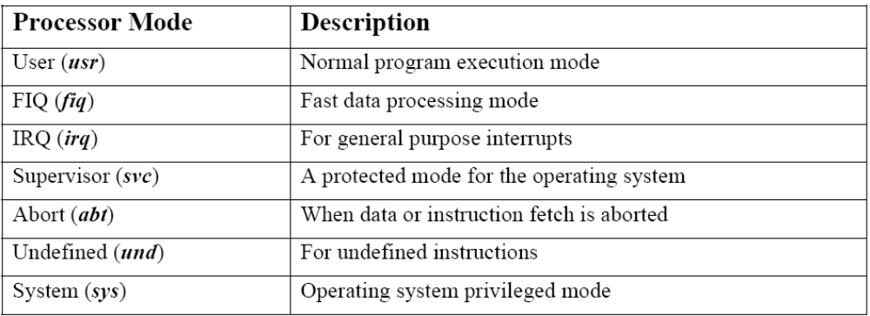
ARM modes of operation

Slide 3
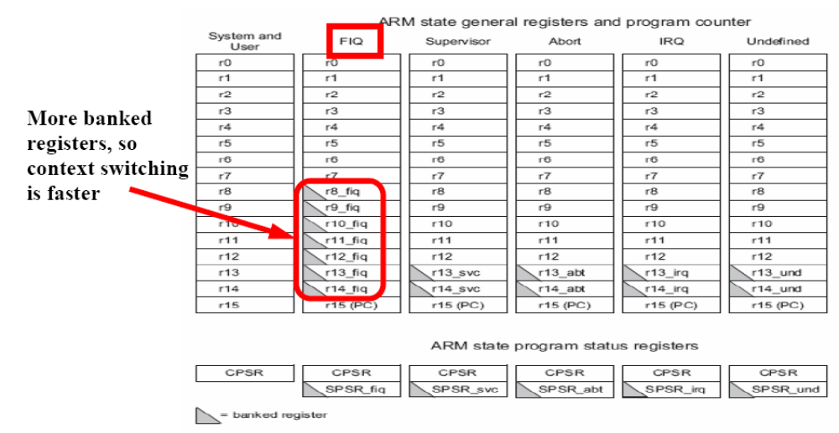
ARM Register set

Slide 4
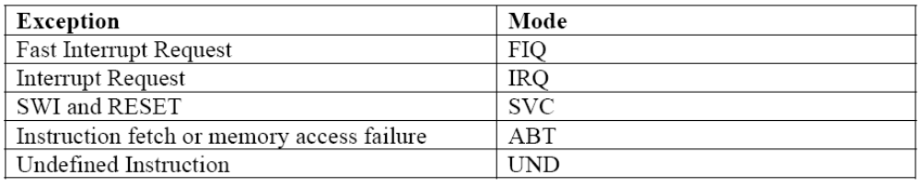
ARM Exceptions
An exception is any condition that needs to halt normal execution of the instructions

Slide 5
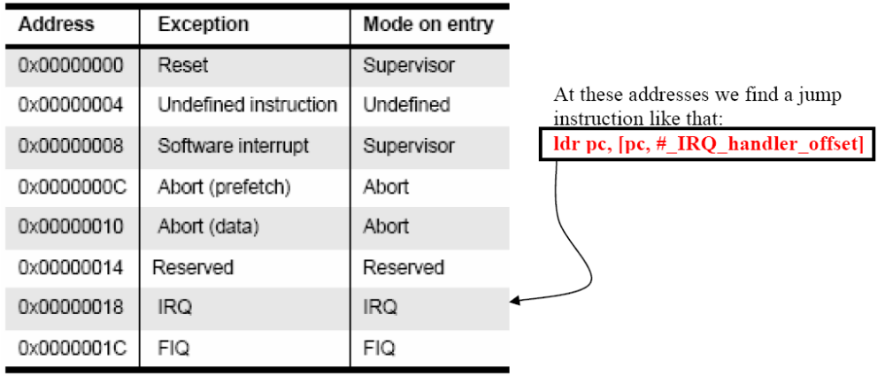
Vector Table
It is a table of instructions that the ARM core branches to when an exception is raised. These instructions are places in a specific part in memory and its address is related to the exception type.

Slide 6
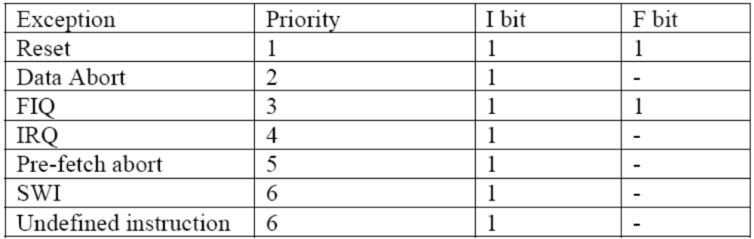
Exception priorities
It is a table of instructions that the ARM core branches to when an exception is raised. These instructions are places in a specific part in memory and its address is related to the exception type.

Slide 7
Entering and exiting an exception handler
Here are the steps that the ARM processor does to handle an exception:
Preserve the address of the next instruction.
Copy CPSR to the appropriate SPSR, which is one of the banked registers for each mode of operation.
Force the CPSR mode bits to a value depending on the raised exception.
Force the PC to fetch the next instruction from the exception vector table.
Now the handler is running in the mode associated with the raised exception.
Page <number>

Slide 8
Entering and exiting an exception handler (2)
And when deciding to leave the exception handler, the following steps
occurs:
Move the Link Register LR (minus an offset) to the PC.
Copy SPSR back to CPSR, this will automatically changes the mode back to the previous one.
Clear the interrupt disable flags (if they were set).
Page <number>

Slide 9
Interrupts
How are interrupts assigned?
Interrupt Latency
IRQ and FIQ exceptions
Interrupt stack
Page <number>

Slide 10
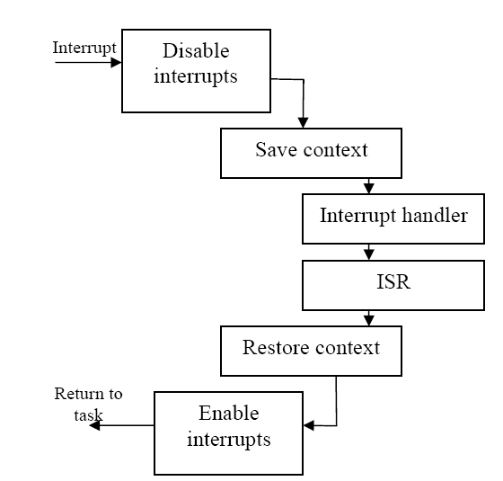
Interrupt handling schemes
Non-nested interrupt handling
Page <number>

Slide 11
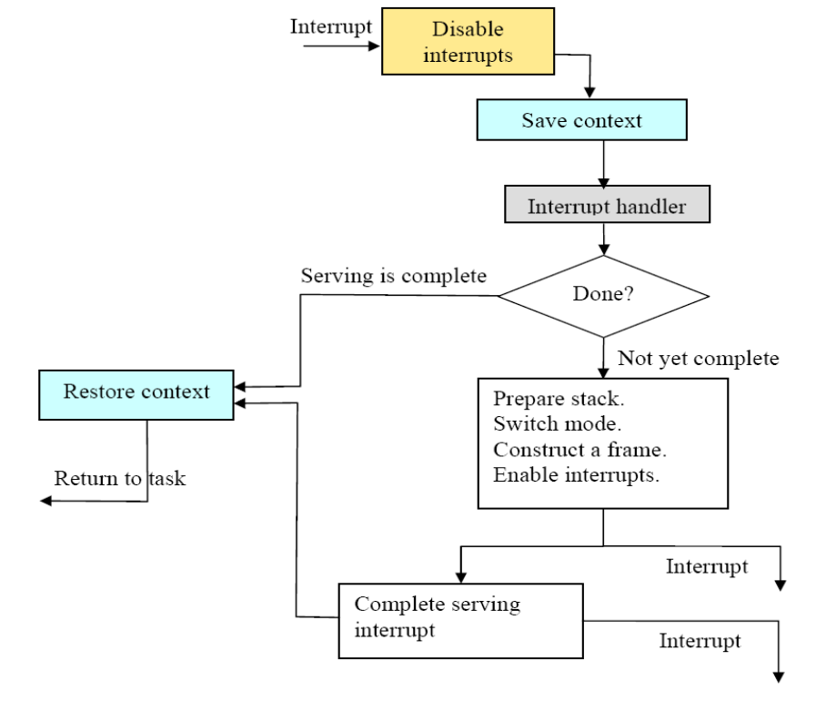
Interrupt handling schemes (2)
Nested interrupt handling
Page <number>

