Slide 1
Learning Machine Learning
A primer on simple feedforward artificial neural networks
B.09
Z1.13
Coronel, Lesli Natasha A. Navarro, Joachim Alfonso A.
Susana, Mark Ebson DR. Tolfo, Michael Christian C. Villa, Jacob Miguel C.

Slide 2
What’s a NN?
A machine learning algorithm
Modeled after the brain
Solves computational problems

Slide 3
Properties of NN
Evolutionary
1
Computationally parallel
2
Uses math to learn
3
Calculus!

Slide 4
The Neuron
This is a neuron.

Slide 5
The Neuron
It holds a number in the range [0, 1].
0.7

Slide 6
The Neuron
This number is called its activation.
0.7

Slide 7
The Layer
0.7
0.2
This is a layer of neurons, each with their own activation.
0.6
0.4
0.8

Slide 8
The Network
0.7
0.2
0.0
0.2
1.0
0.2
Many layers make up a neural network.
0.6
0.6
0.4
0.4
0.5
0.3
0.8
0.1
0.8

Slide 9
Kinds of Layers
0.7
-
-
This is the input layer.
It receives numbers from the training data…
0.2
-
-
0.6
-
-
0.4
-
-
0.8
-
-

Slide 10
Kinds of Layers
0.7
0.7
?
-
0.7
0.2
?
-
0.7
…and passes them on.
0.6
?
-
0.7
0.4
?
-
0.8
0.7
?
-

Slide 11
Kinds of Layers
0.7
?
-
0.2
0.2
?
-
0.2
…and passes them on.
0.2
0.6
?
-
0.2
0.4
?
-
0.8
0.2
?
-

Slide 12
Kinds of Layers
0.7
?
-
0.6
0.2
?
-
0.6
…and passes them on.
?
-
0.6
0.6
0.6
0.4
?
-
0.8
0.6
?
-

Slide 13
Kinds of Layers
0.7
?
-
0.4
0.2
?
-
0.4
…and passes them on.
0.6
?
-
0.4
0.4
0.4
?
-
0.8
0.4
?
-

Slide 14
Kinds of Layers
0.7
?
-
0.8
0.2
?
-
…and passes them on.
0.8
0.6
?
-
0.8
0.4
?
-
0.8
0.8
?
-
0.8

Slide 15
Kinds of Layers
0.7
…
-
This is a hidden layer.
It processes all info from the input layer…
0.2
…
-
0.6
…
-
0.4
…
-
0.8
…
-

Slide 16
Kinds of Layers
0.7
0.2
-
and comes up with an activation for each neuron using a certain math function.
0.2
1.0
-
0.6
0.6
-
0.4
0.5
-
0.8
0.1
-

Slide 17
The Network
0.7
0.2
0.0
0.2
1.0
0.2
This is the output layer.
0.6
0.6
0.4
0.4
0.5
0.3
0.8
0.1
0.8

Slide 18
The Network
0.7
0.2
0.0
0.2
1.0
0.2
It computes its activations just like the hidden layers…
0.6
0.6
0.4
0.4
0.5
0.3
0.8
0.1
0.8

Slide 19
The Network
0.7
0.2
0.0
1.0
0.2
…except that their activations are the outputs of the network.
0.2
0.6
0.6
0.4
0.4
0.5
0.3
0.8
0.1
0.8

Slide 20
Training
Every neural network is trained, just like a brain.

Slide 21
Training
NN
This is done
using a training dataset.

Slide 22
Training
NN
The output
is then
compared to the expected output.
Dataset

Slide 23
Training
From there, the NN’s “untrainedness”, or cost, is obtained.
NN
Dataset

Slide 24
Training
NN
Dataset
Cost
The neural network then attempts to minimize this cost…

Slide 25
Training
NN
Dataset
Cost
…in a process called backpropagation.

Slide 26
How Neurons Work
How does a neuron decide what number to store in it?

Slide 27
How Neurons Work
0.7
-
0.2
Focus on the green neuron.
0.6
0.4
0.8

Slide 28
How Neurons Work
0.7
-
0.2
It takes inputs from each input neuron.
0.6
0.4
0.8

Slide 29
How Neurons Work
0.7
-
0.2
But values some inputs over others.
0.6
0.4
0.8

Slide 30
How Neurons Work
0.7
w = 1.5
-
w = 0.5
0.2
w = 0.75
Each link carries a weight (w)
0.6
w = 3.0
w = 1.125
0.4
0.8

Slide 31
How Neurons Work
0.7
1.5 * 0.7
-
0.5 * 0.2
0.2
0.75 * 0.6
which the neuron multiplies with each input activation (A_{in})
0.6
3.0 * 0.4
1.125 * 0.8
0.4
0.8

Slide 32
How Neurons Work
0.7
1.5 * 0.7
-
0.5 * 0.2
0.2
0.75 * 0.6
And then adds the products together.
0.6
3.0 * 0.4
1.125 * 0.8
0.4
Add
0.8

Slide 33

How Neurons Work
0.7
1.5 * 0.7
-
0.5 * 0.2
0.2
But wait…
$$\sum{wA_{in}}=3.7$$
That’s not between 0 and 1!
0.75 * 0.6
0.6
3.0 * 0.4
1.125 * 0.8
0.4
3.7
0.8

Slide 34
How Neurons Work
0.7
1.5 * 0.7
-
So we squish all real numbers into a range from 0 to 1!
0.5 * 0.2
0.2
0.75 * 0.6
0.6
3.0 * 0.4
1.125 * 0.8
0.4
3.7
0.8

Slide 35

How Neurons Work
0.7
1.5 * 0.7
-
Enter the Sigmoid function.
$$σ\left(x\right)= \frac{1}{1+e^{−x}}$$
0.5 * 0.2
0.2
0.75 * 0.6
0.6
3.0 * 0.4
1.125 * 0.8
0.4
0.8

Slide 36
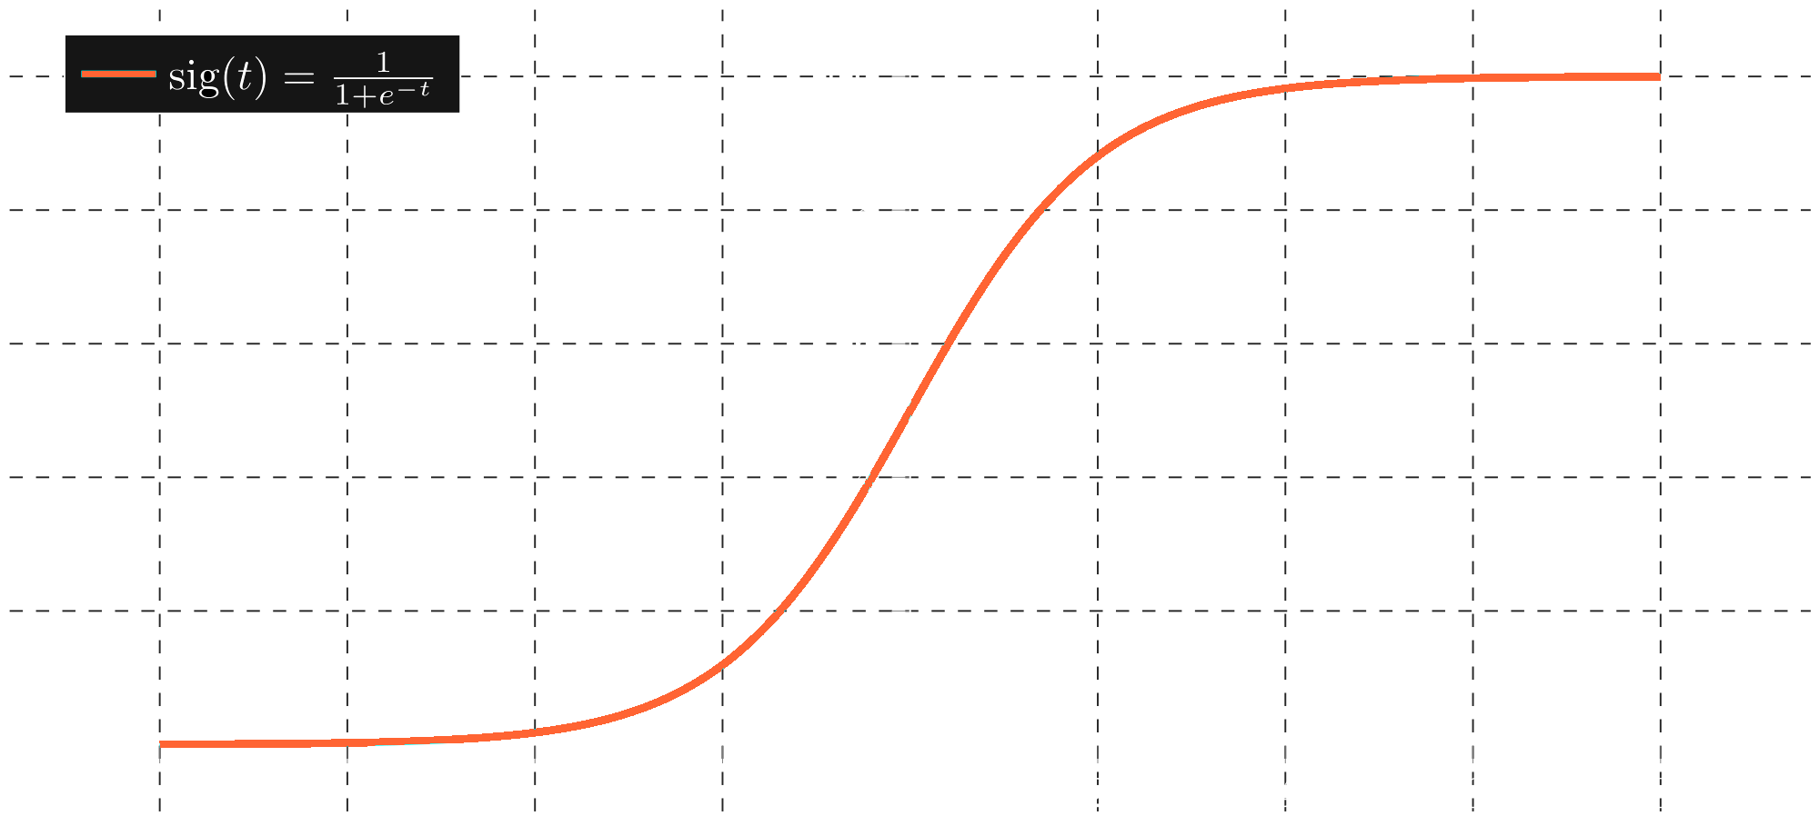
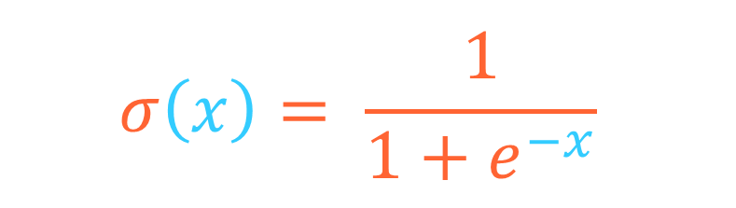
How Neurons Work
$$σ\left(x\right)= \frac{1}{1+e^{−x}}$$
0.7
1.5 * 0.7
-
0.5 * 0.2
0.2
0.75 * 0.6
0.6
3.0 * 0.4
1.125 * 0.8
0.4
0.8

Slide 37
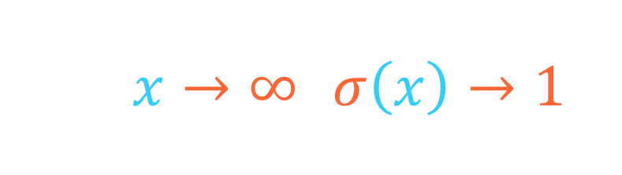
How Neurons Work
As $x→∞$, $σ\left(x\right)→1$
0.7
1.5 * 0.7
-
0.5 * 0.2
0.2
0.75 * 0.6
0.6
3.0 * 0.4
1.125 * 0.8
0.4
0.8

Slide 38
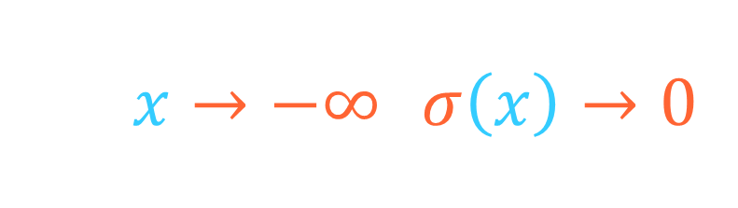
How Neurons Work
As $x→−∞$, $σ\left(x\right)→0$
0.7
1.5 * 0.7
-
0.5 * 0.2
0.2
0.75 * 0.6
0.6
3.0 * 0.4
1.125 * 0.8
0.4
0.8

Slide 39
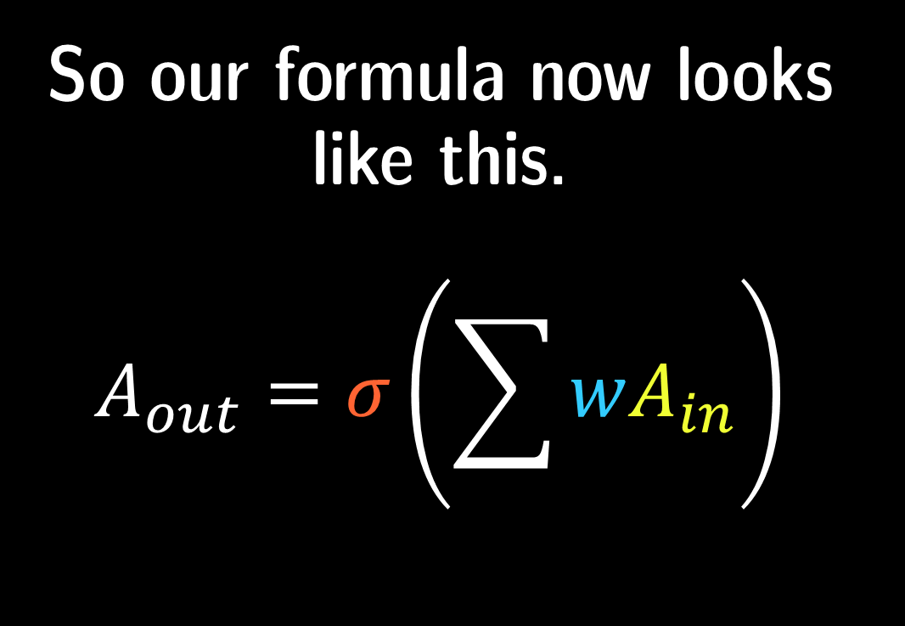
How Neurons Work
0.7
w = 1.5
-
So our formula now looks like this.
$$A_{out}=σ\left(\sum{wA_{in}}\right)$$
w = 0.5
0.2
w = 0.75
0.6
w = 3.0
w = 1.125
0.4
0.8

Slide 40
How Neurons Work
0.7
w = 1.5
-
w = 0.5
0.2
w = 0.75
But that’s not all.
0.6
w = 3.0
w = 1.125
0.4
0.8

Slide 41
How Neurons Work
0.7
w = 1.5
-
w = 0.5
But that’s not all.
What if the green neuron needed to be even harder to please?
0.2
w = 0.75
0.6
w = 3.0
w = 1.125
0.4
0.8

Slide 42
How Neurons Work
0.7
w = 1.5
-
B = −6
w = 0.5
…in other words, that it needed to be biased?
0.2
w = 0.75
0.6
w = 3.0
w = 1.125
0.4
0.8

Slide 43
How Neurons Work
0.7
w = 1.5
-
B = −6
w = 0.5
This can be easily added to the formula as bias!
0.2
w = 0.75
0.6
w = 3.0
w = 1.125
0.4
0.8

Slide 44
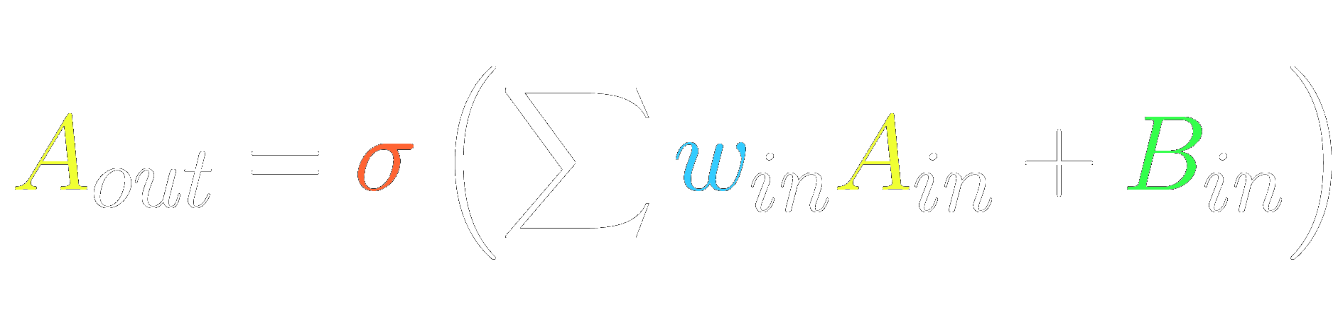
How Neurons Work
And this is how each neuron finds its value.
0.7
w = 1.5
0.1
B = −6
w = 0.5
0.2
w = 0.75
0.6
w = 3.0
w = 1.125
0.4
0.8

Slide 45
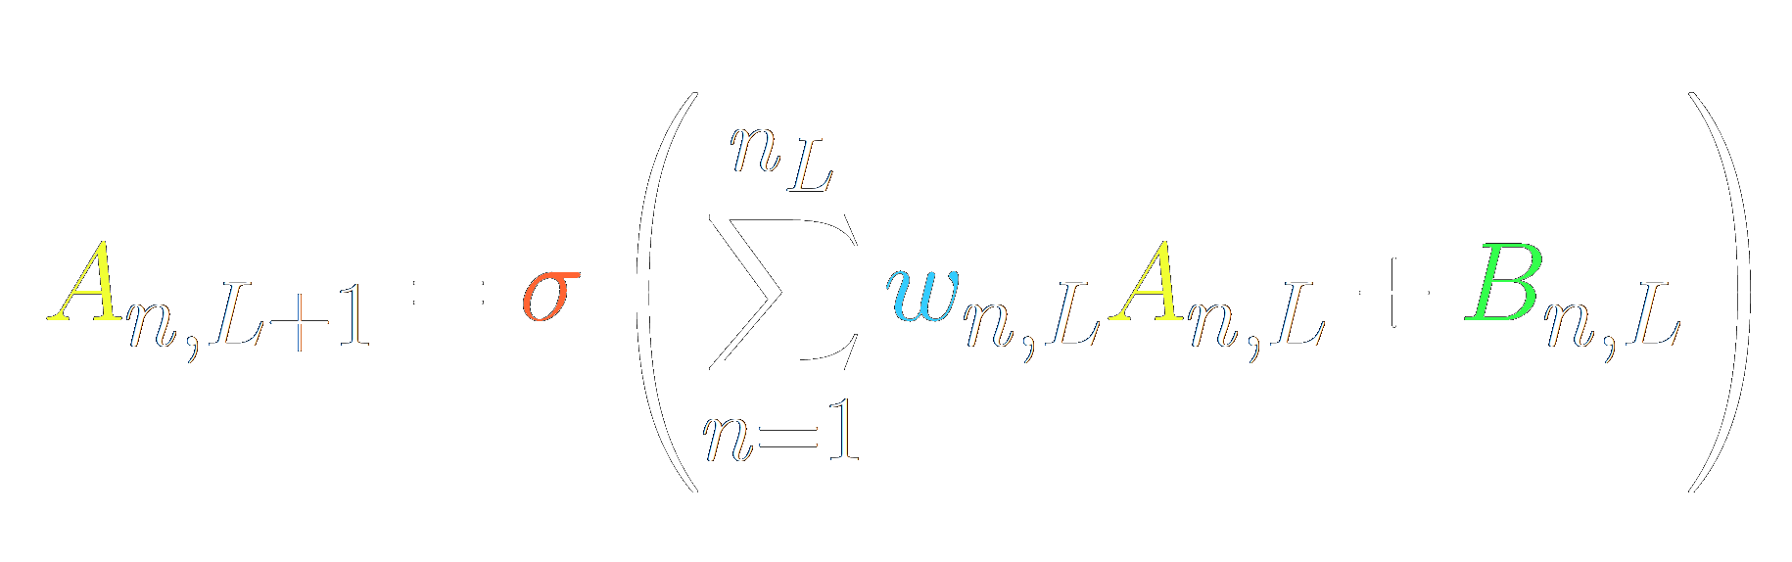
HNW: Extra
This equation applies to all neurons in the network.

Slide 46
Toolbox
0.0
0.0
0.0
0.2
0.2
0.2
0.4
0.4
0.4
0.6
0.6
0.6
0.8
0.8
0.8
1.0
1.0
1.0

