Slide 1
Real-Time Identification of Simple and Extended Musical Chords using Artificial Neural Networks
R3.A.09
Coronel, Lesli Natasha A.
Navarro, Joachim Alfonso A.

Slide 2
Real-Time Identification of Common and Extended Musical Chords using Artificial Neural Networks
BACKGROUND
Pitch Classes / Notes
C
C#
D
D#
E
F
B
A#
A
G#
G
F#
Used almost universally
Coronel
Navarro
R2.B.09

Slide 3
BACKGROUND
Musical Chords
C
E
A
G
C#
F#
C
A
D
Real-Time Identification of Simple and Extended Musical Chords using Artificial Neural Networks
Coronel
Navarro
2 or more
notes
Played
together
Follow “rules of harmony” (Leino, Brattico, Tervaniemi, & Vurst, 2007)
R3.A.09

Slide 4
BACKGROUND
Musical Chords
D7
C
Amaj
E
A
Each
has a
name
C5
G
C#
F#
C
C
A
D
Real-Time Identification of Simple and Extended Musical Chords using Artificial Neural Networks
Coronel
Navarro
R3.A.09

Slide 5
BACKGROUND
Musical Chords
D7
C
Amaj
E
A
Each
has a
root note
C5
G
C#
F#
C
A
D
Real-Time Identification of Simple and Extended Musical Chords using Artificial Neural Networks
Coronel
Navarro
R3.A.09

Slide 6
BACKGROUND
Musical Chords
D7
C
Amaj
E
A
Each
has a
type
C5
G
C#
F#
C
A
D
Real-Time Identification of Simple and Extended Musical Chords using Artificial Neural Networks
Coronel
Navarro
R3.A.09

Slide 7
BACKGROUND
Musical Chords
Am
E
Simple vs Extended
C
A
Chord types
Real-Time Identification of Simple and Extended Musical Chords using Artificial Neural Networks
Coronel
Navarro
Simple
More common chord type
R3.A.09

Slide 8
BACKGROUND
Musical Chords
AmM7
G#
Extension
E
Simple vs Extended
C
A
Chord types
Real-Time Identification of Simple and Extended Musical Chords using Artificial Neural Networks
Coronel
Navarro
Extended
Less common chord type
R3.A.09

Slide 9
BACKGROUND
Musical Chords
D7
C
Amaj
E
A
Each
has an
inversion
number
C5
G
C#
F#
C
A
D
Real-Time Identification of Common and Extended Musical Chords using Artificial Neural Networks
Coronel
Navarro
0
0
0
0th inversion only included in scope of study
R2.B.09

Slide 10
DEFINITION
Chord Identification
The determination of the name of the chord from the notes that constitute it
Real-Time Identification of Simple and Extended Musical Chords using Artificial Neural Networks
Coronel
Navarro
Definition of chord identification
R3.A.09

Slide 11
PROBLEM
Chord Identification
“The general music learning public places a high demand on chord-based representations of popular music.”
Real-Time Identification of Common and Extended Musical Chords using Artificial Neural Networks
Coronel
Navarro
Humphrey, Bello, & Cho, n.d., par. 1
R2.B.09

Slide 12
PROBLEM
Chord Identification
Majority of general music learning public can’t do this by themselves due to lack of skill or training
Real-Time Identification of Simple and Extended Musical Chords using Artificial Neural Networks
Coronel
Navarro
Inference
R3.A.09

Slide 13
PROBLEM
Absolute pitch
Sound
Pitch recognition
Note name
Input
Process
Output
Real-Time Identification of Common and Extended Musical Chords using Artificial Neural Networks
Coronel
Navarro
R2.B.09

Slide 14
PROBLEM
Absolute pitch
Rare amongst music-learning individuals
Real-Time Identification of Common and Extended Musical Chords using Artificial Neural Networks
Coronel
Navarro
Zatorre, Perry, Beckett, Westbury, & Evans, 1998
R2.B.09

Slide 15
PROBLEM
Absolute pitch
Expressed in a low percentage of the human population
Real-Time Identification of Common and Extended Musical Chords using Artificial Neural Networks
Coronel
Navarro
Baharloo, Service, Risch, Gitschier, & Freimer, 2000
R2.B.09

Slide 16
PROBLEM
Absolute pitch
Acquired through favorable genes or early music training
Real-Time Identification of Common and Extended Musical Chords using Artificial Neural Networks
Coronel
Navarro
Baharloo, Service, Risch, Gitschier, & Freimer, 2000
R2.B.09

Slide 17
DEFINITION
Neural networks
Neuron
Input
Input
Output
Input
Real-Time Identification of Simple and Extended Musical Chords using Artificial Neural Networks
Coronel
Navarro
Computational model of neurons in a brain
R3.A.09

Slide 18
DEFINITION
Neural networks
Neuron
Input
Input
Output
Input
Real-Time Identification of Simple and Extended Musical Chords using Artificial Neural Networks
Coronel
Navarro
Many neurons = neural network
R3.A.09

Slide 19
Artificial Neural Networks (ANNs)
Neural network
Input
Input
Output
Input
Real-Time Identification of Simple and Extended Musical Chords using Artificial Neural Networks
Coronel
Navarro
ANN learns by repetitive training
Colina, Perez, & Paraan, 2017
R3.A.09

Slide 20
ANN training & testing
Training phase
Testing phase
Training dataset
Validation dataset
Training accuracy
Validation accuracy
Is VAL_ACChigh enough?
Real-Time Identification of Simple and Extended Musical Chords using Artificial Neural Networks
No
Yes
Coronel
Navarro
Backpropagation
R3.A.09

Slide 21
PROBLEM
Why neural networks?
Previous studies with neural network implementations have not included extended chords in their research
Real-Time Identification of Simple and Extended Musical Chords using Artificial Neural Networks
Coronel
Navarro
Osmalskyj, Embrechts, Piérard, & Van Droogenbroeck, 2012
Perera & Kodithuwakku, 2005
Zhou & Lerch, 2015
R3.A.09

Slide 22
PROBLEM
Problem statement
Using neural networks to identify both common and extended chords is unexplored
Real-Time Identification of Simple and Extended Musical Chords using Artificial Neural Networks
Coronel
Navarro
Osmalskyj, Embrechts, Piérard, & Van Droogenbroeck, 2012
Perera & Kodithuwakku, 2005
Zhou & Lerch, 2015
R3.A.09

Slide 23
OBJECTIVE
Develop a neural network that quickly identifies common and extended musical chords
Real-Time Identification of Simple and Extended Musical Chords using Artificial Neural Networks
Coronel
Navarro
R3.A.09

Slide 24
OBJECTIVES
Minor
Input is a group of 3 or more MIDI note signals played in real-time
Real-Time Identification of Simple and Extended Musical Chords using Artificial Neural Networks
Coronel
Navarro
R3.A.09

Slide 25
OBJECTIVES
Minor
Input chords have one root note and are not inverted
Real-Time Identification of Simple and Extended Musical Chords using Artificial Neural Networks
Coronel
Navarro
R3.A.09

Slide 26
OBJECTIVES
Minor
Identification must be quick enough to be used in live performance (<40ms)
Greeff, 2016
Real-Time Identification of Simple and Extended Musical Chords using Artificial Neural Networks
Coronel
Navarro
R3.A.09

Slide 27
OBJECTIVES
Minor
Implemented in programming languages with neural network, real-time MIDI, and GPU processing libraries
Real-Time Identification of Simple and Extended Musical Chords using Artificial Neural Networks
Coronel
Navarro
thestk, 2017; Bretschneider, 2017
R3.A.09

Slide 28
OBJECTIVES
Minor
Neural network must be run on a GPU for efficient processing
Nickolls, Buck, Garland, & Skadron, 2008
Real-Time Identification of Simple and Extended Musical Chords using Artificial Neural Networks
Coronel
Navarro
R3.A.09

Slide 29
PROCESS
Level 0
1
2
ANN layer structure redesign
Test chord database reconstruction
ANN Development
4
3
Testing and data collection
Real-Time Identification of Simple and Extended Musical Chords using Artificial Neural Networks
Coronel
Navarro
R3.A.09

Slide 30
PROCESS
1 Procurement
1.1
1.2
Acquisition of GPU
Acquisition of programming tools
Real-Time Identification of Common and Extended Musical Chords using Artificial Neural Networks
Coronel
Navarro
END
R2.B.09

Slide 31
PROCESS
2 Dataset Prep & Rn
Preparation of chord dataset
Determination of sample size
2.1
2.2
Stratified random sampling
2.3
Real-Time Identification of Common and Extended Musical Chords using Artificial Neural Networks
Coronel
Navarro
R2.B.09

Slide 32
PROCESS
3 ANN Development
3.1
MIDI input-output coding
Real-Time Identification of Common and Extended Musical Chords using Artificial Neural Networks
Coronel
Navarro
3.2
Neural network coding
R2.B.09

Slide 33
PROCESS
4 Training, Testing, DC
4.1
ANN training and testing
ANN validation accuracy data collection
4.2
Real-Time Identification of Common and Extended Musical Chords using Artificial Neural Networks
Coronel
Navarro
ANN response time testing and data collection
4.3
R2.B.09

Slide 34
RESULTS
Performance
5.5%
3ms
of allowed 10ms
Real-Time Identification of Simple and Extended Musical Chords using Artificial Neural Networks
Coronel
Navarro
R3.A.09

Slide 35
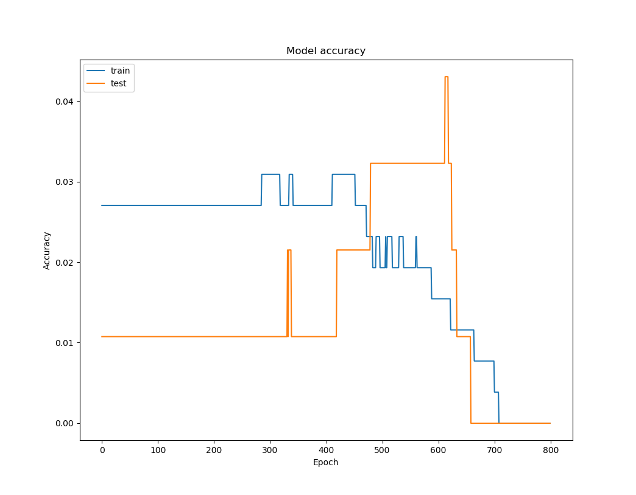
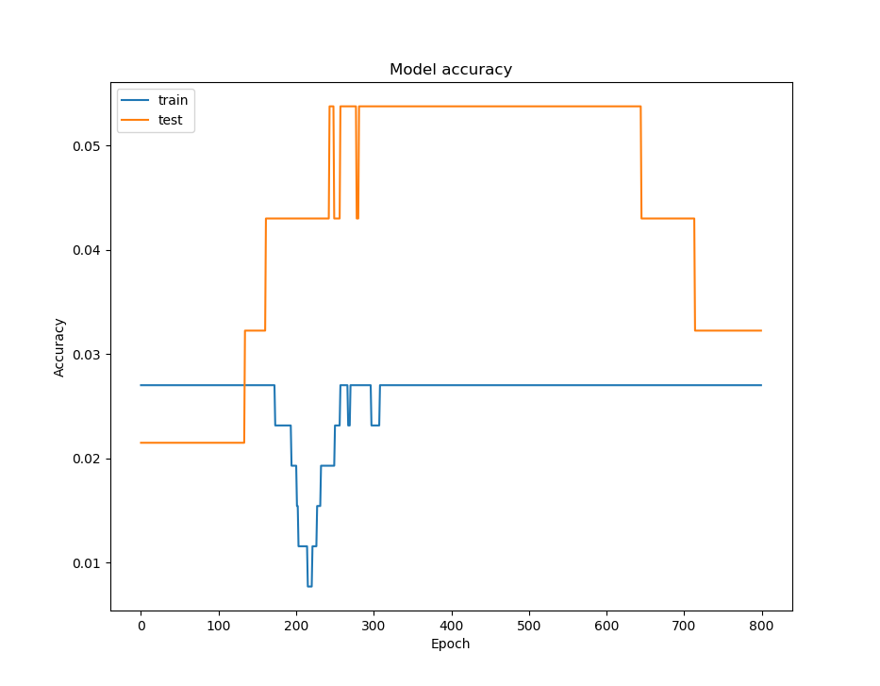
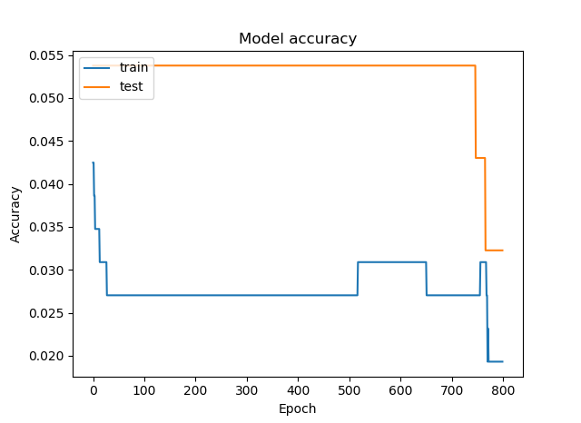
RESULTS
Performance
5.5%
Irregular and sporadic
Real-Time Identification of Simple and Extended Musical Chords using Artificial Neural Networks
Coronel
Navarro
Validation accuracy trends
R3.A.09

Slide 36
RESULTS
Performance
5.5%
Model is underfitting
Real-Time Identification of Simple and Extended Musical Chords using Artificial Neural Networks
Coronel
Navarro
Bodik, 2018
R3.A.09

Slide 37
RESULTS
Performance
Null hypothesis
Alternative hypothesis
r ≥ 10ms
r < 10ms
3ms
of allowed 10ms
T-test for one mean
Real-Time Identification of Simple and Extended Musical Chords using Artificial Neural Networks
Coronel
Navarro
Sample size = 30; Significance = 5%
R3.A.09

Slide 38
RESULTS
Performance
Null hypothesis
Alternative hypothesis
t ≥ -1.699
t < -1.699
3ms
of allowed 10ms
T-test for one mean
Real-Time Identification of Simple and Extended Musical Chords using Artificial Neural Networks
Coronel
Navarro
Sample size = 30; Significance = 5%
R3.A.09

Slide 39
RESULTS
Performance
Null hypothesis
Alternative hypothesis
t ≥ -1.699
t < -1.699
t_{3ms} = -17.19
3ms
of allowed 10ms
T-test for one mean
Real-Time Identification of Simple and Extended Musical Chords using Artificial Neural Networks
Coronel
Navarro
Sample size = 30; Significance = 5%
R3.A.09

Slide 40
RESULTS
Performance
Null hypothesis
Alternative hypothesis
REJECT
t ≥ -1.699
t < -1.699
NN is faster than standard!
3ms
of allowed 10ms
T-test for one mean
Real-Time Identification of Common and Extended Musical Chords using Artificial Neural Networks
Coronel
Navarro
Sample size = 30; Significance = 5%
R3.A.09

Slide 41
CLOSING
Conclusion
5.5%
3ms
accuracy
response time
Real-Time Identification of Simple and Extended Musical Chords using Artificial Neural Networks
Coronel
Navarro
R3.A.09

Slide 42
CLOSING
Recommendations
Revise ANN design
More training
1
2
Real-Time Identification of Simple and Extended Musical Chords using Artificial Neural Networks
Coronel
Navarro
R3.A.09

Slide 43
T
H
E
Rev. B1
E
N
D
Thank you!
Real-Time Identification of Simple and Extended Musical Chords using Artificial Neural Networks
Coronel
Navarro
R3.A.09

Slide 44
References
Baharloo, S., Service, S., Risch, N., Gitschier, J., & Freimer, N. (2000). Familial aggregation of absolute pitch. American Journal of Human Genetics, 67, 755-758. doi:10.1086/303057.
Chord. (2004). In The concise Oxford dictionary of music (4th ed.) Oxford, UK: Oxford University Press.
Colina, N. C. A., Perez, C. E., & Paraan, F. N. C. (2017). Simple techniques for improving deep neural network outcomes on commodity hardware. AIP Conference Proceedings, 1871, 040001. doi:10.1063/1.4996523.
Daniel, G. (2013). Principles of artificial neural networks (3rd ed.) Chicago, IL: World Scientific.
Fujishima, T. (1999). Realtime chord recognition of musical sound: A system using common Lisp music. Retrieved from http://www.music.mcgill.ca/~jason/mumt621/papers5/fujishima_1999.pdf.
Greeff, W. (2016). The influence of perception latency on the quality of musical performance during a simulated delay scenario. Retrieved from https://repository.up.ac.za/bitstream/handle/2263/58578/Greeff_Influence_2017.pdf?sequence=4.
Humphrey, E., Bello, J. P., & Cho, T. (n.d.). Chord Recognition. Retrieved from http://steinhardt.nyu.edu/marl/research/chord_recognition.
Kidd, P. (2017). pyrtmidi: Real-time MIDI I/O for Python [GitHub repository]. Retrieved August 23, 2017, from https://github.com/patrickkidd/pyrtmidi.
Nickolls, J., Buck, I., Garland, M., & Skadron, K. (2008). Scalable parallel programming with CUDA. ACM Queue, 6(2), 40-53.
Osmalskyj, J., Embrechts, J-J., Piérard, S., & Van Droogenbroeck, M. (2012, May 9). Neural networks for musical chords recognition. Retrieved at http://jim.afim-asso.org/jim12/pdf/jim2012_08_p_osmalskyj.pdf.
Perera, N., & Kodithuwakku, S. R. (2005, December 15). Music chord recognition using artificial neural networks. 1st Proceedings of the International Conference on Information and Automation, 304-308.
Root. (2004). In The concise Oxford dictionary of music (4th ed.) Oxford, UK: Oxford University Press.
Stark, A. M., & Plumbley, M. D. (2009). Real-time chord recognition for live performance [PDF file]. Retrieved at https://www.eecs.qmul.ac.uk/~markp/2009/StarkPlumbley09-icmc.pdf.
Zatorre, R. J., Perry, D. W., Beckett, C. A., Westbury, C. F., & Evans, A. C. (1998). Functional anatomy of musical processing in listeners with absolute pitch and relative pitch. Proceedings of the National Academy of Sciences, 95, 3172-3177. Retrieved at http://www.pnas.org/content/95/6/3172.full.
Zhou, X., & Lerch, A. (2015). Chord detection using deep learning. 16th International Society for Music Information Retrieval Conference, 52-58. Retrieved at http://ismir2015.uma.es/articles/96_Paper.pdf.
Real-Time Identification of Common and Extended Musical Chords using Artificial Neural Networks
Coronel
Navarro
R3.A.09

Slide 45
BACKGROUND
Toolbox
C
C#
D
D#
E
F
B
A#
A
G#
G
F#
Real-Time Identification of Common and Extended Musical Chords using Artificial Neural Networks
Coronel
Navarro
4
R2.B.09

