Slide 1
ArdhiTrust
Kenya's Premier Verified Land Marketplace
Connecting genuine land sellers & buyers with geotagged locations, automated valuations, affiliate cadastral surveyors, and legal conveyancing.

Slide 2
The Land Market Challenge
High Fraud & Fake Titles
Buyers lose millions to duplicate title deeds, unregistered sellers, and phantom land plots.
Fraud creates deep distrust in traditional land transactions across Kenya.
Vague Locations & Boundaries
Advertised land listings often lack exact GPS coordinates, boundary pinpoints, or verified local landmarks, causing costly search delays and physical site confusion.
Opaque Land Valuations
Sellers lack reliable valuation data, leading to overpricing or selling below market value.
Buyers struggle to confirm fair property pricing before making deposits.
Complex Conveyancing
Navigating the Ministry of Lands, Ardhisasa portal, and Land Control Boards requires manual coordination with separate lawyers and unverified field surveyors.

Slide 3
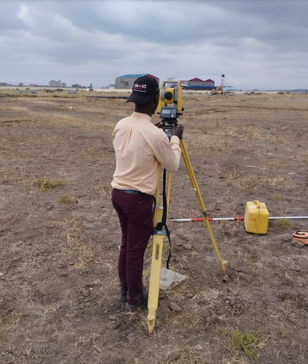
The ArdhiTrust Solution
End-to-End Land Marketplace Ecosystem
ArdhiTrust streamlines the entire land ownership journey into a seamless, trusted digital experience:
  Verified Listings: Direct seller-to-buyer matching backed by title verification.
  GPS & Landmark Pinpointing: Precision geotagging with nearby visual landmarks.
  Affiliate Cadastral Surveyors: On-demand precise boundary re-establishment & mutation checks.
  Turnkey Legal Transfer: Law firm integration for Ardhisasa, NLC, & Ministry filing.
Kenyan land surveyor using GPS survey equipment in land

Slide 4



Core Application Features
Exact GPS & Landmark Geotagging
Pinpoint accuracy showing exact parcel boundaries, pin drop navigation, and proximity to key landmarks (schools, highways, utility grids).
On-Demand Land Valuation
Optional automated valuation model (AVM) combined with licensed valuers to give sellers and buyers reliable price benchmarks.
Affiliate Cadastral Surveyors
Network of licensed surveyors who perform physical beacon verification, acreage confirmation, and mutation map drafting once matched.
Ardhisasa & Legal Integration
Affiliate advocate network handling LCB consents, stamp duty clearance, and seamless titling with the Ministry of Lands and NLC.

Slide 5
Market Pain in Numbers
Urgent Need for Trust & Speed
KES 15+ Billion lost annually in Kenya due to land-related scams, double allocations, and fraudulent title deeds.
45 to 90 Days standard processing time for land search, survey verification, and legal transfer in traditional setups.
ArdhiTrust Reduction: By bringing licensed surveyors and legal advocates onto one digital workflow synced with Ardhisasa, we cut transaction closing time to under 14 days.
70%
Of Kenyan Land Buyers Fear Title Fraud & Scams

Slide 6
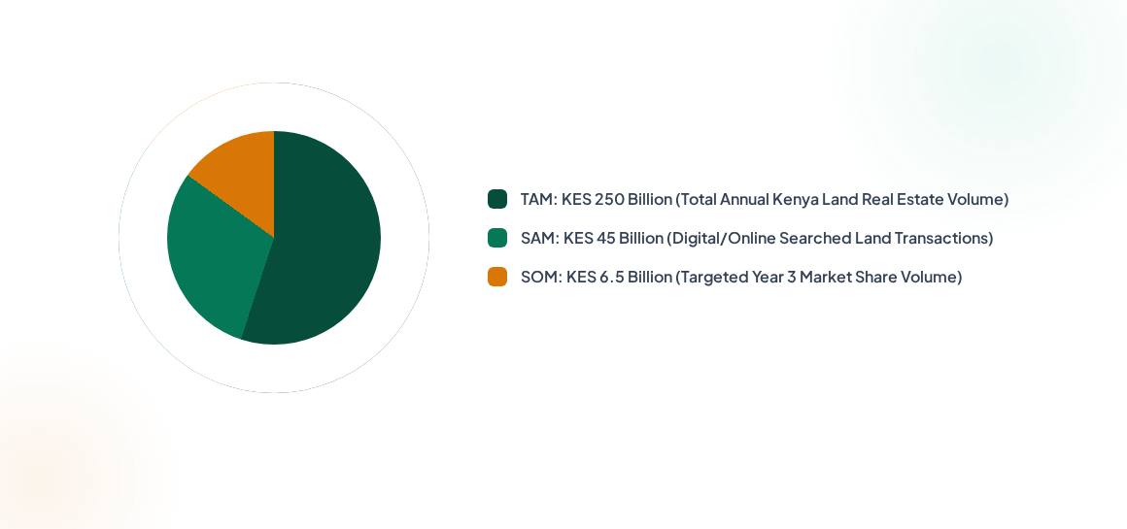
Market Size & Opportunity

Slide 7
Competitive Landscape
Feature / Service | BuyRentKenya / Property24 | Social Media / Brokers | ArdhiTrust (Our App)
Land Search & Title Audit | Listings are uploaded by users/agencies with minimal upfront title verification. | High risk of fraud, double sales, or fake title deeds. | Automated digital title searches integrated with government registers (ArdhiSasa) to verify title validity before listing.
Exact GPS & Landmark Pinpoint | Usually gives general location names or nearest major towns; exact boundary coordinates are rarely provided on listings. | Relies on text descriptions ,dropping a pin manually on WhatsApp, or physically walking the plot. | Interactive mapping with exact polygon/boundary coordinates, physical landmarks, and offline GPS tracking ideal for rural navigation.
Professional Land Valuation | Prices are set arbitrarily by sellers/agents or estimated using basic web market averages. | Broker-driven pricing often inflated by high middleman commissions and lack of market data standard. | Data-driven comparative pricing algorithms combined with access to certified Valuers Registration Board (VRB) professionals.
Affiliate Cadastral Surveyors | Users must find, hire, and manage independent surveyors on their own. | Brokers may suggest local informal surveyors. | Panels of vetted, licensed survey firms/cadastral experts integrated .
Full Legal Conveyancing Support | conveyancing and legal risk fall entirely on buyer/seller. | Basic informal agreements or reliance on broker-provided contracts. | In-app legal workflows linking clients to accredited advocates, managing LCB consents, escrow services, and transfer documentation.

Slide 8
Business & Revenue Model
Multi-stream revenue model combining platform transaction success fees with affiliate service commissions (legal & survey).

Slide 9
Go-To-Market Roadmap
Month 3 - 4
Month 7 - 12
Pilot Launch in Nairobi, Kiambu, Machakos & Nakuru counties.
Nationwide Kenya expansion & County Land Control Board portal Sync.
Month 1 - 2
Month 5 - 6
Platform MVP Build & Partner Onboarding (Advocates & ISK Surveyors).
Kenyan Diaspora Targeted Marketing & Banking Escrow Integration.

Slide 10
Social Impact & SDGs
SDG 11 - Sustainable Cities & Communities: Promotes transparent land allocation, accurate spatial boundary records, and orderly peri-urban real estate development in Kenya.
SDG 16 - Peace, Justice & Strong Institutions: Drastically cuts land fraud and title disputes by digitizing searches and enforcing legal conveyancing via certified advocates and Ministry processes.
SDG 8 - Decent Work & Economic Growth: Creates formal digital contract opportunities for licensed Kenyan surveyors, registered valuers, and legal advocates.

Slide 11
Funding Ask & Allocation
Investment Ask
($190,000 USD Seed Round)
Seeking seed capital to accelerate platform engineering, scale affiliate surveyor networks, and launch targeted diaspora user acquisition.
  Use of Funds
  40% Tech & Mobile Engineering: GPS GIS engine, Ardhisasa API hooks, AVM.
  30% User Acquisition & Marketing: Local & Diaspora investor outreach campaigns.
  20% Partner Network & Legal Operations: Surveyor & Law firm vetting.
  10% Regulatory Compliance & Contingency: Land Board compliance.

Slide 12
Join Us in Securing Kenya's Land Future
Let's build Kenya's most trusted land marketplace together.
www.ardhitrust.co.ke
info@ardhitrust.co.ke
+254 708162932

Slide 13
https://web.facebook.com/fabian.balogun/posts/how-to-become-a-licensed-land-surveyor-in-kenyaas-of-october-2021-refer-list-of-/1105187647101364/?_rdc=1&_rdr#

