Slide 1
MHW1 – Viscuso Giovanni
https://soundcloud.com/

Slide 2
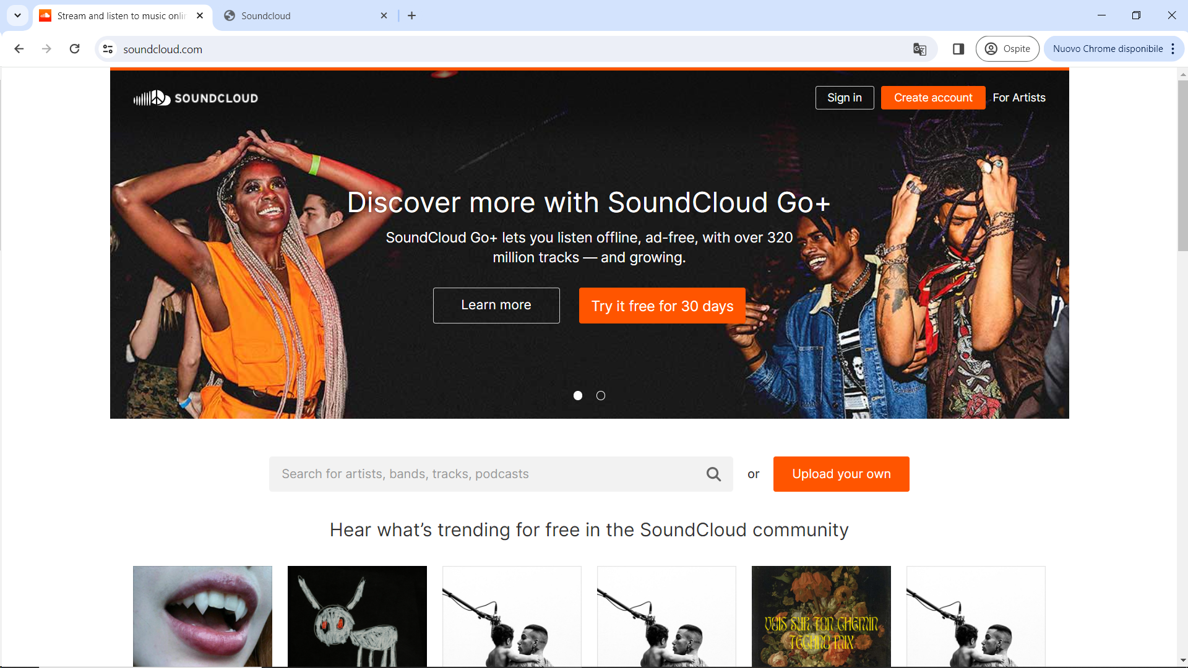

Slide 3
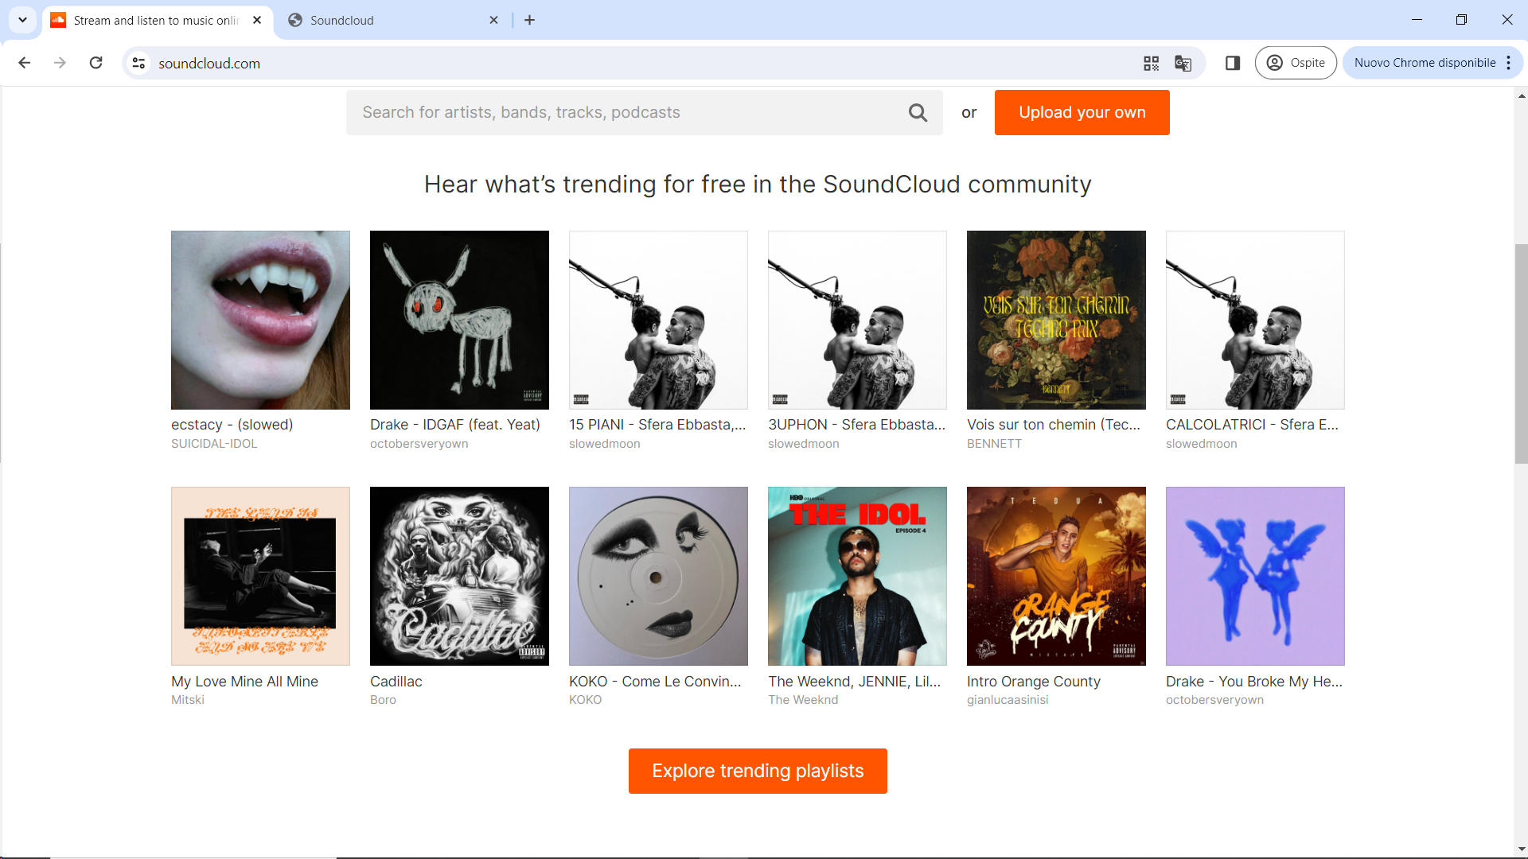

Slide 4
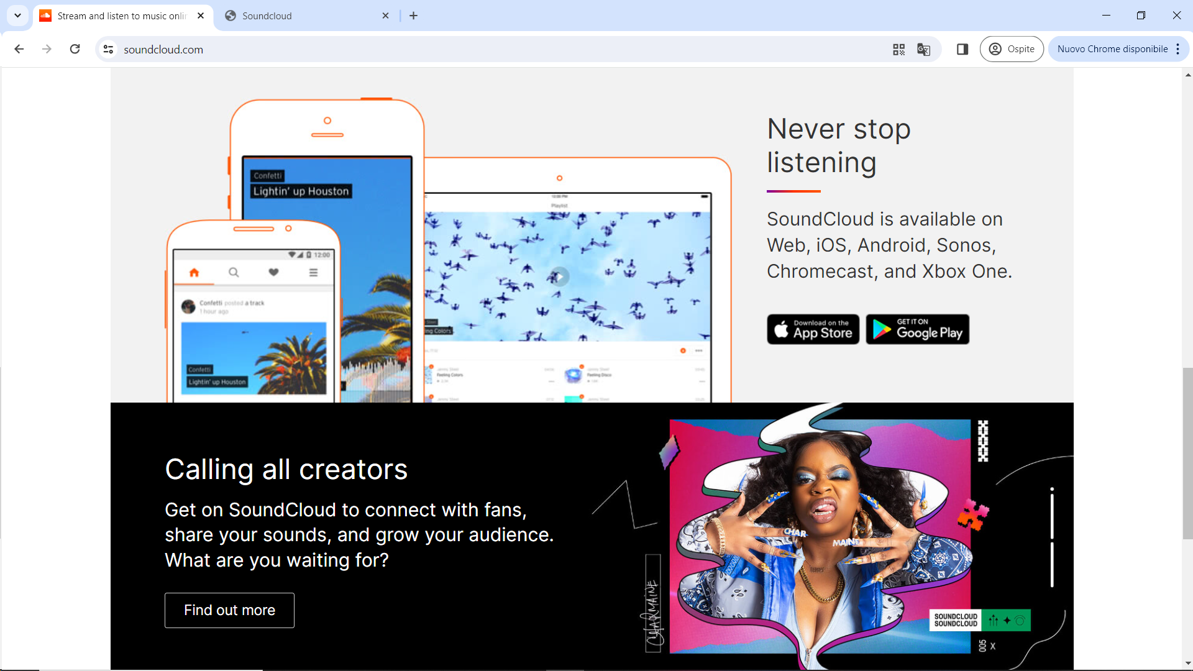

Slide 5
