Slide 1
WEB STACK DEVELOPMENT
GROUP PROJECT PRESENTATION
DEPARTMENT OF COMPUTER SCIENCE
1 MCA A

Slide 2
TEAM MEMBERS:
1.VISESH AGARWAL[2347164]
2.KEERTHANA.C[2347124]
DOMAIN:
E-COMMERCE [VICTORIA’S FRAGRANCES]

Slide 3

Technologies Used to build this web application:
HTML
CSS
Bootstrap
ReactJS
JSON
Geolocation
MySQL

Slide 4
HOME PAGE
"Our homepage welcomes visitors with a captivating design that reflects the essence of our brand and fragrances."
"Users can easily search for products by fragrance name or category using the intuitive search bar."
"User-friendly navigation ensures a seamless journey through our vast fragrance collection."
"Engaging visuals and intuitive layout make discovering your favorite scents effortless."

Slide 5
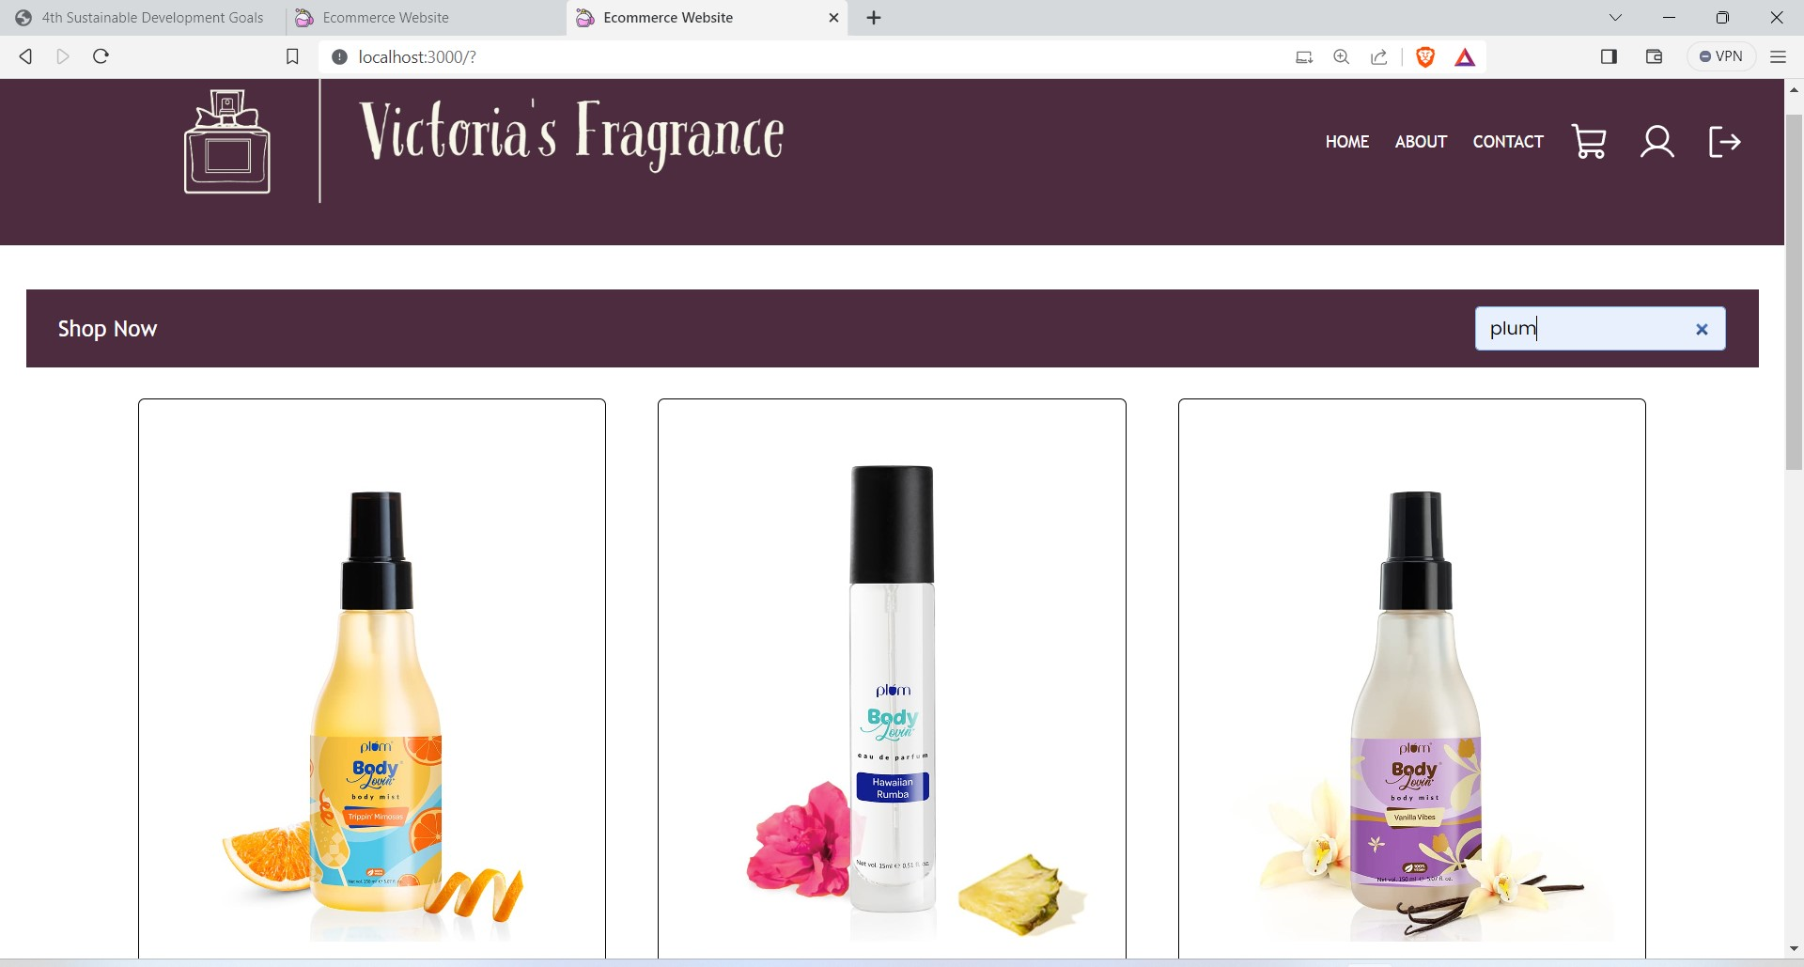
HOME PAGE
I
The above screenshot is an example how the users can easily search for products by fragrance name using the intuitive search field,which makes the web application more user-friendly

Slide 6
ABOUT PAGE
Users can discover our:
Passion for enchanting scents.
Convenient home delivery.
Unwavering dedication to customer satisfaction.
The team behind our web application, ensuring a seamless online experience.
Technologies used to create about page:
React
HTML and CSS
FontAwesome Icons

Slide 7
CONTACT PAGE
Contact Information: Users can easily provide their details, including name, email, phone, and subject, with error handling for data completeness and accuracy.
Contact Form: A user-friendly contact form simplifies message input, offering fields for name, email, phone, subject, and message.
Submit Your Message: By clicking "Submit," users can send their messages after ensuring their data is valid and complete.
Contact Details: Users can find your shop's physical address, hours of operation, phone number, and email for alternative contact methods.
Location Map

Slide 8
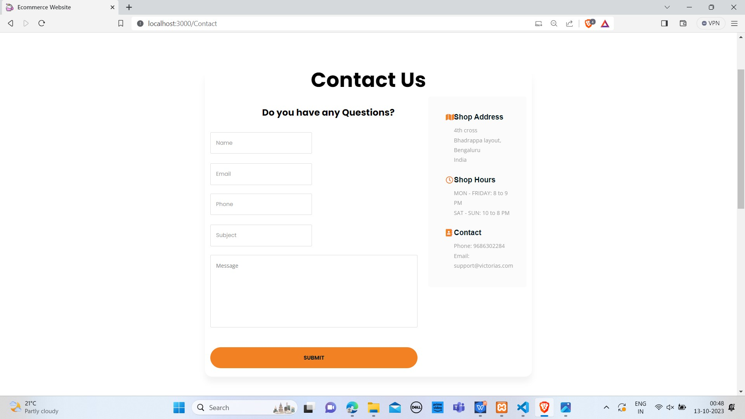
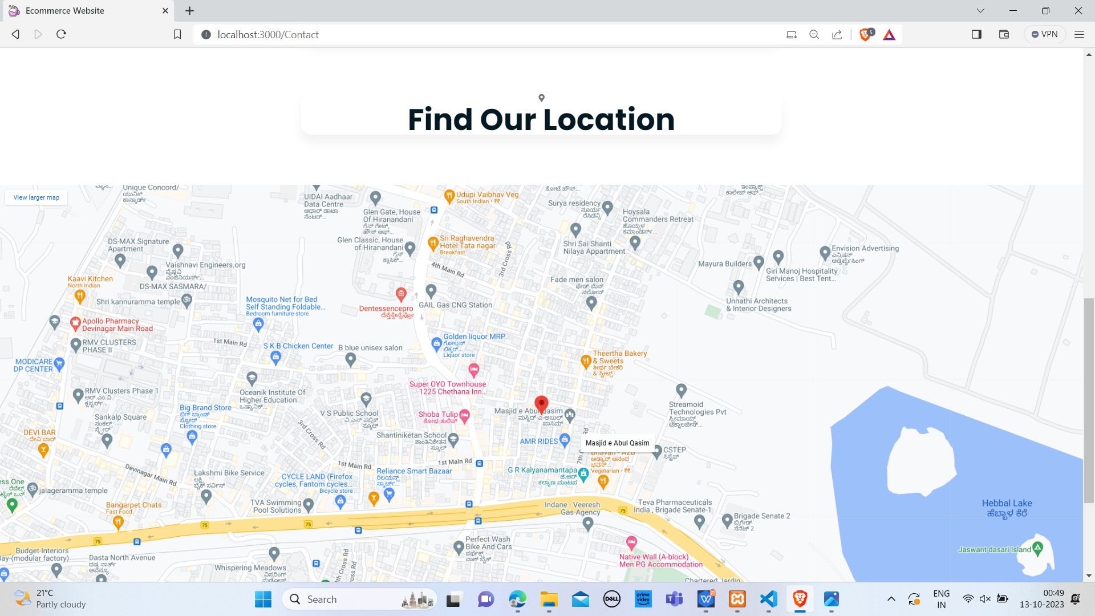
CONTACT PAGE
A user-friendly contact form simplifies message input, offering fields for name, email, phone, subject, and message.
Location Map: To locate our shop, an embedded Google Maps feature is available, offering easy access to physical location.

Slide 9
CART PAGE
Cart Summary:
Review and manage your items, including product name, quantity, price, and total cost. Make changes or remove items as needed.
Checkout:
Ready to complete your purchase? Click 'Checkout' to proceed to payment and shipping details.
Continue Shopping:
Want to add more items? Click 'Continue Shopping' to explore our fragrances further.

Slide 10
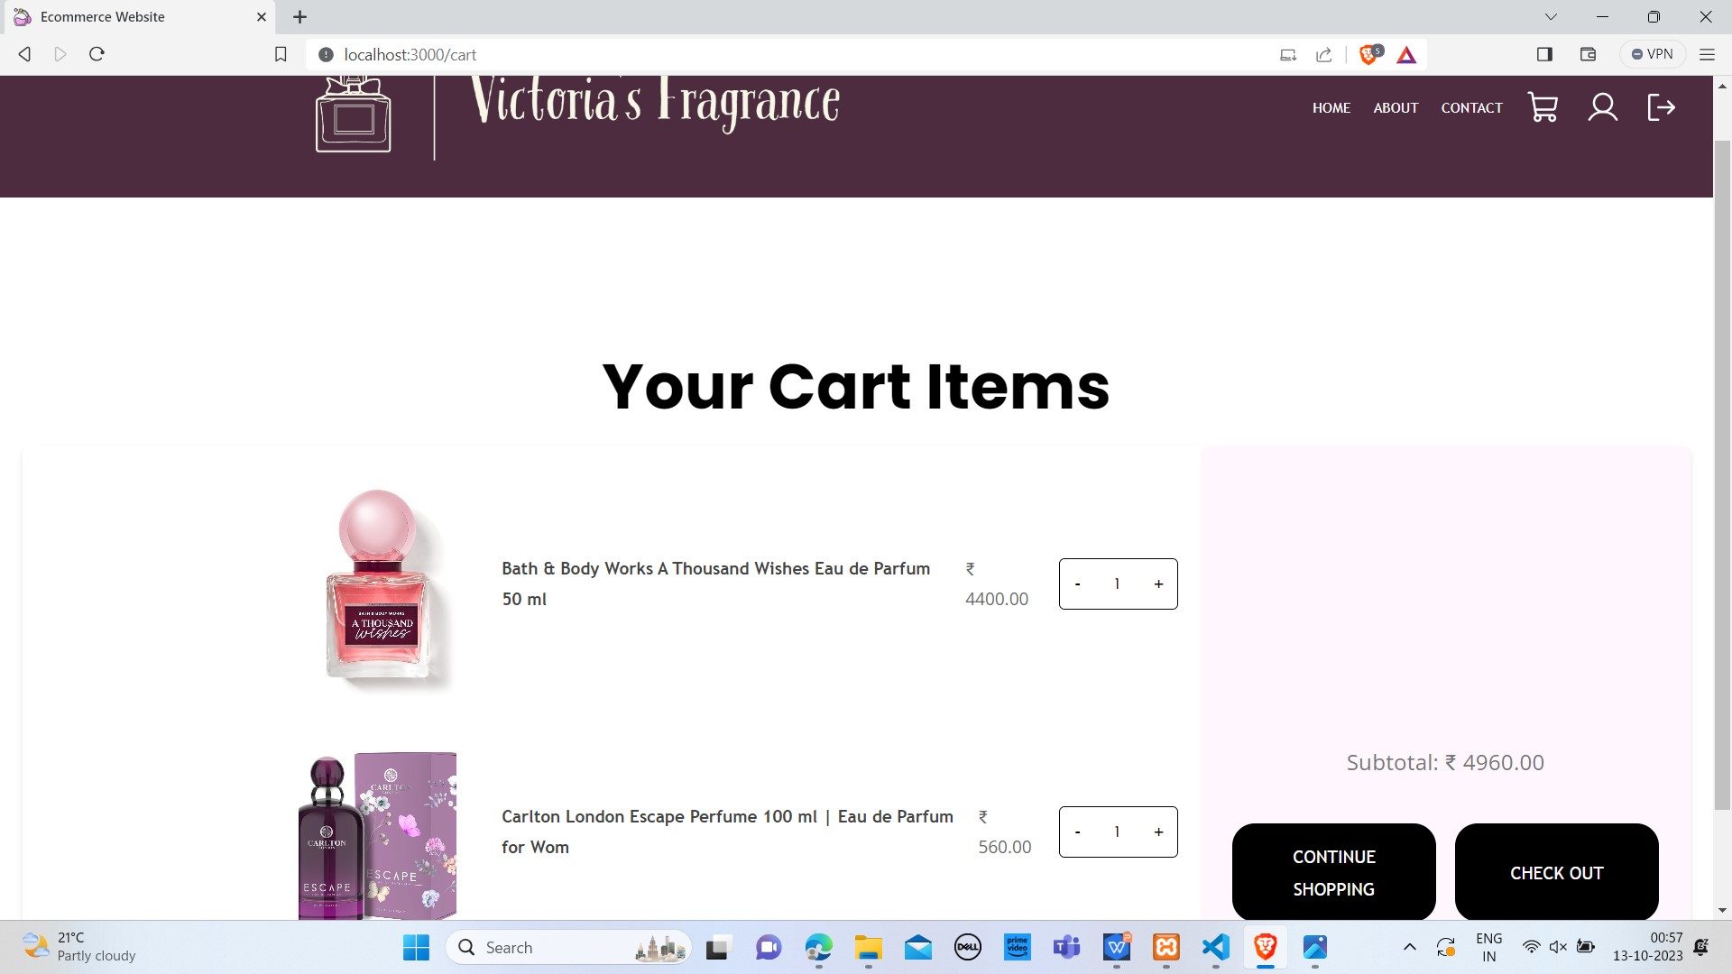
CART PAGE

Slide 11
SIGN-UP PAGE
User Registration: Enter your details, including username, email, name, phone number, password, and address.
Password Strength: Password must meet certain criteria, ensuring security. Password should contain at least 8 characters, including upper and lower case letters, numbers, and special characters.
Secure Registration: Your data is safe with us. We prioritize security during registration.
Registration Confirmation: After successful registration, you'll be notified with a confirmation message.
Already a Member: If you're already a member, you can sign in to access your account.

Slide 12
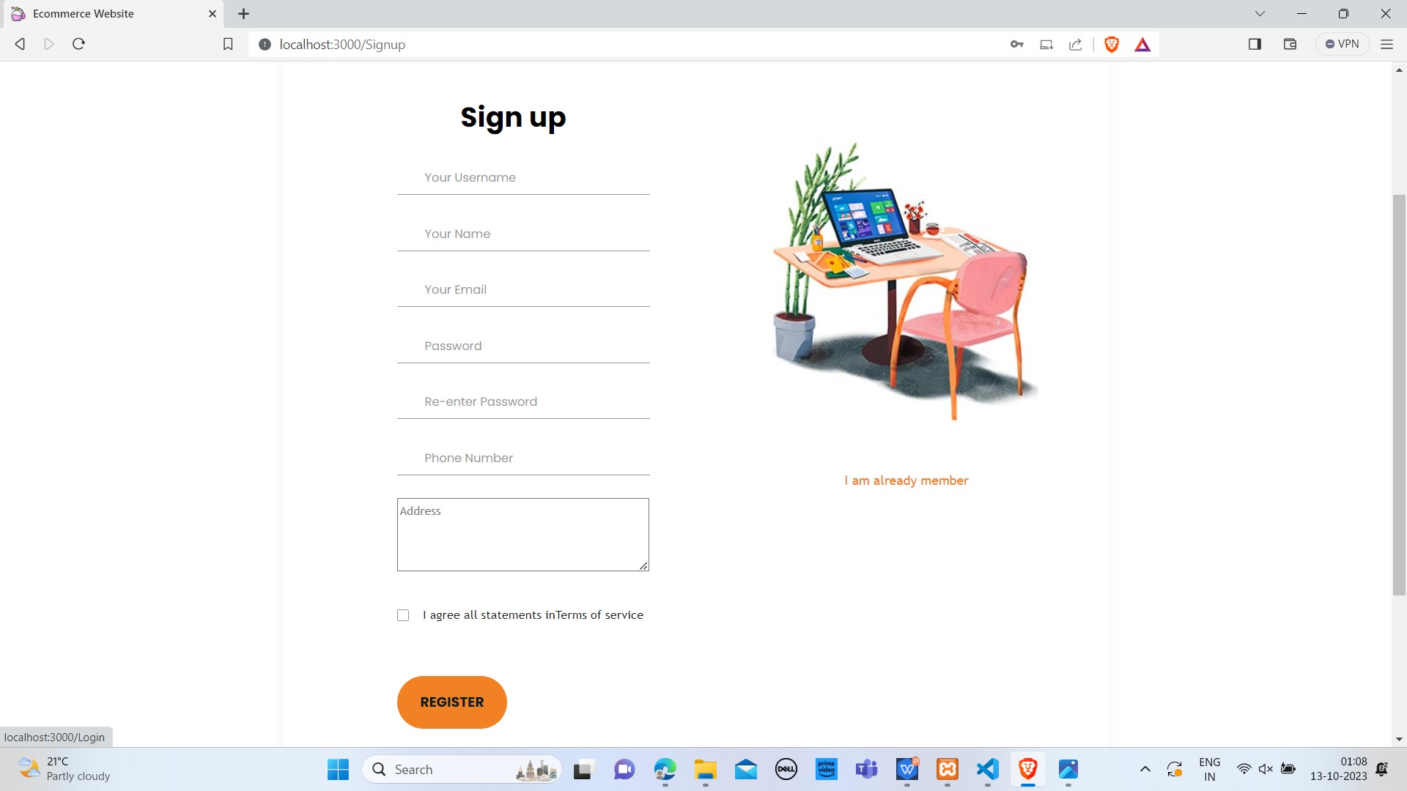
SIGN-UP PAGE

Slide 13
LOGIN PAGE
Follow these steps to login into the application:
Step 1: Access Our Login Page
Step 2: Enter Your Credentials
[Make sure your credentials are accurate]
Step 3: Click "Log In"
Step 4: Successful Login
Step 5: Creating an Account
If you're new to our service, click "Create an account" to sign up.

Slide 14
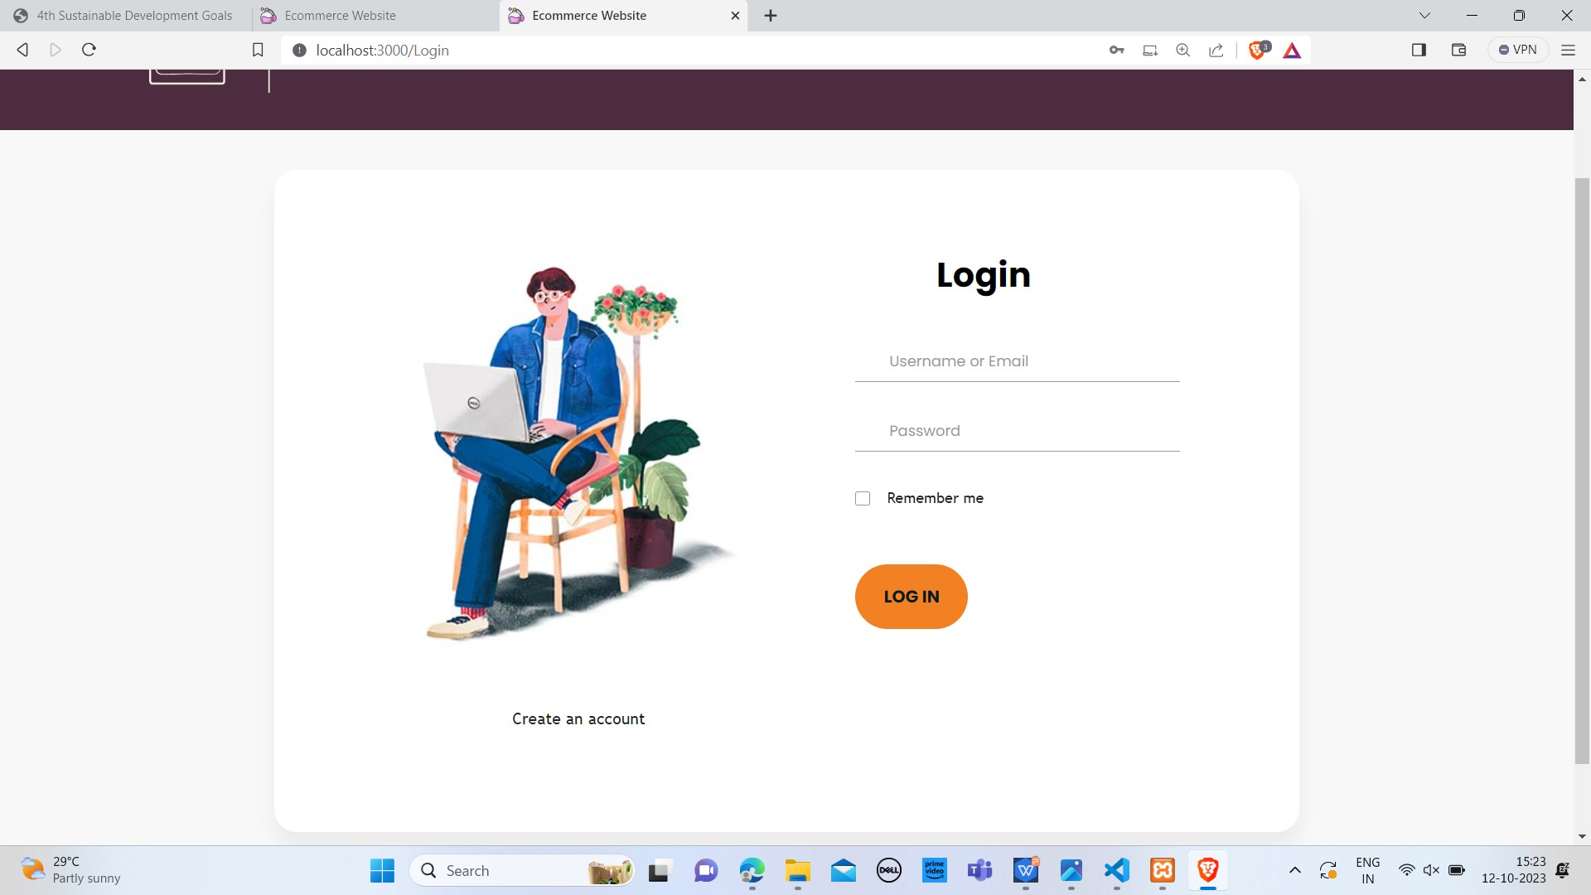
LOGIN PAGE

