Slide 1

ANALYZING BINARY SEARCH PROBLEM SOLUTIONS: COMPARING HUMAN VS. LLM-GENERATED CODE USING EFFIBENCH
By: Teja Reddy Mandadi
Visesh Bentula
Umapathi Konduri

Slide 2
INTRODUCTION
LLMs and SLMs are reshaping code generation in software development.
Widely used in solving algorithmic problems like binary search.
Most research focuses on correctness, but efficiency matters too.
This study evaluates:
✅ Code correctness
⚡ Execution time
💾 Memory usage
Human vs. LLM code

Slide 3
📚 Literature Review
Rise of LLMs in Programming
Large Language Models like ChatGPT, Gemini, and Claude are widely adopted for automated code generation, especially in competitive programming and educational platforms.
Focus of Prior Work
Most studies evaluate code correctness and problem-solving ability of LLMs.
Few works assess execution efficiency, memory usage, and runtime stability.
Benchmarks such as HumanEval and MBPP have explored code quality, but limited emphasis on real-world benchmarking across problem difficulties.
Gap in Research
Lack of standardized datasets comparing LLMs to human solutions across difficulty levels.Little insight into how efficiency varies with problem complexity.

Slide 4
BINARY SEARCH
✅ Definition
An algorithm to efficiently search for an element in a sorted list by repeatedly halving the search space.
🔁Working Principle
Check the middle element.
If target == middle: return index.
If target < middle: search left half.
If target > middle: search right half.
⏱️ Time Complexity
Best Case: O(1)
Average/Worst Case: O(log n)
📊 Space Complexity
Iterative: O(1)
Recursive: O(log n) (due to call stack)
📝 Requirements
input must be sorted (ascending or descending).

Slide 5
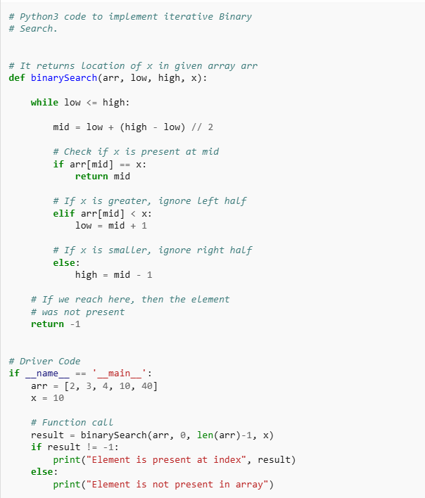
BINARY SEARCH ALGORITHM
🛠️ How It Works:
Start with the entire sorted array. Find the middle element.
Compare the middle element with the target:
If equal ➝ target is found ✅
If target < middle ➝ search in left half
If target > middle ➝ search in right half
Repeat the process until the element is found or the interval is empty.

Slide 6
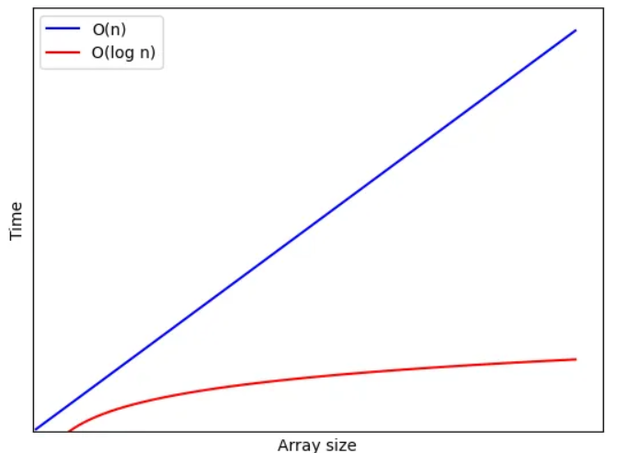
BACKGROUND-BINARY SEARCH
Efficient O(log n) search for sorted data
Used in software systems, APIs, databases, and low-level system design
Popular on LeetCode: rotated arrays, bounds, peaks
Great for benchmarking: simple to learn, Ideal for comparing algorithmic correctness and performance optimization across implementations.
Time complexity graph for Linear Search (blue) and Binary Search (red)

Slide 7

EFFIBENCH OVERVIEW
EffiBench Dataset: 1,000 algorithmic problems from LeetCode.
Ground Truth: Includes human-written solutions.
Benchmarking Criteria:
Execution Time
Memory (Average & Peak)
Code Correctness

Slide 8
OUR BINARY SEARCH PROBLEM SELECTION
✅ Total of 30 Problems
🔹 10 Easy
🔸 10 Medium
🔺 10 Hard
🧪 Tested Across Solutions By
👨‍💻 Human Programmers
🤖 ChatGPT
🌐 Gemini
🧠 Claude
🎯 Evaluation Goals
✔️ Measure Correctness
✔️ Measure Efficiency

Slide 9
EVALUATION APPROACH
Prompted each LLM with problem descriptions
Verified output using test cases for correctness ✅
Collected:
⏱️ Execution Time
💾 Average Memory Usage
📈 Peak Memory Usage
Evaluated all solutions in a consistent runtime environment for fairness

Slide 10
PROMPTS GIVEN TO LLMS
Prompt Format:
We followed the standardized prompt structure provided in the EffiBench GitHub repository to ensure uniformity across all problems.
To each template, we appended the full problem description from LeetCode, preserving the original phrasing and constraints.
All LLMs (ChatGPT, Gemini, and Claude) were evaluated using these identical prompts to maintain a consistent and unbiased testing environment.

Slide 11
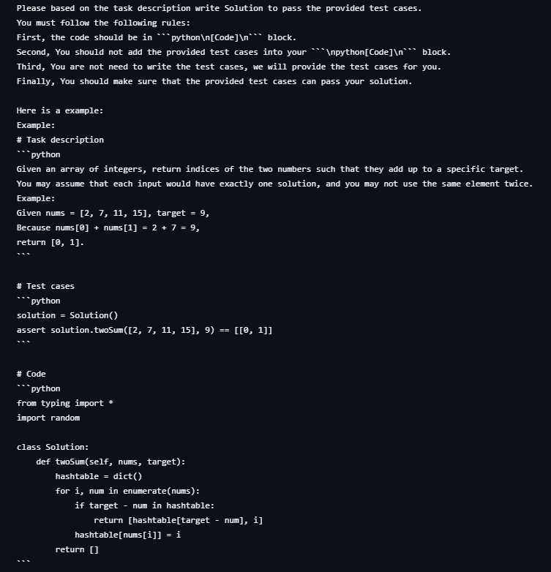
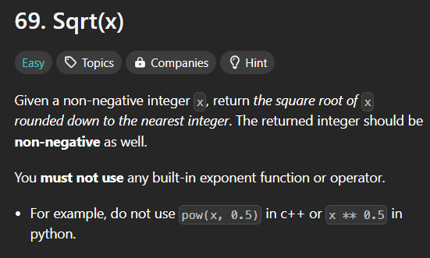
PROMPT EXAMPLE
Example:.

Slide 12
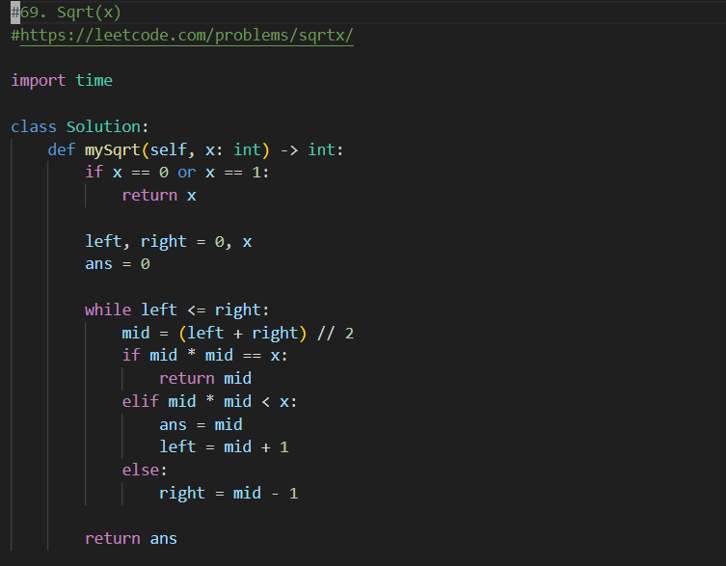
CODE-CORE LOGIC

Slide 13
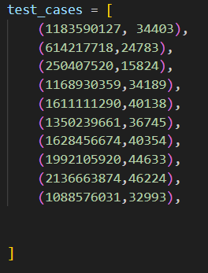
TESTCASES
We have provided a similar test case format for all the problems, including the required input and the expected output. A total of 10 test cases are included.
a

Slide 14
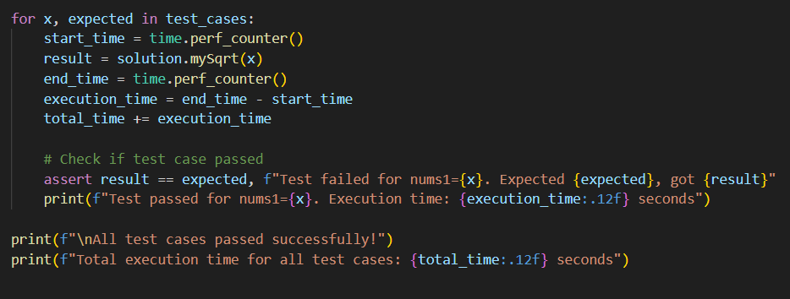
MEASURING EXECUTION TIME

Slide 15
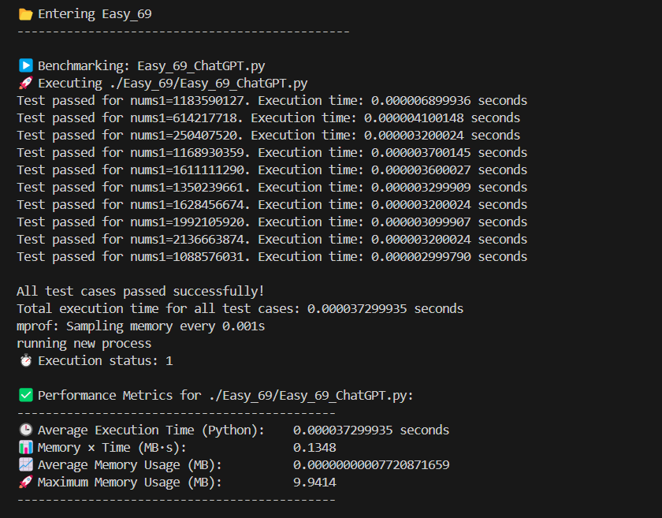
OUTPUT REPRESENTATION

Slide 16
PERFORMANCE EVALUATION WORKFLOW
LOAD & CLEAN DATA
2.CATEGORIZE PROBLEMS
3.CALCULATE SCORES
4.VISUALIZE RESULTS
Imported Excel file with metrics
Cleaned headers and converted values
Labeled each problem as Easy, Medium, or Hard
Grouped for clearer analysis
Computed Efficiency Score = Time × Max Memory
Applied to Human & each LLM
Plotted Execution Time, Max Memory, and Efficiency Score
Used color-coded difficulty backgrounds
Charts used log scale for better comparison

Slide 17
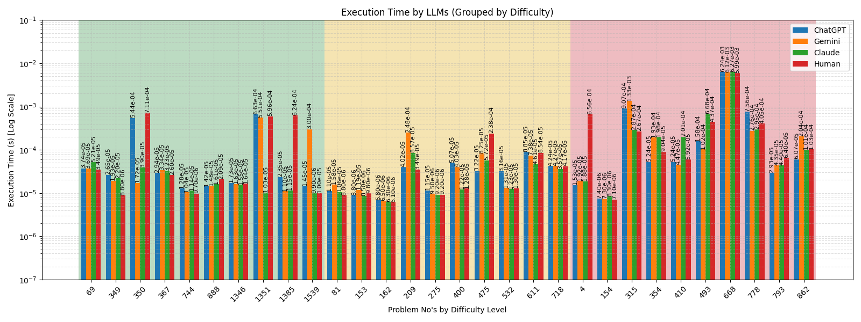
EXECUTION TIME COMPARISON

Slide 18
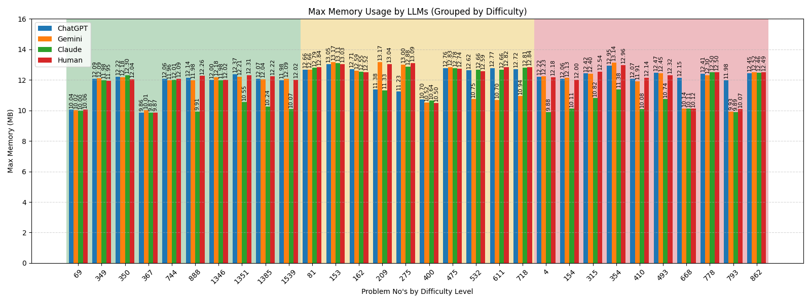
MAX MEMORY USAGE COMPARISON

Slide 19
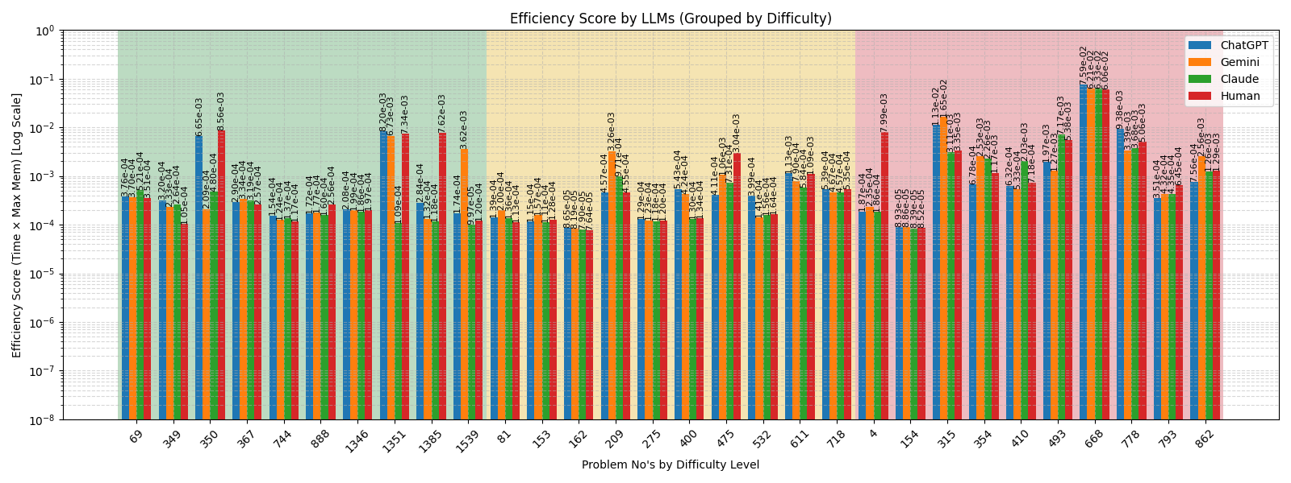
EFFICIENCY SCORE COMPARISON

Slide 20
⚠️PROBLEMS FACED
🧪 Inconsistent Test Case Results
During evaluation, some problems (e.g., LeetCode 1337 - The K Weakest Rows in a Matrix) showed discrepancies.
The canonical solution passed all test cases.
But solutions generated by ChatGPT, Gemini, and Claude failed on edge cases or returned incorrect outputs. ➡️ We will walk through this in the live demonstration

Slide 21
CONCLUSION
✅ GEMINI APPEARS TO BE THE MOST OPTIMIZED IN TERMS OF SPEED AND EFFICIENCY.
⚖️ CHATGPT IS FAIRLY BALANCED BUT NOT ALWAYS THE FASTEST.
🧾 CLAUDE OFFERS SOLID PERFORMANCE BUT MIGHT LAG SLIGHTLY BEHIND OTHERS IN MEMORY EFFICIENCY.
🧠 HUMAN GENERATED SOLUTIONS STILL HOLD UP WELL AND OCCASIONALLY OUTPERFORM AI MODELS.

Slide 22
❓ Q&A

Slide 23
THANK YOU!!
🔗 You can explore the complete project on my GitHub:
GitHub Repository: https://github.com/viseshb/Analyzing_Binary_Search_Problem_Solutions_Comparing_Human_vs_LLM_generated_Code_Using_EffiBench
Feel free to check out the code, leave feedback, or contribute!

