Slide 1
CSCI 5343 Algorithms Spring 2025
Dept. of Computational, Engineering, & Mathematical Sciences
Chapter 22 Single-Source Shortest Paths

Slide 2
Objectives
Discuss the following topics:
Single Source Shortest Path Problem
Algorithms
Dijkstra’s Shortest Path Algorithm with Greedy Strategy
Bellman-Ford Algorithm with Dynamic Programming

Slide 3
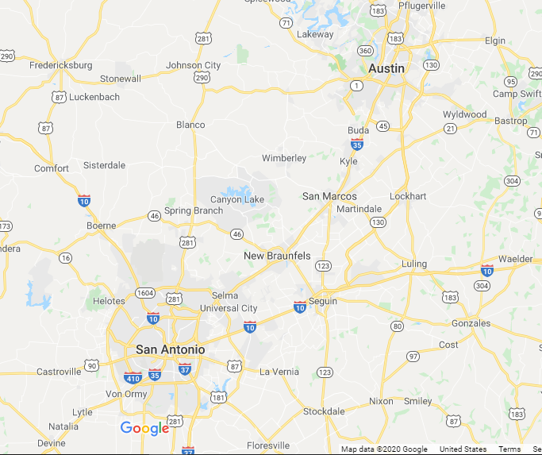
Shortest Possible Route
Wishes to find the shortest possible route from Phoenix to Indianapolis, or A&M-SA to UT Austin.
Given a road map of the United States on which the distance between each pair of adjacent intersections is marked, how can we determine a shortest route?
One possible way would be to enumerate all the routes from Phoenix to Indianapolis, add up the distances on each route, and select the shortest.
It is easy to see, however, that even disallowing routes that contain cycles, we would have to examine an enormous number of possibilities, most of which are simply not worth considering.

Slide 4
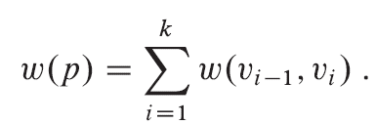
Shortest Paths Problem
How to solve such problems efficiently
Given a weighted, directed graph G = (V, E), with weight function w : E -> R mapping edges to real-valued weights.
The weight w (p) of path p = (v₀, v₁, …, v_{k}) is the sum of the weights of its constituent edges:

Slide 5
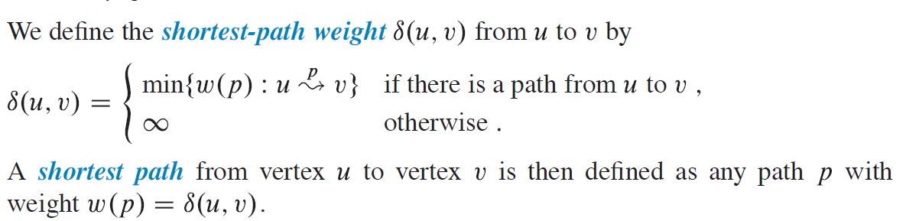
Shortest Path Problem

Slide 6
Phoenix-to-Indianapolis Example
We can model the road map as a graph:
vertices represent intersections
edges represent road segments between intersections
edge weights represent road distances
Our goal is to find a shortest path from a given intersection in Phoenix to a given intersection in Indianapolis.
In similar problems, edge weights can represent metrics other than distances, such as time, cost, penalties, loss, or any other quantity that accumulates linearly along a path and that we would want to minimize.

Slide 7
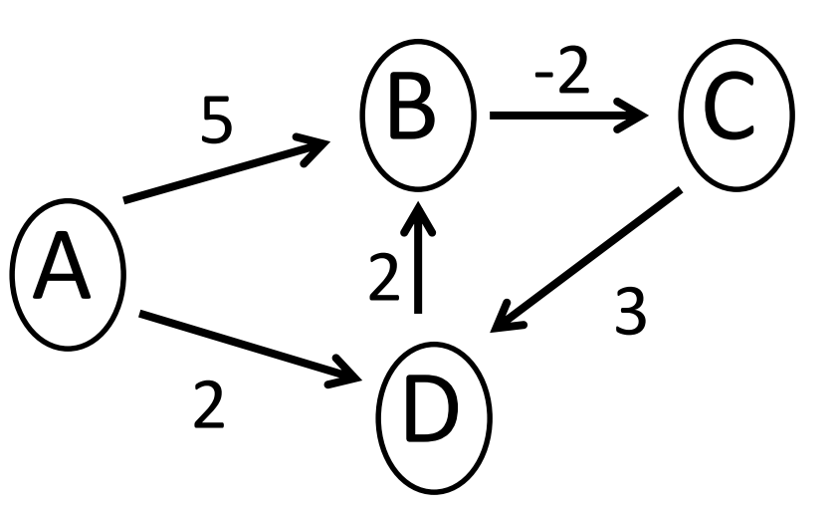
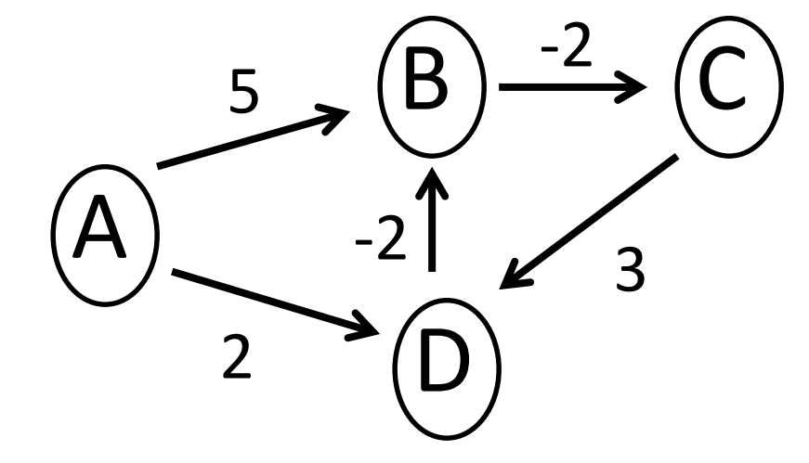
Negative-Weight Edges
Some instances of the shortest-paths problem may include edges whose weights are negative.
If the graph G = (V, E) contains no negative weight cycles reachable from the source s, then for all v ∈ V , the shortest-path (s,v) remains well defined, even if it has a negative value.
If the graph contains a negative-weight cycle reachable from s, however, shortest-path weights are not well defined.

Slide 8
Negative-Weight Edges
Some shortest-paths algorithms, such as Dijkstra’s algorithm, assume that all edge weights in the input graph are nonnegative, as in the road-map example.
Others, such as the Bellman-Ford algorithm, allow negative-weight edges in the input graph and produce a correct answer as long as no negative-weight cycles are reachable from the source.
Typically, if there is such a negative-weight cycle, the algorithm can detect and report its existence.

Slide 9
Cycles
Can a shortest path contain a cycle?
As we have just seen, it cannot contain a negative-weight cycle.
Nor can it contain a positive-weight cycle, since removing the cycle from the path produces a path with the same source and destination vertices and a lower path weight.
That is, if path p = (v₀, v₁, …, v_{k}) is a path and path c = (v_{i}, v_{i+1}, …, v_{j}) is a positive-weight cycle on this path (so that v_{i =} v_{j} and w (c) > 0), then the path p’ = (v₀, v₁, …, v_{i,} v_{i+1}, …, v_{j} , …v_{k}) has weight w(p’) cannot be a shortest path from v₀ to v_{k.}

Slide 10
Cycles
Assume that when we are finding shortest paths, they have no cycles, i.e., they are simple paths.
Since any acyclic path in a graph G = (V,E) contains at most |V| distinct vertices, it also contains at most |V| - 1 edges.
Thus, we can restrict our attention to shortest paths of at most |V| - 1 edges.

Slide 11
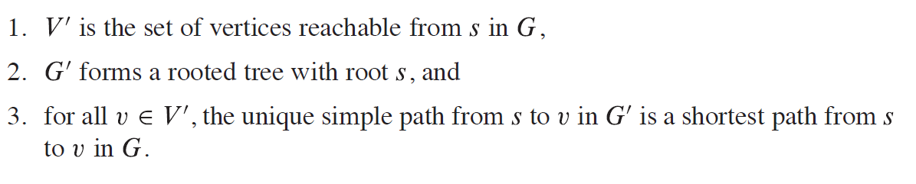
Shortest Path
A shortest-paths tree rooted at s is a directed subgraph G’ = (V’, E’), where V’ ⊆ V and E’⊆ E, such that

Slide 12
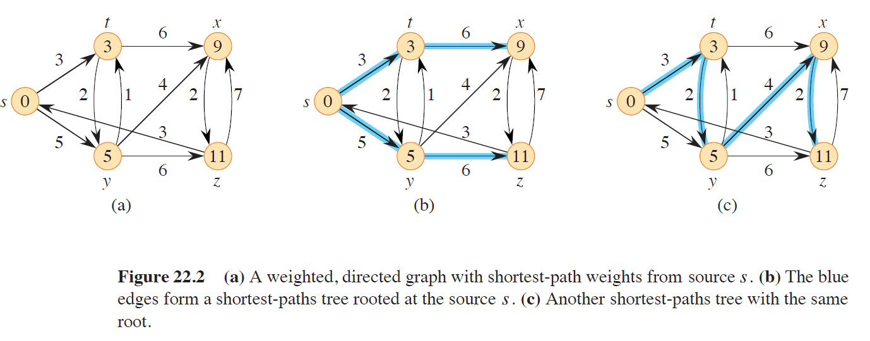
Shortest Path Example

Slide 13
Shortest Path Problem
Determining the shortest path from vertex v to vertex u
Edges can be assigned certain weights representing:
Distances between cities
Times separating the execution of tasks
Costs of transmitting information between locations
Amounts of substance transported from on place to another

Slide 14
Dijkstra’s Algorithm To Find a Shortest Path
DijkstraAlgorithm(weighted simple digraph, vertex first)
for all vertices v
currDist(v) = ∞;
currDist(first) = 0;
toBeChecked = all vertices;
while toBeChecked is not empty
v = a vertex in toBeChecked with minimal currDist(v);
remove v from toBeChecked;
for all vertices u adjacent to v
if currDist(u) > currDist(v) + weight(edge(vu))
currDist(u) = currDist(v) + weight(edge(vu));
predecessor(u) = v;
Notes:
Section 8.3.

Slide 15
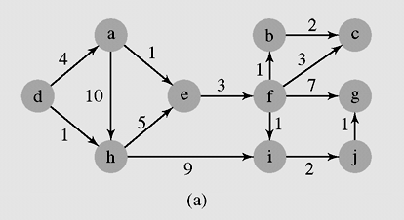
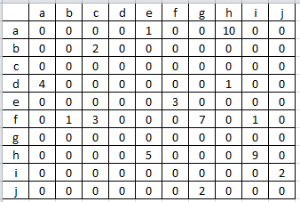
Shortest Paths Example with Dijkstra’s Algorithm
An execution of DijkstraAlgorithm() and its adjcency matrix

Slide 16
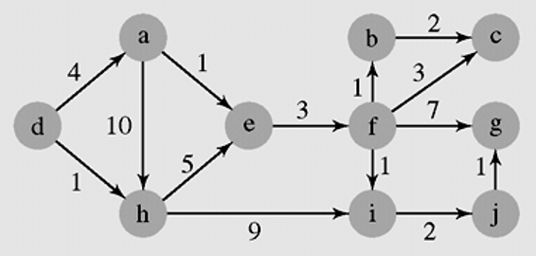
Shortest Paths Example with Dijkstra’s Algorithm
DijkstraAlgorithm(weighted simple digraph, vertex first)
for all vertices v
currDist(v) = ∞;
currDist(first) = 0;
toBeChecked = all vertices;
while toBeChecked is not empty
v = a vertex in toBeChecked with minimal currDist(v);
remove v from toBeChecked;
for all vertices u adjacent to v
if currDist(u) > currDist(v) + weight(edge(vu))
currDist(u) = currDist(v) + weight(edge(vu));
predecessor(u) = v;

Slide 17
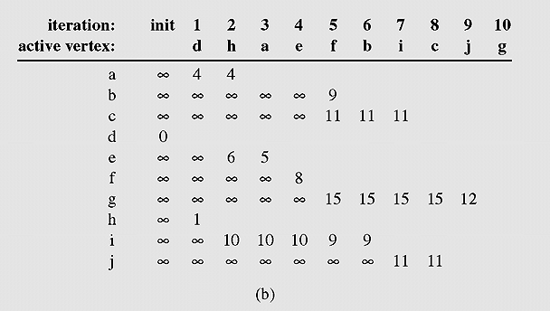
Shortest Paths with Dijkstra’s Algorithm
An execution of DijkstraAlgorithm() (continued)

Slide 18
Another Example with Dijkstra’s Algorithm
predecessor
current distance
2
(a,2)
3
(b,5)
a b c
d e f
6
3
1
1
1
2
(e,4)
(b,5)
(a,6)
(b,3)
(e,5)
iteration: | init
active vertex v:
a | 0
b | ∞
c | ∞
d | ∞
e | ∞
f | ∞
1
a
2
b
3
e
4
d
5
c
6
f
∞
∞
∞
2
5
5
5
6
5
4
3
∞
5
5
5
Notes:
Cf. Figure 8.7.

Slide 19
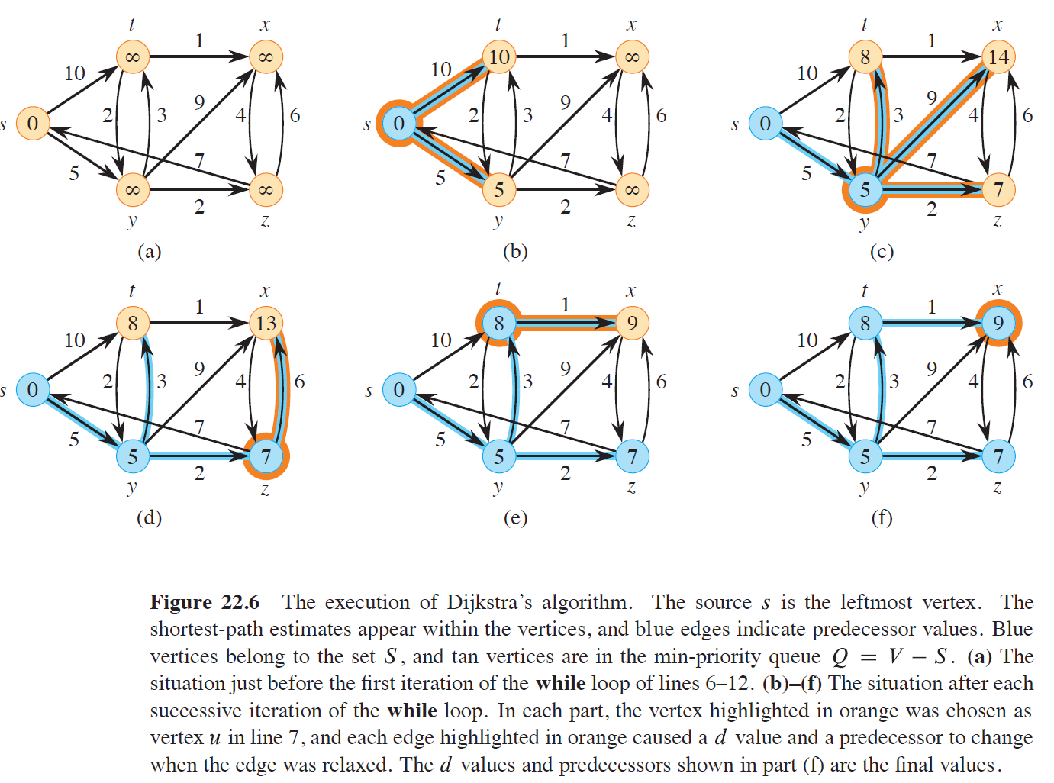
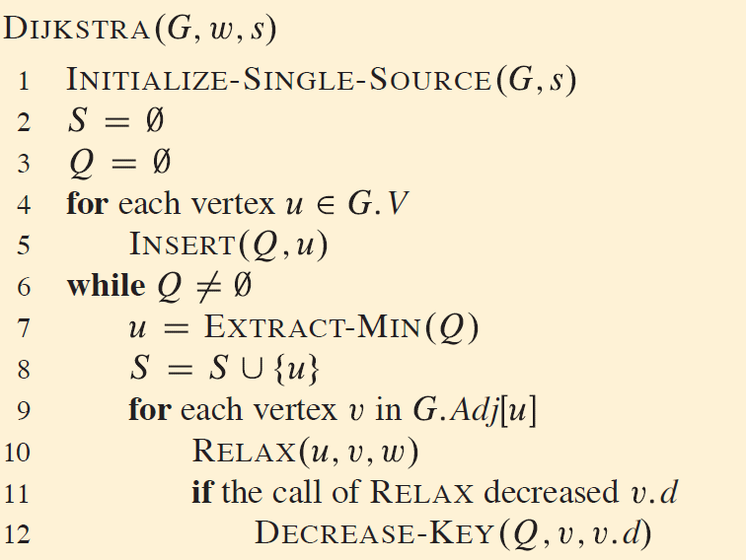
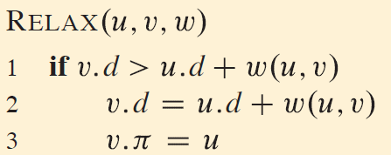
Dijkstra’s Algorithm

Slide 20
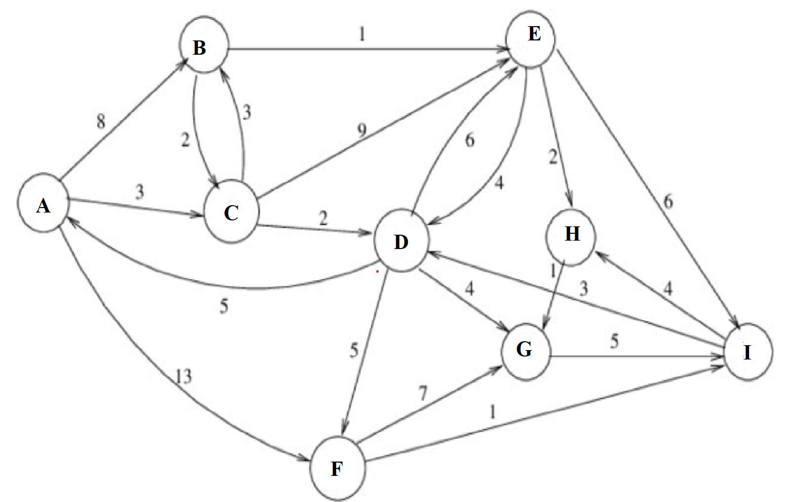
Group Activity Find the shortest distance and path for the distance from the node ‘A’ to nodes ‘B’, ‘C’, ‘D’, ‘E’, ‘F’, ‘G’, ‘H’, and ‘I’ using Dijkstra’s shortest path algorithm

Slide 21
Dijkstra’s Algorithm: Greedy Strategy
Maintains a set S of vertices whose final shortest-path weights from the source s
Repeatedly selects the vertex u ∈ V - S with the minimum shortest-path estimate, adds u to S, and relaxes all edges leaving u.
Uses a greedy strategy: always chooses the “lightest” or “closest” vertex in V to add to set S.
Greedy strategies do not always yield optimal results in general.
Dijkstra’s algorithm does indeed compute shortest paths.

Slide 22
Complexity Analysis
For each vertex u element of V, O|V| , in line 3
while loop of lines 4–8 iterates exactly |V| times
EXTRACT-MIN in line 5 operation takes O|V| time since we have to search through the entire array
Each edge in the adjacency list Adj[u] is examined in the for loop of lines 7–8 exactly once - Since the total number of edges in all the adjacency lists is |E|, this for loop iterates a total of |E| times
A total time of O(V² + E) = O(V²)

Slide 23
Complexity Analysis
The efficiency can be improved by using a min heap to store and order vertices.
Line 3 initializes the min-priority queue Q to contain all the vertices in V
Each EXTRACT-MIN operation then takes time O(lg |V|).
Each time through the while loop for |V|, the cost of restoring the heap after removing a vertex is proportional to O (lg|V|)
Line 4-5: O (|V|lg|V|)
loop of lines 7–8 exactly once - this for loop iterates a total of |E| times
A total time of O (|v|lg|V| + |E| ) => O (|V| lg |V|)

Slide 24
Single Source Shortest Path Problem
Dijkstra’s Algorithm with Greedy Strategy
Bellman-Ford Algorithm with Dynamic Programming

Slide 25
Single Source Shortest Path Problem
Dijkstra’s Algorithm with Greedy Strategy
Always chooses the “lightest” or “closest” vertex in V to add to set S
Greedy strategies do not always yield optimal results in general.
Dijkstra’s algorithm does indeed compute shortest paths
Assume that all edge weights in the input graph are nonnegative

Slide 26
Bellman-Ford Algorithm
Solves the single-source shortest-paths problem in general
Case in which edge weights may be negative

Slide 27
Single Source Shortest Path Problem
Bellman-Ford Algorithm with Dynamic Programming
Allows negative-weight edges in the input graph
Produces a correct answer as long as no negative-weight cycles are reachable from the source.
If there is such a negative-weight cycle, the algorithm can detect and report its existence – no solution.
Calculates shortest paths in bottom-up manner: Dynamic Programming
First calculates the shortest distances with all the edges
Recalculates the shortest distances by using the distances calculated from the previous step
Repeats this maximum |V| – 1 times with all the edges

Slide 28
Bellman-Ford Algorithm
Given a weighted, directed graph G = (V, E) with source s and weight function w
Algorithm returns a boolean value indicating whether or not there is a negative-weight cycle that is reachable from the source
If there is such a cycle, the algorithm indicates that no solution exists.
If there is no such cycle, the algorithm produces the shortest paths and their weights.

Slide 29
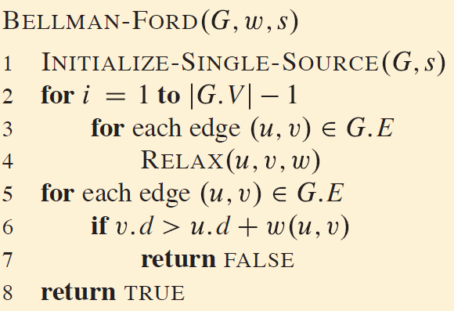
Bellman-Ford Algorithm
The algorithm relaxes edges, progressively decreasing an estimate v.d on the weight of a shortest path from the source s to each vertex v until it achieves the actual shortest-path weight (s, v).
The algorithm returns TRUE if and only if the graph contains no negative-weight cycles that are reachable from the source.

Slide 30
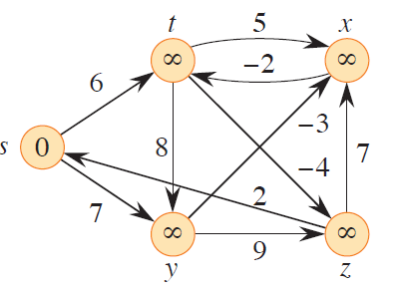
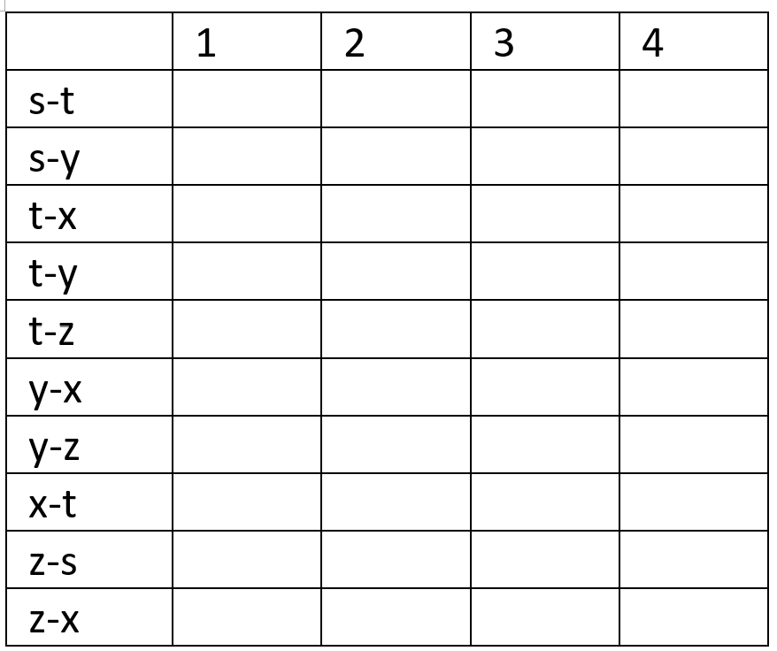
Bellman-Ford Algorithm: Example
5 Vertices and 10 edges

Slide 31
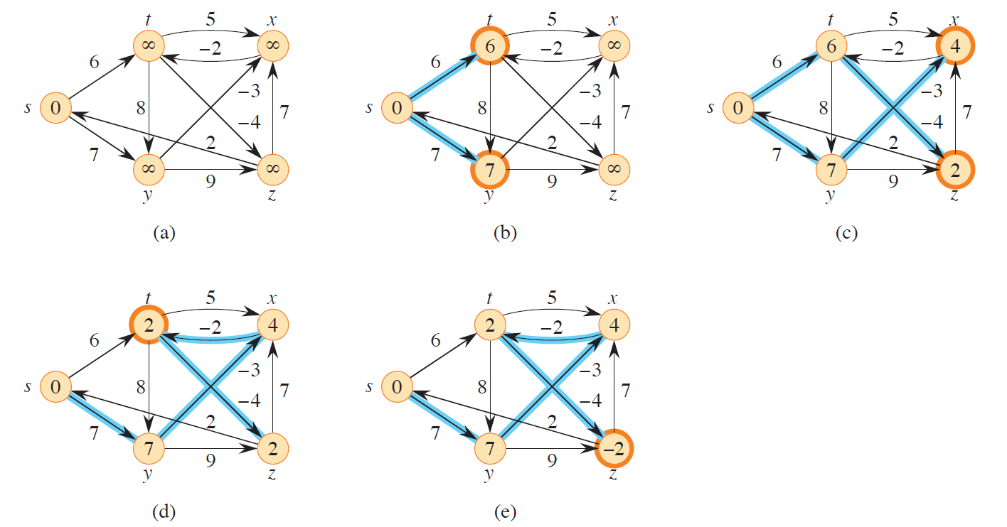
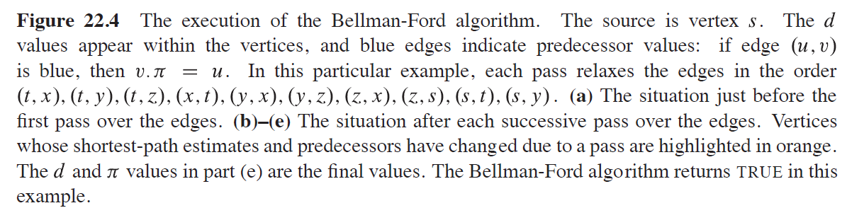

Slide 32
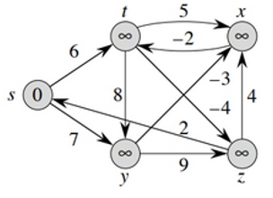
Exercise
Change the weight of edge (z, x) to 4 on the directed graph of Figure 24.4 and run the Bellman-Ford algorithm, using s as the source, and show the d after each pass.
10 edges

Slide 33
Bellman-Ford Algorithm: Analysis
After initializing the d and values of all vertices in line 1, the algorithm makes |V| - 1 passes over the edges of the graph
Each pass is one iteration of the for loop of lines 2–4 and consists of relaxing each edge of the graph once
Lines 5–8 check for a negative-weight cycle and return the appropriate boolean value
The algorithm runs in time O(VE)
initialization in line 1 takes O(V) time
each of the |V| - 1 passes over the edges in lines 2–4 takes O(E) time
for loop of lines 5–7 takes O(E) time

