Slide 1
CSCI 5343 Algorithms Spring 2025
Dept. of Computational, Engineering, and Computational Sciences
Chapter 15 Dynamic Programming

Slide 2
Objectives
Discuss the following topics:
Divide-and-conquer algorithms
Dynamic programming algorithms
With Rod Cutting Problem
Implementation
Recursive Top-down
Top-down with memorization – dynamic programming
Bottom-up with memorization – dynamic programming
Max subarray problem

Slide 3
Divide-and-Conquer & Dynamic Programming
Divide-and-conquer algorithms
divide the problem into subproblems, solve the subproblems recursively, and then combine their solutions to solve the original problem.
do more work than necessary, repeatedly solving the common subproblems
Dynamic programming
applies when the subproblems overlap—that is, when subproblems share other subproblems
solves each subproblem just once and then saves its answer in a table, thereby avoiding the work of recomputing the answer every time it solves each subproblem.

Slide 4
Optimization Problems
Typically apply dynamic programming to optimization problems
Can have many possible solutions
Each solution has a value, and wish to find a solution with the optimal (minimum or maximum) value – optimal solution

Slide 5
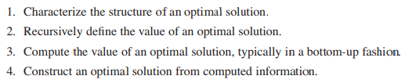
Developing a Dynamic-Programming Algorithm
Follow a sequence of four steps

Slide 6
Example - Rod Cutting Problem
Problem in deciding where to cut steel rods
Serling Enterprises buys long steel rods and cuts them into shorter rods, which it then sells.
The management of Serling Enterprises wants to know the best way to cut up the rods for maximizing profits.

Slide 7

Rod Cutting Problem
Problem in deciding where to cut steel rods
Given a rod of length n inches and a table of prices p_{i} for i for i = 1, 2, …, n
Determine the maximum revenue r_{n} obtainable by cutting up the rod and selling the pieces

Slide 8
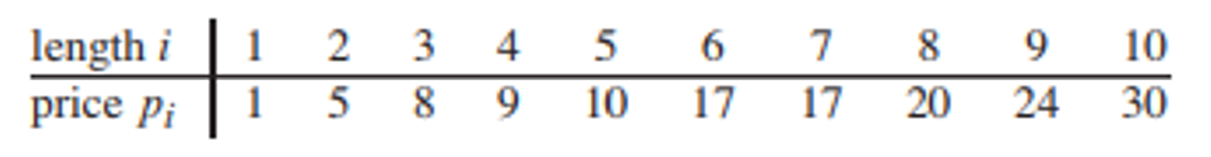
Rod Cutting Problem
When n = 4
have all the ways to cut up a rod of 4 inches in length, including with no cuts at all

Slide 9
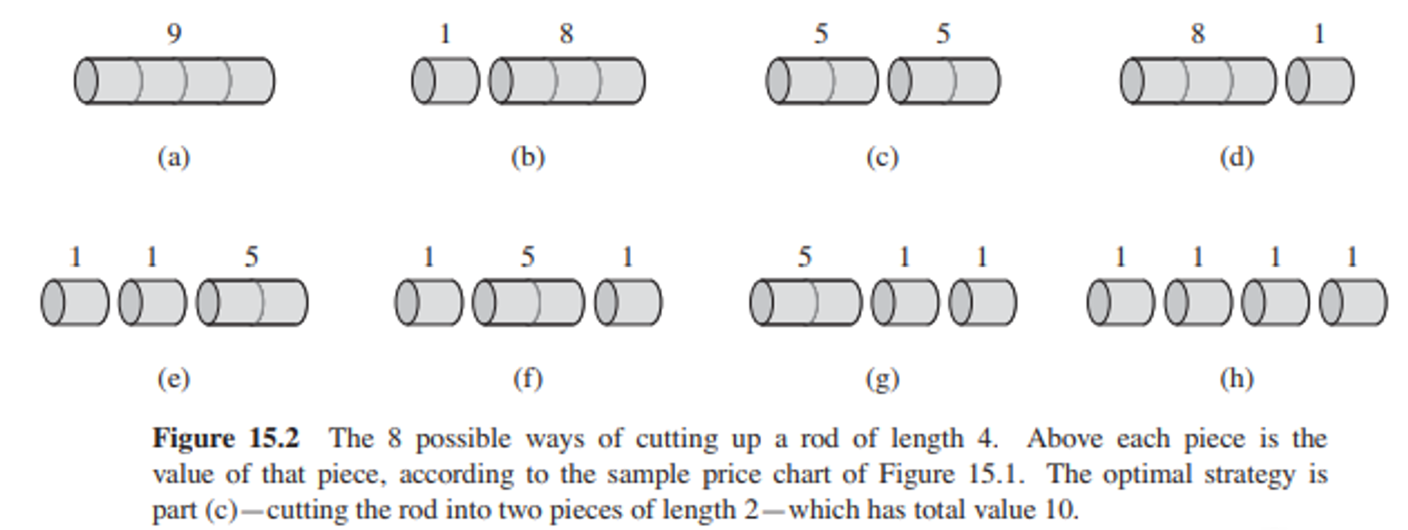
Rod Cutting Problem
When n = 4
have all the ways to cut up a rod of 4 inches in length, including with no cuts at all

Slide 10
Rod Cutting Problem
When n = 4
cut a 4-inch rod into two 2-inch pieces produces revenue p₂ + p₂ = 5 + 5 = 10, which is optimal
cut up a rod of length n in 2^{n-1} different ways

Slide 11
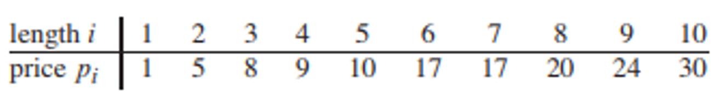
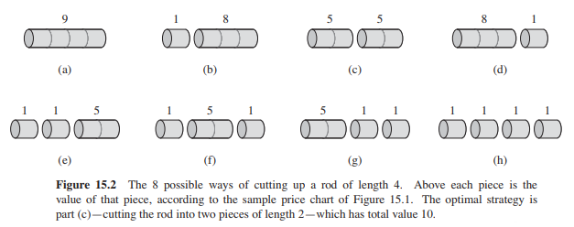
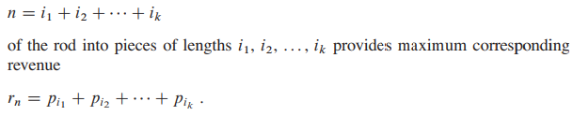
Cutting Up a Rod of 4 Inches in Length
If an optimal solution cuts the rod into k pieces, for some 1 <= k <= n, then an optimal decomposition

Slide 12
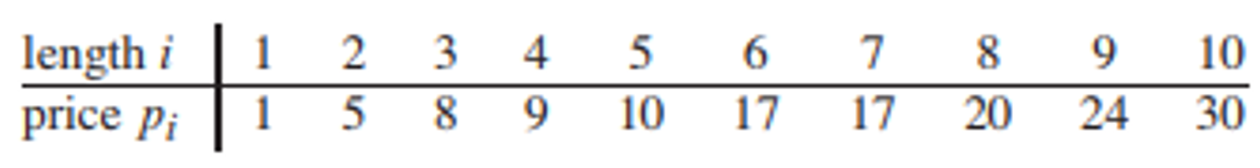
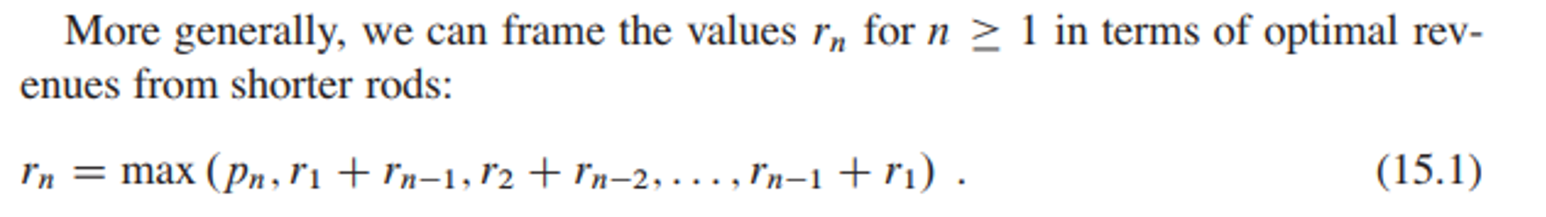
Optimal Solution
Determine the optimal revenue figures r_{i} for i = 1, 2, …, 10, by inspection, with the corresponding optimal decompositions

Slide 13
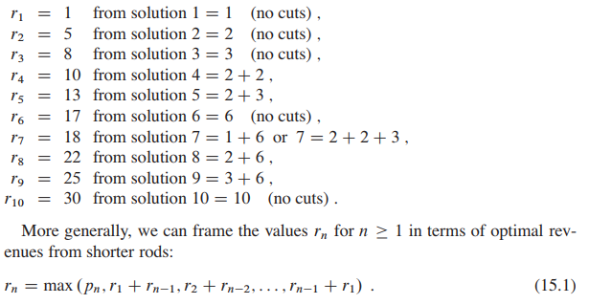
Optimal Solution
Determine the optimal revenue figures r_{i} for i = 1, 2, …, 10, by inspection, with the corresponding optimal decompositions

Slide 14

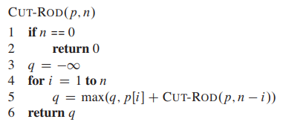
1. Recursive Top-Down Implementation
Simpler version of equation
Recursive top-down implementation

Slide 15
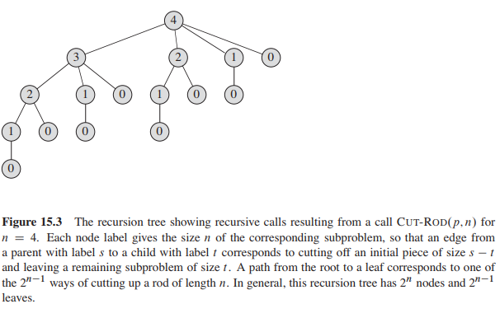
Recursion Tree

Slide 16
2. Using Dynamic Programming for Optimal Rod Cutting
Convert CUT-ROD into an efficient algorithm, using dynamic programming
Recursive solution is inefficient because it solves the same subproblems repeatedly
Arrange for each subproblem to be solved only once, saving its solution
Uses additional memory to save computation time– time-memory trade off

Slide 17
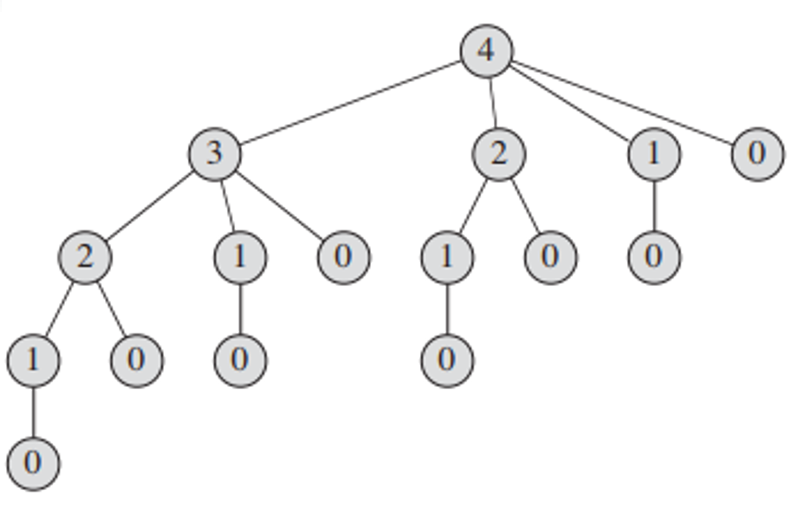
2. 1 Using Dynamic Programming
Top-down with memoization
Write the procedure recursively in a natural manner, but modified to save the result of each subproblem (usually in an array or hash table).
The procedure first checks to see whether it has previously solved this subproblem.
If so, it returns the saved value, saving further computation at this level
If not, the procedure computes the value in the usual manner.
The recursive procedure has been memoized; it “remembers” what results it has computed previously.

Slide 18
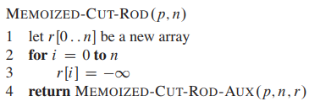
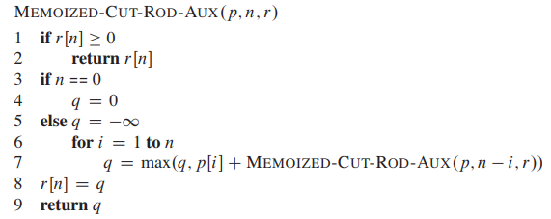
2.1 Using Dynamic Programming
Top-down CUT-ROD procedure, with memoization added:
Runs in polynomial time O(n²)

Slide 19
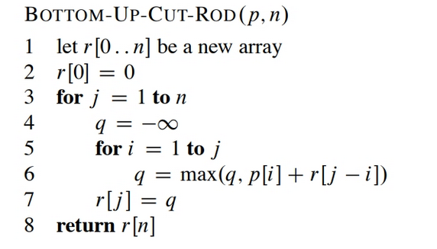
2. 2 Using Dynamic Programming
Bottom-up CUT-ROD procedure, with memoization added
Runs in polynomial time O(n²)

Slide 20
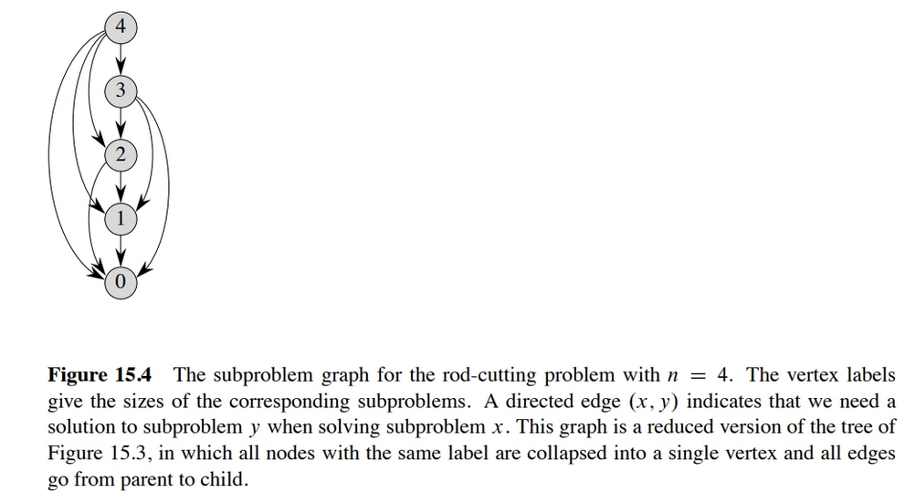

Slide 21
2.2 Reconstructing a Solution
Dynamic-programming solutions to the rod-cutting problem return the value of an optimal solution
But they do not return an actual solution: a list of piece sizes

Slide 22
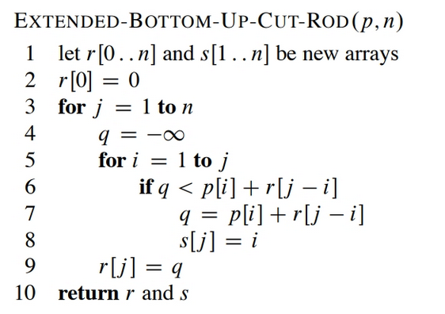
2.2 Reconstructing a Solution
Extend the dynamic-programming approach to record not only the optimal value computed for each subproblem, but also a choice that led to the optimal value.
With this information, we can readily print an optimal solution

Slide 23
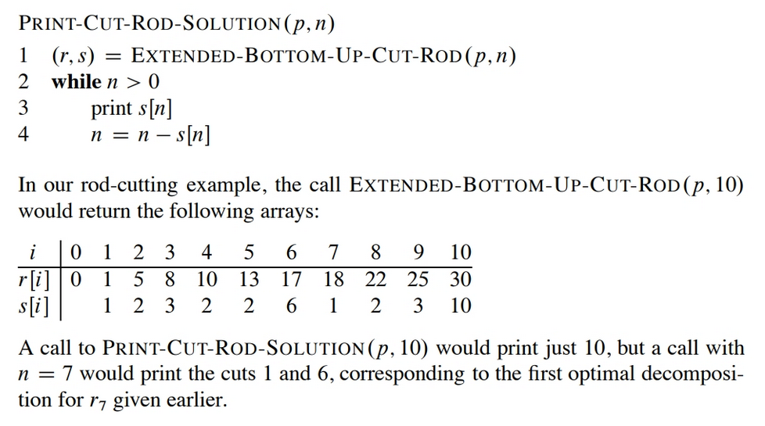
Reconstructing a Solution

