Slide 1
CSCI 5343 Algorithms Spring 2025
Dept. of Computational, Engineering, & Mathematical Sciences
Chapter 16 Greedy Algorithms

Slide 2
Objectives
Discuss the following topics:
Greedy Algorithms
Making the greedy choice
Elements of the greedy strategy
Knapsack problem
Dynamic programming
Greedy strategy

Slide 3
Greedy Algorithm
Always makes the choice that looks best at the moment
Makes a locally optimal choice in the hope that this choice will lead to a globally optimal solution
Does not always yield optimal solutions, but for many problems, they do
The greedy method is quite powerful and works well for a wide range of problems
Minimum-spanning-tree algorithms
Dijkstra’s algorithm for shortest paths

Slide 4
Elements of Greedy Strategy
Greedy algorithms differ from dynamic programming
Greedy-choice property
Assemble a globally optimal solution by making locally optimal (greedy) choices
Make the choice that looks best in the current problem, without considering results from subproblems
Dynamic programming
Make a choice at each step, but this choice usually depends on the solutions to subproblems
Solve dynamic-programming problems in a bottom-up manner, progressing from smaller subproblems to larger subproblems

Slide 5
Greedy Strategy Vs. Dynamic Programming
Greedy Strategy
makes its first choice before solving any subproblems
usually progresses in a top-down fashion
making one greedy choice after another
Dynamic Programming
solves the subproblems to solve next problems
proceeds bottom up
Greedy vs. dynamic programming
The knapsack problem is a good example of the difference.

Slide 6
0-1 Knapsack Problem
0-1 knapsack problem
A thief robbing a store finds n items
The ith item is worth v_{i} dollars and weighs w_{i} pounds, where v_{i} and w_{i} are integers
The thief wants to take as valuable a load as possible, but he/she can carry at most W pounds in the knapsack, for some integer W.
Which items should he/she take?
0-1 knapsack problem because, for each item, the thief must either take it or leave it behind

Slide 7
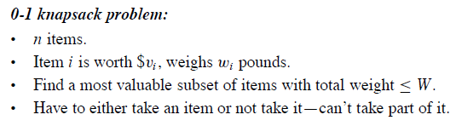
0-1 Knapsack Problem

Slide 8
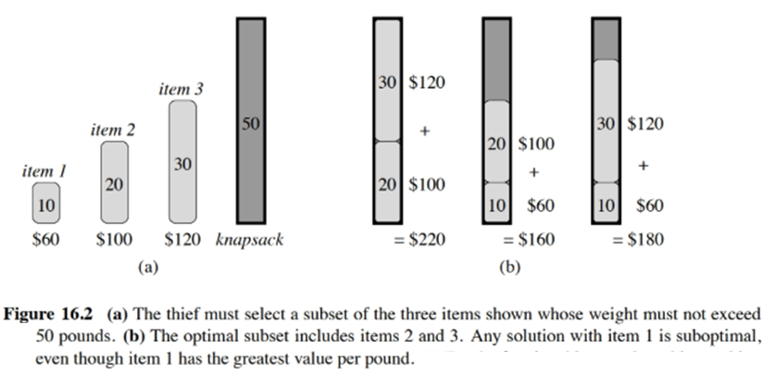
0-1 Knapsack Problem

Slide 9
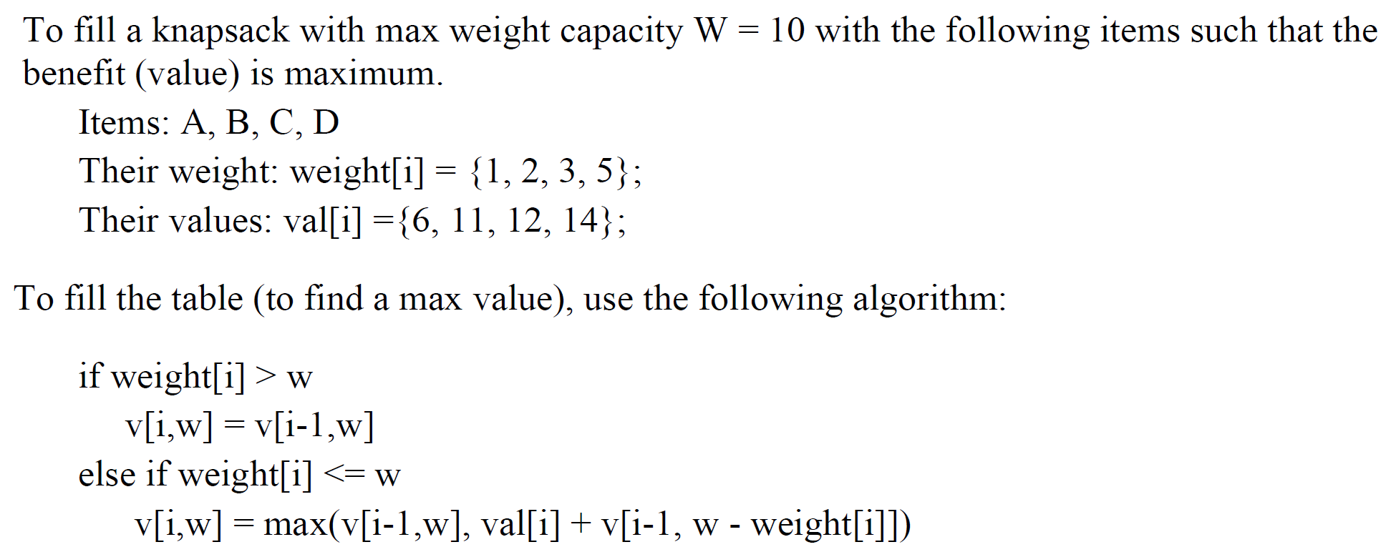
0-1 Knapsack Problem Using Dynamic Programming

Slide 10
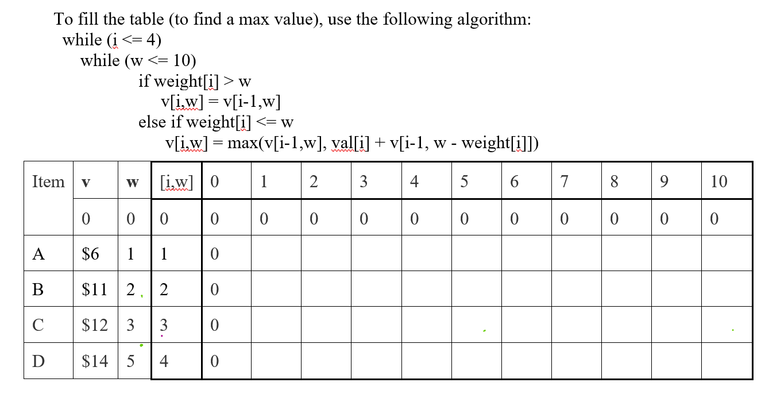










Exercise
Items: A, B, C, D
Their weight: weight[i] = {1, 2, 3, 5};
Their values: val[i] ={6, 11, 12, 14};

Slide 11
Fractional Knapsack Problem Using Greedy Strategy
Fractional knapsack problem
The setup is the same
The thief can take fractions of items, rather than having to make a binary (0-1) choice for each item

Slide 12
Fractional Knapsack Problem Using Greedy Strategy
Although the problems are similar
Solve the fractional knapsack problem by a greedy strategy
Cannot solve the 0-1 problem by such a strategy

Slide 13
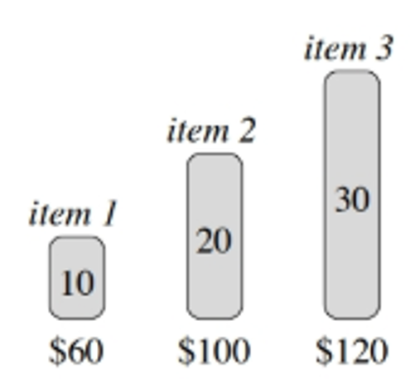
Fractional Knapsack Problem Using Greedy Strategy
To solve the fractional problem
First compute the value per pound for each item (value / weight)
Obeying a greedy strategy, the thief begins by taking as much as possible of the item with the greatest value per pound
If the supply of that item is exhausted and he/she can still carry more, he/she takes as much as possible of the item with the next greatest value per pound, and so forth, until he/she reaches the weight limit W.

Slide 14
Fractional Knapsack Problem Using Greedy Strategy
Example in Figure 16.2(a)
This example has 3 items and a knapsack that can hold 50 pounds. Item 1 weighs 10 pounds and is worth 60 dollars.
Item 2 weighs 20 pounds and is worth 100 dollars. Item 3 weighs 30 pounds and is worth 120 dollars.
Thus, the value per pound of item 1 is 6 dollars per pound, which is greater than the value per pound of either item 2 (5 dollars per pound) or item 3 (4 dollars per pound).

Slide 15
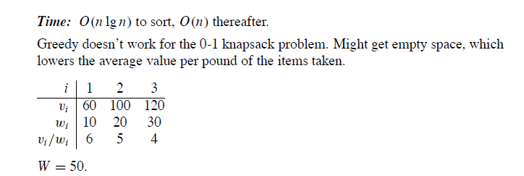
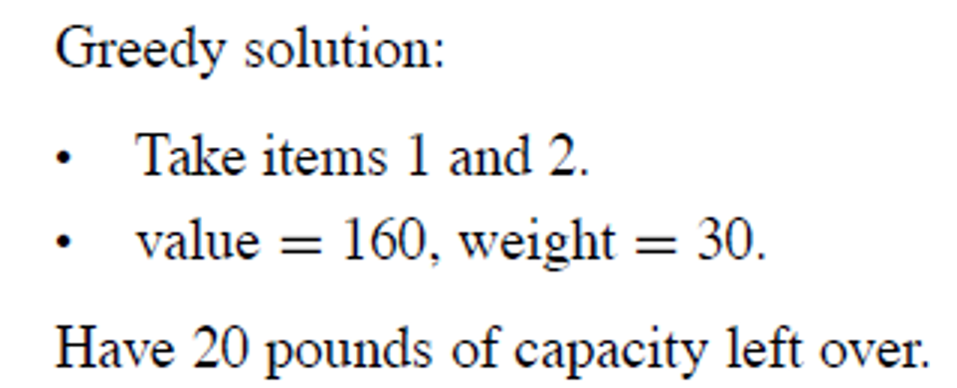
Fractional Knapsack Problem Using Greedy Strategy
And take 20 pounds of item 3
20 pounds * $4 = $80
So greedy solution
$160+ $80 = $240
0-1 knapsack solution: $220

Slide 16
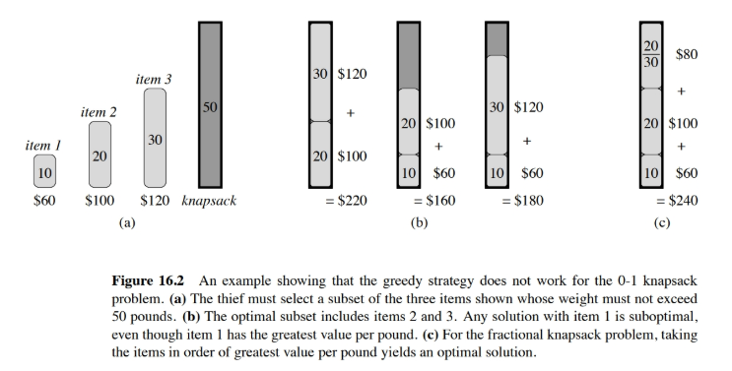
Fractional Knapsack Problem Using Greedy Strategy

Slide 17
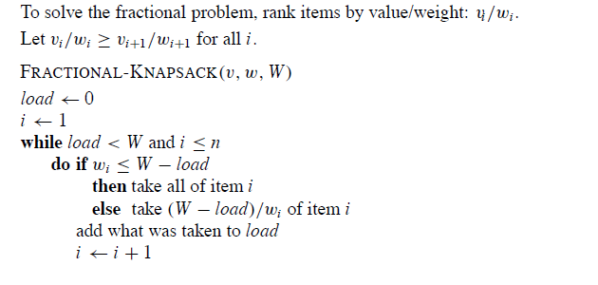
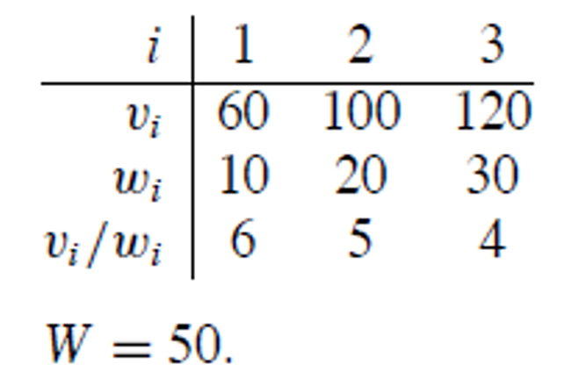
Fractional Knapsack Problem Using Greedy Strategy

